Slide 1
Unit 10. Our houses in the future
LESSON 6. SKILLS 2

Slide 2
OBJECTIVES
By the end of the lesson, students will be able to:
01
02
Listen to get information about dream houses.
Write about a dream house.

Slide 3
I
Listening

Slide 4
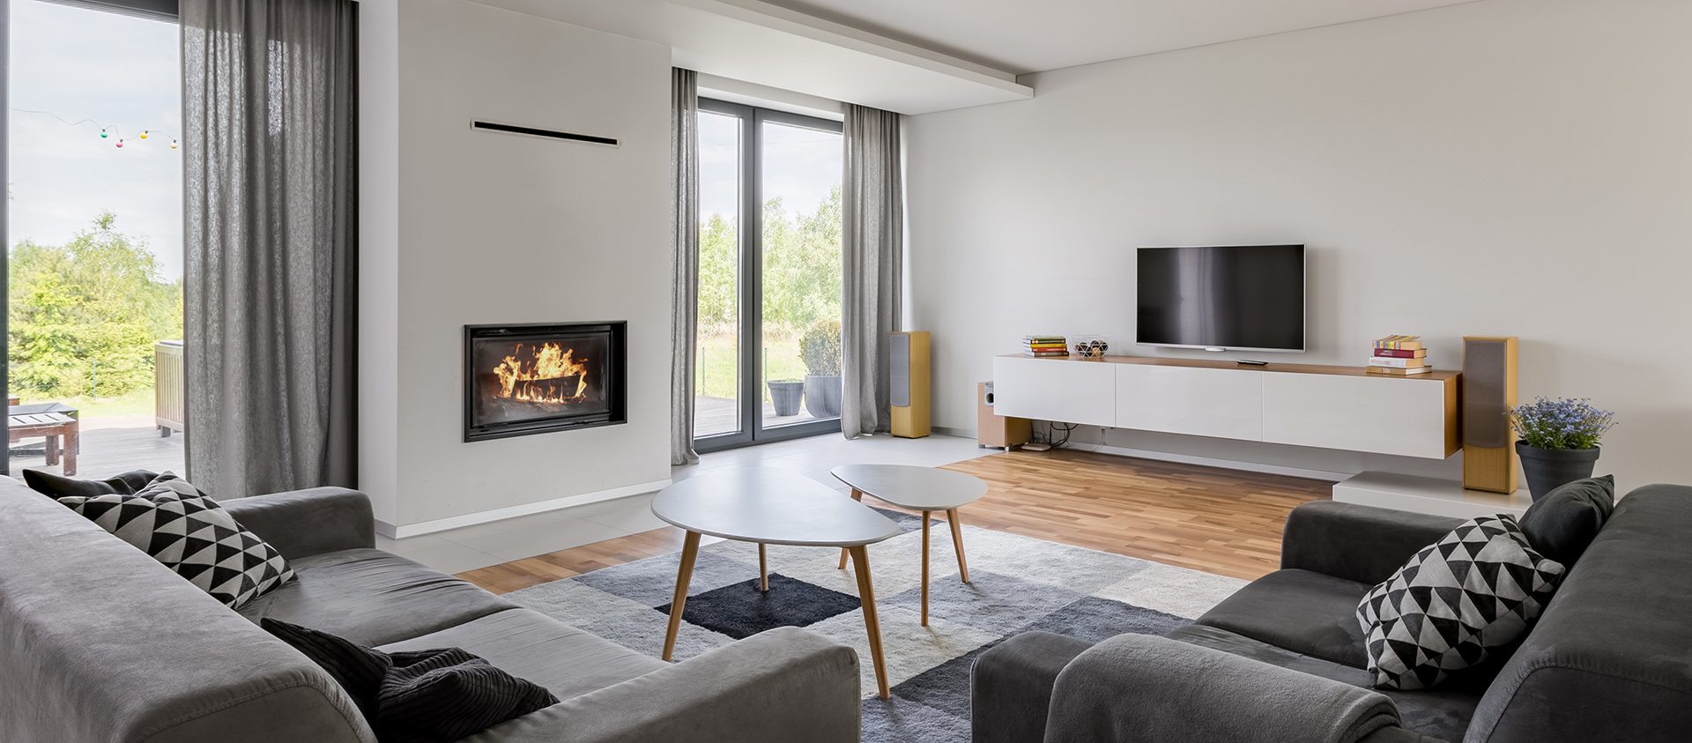
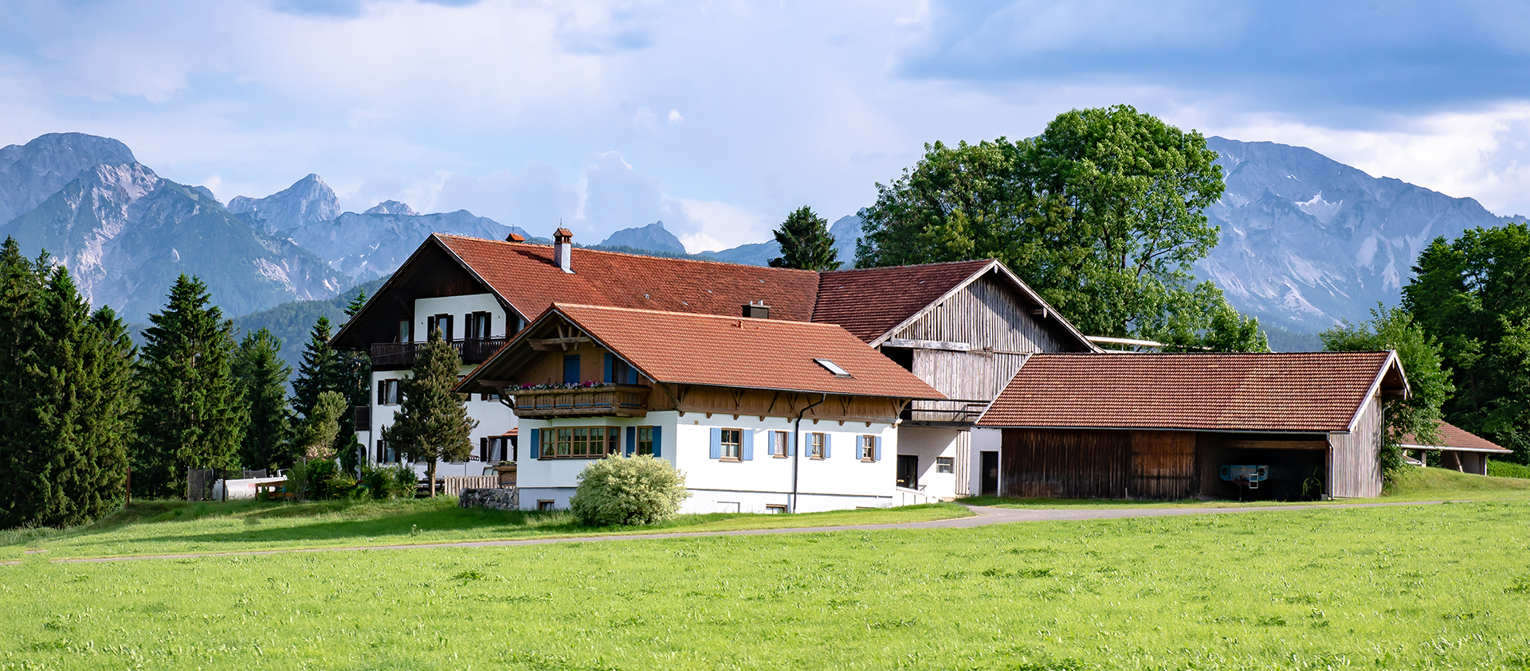
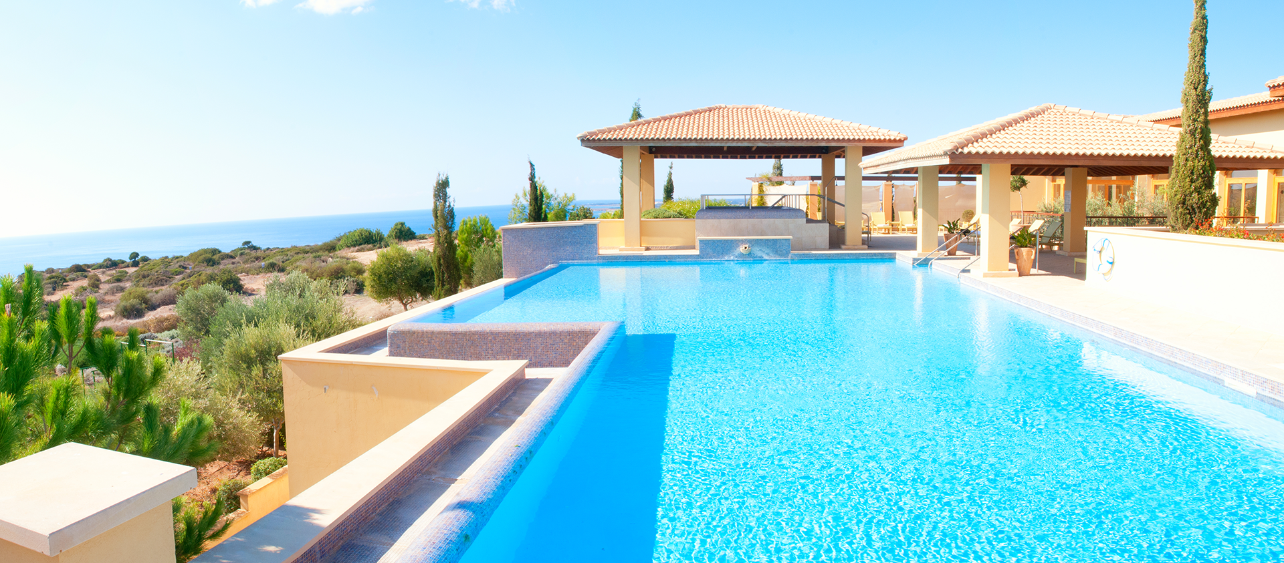

1
2
Can you describe these houses?
3
Where are they?
What types of houses are there?

Slide 5


Ex 1. (p 45) Listen to Nick and Linda talking about their dream house. Which one would each prefer?
1
2
Nick
(a flat in the city)
3
(a villa by the sea, with a swimming pool and a garden)
Linda
Notes:
Ấn lần 1 để nghe toàn bài
Ấn lầ 2 để nghe thông tin bức tranh thứ 3 và đáp án
Ấn lần 3 để nghe thông tin bức tranh 1 và đáp án

Slide 6
Ex 2. (p 45) What is important to Nick? What is important to Linda?
Listen and tick.
 | Linda | Nick
1. park view
2. city view
3. sea view
4. swimming pool
5. garden
Linda: Well, it's a big villa by the sea. It has a view of the sea. It has a swimming pool and a garden.




Nick: It's a beautiful flat in the city. It has a park view in front and a city view at the back.


Slide 7
Ex 3. (p 45) Memory check. Answer the questions about their dream houses. Then listen and check again.
1. What type of house does Linda have?
2. Where is her house?
3. What is around her house?
4. What type of house does Nick have?
5. Where is it?
Nick: Can you tell me about your dream house, Linda?
Linda: Well, it's a big villa by the sea. It has a view of the sea. It has a swimming pool and a garden.
Nick: My dream house is different.
Linda: Really? What's it like?
Nick: It's a beautiful flat in the city. It has a park view in front and a city view at the back.
Linda: Oh, sounds great!
Nick: It has a super smart TV. I can watch films from other planets.
Linda: That sounds great, too. But I think it'll be...
Nick: Can you tell me about your dream house, Linda?
Linda: Well, it's a big villa by the sea. It has a view of the sea. It has a swimming pool and a garden.
Nick: My dream house is different.
Linda: Really? What's it like?
Nick: It's a beautiful flat in the city. It has a park view in front and a city view at the back.
Linda: Oh, sounds great!
Nick: It has a super smart TV. I can watch films from other planets.
Linda: That sounds great, too. But I think it'll be...
Nick: Can you tell me about your dream house, Linda?
Linda: Well, it's a big villa by the sea. It has a view of the sea. It has a swimming pool and a garden.
Nick: My dream house is different.
Linda: Really? What's it like?
Nick: It's a beautiful flat in the city. It has a park view in front and a city view at the back.
Linda: Oh, sounds great!
Nick: It has a super smart TV. I can watch films from other planets.
Linda: That sounds great, too. But I think it'll be...
→ She has a big villa.
→ Her house / It is by the sea.
→ There’s a swimming pool and a garden around her house.
→ He has a flat.
→ It’s in the city.

Slide 8
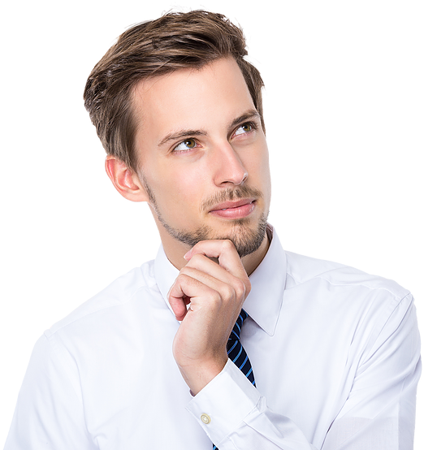

II
Writing
Let’s imagine!
Write!
What type of your dream house is it?

Slide 9

palace
Ex 4. (p 45) Work in pairs. Discuss your dream house, and fill the table.
Type of house
Location
Number of rooms
Appliances in the house and what they will/ might do for you
What type of dream house is it?
in the mountains
It's a palace.
Where is it?
It's in the mountains.

Slide 10
Ex 5. (p 45) Use the information in to write a paragraph of about 50 words about your dream house.
My dream house is a big palace. It is in the mountains. It is surrounded by lots of trees. It has seven rooms: three bedrooms, two bathrooms, one kitchen and one living room. There is a large swimming pool in front of it. I have some robots in the palace. They help me to clean the floor, cook meals, water flowers.... I'm happy to live in my palace.
1. What type of dream house is it?
2. Where is it?
3. What does it look like?
4. How many rooms are there?
5. What appliances are there and what will they help you to do?
Let’s replace the words in black!

Slide 11
Peer check
No. | Question?
1 | Are the verbs in the correct form?
2 | Are the nouns in the correct form?
3 | Is the spelling correct?
4 | Has the paragraph answered all questions?

Slide 12
RECAP
Listening
Writing
Listen to get information about dream house.
Write about dream house.

Slide 13
Thanks!
#TraditionalMedicineWorkshop
Do you have any questions?

Slide 14
Alternative resources
Here’s an assortment of alternative resources whose style fits the one of this template
Vectors
Flat world book day illustration
Flat autumn illustration I
Flat autumn illustration II

