Slide 1
UNIT 11:
OUR GREENER WORLD
LESSON 4: COMMUNICATION

Slide 2
OBJECTIVES
Vocabulary:
Structures:
Lexical items related to the topic “Our greener world”
Using imperatives and conditional sentences – type 1 to give warnings

Slide 3
Let’s warm up!!

Slide 4
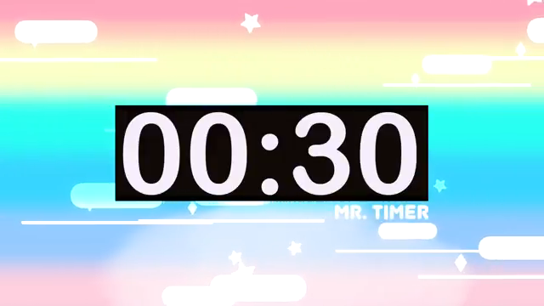

Sentence racing!!
Work in 8 teams.
In 30 seconds, take turns to make complete sentences using the given words. There are 5 rounds.
Each correct answer gets 1 point. Fastest team gets 2 points.
EG:
If
we
recycle
used materials,
we
help
nature.
If we recycle used materials,
we will help the nature.
Notes:
T give each team a small board and a marker to write their answers.

Slide 5

Make complete sentences using the given words
If
we
use
reusable bag,
we
help
environment.
If we use reusable bags, we will help the environment.
Notes:
Chur nhieemj ohair sats sao

Slide 6
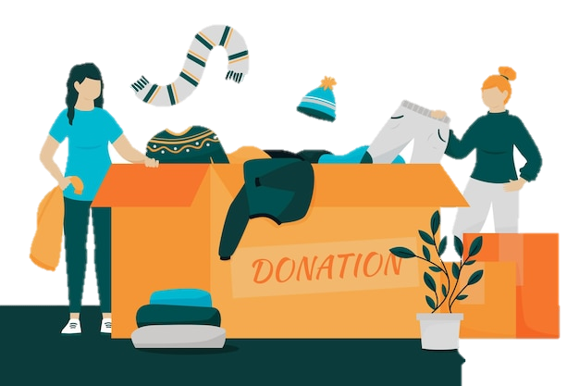
Make complete sentences using the given words
throw
your old uniform!
Give
poor children!
Don’t throw away your old uniform! Give it to poor children!
Notes:
Thay ddooir cachs lamf vieejc

Slide 7

Make complete sentences using the given words
If
we
use
Less water,
we
save
Some money.
If we use less water,
we will save some money.
Notes:
Thay ddooir cachs lamf vieejc

Slide 8
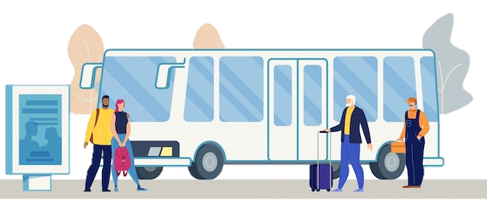
Make complete sentences using the given words
If people
use
public transport,
there
be
less pollution.
If people use public transport, there will be less pollution.

Slide 9

Make complete sentences using the given words
throw
trash
into
sea.
It
harm
many sea creatures.
Don’t throw trash into the sea!
It will harm many sea creatures.

Slide 10
What types of sentences are these?
1. If we use reusable bags, we will help the environment.
2. Don’t throw away your old uniform! Give it to poor children!
3. If we use less water, we will save some money.
4. If people use public transport, there will be less pollution.
5. Don’t throw trash into the sea! It will harm many creatures.
First conditional
Imperative sentences
Notes:
Questions: Can you name 2 types of sentences on the slide? Which are 1st conditional and which are imperatives? Lead to the conversation

Slide 11
01
Everyday English
Giving warnings

Slide 12

1. Listen and read (p.53)
1. Pay attention to the highlighted sentences. (p.53)
Mi: You are giving the goldfish too much food. Don't do that.
Mike: Why?
Mi: If you give them too much food, they will die.
Mike: I see. Thank you.
Imperative sentences
First conditional
Notes:
Can you find the imperative sentences and the 1st conditional?
What are these sentences for? giving warnings -> other structures?
Don’t + Vo or …../Unless…

Slide 13
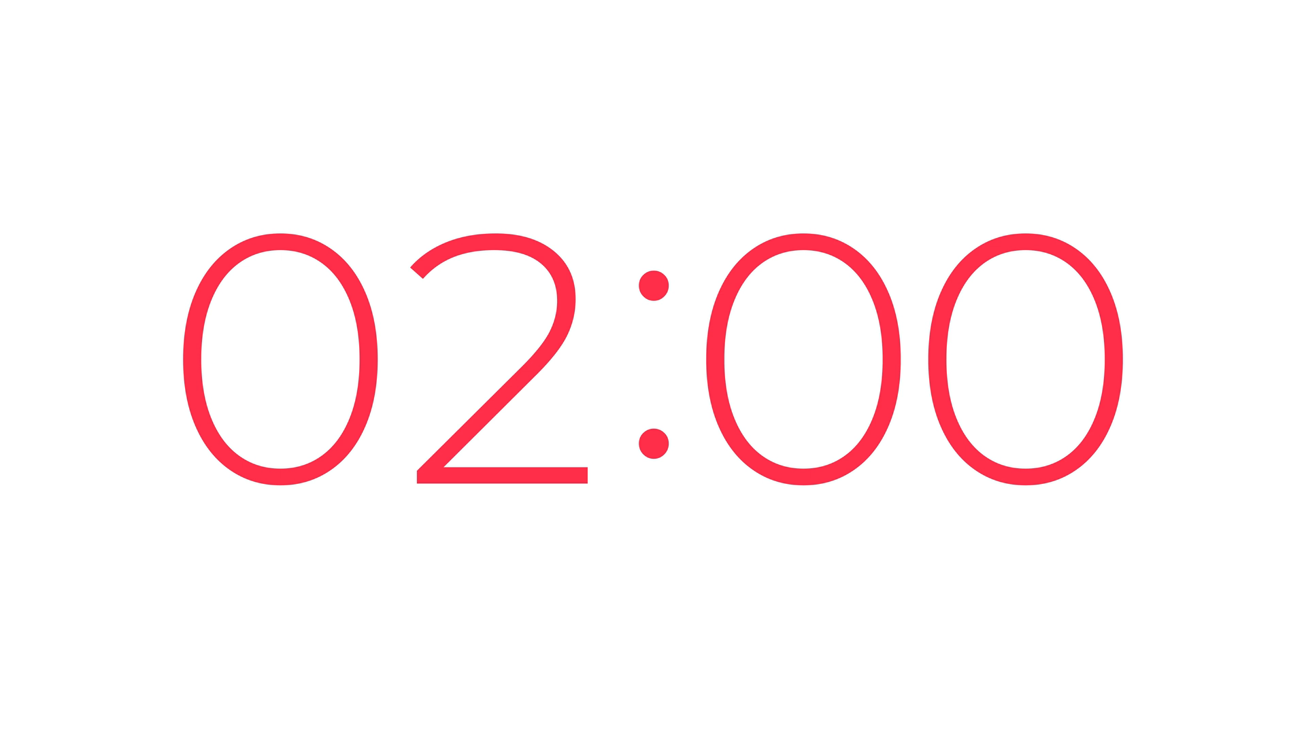
2. Make similar dialogues (p.53)
Work in pair in 4 minutes
Use these pictures and take turn to make 2 dialogues using the languages for giving warnings.
Notes:
Advanced version: 2 minutes per dialogue
SAMPLE:
A: You are using too much water. Don’t do that.
B: Why?
A: if you waste water, you will waste a lot of money
B: I see. Thank you!
A: You are throwing trash into the sea. Don’t do that.
B: Why?
A: if you do that, it will harm many sea creatures.
B: I see. Thank you!

Slide 14
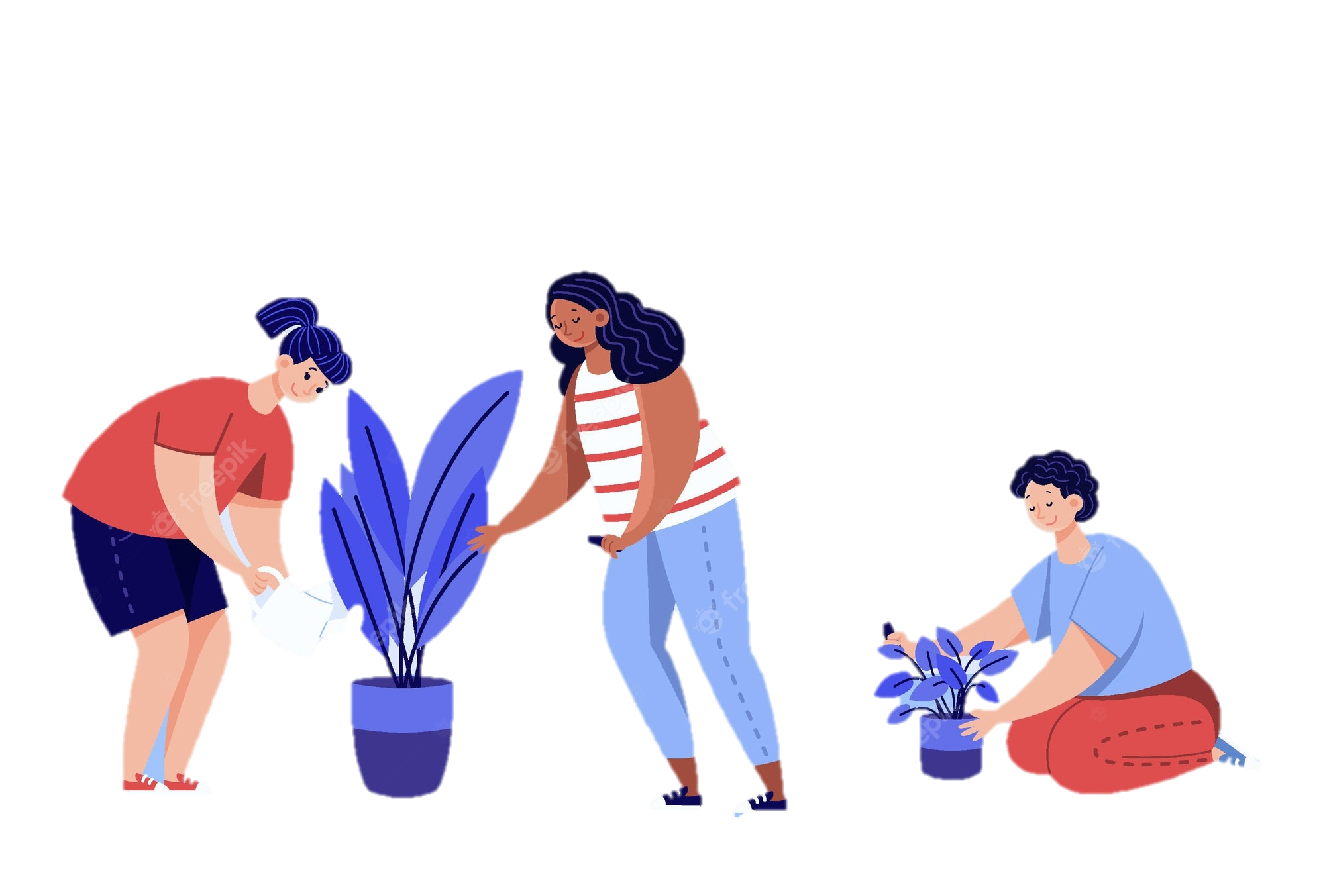
2. Make similar dialogues (p.53)
Work in pair in 2 minutes
Student A is watering flowers in the garden.
Student B is giving some warnings.
Act out the dialogue using the languages for giving warnings.
Notes:
Student’s book version: Teacher remind students to change role after 1 minute
SAMPLE
A: You are using too much water. Don’t do that.
B: Why?
A: if you put in too much water, the plant will die.
B: I see. Thank you!

Slide 15
PRESENT TIME!!

Slide 16
02
A survey on ways to go green

Slide 17
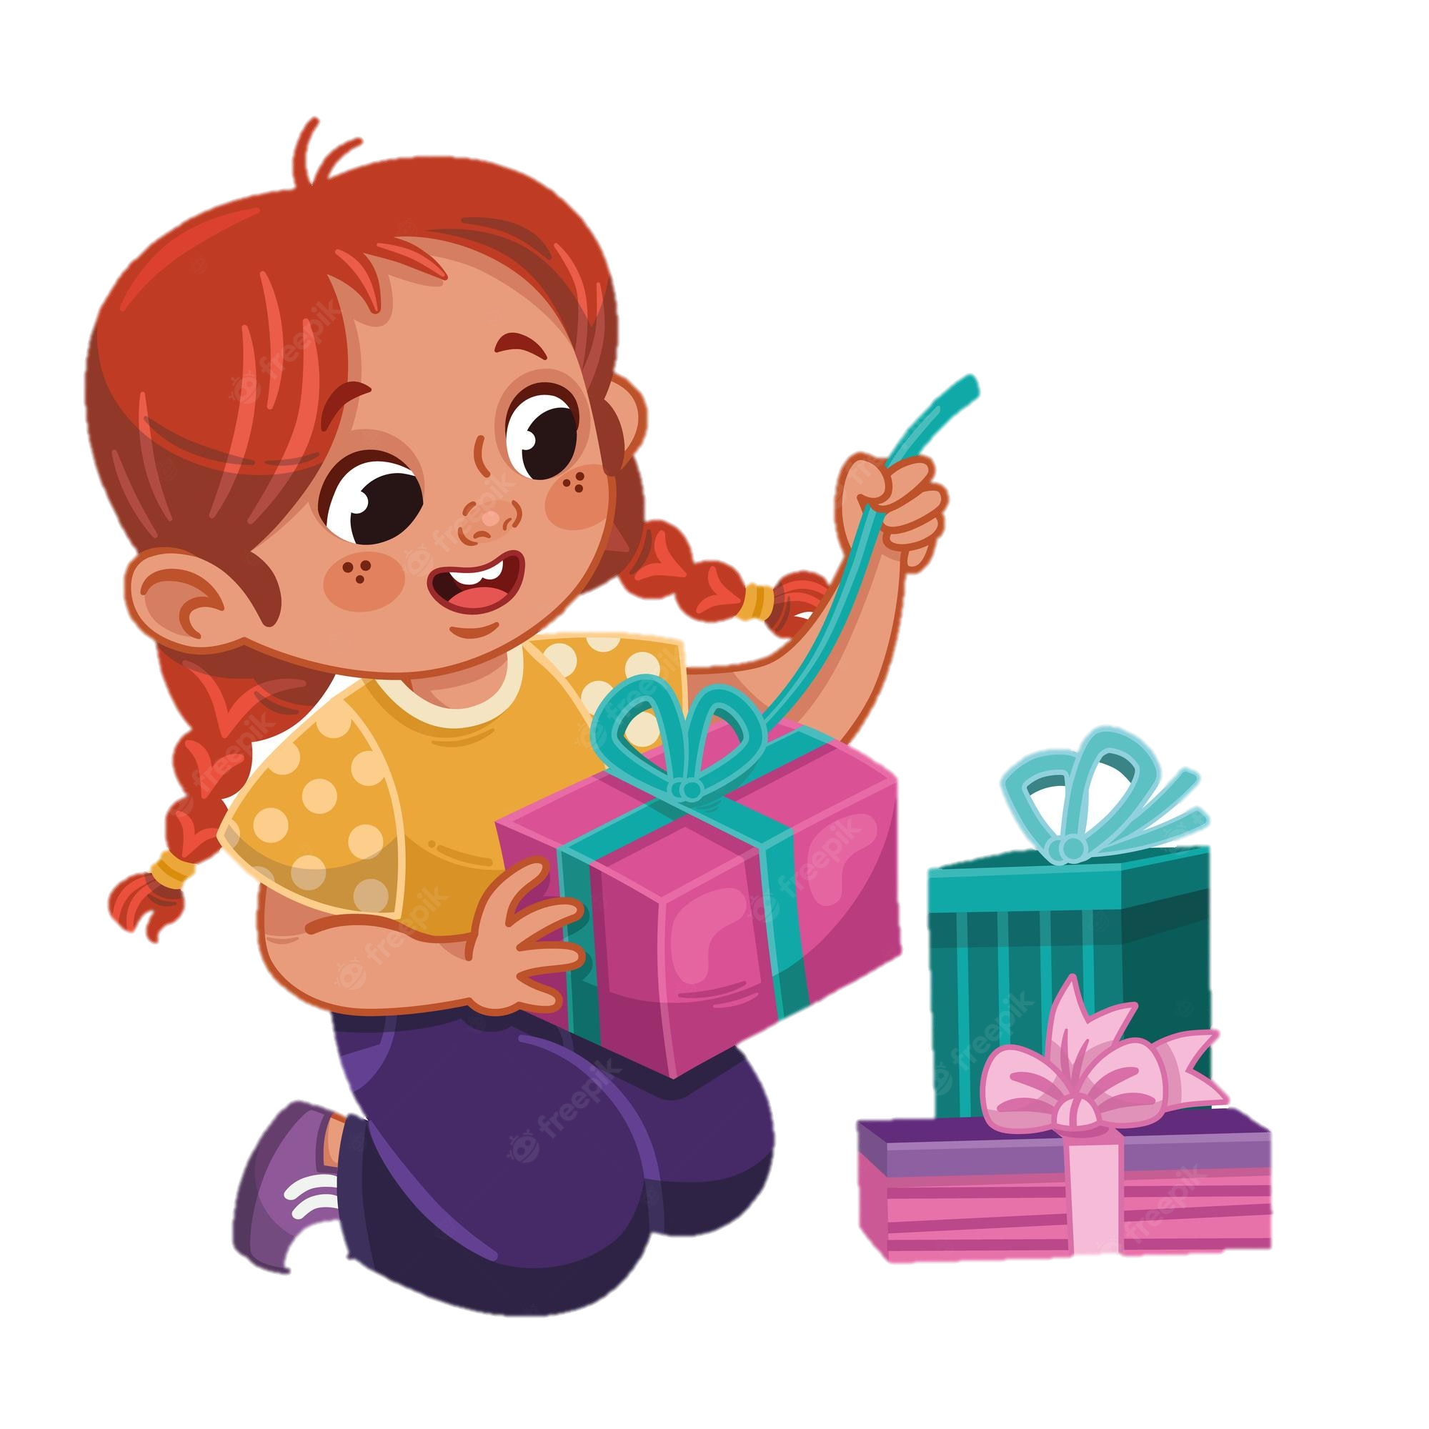


VOCABULARY
(to) do a survey: /ˈsɜːveɪ/
làm khảo sát
2. (to) wrap /ræp/
bọc, gói lại
3. breeze (n) /bri:z/
gió nhẹ

Slide 18

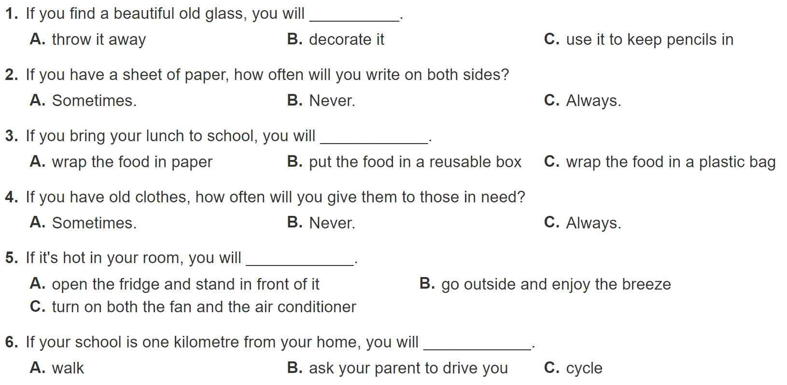
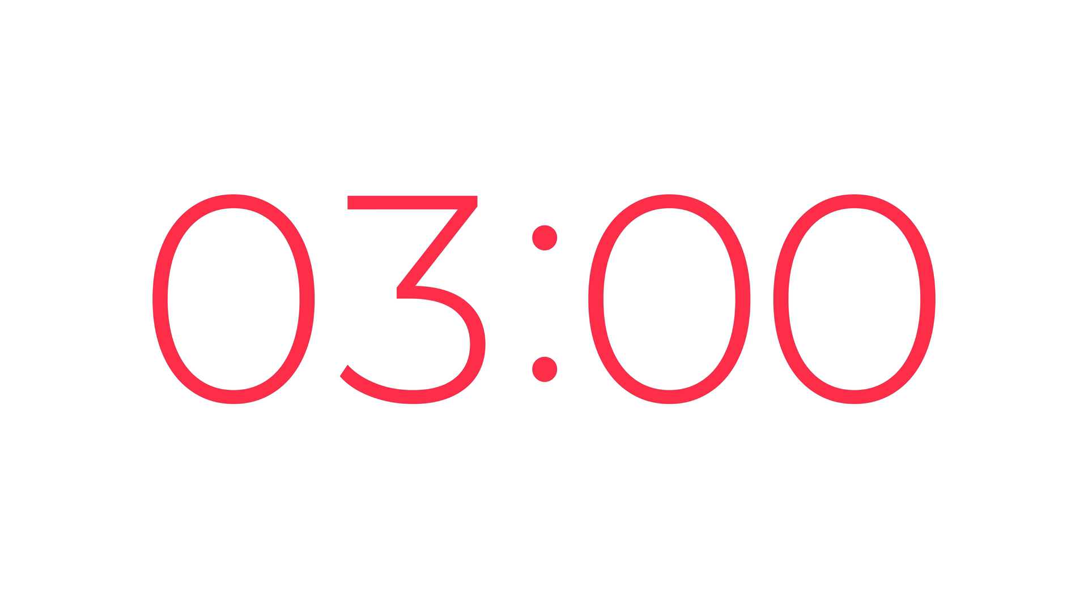
3. Do a survey (P53)

Slide 19
3. Do a survey
Answer Key
Q1: A(0) B(2) C(2)
Q2: A(1) B(0) C(2)
Q3: A(0) B(2) C(0)
Q4: A(1) B(0) C(2)
Q5: A(0) B(2) C(0)
Q6: A(2) B(0) C(2)
9-12 points:
You’re green!
5-8 points:
Try to be green!
1-4 points:
You aren’t green at all!

Slide 20
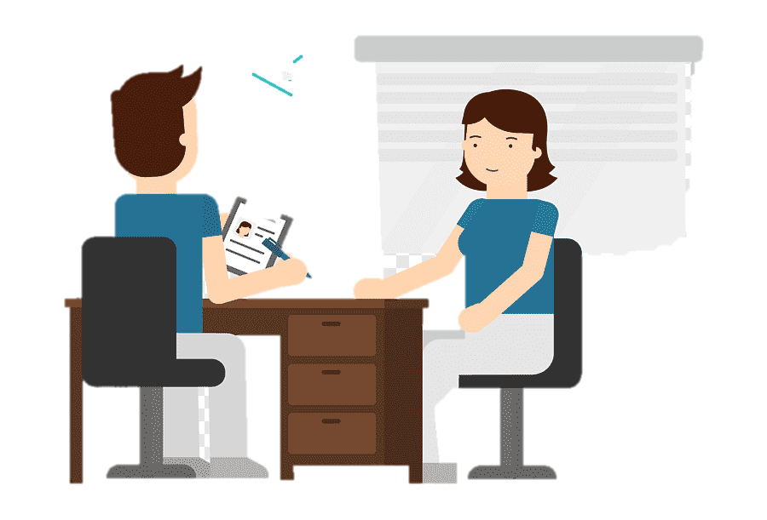
4. Interview a classmate (P53)
Work in pairs: one student is the interviewer, and the other is the interviewee using the survey in 3.
Note down your friend’s answers.
Switch role after 2 minutes
Report back to the class about
your friend’s answers

Slide 21
PRESENT TIME!!

Slide 22
Let’s recap
Thanks for listening
What types of sentences do you use to give warnings
Imperatives and the 1st conditional
What is the name of The 3Rs club survey?
✓
How green you are?
How tall you are?
How do you protect the Earth?

Slide 23
Thanks for listening
Homework
Prepare for the next lesson

