Slide 1
Unit 11:
OUR GREENER WORLD
Lesson 7: Looking back

Slide 2
OBJECTIVES
REVIEW THE VOCABULARY AND GRAMMAR OF UNIT 11

Slide 3
VOCABULARY
THINGS THAT CAN BE REDUCED, REUSED, RECYCLED:
paper, plastic, glass, metal, packaging, bottles, can, rubbish, clothes, water, noise, gas, plastic bags, light bulbs, envelopes, books, etc.

Slide 4

GRAMMAR: Article
There are two kinds of articles in English: the indefinite article (a / an) and the de finite article (the).
We use a / an
- with singular countable nouns when we are talking about them in general.
Example:
An ant is a tiny animal.
- after the verbs to be and to have.
Example:
I’m a student. / I have an eraser.

Slide 5
GRAMMAR: Article
We use the
- with singular or plural nouns when we already know them or when they are mentioned for the second time.
Example:
The bike in front of her house is nice.
- with nouns which are unique.
Example:
The air is dirty.

Slide 6
GRAMMAR: First conditional
Might for future possibility
First conditional sentences describe things which are possible and likely to happen in the present or the future.
If + subject + V (present simple),
If-clause
subject + will / won’t + V (base form)
main clause
Example:
If you use less paper, you will save a lot of trees.

Slide 7
01
VOCABULARY

Slide 8
Add more words to the word webs below.
REDUCE
water
paper
electricity
gas

Slide 9
Add more words to the word webs below.
REUSE
cans
bottles
envelopes
light bulbs

Slide 10
Add more words to the word webs below.
RECYCLE
newspaper
cans
books
plastic bags

Slide 11
02
GRAMMAR

Slide 12
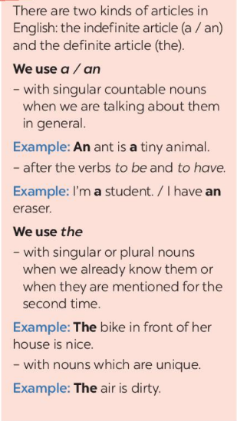
Write a / an or the.
1. If I see .......... dog, I will run away.
2. Does your town have ............ art gallery?
3. ................. Moon is bright tonight.
4. There is a big temple in the town.
........... temple is very old.
5. - Is your mother............. teacher?
- No, she isn't. She's ........... artist.
a
an
The
The
a
an

Slide 13
Write the correct form of each verb in brackets.
1. If they (build) ............... an airport here, it (be) ........................ very noisy.
2. People (save) ........................ the environment if they (reuse) .................. old items.
3. If we (grow) ...............trees, our school (be) ..................... greener.
4. If we (not have).............................. enough food. We (be) .................... hungry.
5. If we (be)................... hungry, we (be) ..................... tired.
build
will be
will save
reuse
grow
will be
don’t have
will be
are
will be
Cấu trúc câu điều kiện loại 1:
If + S + V (hiện tại đơn), S + will V (tương lai đơn)

Slide 14
Combine each pair of sentences below to make a first conditional sentence.
1. We walk or cycle. We are healthy.
→ If we walk or cycle, we will be healthy.
2. We use the car all the time. We make the air dirty.
→ If we use the car all the time, we will make the air dirty.
3. You reuse paper. You save trees.
→ If you reuse paper, you will save trees.
4. You make noise. Your sister doesn't sleep.
→ If you make noise, you sister won't sleep.
5. I see a used bottle on the road. I put it in the bin.
→ If I see a used bottle on the road, I will put it in the bin. -

Slide 15
THANK YOU!

