Slide 1
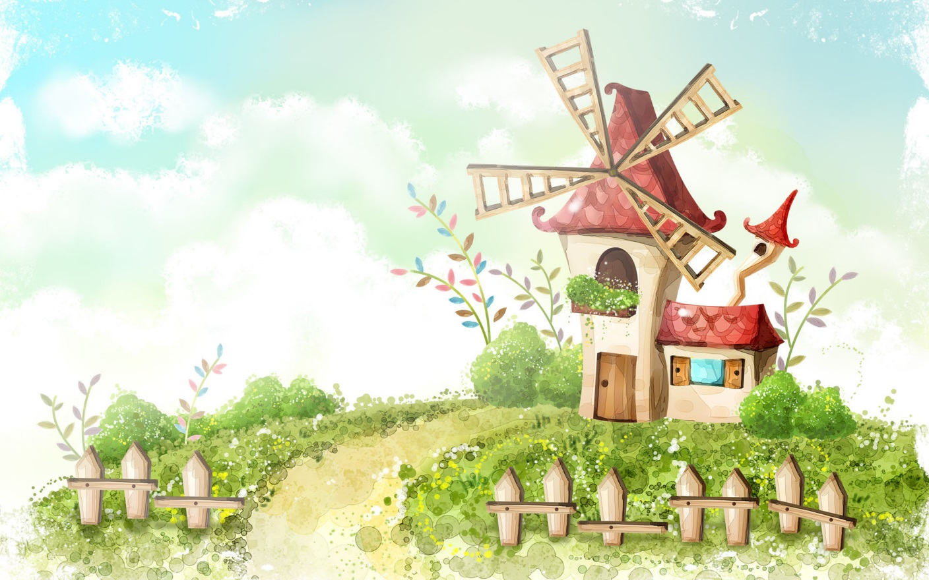
Welcome to our class 7C8
Teacher: Vu Thi Hien

Slide 2

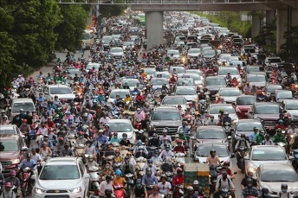
Warm - up
* Chitchatting
+ How do you people travel every day?
+ What do you think about the traffic in the picture?
→ People travel by different means of transport such as cars, motorbikes, bicycles, buses or on foot
→ There's too much traffic on the road. This can easily cause traffic congestion ( traffic jam)

Slide 3
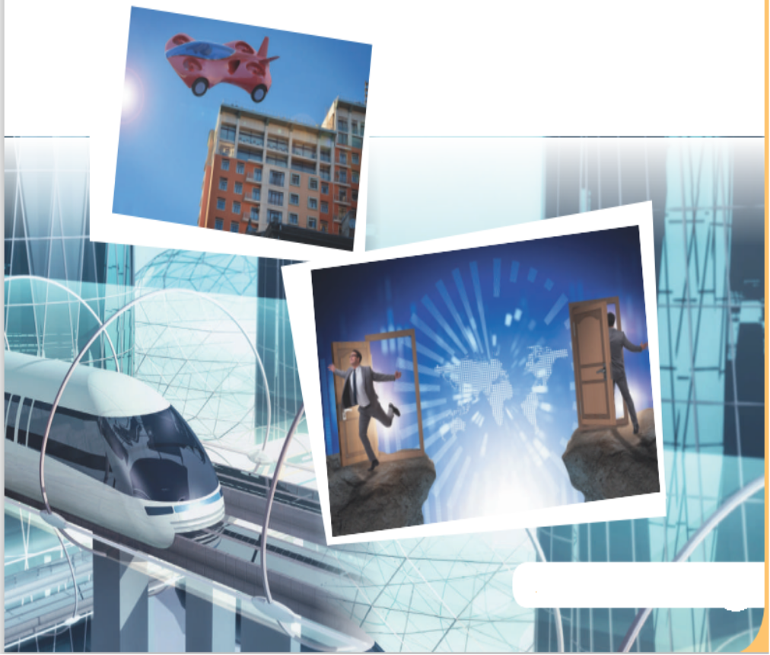
+ How about traffic in the future?
→ I think there will be many modern means of transport that will save energy and protect the environment.

Slide 4


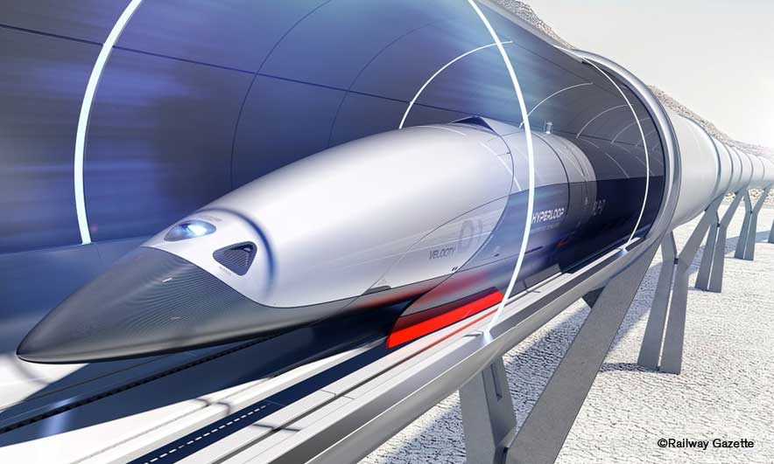
Unit
11
TRAVELLING IN THE FUTURE
Period 88:LESSON 1: GETTING STARTED
I hope we will have a hyperloop soon!
HOBBIES

Slide 5
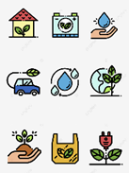

* Vocabulary
- eco – friendly (a):
thân thiện với môi trường
/ˈiː.kəʊˌfrend.li/

Slide 6

* Vocabulary
- fume (n):
khói
/fjuːm/

Slide 7

* Vocabulary
- hyperloop (n):
hệ thống giao thông tốc độ cao
/ˈhaɪ.pərluːp/

Slide 8

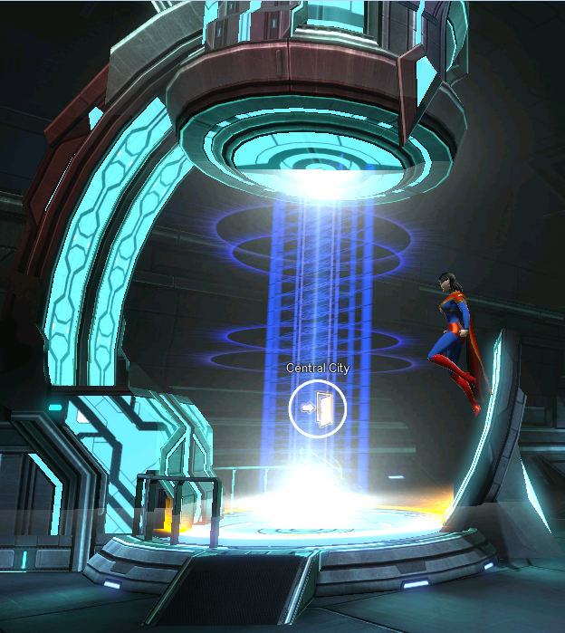
* Vocabulary
- teleporter (n):
phương tiện di chuyển tức thời
/ˈtel.ɪ.pɔː.tər/

Slide 9
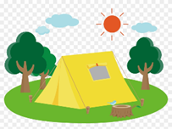
* Vocabulary
- campsite (n):
địa điểm cắm trại
/ˈkæmp.saɪt/

Slide 10
* Vocabulary
New words | Pronunciation | Meaning
1. eco – friendly (a) | /ˈiː.kəʊˌfrend.li/ | thân thiện với môi trường
2. fume (n) | /fjuːm/ | khói
3. hyperloop (n) | /ˈhaɪ.pərluːp/ | hệ thống giao thông tốc độ cao
4. teleporter (n) | /ˈtel.ɪ.pɔː.tər/ | phương tiện di chuyển tức thời
5. campsite (n) | /ˈkæmp.saɪt/ | địa điểm cắm trại

Slide 11

* Checking vocabulary
fume
hyperloop
teleporter
eco – friendly
campsite

Slide 12
1. LISTEN AND READ
+ Who are they in the conversation ?
→They are Minh and Ann.
+ What are they talking about?
→They are talking about means of transport in the future.

Slide 13
1. LISTEN AND READ
Minh: Oh, another traffic jam.
Ann: How will we get to the campsite on time now?
Minh: I don’t know. It’s a pity that we don’t have a hyperloop now!
Ann: What’s a hyperloop?
Minh: It’s a system of tubes. You can go from one place to another in just minutes.
Ann: Amazing! Even faster than a flying car!
Minh: Yes, and there are no traffic jams.
Ann: Will it pollute the environment?
Minh: No. There will be no fumes, and it’s totally safe.
Ann: Like a teleporter?
Minh: A teleporter is also fast, safe and eco-friendly. But it’s a different mode of travel.
Ann: So when we travel in hyperloops, we won’t have to worry about bad weather, right?
Minh: Right.
Ann: Sounds great! I hope we’ll have them soon.

Slide 14
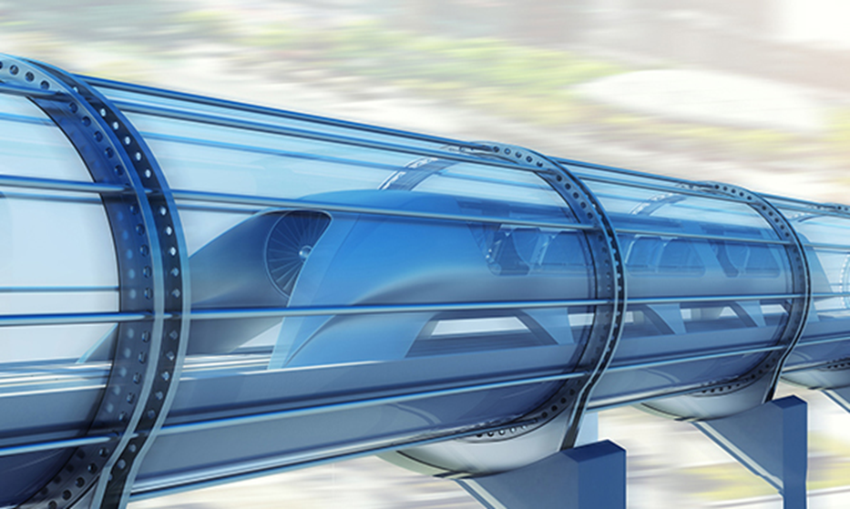
1
Listen and read. What are Ann and Minh talking about?
A. Travelling by teleporter
B. Future modes of travel
C. Being in a traffic jam

Slide 15
2
Read the conversation again and tick T (True) or F (False).
 | T | F
1. Ann and Minh are in a traffic jam now.
2. Ann and Minh are going to school.
3. Ann knows a lot about hyperloops.
4. Minh seems to know about different modes of travel.
5. They hope there will be hyperloops soon.





→ Ann: How will we get to the campsite on time now?
→ Ann: What’s a hyperloop?

Slide 16
3
Find the words and phrases that describe the means of transport in the conversation and write them in the correct columns.
Hyperloop | Teleporter
a system of tubes
Faster than a flying car
No traffic jams
No fumes
safe
Fast
Safe
Eco - friendly

Slide 17

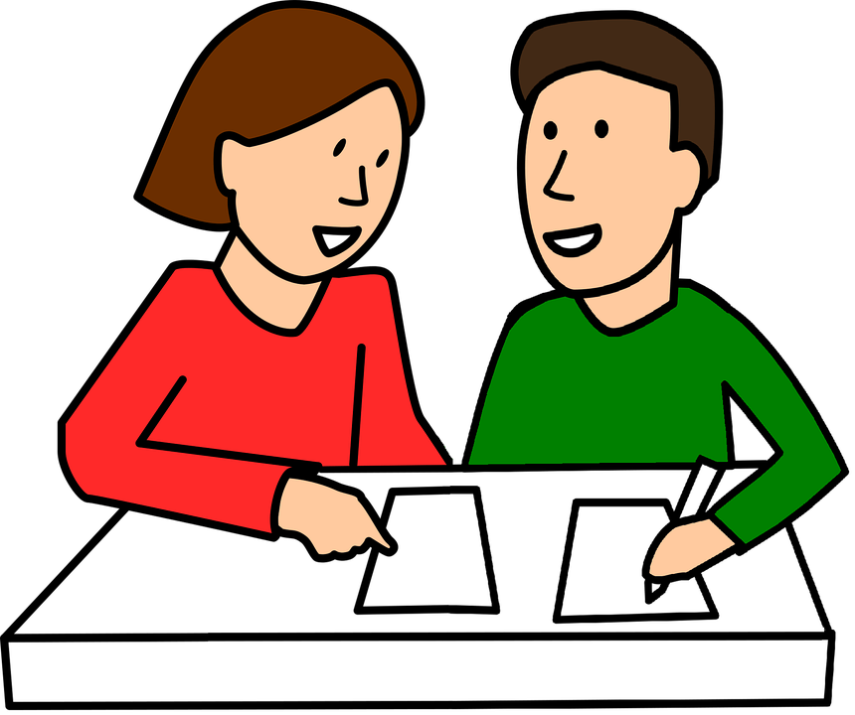
4
Quiz

Slide 18

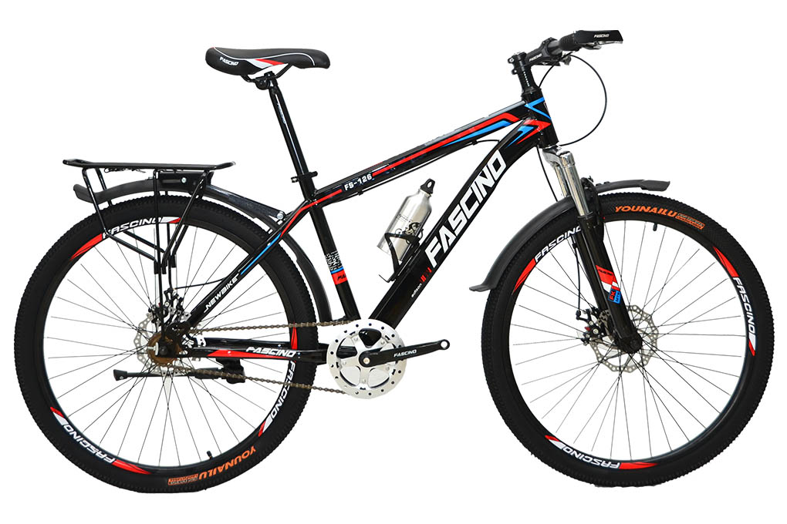
4
Quiz
What vehicle is this?
1. It has two wheels and you pedal it.
→bicycle / bike

Slide 19
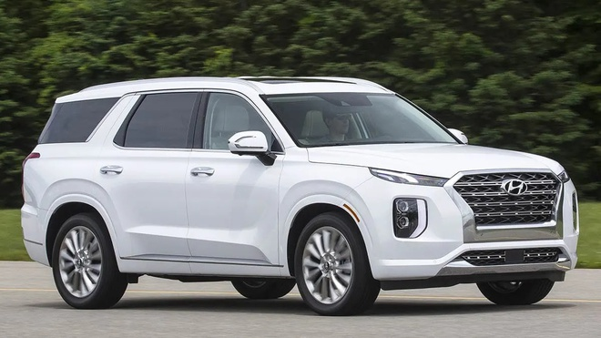
4
Quiz
What vehicle is this?
2. It has four wheels. It runs on petrol or electricity, and can carry up to eight passengers.
→ It’s a car

Slide 20
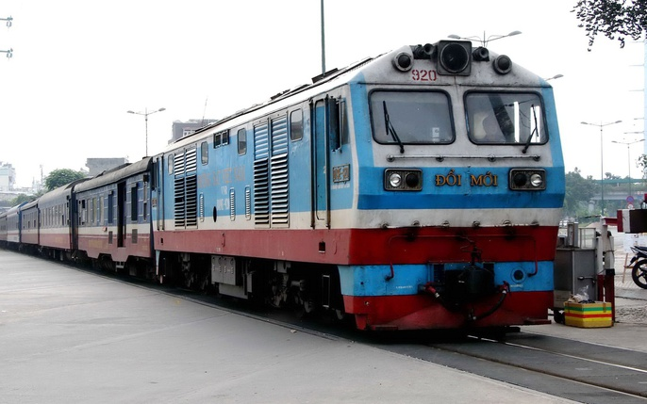
4
Quiz
What vehicle is this?
3. It carries many passengers and runs on tracks.
→ It’s a train

Slide 21
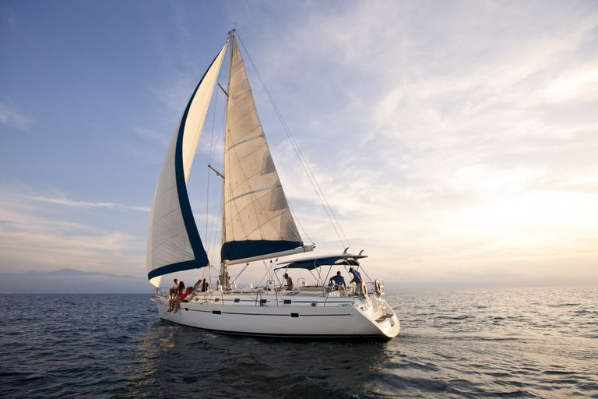
4
Quiz
What vehicle is this?
4. It sails on the sea. It needs wind to sail.
→ Sailing boat

Slide 22
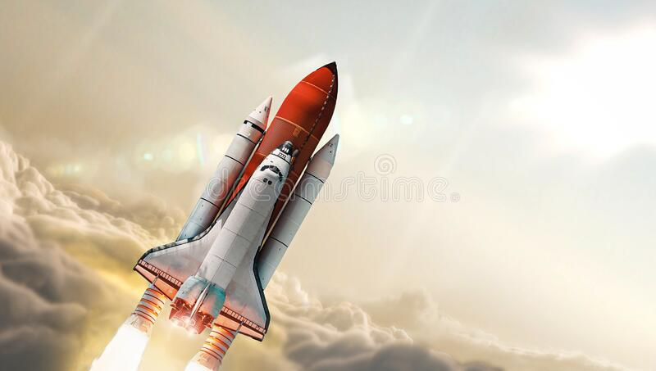
4
Quiz
What vehicle is this?
5. It travels in space. It can even carry people to the moon.
→ It’s a rocket / spaceship

Slide 23
* CONSOLIDATION
TRAVELLING IN THE FUTURE
Topic of the unit
Vocabulary

Slide 24

Home assignments:
Do exercise in the textbook.
Prepare the vocabulary for the next lesson:
A closer look 1.

Slide 25

Thanks for your atendance!
Goodbye. See you again
Notes:
25

