Slide 1



Minh Duc Secondary School
WARMLY WELCOME ALL THE TEACHERS TO CLASS 6A2!

Slide 2
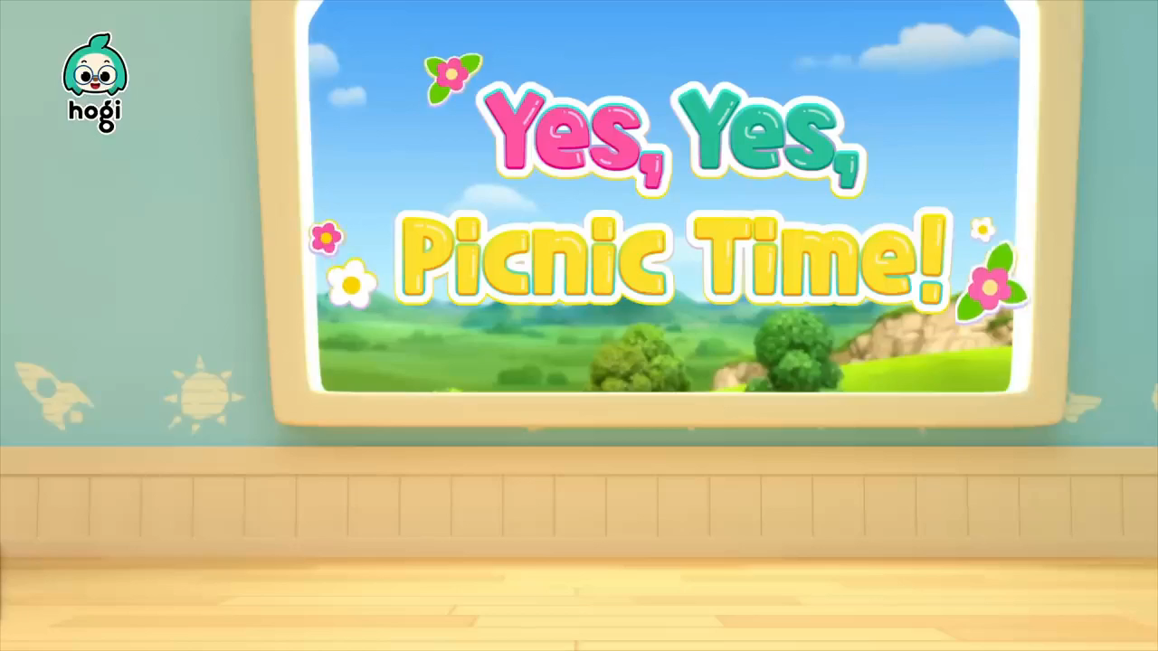
Watch a music video and answer the questions.

Slide 3
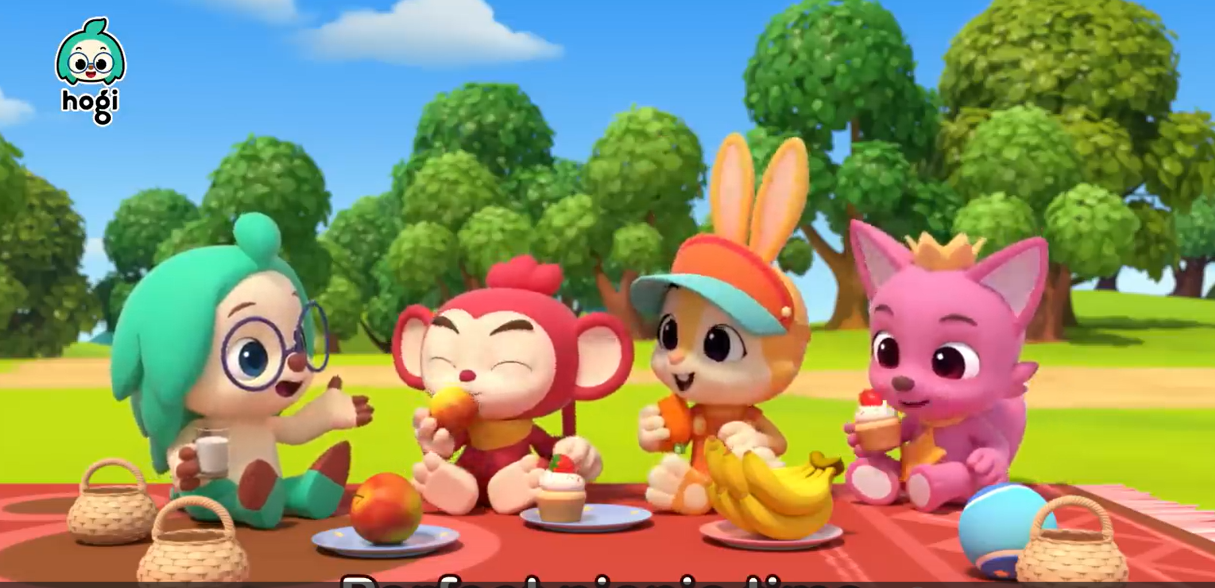
1. What are they doing ?
2. Do you like going on a picnic ?
3. What should you bring along when you go on a picnic ?

Slide 4
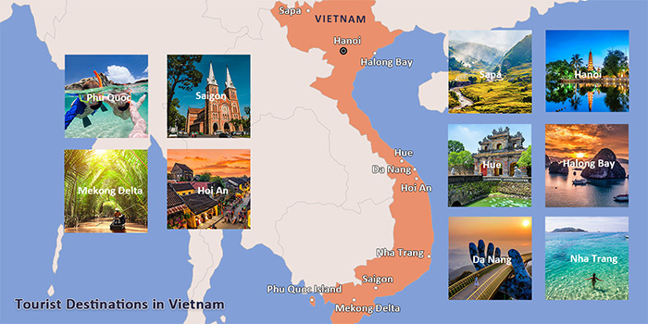
Unit 5: Natural wonders of Viet Nam
Lesson 2: A closer look 1 (p.50-51)

Slide 5
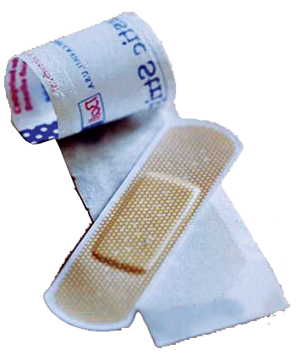
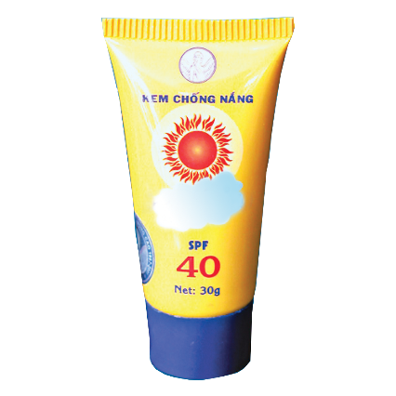
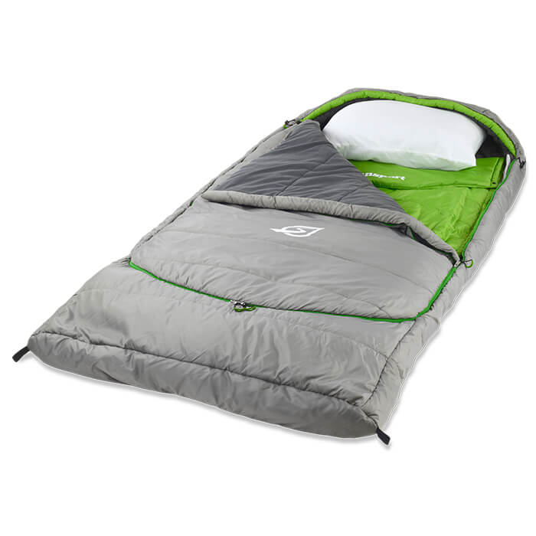
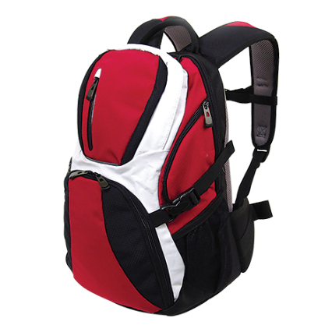

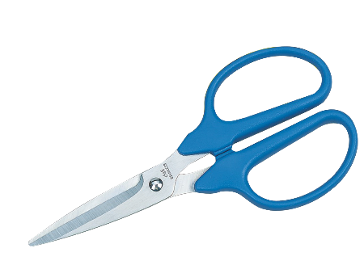
Unit 5: Natural wonders of Viet Nam
Lesson 2: A closer look 1 (p.50-51)
I. Vocabulary
plaster (n):
băng, gạc y tế
suncream (n):
kem chống nắng
sleeping bag(n):
túi ngủ
scissors (n):
cái kéo
backpack(n):
ba lô
compass (n):
la bàn

Slide 6
* Checking words.
RUB OUT AND REMEMBER
- plaster (n):
băng, gạc y tế
- sleeping bag (n):
túi ngủ
- backpack (n):
ba lô
- compass (n):
la bàn
- suncream (n):
kem chống nắng
- scissors (n):
cái kéo

Slide 7

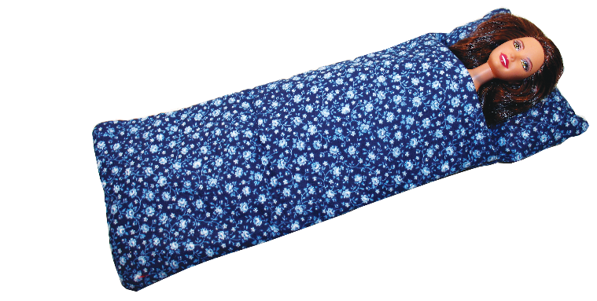
Write a word under each picture. Practise saying the words.
plaster
sleeping bag
backpack
compass
suncream
scissors
plaster
2.
suncream
3.
sleeping bag
1.
6.
5.
compass
4.
backpack
scissors

Slide 8

Complete the following sentences. Use the words in 1.
1. We’re lost. Please give me the__________.
compass
compass
2. It’s so sunny today. I need to put on some _________.
suncream
3. A ____________ is very useful when you go camping overnight.
sleeping bag
3. A ____________ is very useful when you go camping overnight.
4. I’ve finished packing. All my things are in my __________.
backpack
5. My foot hurts. I need to put a ___________ on my foot.
plaster

Slide 9

Now put the items in order of usefulness. Number 1 is the most useful, number 6 is the least useful on holiday.
plaster
sleeping bag
backpack
compass
suncream
scissors
1.
2.
3.
4.
5.
6.

Slide 10


II. Pronunciation:
/t/ and /d/
Listen and repeat the words.
/t/ | /d/
mountain waterfall desert plaster | wonder island guide holiday

Slide 11


If you hear /r/ please wave your hand.
If you hear /l/ please clap your hands.
/t/
/d/

Slide 12

Listen and repeat. Pay attention to the bold-typed parts of the words.
1.
Where’s my hat?
Oh, it’s on your head.
2.
Where do they stay on their holiday?
3.
I need some meat for my cat.
4.
The Sahara is a very hot desert.
5.
I want to explore the island by boat.

Slide 13


III. HOME ASSIGNMENT
Make sentences using each of the new words learned.
Prepare the next lesson: A closer look 3

Slide 14

THANK YOU FOR YOUR ATTENTION!

