Slide 1
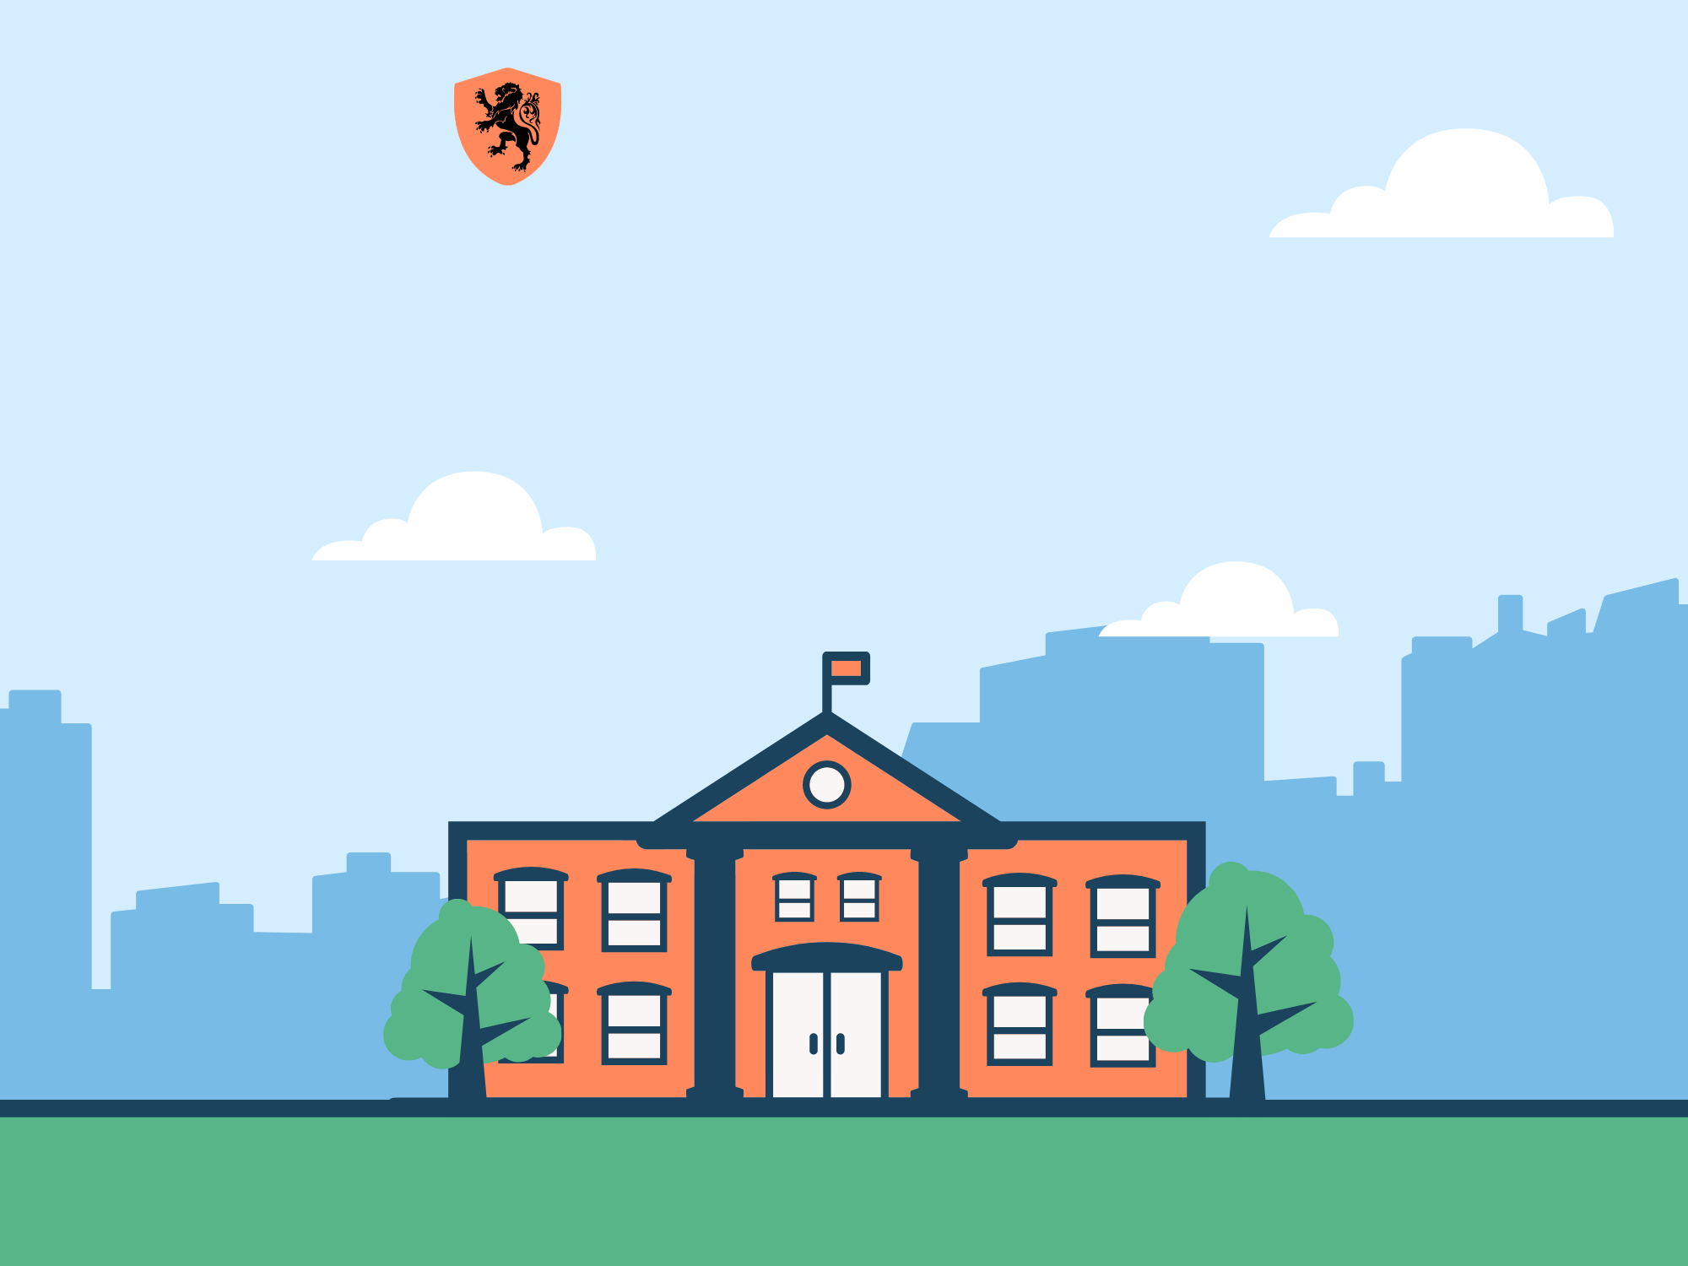
Trường THCS Ngọc Hải
Chào mừng thầy cô
và các em đến với tiết học

Slide 2
Unit 1. My new school
Lesson 3. A closer look 2

Slide 3
Objectives
After this lesson, students will be able to:
- Use the present simple.
- Use the adverbs of frequency.

Slide 4
Unjumble to complete the sentence.
1
go/ the same/ to/ They/ school.
2
3
5
They go to the same school.
don’t/ I/ a sister/ have.
I don’t have a sister.
What tense is it?
Where do you live?
live/ do/ you/ Where/ ?
4
near/ lives/ Peter/ school.
Peter lives near school.
We always look smart in our uniform.
in/ always/ smart/ uniform/ We/ look/ our.

Slide 5
Present simple

Slide 6
Present simple - Uses
They go to the same school.
Peter lives near school.
I don’t have a sister.
Where do you live?
→ To talk about actions or events that are fixed
We always look smart in our uniform.
→ To talk about actions or events that often happen

Slide 7
Present simple - Form
a. They go to the same school.
V inf
(+) Positive
I/ You/ We/ They
+ V inf
b. Peter lives near school.
V s/es
He/ She/ It
+ V s/es

Slide 8
Present simple - Form
a. I don’t have a sister.
don’t + V
(-) Negative
I/ You/ We/ They
+ don’t + V
b. She doesn’t like rap songs.
doesn’t + V
He/ She/ It
+ doesn’t + V

Slide 9
Present simple - Form
a. Do you like science?
Do
I/ you/ we/ they
+ V ?
Yes, I do./ No, I don’t.
(?) Question
b. Does she have a calculator?
Does
he/she/it
+ V ?
Yes, she does./No, she doesn’t.

Slide 10
I/ You/ We/ They + V
He/ She/ It + V(s/es)
POSITIVE
I/ You/ We/ They + don’t + V
He/ She/ It + doesn’t + V
NEGATIVE
Do + I/you/we/they + V?
→ Yes, I do / No, I don’t
Does he/she/it + V?
→ Yes, she/he/it does
→ No, she/ he/it doesn’t
QUESTIONS

Slide 11

Ex 1. (p 9) Underline the subject, then circle your answer.
+ V inf
1. We ___________ new subjects for this school year.
A. have B. has C. having
2. Duy ___________ to school every day.
A. cycling B. cycle C. cycles
3. My new school ____________ in the centre of the village.
A. not B. isn’t C. doesn't
4. I live near here. Where ____________ live?
A. do you B. you C. are you
5. My friend has a sister, but she ____________ a brother.
A. not has B. don't have C. doesn't have
+ V s/es
+ be
+ doesn’t V

Slide 12
Ex 2. (p 9) Write the correct forms of verb.
Miss Nguyet: Tell us about yourself Duy.
Duy: Sure! I live near here now. This is my new school. Wow! It (1. have) _____ a large playground.
Miss Nguyet: ______ you _______ (2. have) any new friends?
Duy: Yes. I ______ (3. love) my new school and my new friends, Vy and Phong.
Miss Nguyet: ______ Vy ______ (4. walk) to school with you?
Duy: Well, we often _________ (5. ride) our bicycles to school.
has
(+) He/ She It + V(s/es)
Do
have
(?) Do + you/we/they + V?
love
(+) I/ You/ We/ They + V
Does
walk
(?) Does + he/she/it + V?
ride
(+) I/You/ We/ They + V

Slide 13
Present simple
Tom usually go to the cinema on Sunday.
Adverb of frequency
- To show HOW OFTEN something happens.
- What to do?
- Where is it?
- BEFORE the main verb.

Slide 14

Ex 3. (p 10) Write a sentence with one of these adverbs.
Ex 3. (p 10) Fill in the blank with usually, sometimes or never.
100%
1. always
usually
90%
2. ______
sometimes
50%
3. ______
5%
4. rarely
never
0%
5. ____

Slide 15
Ex 4. (p 10) Choose the correct answer.
1. I __________ late on Saturdays.
A. get up usually B. usually get up
2. My mum __________ to work late.
A. rarely goes B. goes rarely
3. __________ at weekends?
A. Do you often travel B. Often do you travel
4. What kind of music __________?
A. usually does Susan listen to B. does Susan usually listen to
5. When __________ go on holiday each year?
A. do you usually B. you usually

Slide 16
Ex 5. (p 10) Write full questions in your notebook.
Ex 5. (p 10) In group of 6, ask and answer these questions.
1. you/ often/ ride your bicycle/ to school
2. you/ sometimes/ study/ in the school library
3. you/ like/ your new school
4. your friends/ always /go to school/ with you
5. you/ usually/ do homework/ after school
→ Do you often ride your bicycle to school?
→ Do you sometimes study in the school library?
→ Do you like your new school?
→ Do your friends always go to school with you?
→ Do you usually do your homework after school?

Slide 17
RECAP
1. What tense do you learn today?
THE PRESENT SIMPLE
2. List 5 adverbs of frequency in this lesson.
always, usually, sometimes, rarely, never

Slide 18
THANK YOU!

