Slide 1

Trường THCS Ngọc Hải
Chào mừng thầy cô
và các em đến với tiết học

Slide 2
Unit 1: MY NEW SCHOOL
Lesson 7: Looking back

Slide 3
OBJECTIVES
Review the vocabulary and grammar of Unit 1

Slide 4
VOCABULARY
School things:
table, chair, white board, black board, desk, teacher, student, classroom, marker, compass, bag, computer, scissor, pencil, clip, book, friends, ect.
study, play sports, read a book, practice, experiment, make friends, ect.
study English, play the Guitar, wear a uniform, read a book, make friends, ect.
School activities:
Verb + N :

Slide 5
PRONUNCIATION
/ɑː/ | /ʌ/
After, glass, tomato, father, bath, class, calm, aunt, smart, dance, fast, bar, car, card, far, star, heart.
Bus, sun, run, much, lung, drug, study, dust, uncle, number, mother, come, dove, love, young, touch, cousin, flood, blood

Slide 6
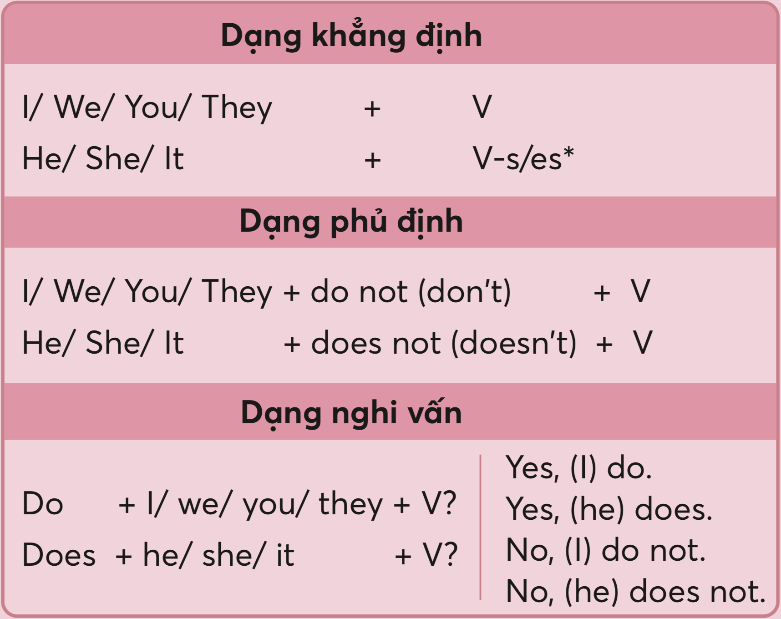
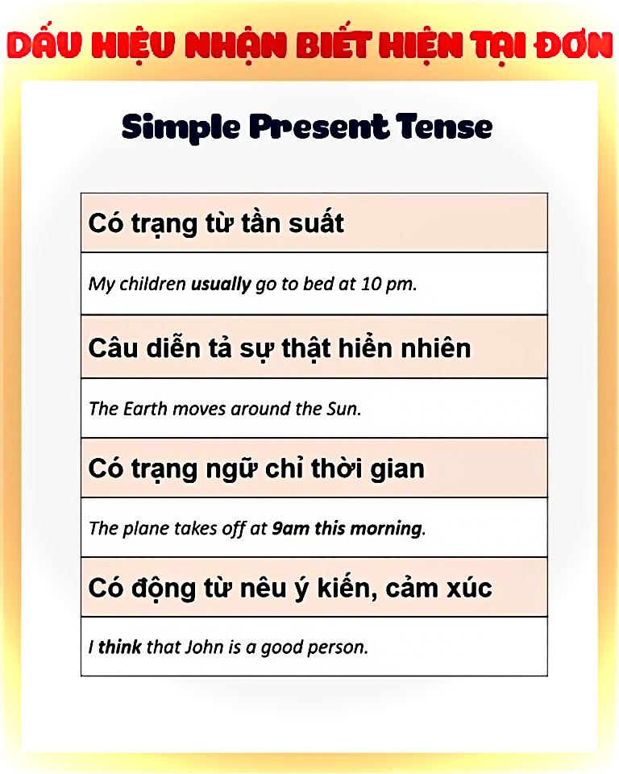
GRAMMAR: present simple

Slide 7
GRAMMAR: adverbs of frequency
Frequency | Adverb of Frequency | Example Sentence
100% | always | I always go to bed before 11 p.m.
90% | usually | I usually have cereal for breakfast.
80% | normally / generally | I normally go to the gym.
70% | often* / frequently | I often surf the internet.
50% | sometimes | I sometimes forget my wife's birthday.
30% | occasionally | I occasionally eat junk food.
10% | seldom | I seldom read the newspaper.
5% | hardly ever / rarely | I hardly ever drink alcohol.
0% | never | I never swim in the sea.

Slide 8
VOCABULARY

Slide 9
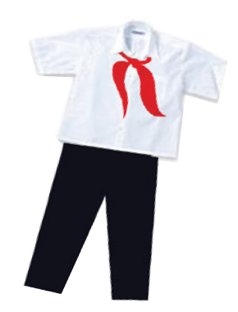



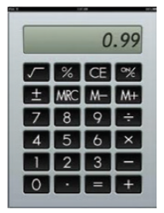

Ex1: Look at the pictures. Write the correct words in the gaps.
Our new _____________ is very nice.
I have a red ____________________.
This is my ___________ for writing English words.
We often use a ______________ in a maths class.
Can you lend me your ___________ for a minute?
6. My new ______________ is short.
uniform
pencil sharpener
notebook
compass
calculator
ruler

Slide 10
Ex2: Match the words in A with the words / phrases in B.
A
B
1. study
e. new words
a. lunch
2. do
d. exercise
b. the Piano
3. play
b. the Piano
c. a uniform
4. have
a. lunch
d. exercise
5. wear
c. a uniform
e. new words

Slide 11
GRAMMAR

Slide 12
Ex3: Complete the sentences with the present simple.
He (come) ___________ from Da Nang.
- Do you learn Russian?
- No, I (not do) ______________.
3. She always (walk) __________ to school with her friends.
I often (do) _________ my homework after school.
Mr Nam (teach) _____________ history at my school.
Present Simple
(+) S + V(s/es).
(-) S + don’t/doesn’t + S.
(?) Do/Does + V ?
comes
don’t
walks
do
teachs

Slide 13
Ex4: Complete the text with the correct form of the verbs in brackets.
Hoang lives in a small house in the centre of his village. His house (1. be) ________ near his new school. Every day, he (2. have) _______ breakfast at 6 o’clock. Then he (3. walk) ________ to school with his friends. Hoang and his friends (4. study) ________ in grade 6 at An Son School. Hoang
(5. like) _________ his new school.

Slide 14
Ex4: Complete the text with the correct form of the verbs in brackets.
Hoang lives in a small house in the centre of his village. His house (1. be) ________ near his new school. Every day, he (2. have) _______ breakfast at 6 o’clock. Then he (3. walk) ________ to school with his friends. Hoang and his friends (4. study) ________ in grade 6 at An Son School. Hoang (5. like) _________ his new school.
It + Vs/es
He + Vs/es
He + Vs/es
They + V
He + Vs/es
is
has
walks
study
likes

Slide 15
Ex5: Put the adverb in brackets in the correct place in each sentence.
1. I remember to do my homework (always)
2. Nick gets good marks in exams. (usually)
3. We do not see a rabbit in town. (often)
4. I read in bed at night (rarely)
5. Do you sing in the shower? (sometimes)
🡪 I always remember to do my homework.
S + adverb frequency + V
VD: He often cooks.
S + be + adverb frequency
VD: You are always late
🡪 Nick usually gets good marks in exams.
🡪 We do not often see a rabbit in town.
🡪 I rarely read in bed at night.
🡪 Do you sometimes sing in the shower?

Slide 16
REFERENCE

Slide 17


Describe your dream school.

Slide 18


01 PRODUCT
3 pts
Criteria
02 PRESENT
3 pts
03 TEAMWORK
3 pts
04 DEADLINE
1 pt

Slide 19

PRESENTATION
VOCABULARY
GRAMMAR
PRONUNCIATION
Using vocabulary related to the topic
Using sentences with no or a few mistakes
Good effort at accent and clear pronunciation

Slide 20


DEADLINE
You will lose one score if you miss any deadlines.

Slide 21




Timeline 6H
Grouping
Project plan
Checking progress
Present
15/9
21/9
22/9
28/9

Slide 22

Grouping
Leader
Presenter (s)
Idea thinker (s)
Powerpoint makers (s)

Slide 23
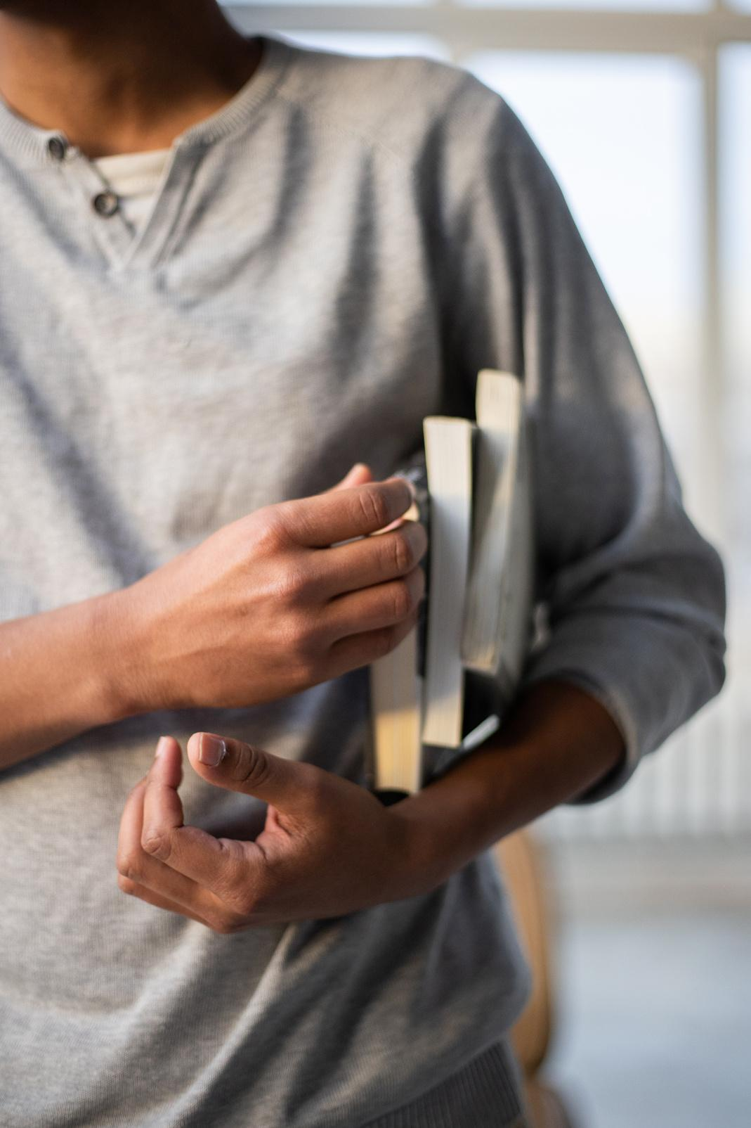

PROJECT PLAN
Members
Roles
What does your dream school look like?
Why is it your dream school?

Slide 24


CHECKING PROGRESS
What have you done?
Does your team work well?
Do you need any support?

Slide 25
Thanks!
See you next time

