Slide 1
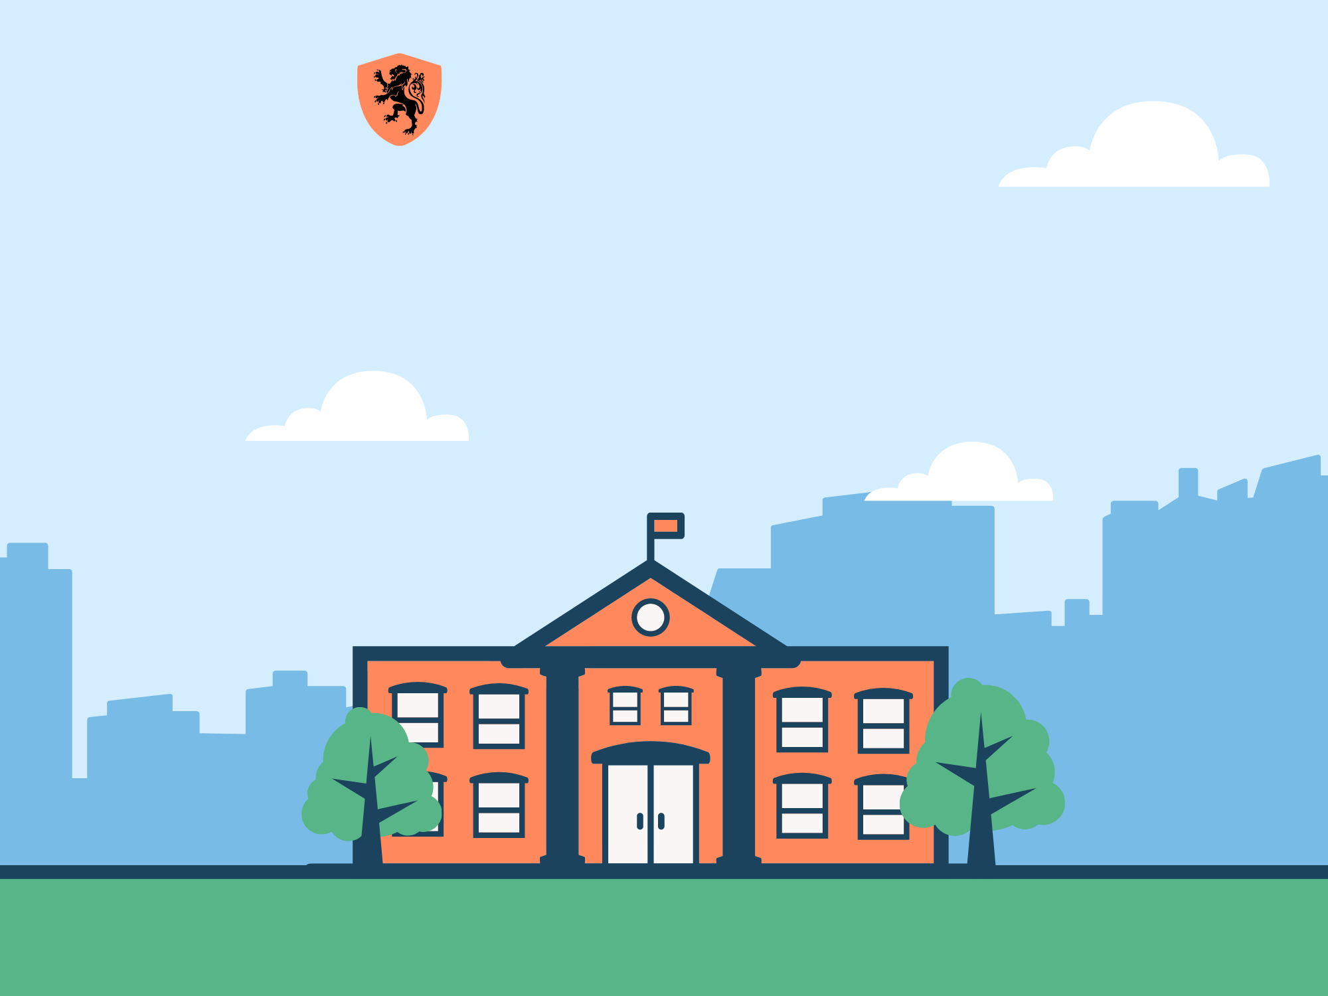
Trường THCS Ngọc Hải
Chào mừng thầy cô
và các em đến với tiết học

Slide 2
CROSSWORDS
- 4-5 students/ team
- Guess the cross words
+ cross word = 1pt
+ key word = 3 pts

Slide 3

CROSSWORDS
S
1
A
P
A
R
T
M
M
E
N
T
2
C
O
U
N
T
R
Y
Y
K
I
T
C
H
3
H
E
N
T
O
4
O
W
N
R
O
O
M
5
M
F
R
I
D
G
E
6
E
Notes:
Nhấn vào số để ra câu hỏi, nhấn ngôi sao để ra đáp án.
Nhấn welcome để ra màn hình Unit 1: getting started

Slide 4
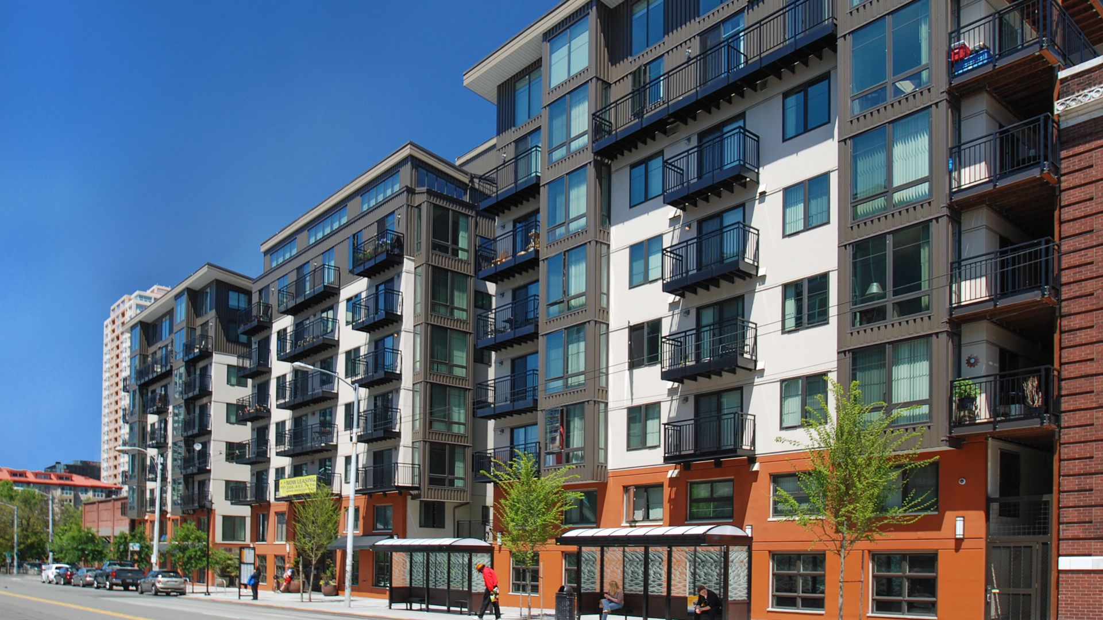
Where does Mi live? ⇨ She lives in a(n) ____________.
back

Slide 5
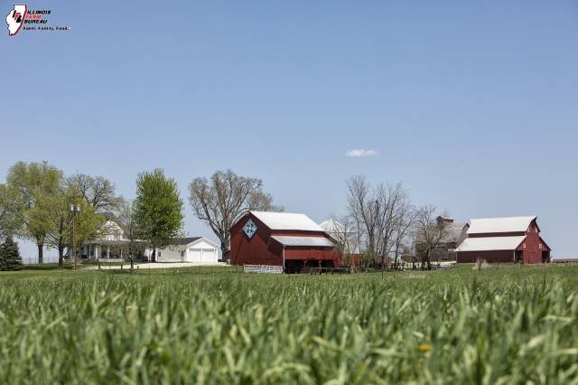
They have a small house in the ________.
back

Slide 6
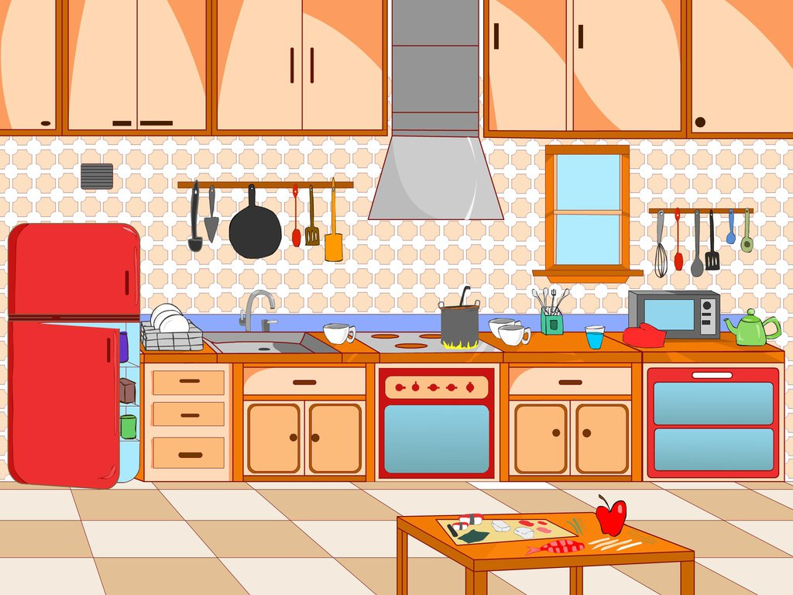
Which room is it? ⇨ It is a ____________
back

Slide 7
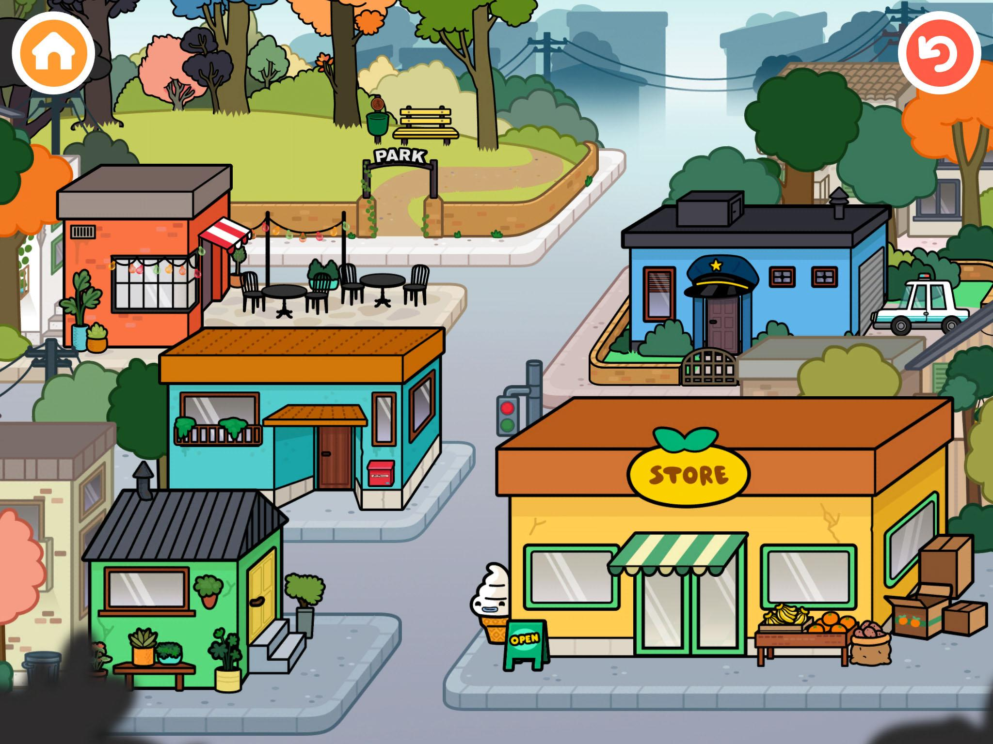
What word is it? NOTW
back

Slide 8
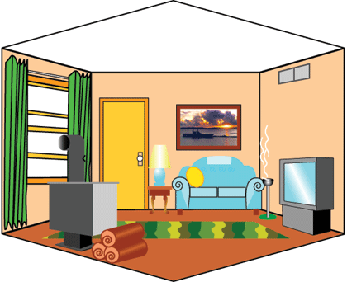
What is this ? ⇨ This is __________
back

Slide 9
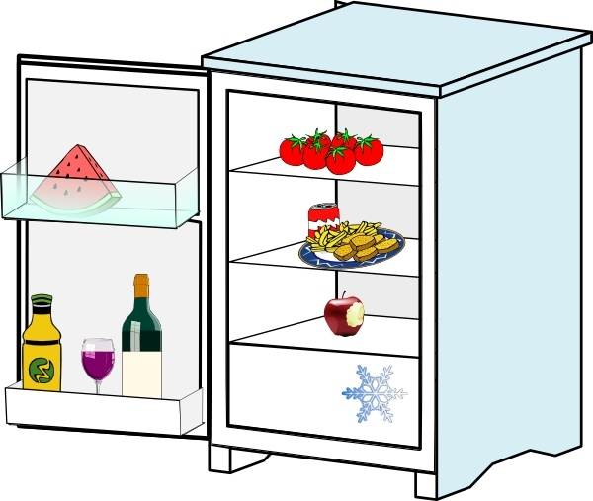
The tomatoes are in the __________.
back

Slide 10
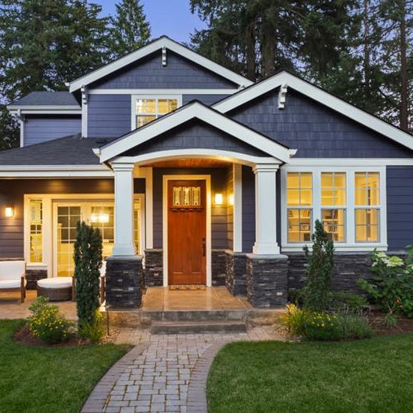
2022
Unit 2
My house
Getting Started
6th GRADE
Lesson 1
2022

Slide 11


Objectives
2022
By the end of this lesson, students will be able to:
get an overview about the topic My house.
use the vocabulary to talk about My house.
Unit 2 | My house

Slide 12
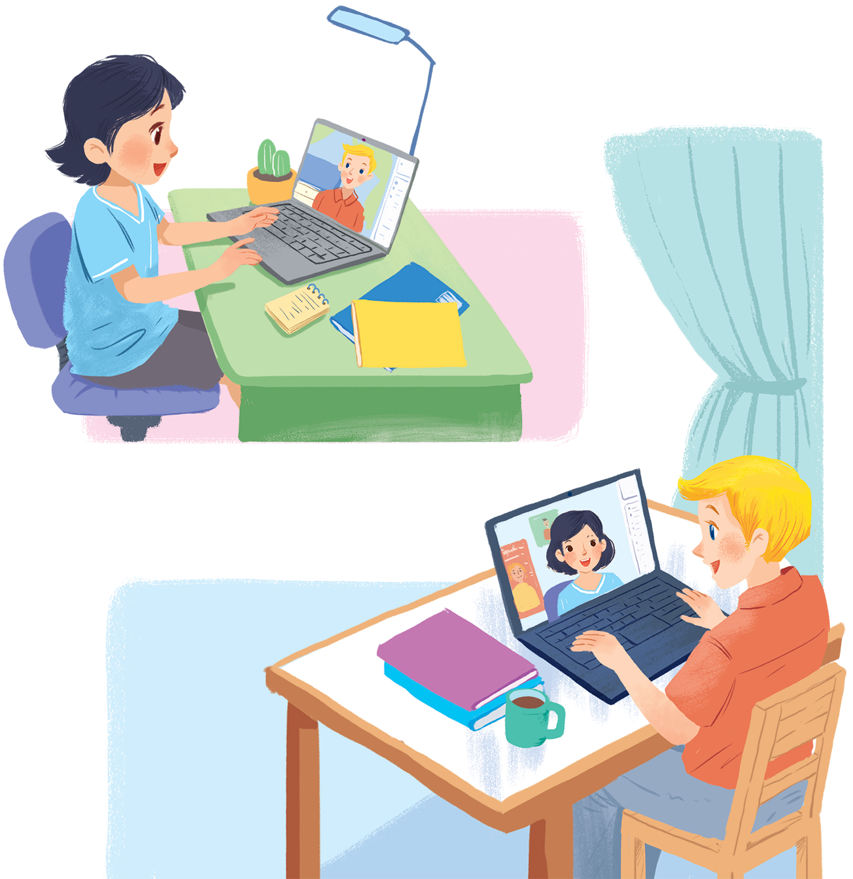
2022
1. Who are they?
2. Where are they?
Mi
At home
3. What are they talking about?
Let’s listen and check
Nick
Unit 2 | My house

Slide 13

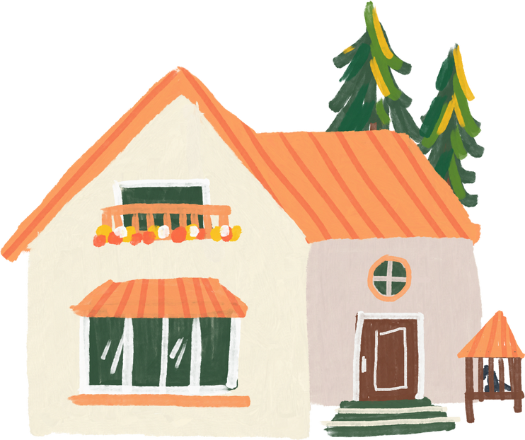
2022
1
Listen and read (pg 16)
Mi: Wow! Your room looks so big, Nick
Nick: It's Elena's room. She's my sister.
Mi: I see. Is there a TV behind you?
Nick: Yes, there is. Where do you live, Mi?
Mi: I live in a town house. And you?
Nick: I live in a country house. Who do you live with?
Mi: My parents and younger brother. We're moving to a flat next month! Nick Are you?
Mi: Yes. My aunt lives near there, and I can play with my cousin.
Nick: Are there many rooms in your new flat?
Mi: Yes, there are. There's a living room, three bedrooms, a kitchen and two bathrooms.
My house
Unit 2 | My house

Slide 14

2
Which family members does Mi talk about? Put a tick (✓)
Mi: Wow! Your room looks so big, Nick
Nick: It's Elena's room. She's my sister.
Mi: I see. Is there a TV behind you?
Nick: Yes, there is. Where do you live, Mi?
Mi: I live in a town house. And you?
Nick: I live in a country house. Who do you live with?
Mi: My parents and younger brother. We're moving to a flat next month! Nick Are you?
Mi: Yes. My aunt lives near there, and I can play with my cousin.
Nick: Are there many rooms in your new flat?
Mi: Yes, there are. There's a living room, three bedrooms, a kitchen and two bathrooms.
 | Yes
1. parents
2. sister
3. brother
4. aunt
5. cousin

Slide 15


3
Read the conversation again. Complete the sentences.
1. Elena is Nick’s _____________.
2. There is a _____________ in Elena's room.
3. Now Mi lives in a _____________ house.
4. Nick lives in a _____________ house.
5. Mi's new flat has _____________ bedrooms.

Slide 16

3
Check your answers.
1. Elena is Nick’s _____________.
sister
Mi: Wow! Your room looks so big, Nick
Nick: It's Elena's room. She's my sister.
2. There is a _____________ in Elena's room.
TV
Mi: I see. Is there a TV behind you?
Nick: Yes, there is. Where do you live, Mi?

Slide 17
3
Check your answers.
3. Now Mi lives in a _____________ house.
town
Nick: Yes, there is. Where do you live, Mi?
Mi: I live in a town house. And you?
4. Nick lives in a _____________ house.
country
Mi: I live in a town house. And you?
Nick: I live in a country house. Who do you live with?
5. Mi's new flat has _____________ bedrooms.
three/3
Nick: Are there many rooms in your new flat?
Mi: Yes, there are. There's a living room, three bedrooms, a kitchen and two bathrooms

Slide 18
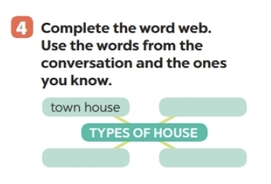

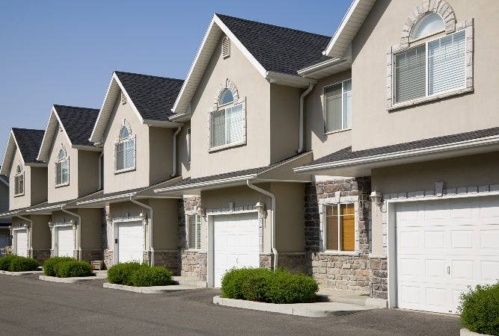
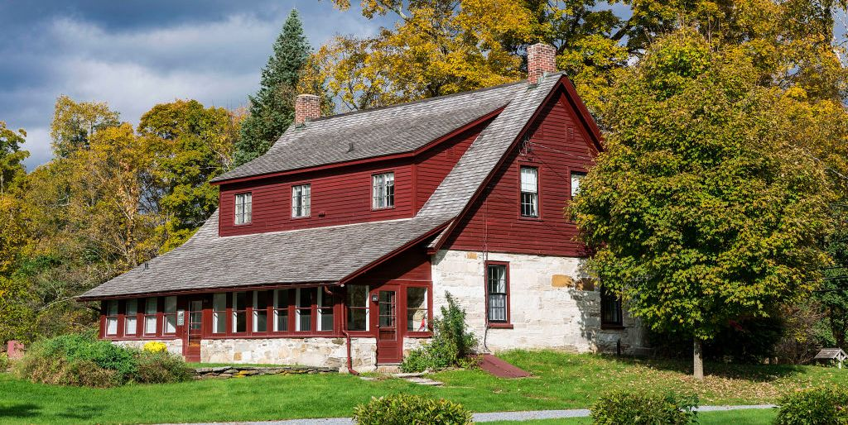

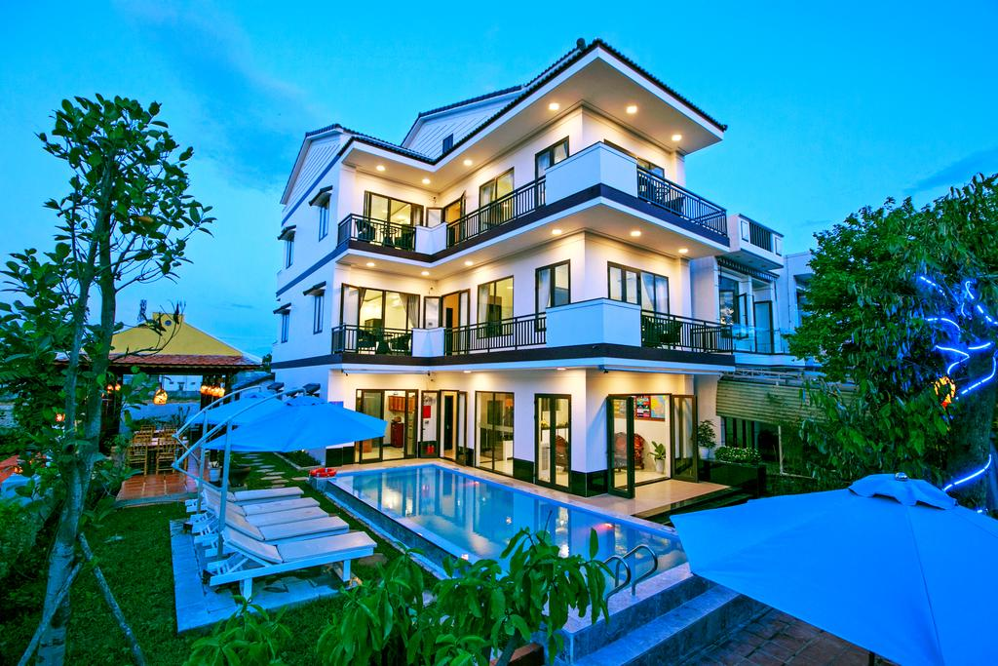

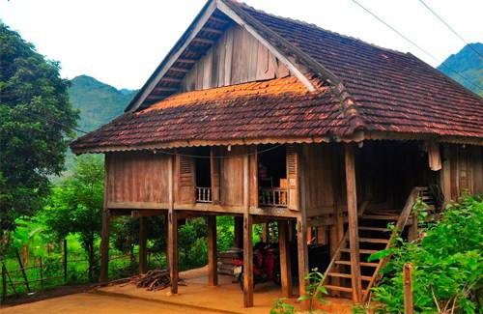

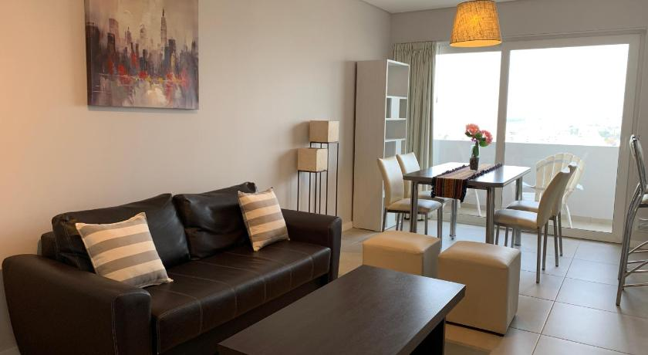
Complete the word web. Use the words from the conversation and the ones you know.
4
town house
Types of house
farm house
2 minutes
villa
flat/ apartment
stilt house

Slide 19




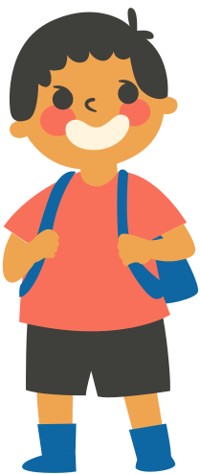
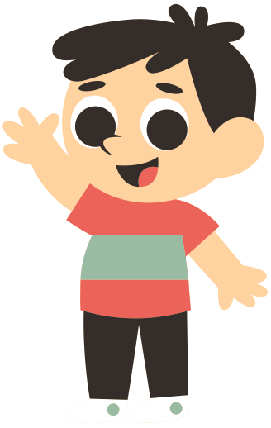
Work in groups of 3.
Ask your friends where they live, then take notes
5
Where do you live?
I live in a flat.

Slide 20

RECAP
1
What is the topic of this unit?
A. My school
B. My friends
C. My house

Slide 21
RECAP
Which is not belong to topic “My house?”
bedroom
kitchen
living room
bathroom
town
house
uniform
uniform

Slide 22

Thank you!

