Slide 1



BAAM!

Slide 2
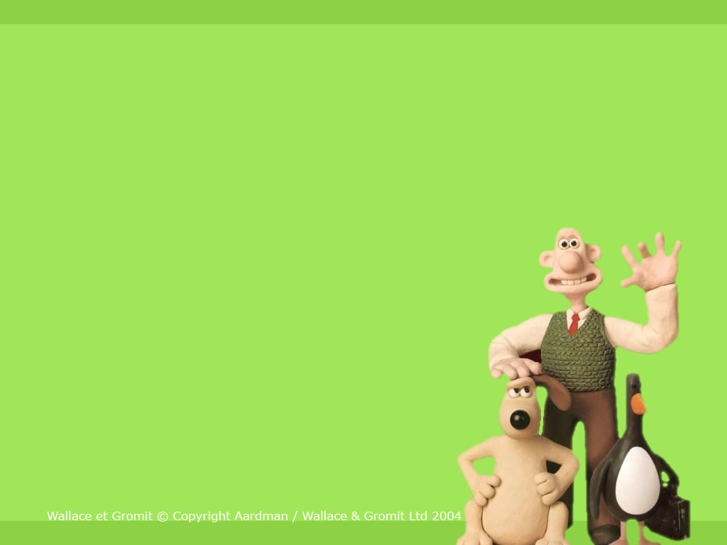
1
2
3
4
5
X
X
X
X
X
6
7
8
9
10
X
X
X
X
X
X
11
12
13
14
15
Pick a Number! Don't get BAAMed!
The End

Slide 3


Q. What are you doing? I’m .........
A: reading a book
$600

Slide 4
BAAM!
You are broke!

Slide 5
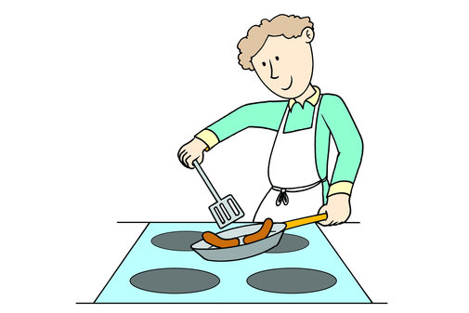
Q. What is he doing? He’s .....
A: cooking
$300

Slide 6
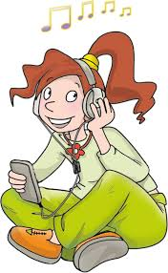
Q. What is she doing? She’s .......
A: listening to music
$100

Slide 7
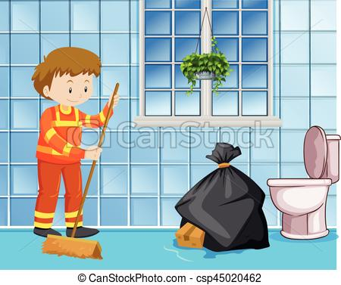
Q. What is he doing? He’s......
A: cleaning the floor
$400

Slide 8
BAAM!
Unlucky!

Slide 9
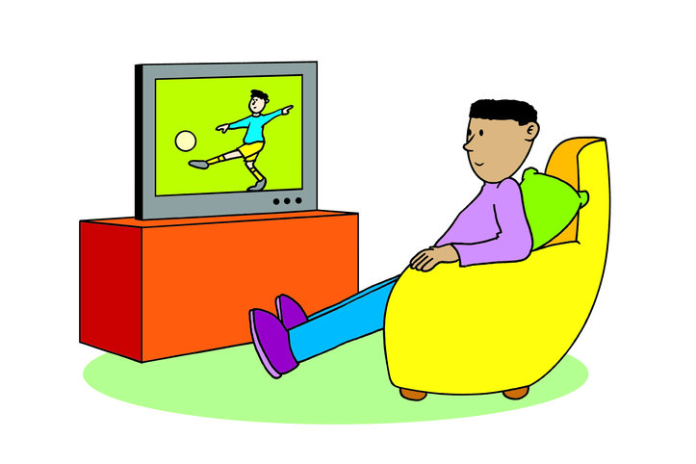

Q. What is he doing? He’s.............
A: watching TV

Slide 10

Q. They are .............
A: singing

Slide 11
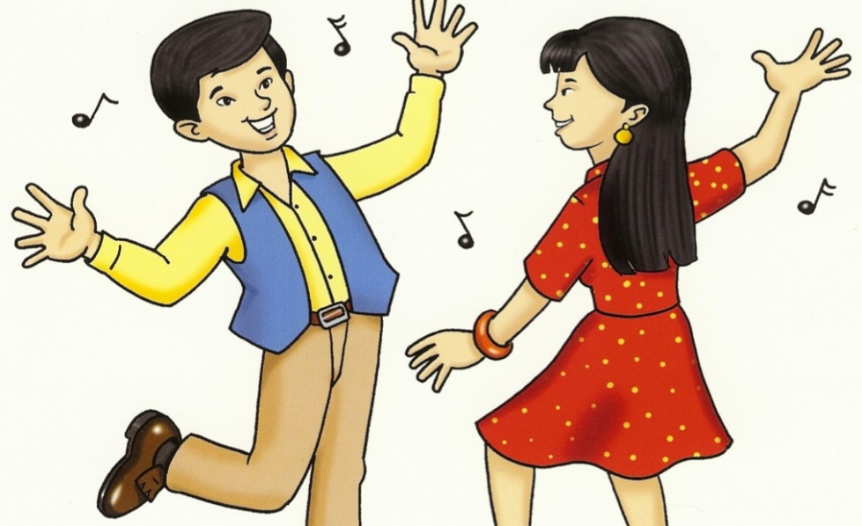

Q. They are.......................
A: dancing

Slide 12
BAAM!
You have no
money!

Slide 13
BAAM!
You’ve lost all your
money!

Slide 14

Q. What is she doing? She’s .......
A: playing the piano
$700

Slide 15

Q. What is he doing? He’s .......
A: drawing
$500

Slide 16

Q. He’s ...............his homework.
A: doing
$400

Slide 17
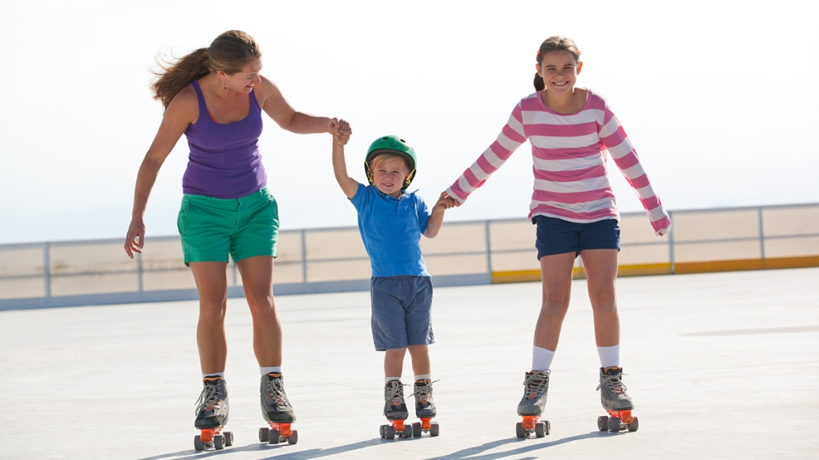
Q. What are they doing? They’re .......
A: Skating
$400

Slide 18
THE WINNING TEAM IS…
Team 1
Team 2

Slide 19

Team 1

Slide 20
Team 2

