Slide 1
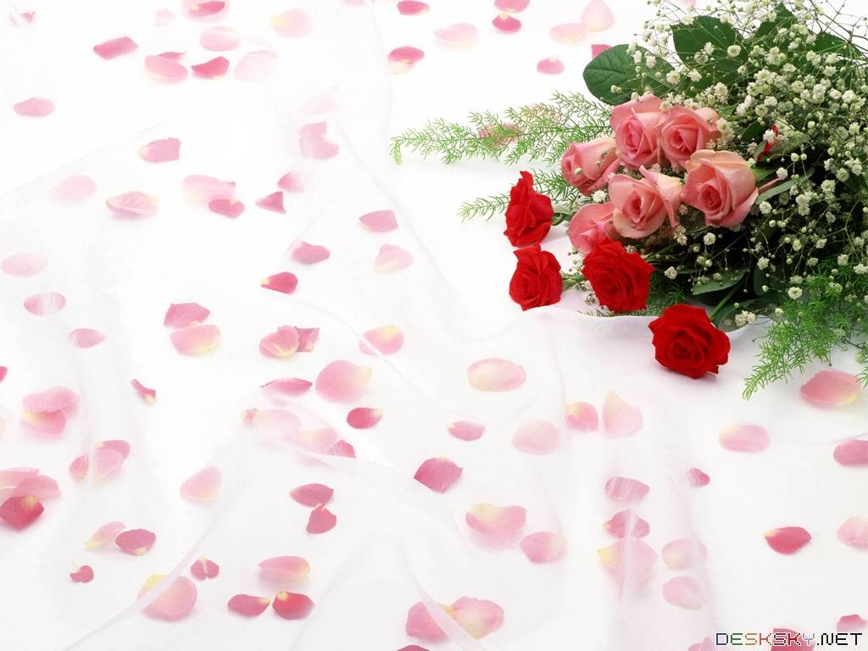
Welcome to the teachers
Attending our class
Teacher: Nguyen Thi Nguyet
Class: 7

Slide 2
Task 1

Slide 3

Unit
1
HOBBIES
LESSON 2
A CLOSER LOOK 1
VOCABULARY
PRONUNCIATION

Slide 4

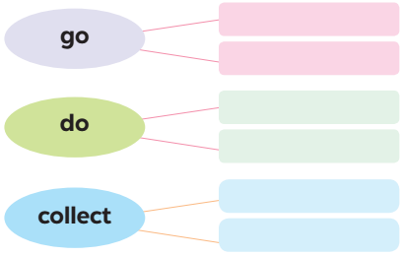
VOCABULARY
1
Complete the word webs below with the words from the box.
dolls
jogging
coins
judo
swimming
yoga

Slide 5
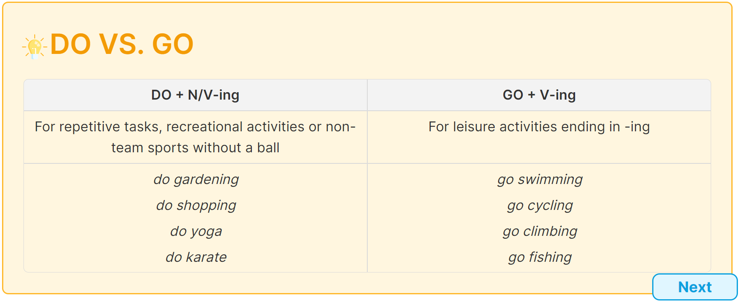

Slide 6
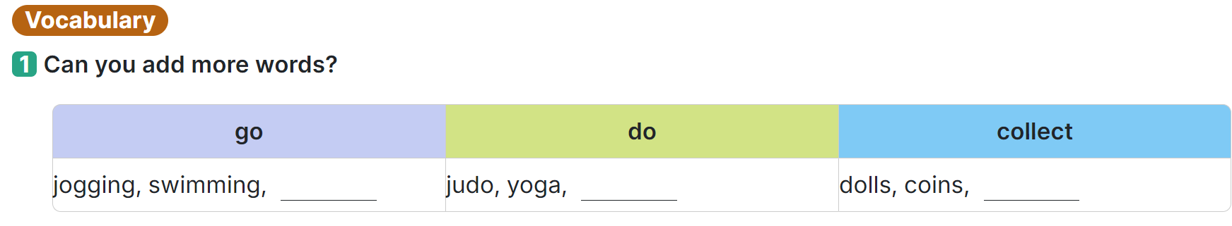
go fishing ,
go shopping
...
do housework ,
do homework ,
...
collect comic books ,
collect greeting cards
...

Slide 7
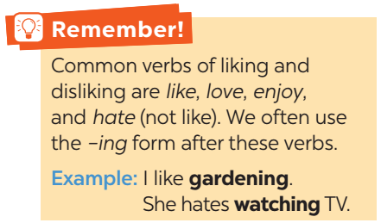
VOCABULARY
Like/ love/ / enjoy/ fancy…..+ V – ing /n
dislike / hate …..+ V – ing /n

Slide 8
VOCABULARY
2
Complete the sentences, using the –ing form of the verbs from the box.
go play collect do make
1. My dad has a big bookshelf because he loves _________ old books. 2. My sister likes _________ camping at the weekend. 3. My best friend hates _________ computer games. 4. Does your brother like _________ models? 5. My mum enjoys _________ yoga every day to keep fit.

Slide 9
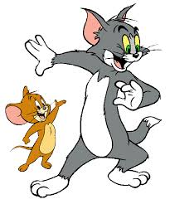
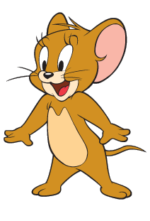
Questions: Lucky numbers
1
2
3
4
5
6
7
8

Slide 10
VOCABULARY
2
Complete the sentences, using the –ing form of the verbs from the box.
go play collect do make
1. My dad has a big bookshelf because he loves _________ old books.
collecting

Slide 11
VOCABULARY
2
Complete the sentences, using the –ing form of the verbs from the box.
go play collect do make
2. My sister likes _________ camping at the weekend.
going

Slide 12
VOCABULARY
2
Complete the sentences, using the –ing form of the verbs from the box.
go play collect do make
3. My best friend hates ________computer games.
playing

Slide 13
VOCABULARY
2
Complete the sentences, using the –ing form of the verbs from the box.
go play collect do make
4. Does your brother like _________ models?
making

Slide 14
VOCABULARY
2
Complete the sentences, using the –ing form of the verbs from the box.
go play collect do make
5. My mum enjoys ________yoga every day to keep fit.
doing

Slide 15
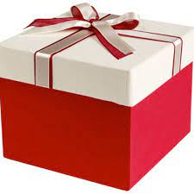
LUCKY NUMBER
YOU GET A GIFT

Slide 16

LUCKY NUMBER!

Slide 17
LUCKY NUMBER!

Slide 18
VOCABULARY
2
Complete the sentences, using the –ing form of the verbs from the box.
go play collect do make
1. My dad has a big bookshelf because he loves _________ old books. 2. My sister likes _________ camping at the weekend. 3. My best friend hates _________ computer games. 4. Does your brother like _________ models? 5. My mum enjoys _________ yoga every day to keep fit.
collecting
going
playing
making
doing

Slide 19
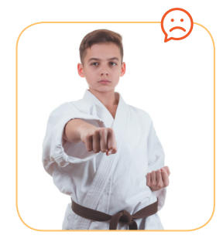
VOCABULARY
3
Look at the pictures and say the sentences. Use suitable verb of liking or disliking and the –ing form.
He hates / doesn’t like doing judo.

Slide 20
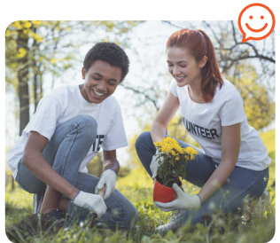
VOCABULARY
3
Look at the pictures and say the sentences. Use suitable verb of liking or disliking and the –ing form.
They love / like / enjoy gardening.

Slide 21
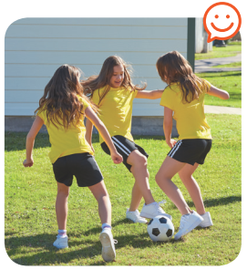
VOCABULARY
3
Look at the pictures and say the sentences. Use suitable verb of liking or disliking and the –ing form.
They like / love / enjoy playing football.

Slide 22
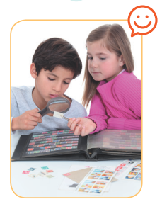
VOCABULARY
3
Look at the pictures and say the sentences. Use suitable verb of liking or disliking and the –ing form.
They enjoy / like / love collecting stamps.

Slide 23
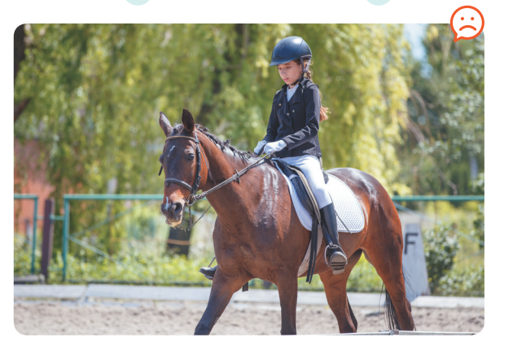
VOCABULARY
3
Look at the pictures and say the sentences. Use suitable verb of liking or disliking and the –ing form.
She hates / doesn’t like riding a horse / horse riding.

Slide 24

* PRONUNCIATION
/ə/ and /ɜ:/
Aims of the stage:
to help Ss identify how to pronounce the sounds /ə/ and /ɜ:/
to help Ss practise pronouncing these sounds in words & sentences

Slide 25
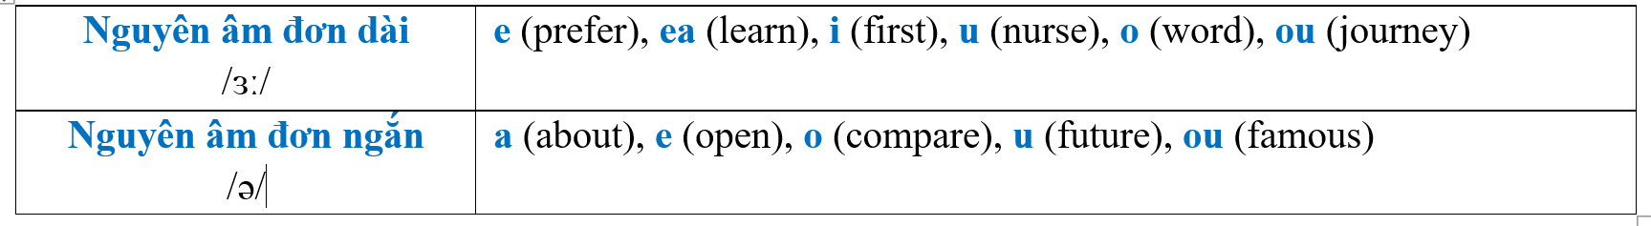

Slide 26

* PRODUCTION
Game: Who is faster?
Work in groups of four
Write sentences including: hobbies and one of the sounds /ə/ and /ɜ:/
(e.g: Listening to music is a very common hobby.)
The group with the most correct sentences is the winner.

Slide 27

* CONSOLIDATION
* HOMEWORK
Learn new words
Find 3 more words relating to hobbies that have the sound /ə/ or /ɜ:/.

Slide 28



