Slide 2


Slide 3
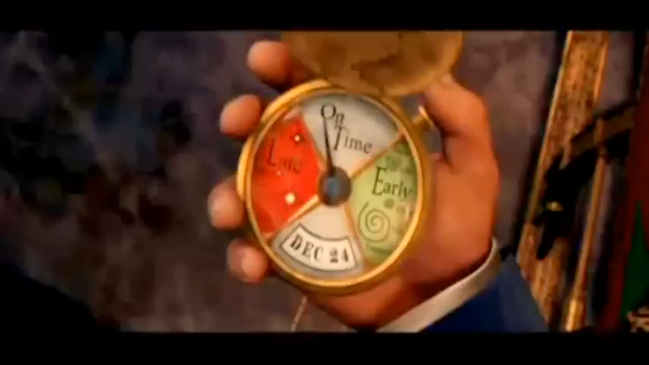

Slide 4
WARM-UP
OPTION 1
Supply the correct form of the verbs in bracket
1. Andy wishes he ________think of a way of helping
2. I (do)_________ a quiz about civilization all Sunday morning
3. Sarah(not attend)__________ concerts of “ATSH” that singer yet
4. He promises (not reveal)____________ my secret to anyone, but he lied!
5. Hoa suggested (wear)_________ aodai for the presentation
could
was doing
hasn’t attended
not to reveal
wearing

Slide 5


REVIEW 1
GRAMMAR
(past cont., present perfect , wish sentence, verb form).

Slide 6

LESSON 1: GETTING STARTED
WARM-UP
Option 1: Think!
Option 2: Q&A
Review grammar of unit 4, 5, 6
PRESENTATION
Task 1:
Task 2:
Task 3:
Task 4:
PRACTICE
PRODUCTION
Task 5: Quiz
CONSOLIDATION
Wrap-up
Homework

Slide 7

Past continuous tense
Present perfect tense
Wish sentence
To inf and Ving

Slide 8
PAST CONT. & PRESENT PERFECT
1
UNDERLINED CORREC ANSWER.
1. (did you ever tried/ have you ever) tried bungee jumping before?
2. She (was reading/ read) a book when a loud noise (interuped/ was interrupting) her concentration
3. I (thought/ was thinking) my grand mother for year after she died
4. They haven’t tasted any street food in Bangkok (just/ yet)
5.

Slide 9
WISH SENTENCE
2
COMPLETE THE SECOND SENTENCE.
1. What a pity! I don’t have money to travel around the world
-> I wish______________________________________________
2. I’m sorry! You are not old enough to drive a car
-> I wish ______________________________________________
3. Our school won’t organize out door activities at Chrismas
-> I wish______________________________________________
4. I/ wish/go camping/ friends/ after/ final exam
-> I __________________________________________________
5. Beth/ wish/ she/ can/ stay/ Cambrige/ forever
-> Beth_______________________________________________
I had money to travel around the world
You were old enough to drive a car
Our school would organize out door activities at Chrismas
wish I went camping with friends after the final exam
wishes she could stay at Cambfidge forever

Slide 10
TO INF/ V-ING
3
CHOOSE THE BEST ANSWER A, B, C, OR D.
1. They don't mind_______in the volunteer group to help the poor people.
A. join B. to join C. to joining D. joining
2. Tim really wants_______all Viet Nam traditional cuisines when he comes to our house.
A. tasting B. to taste C. taste D. to tasting
3. I hope_______my younger brother with his History project.
A. to help B. help C. to helped D. being helped
4. Nowadays students fancy_______lessons which have the IT support.
A. attend B. to attend C. attending D. to attending
5. I have finished_______a book about life in Viet Nam in the 19th century.
A. to read B. reading C. read D. reads
mind + Ving
wants + to V
hope + to V
fancy+ Ving
finished + Ving

Slide 11

PRODUCTION
- hoclieu.vn
Advantages team | Disadvantages team

Slide 12
WARM-UP
OPTION 2
Now, share your ideas.
Questions
- What are some hobbies that you enjoy or want to try?
- How do you balance your hobbies and your work or study?
- What are some benefits or challenges of having hobbies?
- How did you discover or develop your hobbies?
Advantages team | Disadvantages team

Slide 13

CONSOLIDATION
2
Homework
- Do exercises in the workbook.

Slide 14
CONSOLIDATION
2
Homework
- Prepare for the Project of the unit
- Open book p.69, look at the picture and say what the topic of the project is
- Work individually to design a poster.
- You will show and present in Lesson 7 – Looking back and Project.

Slide 15
Website: hoclieu.vn
Fanpage: facebook.com/www.tienganhglobalsuccess.vn/

