Slide 1

GOOD MORNING EVERYONE !!!

Slide 2

* Warm - up:
Chatting
What can you see in the picture?
Can you guess the name of the festival?
Have you ever heard of this festival? What do you know about it?
There are many tulips
A Tulip Festival
the Tulip Festival in Australia,……

Slide 3



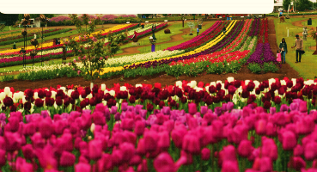
Unit
9
FESTIVALS AROUND THE WORLD
LESSON 1: GETTING STARTED
A Tulip Festival
HOBBIES

Slide 4

* VOCABULARY
-folk dance (n):
điệu nhảy/múa dân gian
/ˈfəʊk ˌdɑːns/

Slide 5
* VOCABULARY
- costume (n):
trang phục
/ˈkɒs.tʃuːm/

Slide 6
* VOCABULARY
parade (n):
diễu hành
/pəˈreɪd/

Slide 7
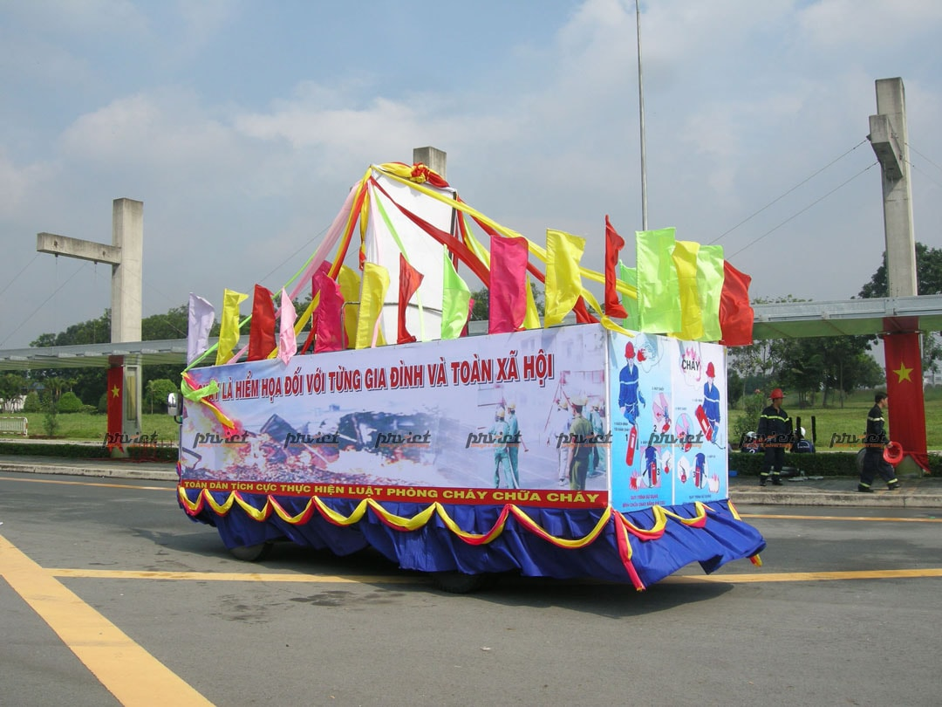
* VOCABULARY
- float (n):
Xe diễu hành
/fləʊt/

Slide 8
* VOCABULARY
-feast (n):
bữa tiệc
/fiːst/
a special meal with very good food or a large meal for many people:

Slide 9
* VOCABULARY
- fireworks display (n):
màn bắn pháo hoa
/ˈfɑɪərˌwɜrks dɪˈspleɪ/

Slide 10
* VOCABULARY
New words | Pronunciation | Meaning
folk dance | /ˈfəʊk ˌdɑːns/ | điệu múa/ nhảy dân gian
costume | /ˈkɒs.tʃuːm/ | trang phục
float | fləʊt/ | xe diễu hành
parade | /pəˈreɪd/ | diễu hành
feast | /fiːst/ | bữa tiệc
fireworks display | ˈfɑɪərˌwɜrks dɪˈspleɪ/ | màn bắn pháo hoa

Slide 11
* Checking vocab
say words in English
Diễu hành
điệu múa dân gian
parade
folk dance
bữa tiệc
feast
Xe diễu hành
float
trang phục
costume
fireworks display
màn bắn pháo hoa

Slide 12
1
Listen and read.
Mark and Trang: Good afternoon, Ms Hoa.
Ms Hoa: Oh, hi. Come in.
Trang: Wow! This is a nice cozy room, Ms Hoa. I like the photos on the wall.
I can see you among all those tulips. Where did you take the photos?
Ms Hoa: I took them at the Tulip Festival in Australia last September.
Mark: Really? I went to a tulip festival two years ago but it was in the Netherlands.
It was the Dutch Tulip Festival.
Trang: What did you do at the festival, Ms Hoa?
Ms Hoa: I watched Dutch folk dances. The dancers wore traditional costumes.
I also got a chance to try some delicious Dutch food and drinks. What about you, Mark?
Mark: I watched folk dances too, but there wasn't any food or drinks.
I also saw beautiful tulip floats at a parade.
Trang: Do they hold the festival every year in Australia?
Ms Hoa: Yes, they do.

Slide 13
2
Read the conversation again. Who did the following activities? Tick (✓) the correct column. Sometimes you need to tick both.
 | Ms Hoa | Mark
1. went to the Tulip Festival in Australia
2. went to the Tulip Festival in the Netherlands
3. tried Dutch food and drinks
4. watched traditional Dutch dancing
5. saw tulip floats
✓
✓
✓
✓
✓
✓

Slide 14
3
Write a word or phrase from the box under each picture.
costumes feast float fireworks display parade folk dance
1. ___________
2. ___________
3. ___________
parade
costumes
feast
4. ___________
5. _________________
6. ___________
float
fireworks display
folk dance

Slide 15
4
Fill in each blank with a word or phrase from 3. You may have to change the form of the word or phrase.
costumes feast float fireworks display parade folk dance
1. The dancers performed ___________ at the Tulip Festival.
2. On New Year’s Eve, we went to Hoan Kiem Lake to watch the ______________.
3. For Tet, we usually prepare a ___________ with special food.
4. People hold flower ___________ in several countries to welcome the new season.
5. The ___________ carried the dancers in special ___________.
Game:

Slide 16
LUCKY NUMBERS
1
2
3
4
5
6
7
8
A
2
4
6
8
10
12
B
2
4
6
8
10
12

Slide 17
4
Fill in each blank with a word or phrase from 3. You may have to change the form of the word or phrase.
1. The dancers performed ___________ at the Tulip Festival.
folk dances

Slide 18
4
Fill in each blank with a word or phrase from 3. You may have to change the form of the word or phrase.
2. On New Year’s Eve, we went to Hoan Kiem Lake to watch the ______________.
fireworks display

Slide 19
4
Fill in each blank with a word or phrase from 3. You may have to change the form of the word or phrase.
3. For Tet, we usually prepare a ___________ with special food.
feast

Slide 20
4
Fill in each blank with a word or phrase from 3. You may have to change the form of the word or phrase.
parades
4. People hold flower ___________ in several countries to welcome the new season.

Slide 21
4
Fill in each blank with a word or phrase from 3. You may have to change the form of the word or phrase.
5. The ___________ carried the dancers in special ___________.
floats
costumes

Slide 22

LUCKY NUMBER

Slide 23
LUCKY NUMBER

Slide 24
4
Fill in each blank with a word or phrase from 3. You may have to change the form of the word or phrase.
1. The dancers performed ___________ at the Tulip Festival.
2. On New Year’s Eve, we went to Hoan Kiem Lake to watch the ______________.
3. For Tet, we usually prepare a ___________ with special food.
4. People hold flower ___________ in several countries to welcome the new season.
5. The ___________ carried the dancers in special ___________.
folk dances
fireworks display
feast
parades
floats
costumes

Slide 25
5
What festival is it? Match each description with a festival.
1. At this festival, people eat moon cakes. |  | a. La Tomatina
2. At this festival, people throw tomatoes. |  | b. Cheese rolling
3. People eat banh chung at this festival. |  | c. Christmas
4. People decorate pine trees and give each other gifts. |  | d. Tet
5. People chase after a wheel of cheese. |  | e. Mid-Autumn Festival
1-e
2-a
3-d
4-c
5-b

Slide 26
CONSOLIDATION
Festivals around the world
Festivals
Topic of the unit
Vocabulary

Slide 27

homework
- Learn all the new words by heart
- Name at leat 3 festivals around the world
- Exercises in workbook

Slide 28

Goodbye!
See you again
Thank you!
Have a nice day!

Slide 29
PRACTICE
4
Fill in each blank with a word or phrase from 3. You may have to change the form of the word or phrase.
Aim of the task:
to help Ss practise the words/phrases in 3.

