Slide 1



Unit
9
FESTIVALS AROUND THE WORLD
LESSON 2: A CLOSER LOOK 1
VOCABULARY
PRONUNCIATION
Unit
HOBBIES

Slide 2

Hello every one !!!

Slide 3

WARM-UP
Game: Hot seat
Each leader stands against the board.
Teacher shows/ writes the names of the festivals .
Other members from each team describe the festivals and let the leader guess the names of the festivals.
The team with more correct answers is the winner.

Slide 4
WARM-UP
Christmas

Slide 5
WARM-UP
Tet

Slide 6
WARM-UP
La Tomatina

Slide 7
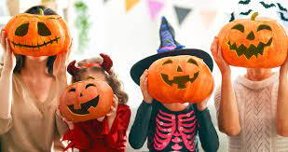
WARM-UP
Halloween

Slide 8
WARM-UP
Mid-Autumn Festival

Slide 9
WARM-UP
Thanksgiving

Slide 10

* Vocabulary
- Cannes Film Festival:
Liên hoan phim Cannes
/kæn fɪlm fes.tɪ.vl/

Slide 11
* Vocabulary
- Thanksgiving:
Lễ Tạ ơn
/ˌθæŋksˈɡɪv.ɪŋ/

Slide 12
* Vocabulary
- Easter (n):
Lễ Phục sinh
/ˈiː.stər/

Slide 13
* Vocabulary
- carve (v):
chạm, khắc
/kɑːv/

Slide 14
* Vocabulary
- perform (v):
biểu diễn
/pəˈfɔːm/

Slide 15
* Vocabulary
- Mid-Autumn Festival :
Lễ hội trung thu
/mɪd ˈɔː.təm ˈfes.tɪ.vəl/

Slide 16
* Vocabulary
Form | Pronunciation | Meaning
1. Cannes Film Festival | /kæn fɪlm fes.tɪ.vl/ | Liên hoan phim Cannes
2. Thanksgiving (n) | /ˌθæŋksˈɡɪv.ɪŋ/ | Lễ Tạ ơn
3. Easter (n) | /ˈiː.stər/ | Lễ Phục sinh
4. carve (v) | /kɑːv/ | chạm, khắc
5. perform (v) | /pəˈfɔːm/ | biểu diễn
5. perform (v) | /pəˈfɔːm/ | biểu diễn
6. Mid-Autumn Festival | /mɪd ˈɔː.təm ˈfes.tɪ.vəl/ | Lễ hội trung thu

Slide 17
* Checking vocabulary
Form | Meaning
1. | Liên hoan phim Cannes
2. | Lễ Tạ ơn
3. | Lễ Phục sinh
4. | chạm, khắc
5. | biểu diễn
Cannes Film Festival
Thanksgiving (n)
Easter (n)
carve (v)
5. perform (v) | biểu diễn
perform (v)
6. | Lễ hội trung thu
Mid-Autumn Festival

Slide 18
1
Write under each picture a festival name from the box.
Cannes Film Festival Mid-Autumn Festival Thanksgiving Christmas Halloween Easter
1. ___________
2. ___________
3. ___________
Halloween
Christmas
Mid-Autumn Festival
4. ___________
5. _________________
6. ___________
Cannes Film Festival
Easter
Thanksgiving

Slide 19
2
Complete the table below with the phrases from the box.
having a feast moon cakes chocolate eggs candy apples turkey painting eggs carving pumpkins performing a lion dance
Festival | Food | Activity
Easter
Halloween
Mid-Autumn Festival
Thanksgiving
chocolate eggs
painting eggs
candy apples
carving pumpkins
moon cakes
performing a lion dance
turkey
having a feast

Slide 20
3
Fill in blank with a word/phrase from the box.
painting eggs Christmas Mid-Autumn Festival candy apples Cannes Film Festival turkey
At ______________, people give gifts to each other.
My children love ______________ at Easter.
How many ______________ do you need for the Halloween party?
At the _________________, there are many interesting films.
Performing lion dances is one of the activities at the _________________.
Bill’s mum is cooking a ______________ for Thanksgiving.
Game

Slide 21
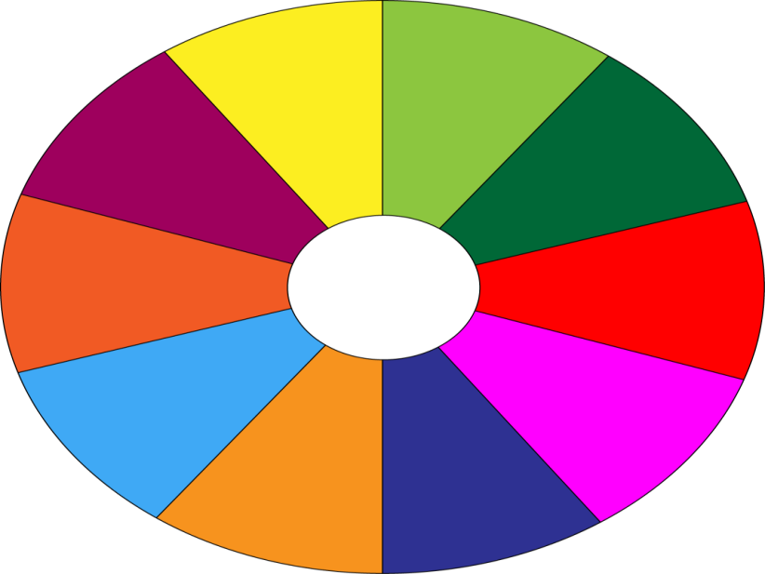
THE BIG WHEEL GAME
QUESTIONS
10
40
30
1
2
50
SPIN
10
3
4
20
-15
-20
5
6
05
60

Slide 22
3
Fill in blank with a word/phrase from the box.
painting eggs Christmas Mid-Autumn Festival candy apples Cannes Film Festival turkey
At ______________, people give gifts to each other.
Christmas

Slide 23
3
Fill in blank with a word/phrase from the box.
painting eggs Christmas Mid-Autumn Festival candy apples Cannes Film Festival turkey
2. My children love ______________ at Easter.
painting eggs

Slide 24
3
Fill in blank with a word/phrase from the box.
painting eggs Christmas Mid-Autumn Festival candy apples Cannes Film Festival turkey
3. How many ______________ do you need for the Halloween party?
candy apples

Slide 25
3
Fill in blank with a word/phrase from the box.
painting eggs Christmas Mid-Autumn Festival candy apples Cannes Film Festival turkey
4. At the _________________, there are many interesting films.
Cannes Film Festival

Slide 26
3
Fill in blank with a word/phrase from the box.
painting eggs Christmas Mid-Autumn Festival candy apples Cannes Film Festival turkey
5. Performing lion dances is one of the activities at the _________________.
Mid-Autumn Festival

Slide 27
3
Fill in blank with a word/phrase from the box.
painting eggs Christmas Mid-Autumn Festival candy apples Cannes Film Festival turkey
6. Bill’s mum is cooking a _____________for Thanksgiving.
turkey

Slide 28
3
Fill in blank with a word/phrase from the box.
painting eggs Christmas Mid-Autumn Festival candy apples Cannes Film Festival turkey
At ______________, people give gifts to each other.
My children love ______________ at Easter.
How many ______________ do you need for the Halloween party?
At the ___________________, there are many interesting films.
Performing lion dances is one of the activities at the _________________.
Bill’s mum is cooking a ______________ for Thanksgiving.
Christmas
painting eggs
candy apples
Cannes Film Festival
Mid-Autumn Festival
turkey

Slide 29


* PRONUNCIATION
Stress in two-syllable words
- Phần lớn danh từ và tính từ trong tiếng Anh có hai âm tiết thì trọng âm thường rơi vào âm tiết thứ nhất.
- money (n.) /ˈmʌni/
- artist (n.) /ˈɑːtɪst/
- lovely (adj.) /ˈlʌvli/
- healthy (adj.) /ˈhelθi/
- Hầu hết động từ có hai âm tiết thì trọng âm sẽ rơi vào âm tiết thứ hai.
- accept (v) /əkˈsept/
- invite (v) /ɪnˈvaɪt/
- provide (v) /prəˈvaɪd/
- refuse (v) /rɪˈfjuːz/

Slide 30
* PRONUNCIATION
4
Listen and repeat. Then underline the stressed syllable in each word.
Nouns and Adjectives | Verbs
costume fireworks turkey happy | enjoy decide discuss prepare

Slide 31
5
Listen and repeat the sentences. Underline the stressed syllables in the bold words.
We’re going to attend an Easter party at Nick’s house.
The dancers will perform traditional dances at the festival.
At Christmas, people usually buy presents for their family.
Did you go to the Da Lat Flower Festival with your parents?
My aunt is clever and patient.

Slide 32
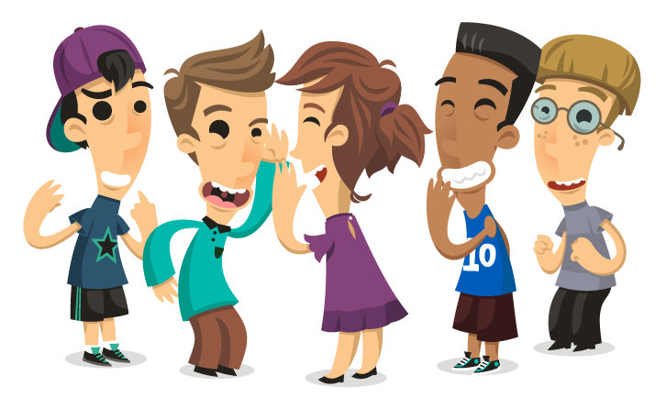
* PRODUCTION
Game: Up and down
Aims of the stage:
To test students' quick reaction.
Notes:
Teacher says 1-15 words containing two-syllable words. Students stand up for the ones with first main stress pattern, sit down for the second main stress pattern.

Slide 33
* CONSOLIDATION
1
VOCABULARY
PRONUNCIATION

Slide 34

homework
Redo all the exercises.
Prepare A CLOSER LOOK 2.

Slide 35
