Slide 1
WARM-UP
Sentence puzzling
1. that | is | your Christmas present | ?
→ Is that your Christmas present?
2. they | did | eat | Moon cakes | at the festival | last year | ?
→ Did they eat moon cakes at the festival last year?
3. he | can | all these moon cakes | eat | ?
→ Can he eat all these moon cake?

Slide 2
WARM-UP
Sentence puzzling
1.→ Is that your Christmas present?
2.→ Did they eat moon cakes at the festival last year?
3. → Can he eat all these moon cake?
Yes/No questions

Slide 3


Unit
9
FESTIVALS AROUND THE WORLD
LESSON 3: A CLOSER LOOK 2

Slide 4
* Grammar:
Yes/No questions
Can he eat all these moon cake?
S
We put the auxiliary verb or modal verb before the subject.
Did they eat moon cakes at the festival last year?
S
Is that your Christmas present?
We don’t use an auxiliary verb when we use be as a main verb.

Slide 5
* Grammar:
Yes/No questions
+ Chúng ta hình thành câu hỏi Yes/No với một trợ động từ (be, do hoặc have) hoặc với động từ khuyết thiếu. Chúng ta đặt trợ động từ hoặc động từ khuyết thiếu trước chủ ngữ.
* Form: Be/ Do/ Have/ Modals + S + (V)…?
Ex: Are you eating moon cakes? – Yes, I am.
Did they eat moon cakes at the festival last year? – No, they didn’t.
Can you swim? No, I can’t
+ Chúng ta không sử dụng trợ động từ khi chúng ta sử dụng “be” như động từ chính.
Ex: Is that your Christmas present? – Yes, it is.

Slide 6
* PRACTICE:
1
Fill in each blank with a correct auxiliary verb or modal verb.
1. ______ they hold the festival in Ha Noi every year?
2. ______ he visit Hoi An last year?
3. ______ they performing folk dances?
4. A: ______ you make banh chung?
B: Yes, I can.
5. ______ your brother usually come back home at Tet?
Do
Did
Are
Can
Does

Slide 7
2
Change the sentences into Yes / No questions.
My mother can make a costume for me.
She will bake a birthday cake for him.
The dragon dances are interesting.
The Rio Carnival takes place every year in Brazil.
They saw a fireworks display on New Year’s Eve.

Slide 8

LUCKY NUMBER!
1
2
3
4
5
6
7

Slide 9
2
Change the sentences into Yes / No questions.
My mother can make a costume for me.
→ Can your mother make a costume for you?

Slide 10
2
Change the sentences into Yes / No questions.
2. She will bake a birthday cake for him.
→ Will she bake a birthday cake for him?

Slide 11
2
Change the sentences into Yes / No questions.
3. The dragon dances are interesting.
→ Are the dragon dances interesting?

Slide 12
2
Change the sentences into Yes / No questions.
4. The Rio Carnival takes place every year in Brazil.
→ Does Rio Carnival take place every year in Brazil?

Slide 13
2
Change the sentences into Yes / No questions.
5. They saw a fireworks display on New Year’s Eve.
→ Did they see a fireworks display on New Year’s Eve?

Slide 14
2
Change the sentences into Yes / No questions.
My mother can make a costume for me.
She will bake a birthday cake for him.
The dragon dances are interesting.
The Rio Carnival takes place every year in Brazil.
They saw a fireworks display on New Year’s Eve.
Can your mother make a costume for you?
Will she bake a birthday cake for him?
Are the dragon dances interesting?
Does Rio Carnival take place every year in Brazil?
Did they see a fireworks display on New Year’s Eve?

Slide 15

LUCKY NUMBER!

Slide 16
LUCKY NUMBER!

Slide 17
2
Change the sentences into Yes / No questions.
My mother can make a costume for me.
She will bake a birthday cake for him.
The dragon dances are interesting.
The Rio Carnival takes place every year in Brazil.
They saw a fireworks display on New Year’s Eve.
Can your mother make a costume for you?
Will she bake a birthday cake for him?
Are the dragon dances interesting?
Does Rio Carnival take place every year in Brazil?
Did they see a fireworks display on New Year’s Eve?

Slide 18
3
Match the questions in column A with their answers in column B.
A | B
1. Will you help me take a photo? | a. Yes, he is.
2. Is he painting Easter eggs? | b. No, I’m not.
3. Do they eat candy apples on Halloween? | c. Yes, I will.
4. Are you excited about your holiday? | d. No, she can’t.
5. Can she perform Dutch folk dances? | e. Yes, they do.
1 - c
2 - a
3 - e
4 - b
5 - d

Slide 19
4
Mark is talking to Trang about the Mid-Autumn Festival. Fill in the blanks with Trang’s answers below.
Yes, we do. We watch lion dances, too.
No, we celebrate it in the middle of the eighth lunar month.
Yes, I do. It’s one of my favourite festivals.
Yes. Just come over to my house on the night of the festival.
Yes, we do. We also have some autumn fruits.
Mark: Do you celebrate the Mid-Autumn Festival in December?
Trang: (1) ______.
Mark: Do you eat moon cakes at the festival?
Trang: (2) ______.
Mark: Do you make lanterns at the festival?
Trang: (3) ______.
Mark: Do you like the festival?
Trang: (4) ______.
Mark: Can I join the festival with you next month?
Trang: (5) ______.
b
e
a
c
d

Slide 20
* PRODUCTION
5
GAME. Festival mystery
Work in groups. One student thinks of a festival he / she likes.
Other students ask Yes / No questions to find out what the festival is.
Example:
A: Do many countries celebrate the festival?
B: Yes, they do.
C: Do children like the festival?
B: Yes, they do.
A: Do they paint eggs?
B: Yes, they do.
C: Is it Easter?
B: Yes, it is.

Slide 21
* PRODUCTION
Fill in each blank with a correct auxiliary verb or modal verb.
____ your aunt a nurse? – Yes, she ____
____ you have a pet? – No, I ____
____ those shoes beautiful? – Yes, ____
____ your sister like pizza? – No, ____
____ Linh’s sisters at home? – Yes, ____
____ Peter live with his father? – No, he ____
____ his house next to a post office? – Yes, ____
____ Andrew and Martin ride their bikes to school? – Yes, ____
____ your friends tall? – No, they ____
____ the children in the garden? – No, ____
Is – is
Do – don’t
Are – those are
Does – she doesn’t
Is – she is
6. Does – doesn’t
7. Is – it is
8. Do – they do
9. Are – aren’t
10. Are – they aren’t

Slide 22
CONSOLIDATION
Grammar: Yes/No questions

Slide 23
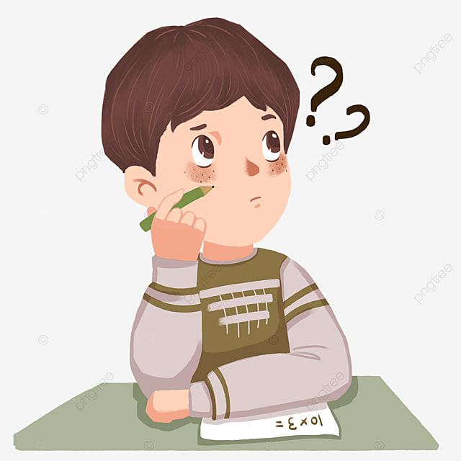
* Homework
- Do exercises in the workbook.
- Prepare lesson 4 ( Communication)

