Slide 1

Good morning class !!!
Class : 7A

Slide 2
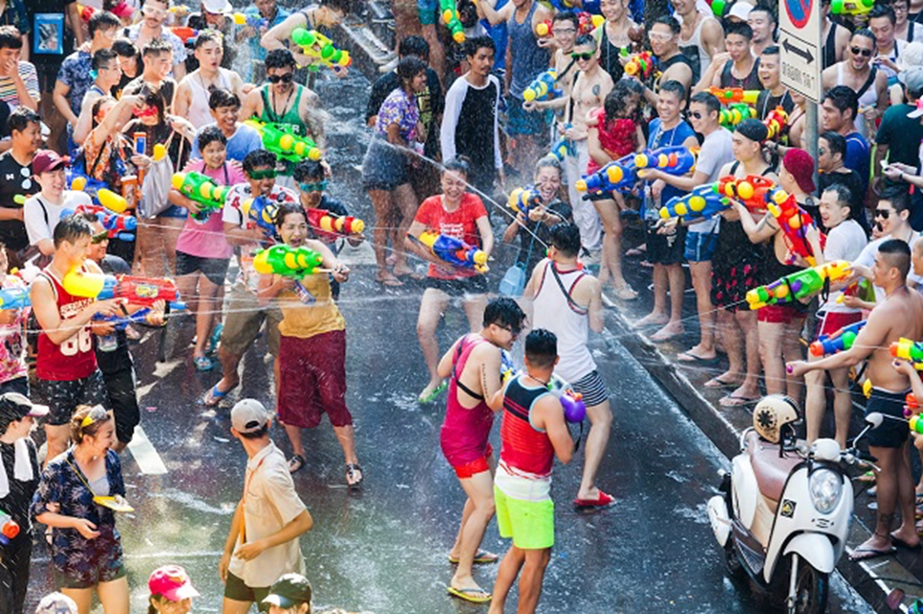
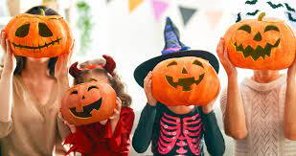
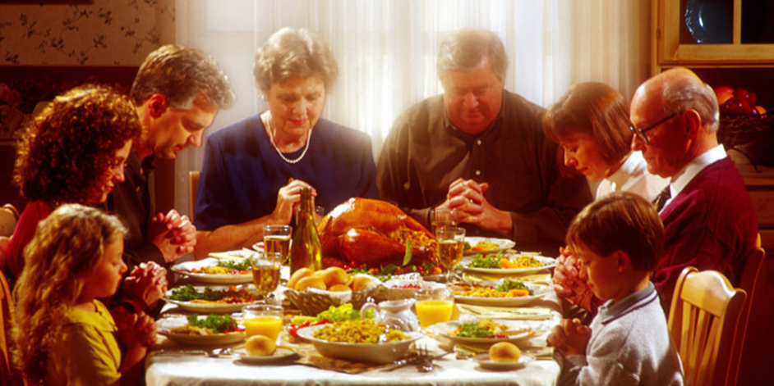
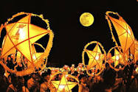
* Game: Pelmanism: Name the festivals
1
2
3
4
5
6
Halloween
8
Thanksgiving
10
7
9
Christmas
Tet
Mid-Autumn Festival
11
Water Festival
12

Slide 3
* Game: Pelmanism: Name the festivals
Christmas
Tet
Water Festival
Halloween
Thanksgiving
Mid-Autumn Festival

Slide 4


Unit
9
FESTIVALS AROUND THE WORLD
LESSON 4: COMMUNICATION

Slide 5

1
Listen and read the conversation. Pay attention to the highlighted sentences.
Mi: How was the music festival last Sunday? Mark: It was disappointing! Mi: Why? Mark: The band was late.
Trang: And the singers weren’t very good either. It was a big disappointment.
Other expressions:
* That’s too bad!
* What a disaster!
* That’s so disappointing!

Slide 6
Everyday English
2
Work in groups. Make a similar conversation for each situation below.
1
1. Your friend went to a film festival for teenagers, but there were not many films he / she liked.
2. Your friend went to the market to buy decorations for the Mid-Autumn Festival. But there were not many decorations to choose from.

Slide 7
Everyday English
2
Work in groups. Make a similar conversation for each situation below.
1
* Situation 1:
Your friend went to a film festival for teenagers, but there were not many films he / she liked.
A: How was the film festival last Sunday?
B: It was disappointing!
A: Why?
B: There were not many films I liked.

Slide 8
Everyday English
2
Work in groups. Make a similar conversation for each situation below.
1
* Situation 2:
Your friend went to the market to buy decorations for the Mid-Autumn Festival. But there were not many decorations to choose from.
A: Yesterday, I went to the market to buy decorations for the Mid-Autumn Festival, but it was a big disappointment.
B: What’s wrong?
A: There was not many decorations to choose, so I didn’t buy anything.

Slide 9
Festival symbols
3
Listen to Mark talking about festival symbols. Fill in each blank with ONE word.
1. A symbol is an image we use or _________ of when celebrating a festival.
2. A symbol usually has a special _________.
3. The Christmas tree is the symbol of a long _________.
4. Santa Claus is the symbol of joy and _________.
think
meaning
life
happiness

Slide 10
Festival symbols
2
4
Work in pairs. Match each festival with its symbol and meaning.
1. Mid-Autumn Festival | A. black cat | a. It is the symbol of a new life because it has a lot of babies.
2. Halloween | B. The Golden Palm | b. It is the symbol of the moon, prosperity and family reunion.
3. Easter | C. moon cake | c. It is the symbol of bad luck.
4. Cannes Film Festival | D. Easter Bunny | d. It is the symbol of the winner’s prize.
1-C-b
2-A-c
3-D-a
4-B-d

Slide 11
* Production
2
5
Work in groups. Choose a festival and talk about its symbol(s) and meaning.
Example:
When we talk about Christmas, we think of the Christmas tree. It is the symbol of a long life.

Slide 12
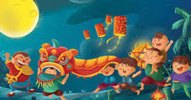
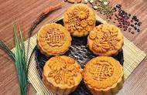
* Production
2
5
Work in groups. Choose a festival and talk about its symbol(s) and meaning.
When we talk about Mid-Autumn Festival, we think of the moon cake. It is the symbol of the moon, prosperity and family reunion.

Slide 13
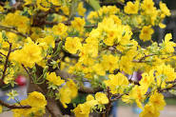
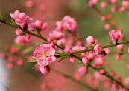
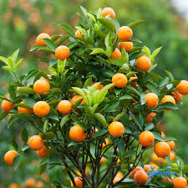
* Production
2
5
Work in groups. Choose a festival and talk about its symbol(s) and meaning.
When we talk about Tet holiday, we often think of peach blossoms, apricot blossoms and kumquat trees.

Slide 14
Consolidation
In this lesson, we have learn to
use lexical items related to festival activities and festival symbols
express disappointment

Slide 15

* homework
Learn new words by heart.
Redo all the exercises.
Prepare skills 1.

Slide 16

Thanks for your atendance!
Goodbye. See you again
Notes:
16

Slide 17
Lesson 4: Communication
WARM-UP
Name the festivals
Stage aims:
to activate students’ knowledge
to get students interested in the topic

Slide 18
Warm up
Name the festivals
Halloween

Slide 19
Warm up
Name the festivals
Tet

Slide 20
Warm up
Name the festivals
Diwali

Slide 21
Warm up
Name the festivals
Rock in Rio

Slide 22
Warm up
Name the festivals
Songkran (Water Festival)

