Slide 1
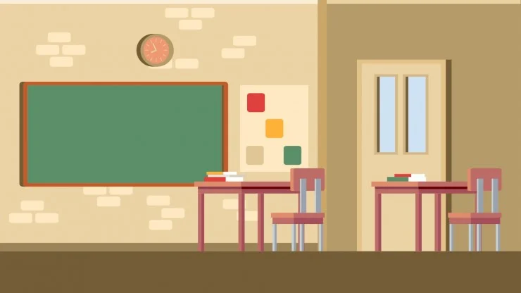
Hello every one!!!

Slide 2
* WARM –UP :
Memory game
LANGUAGE LEARNT IN
UNIT 10,11,12
Pronunciation
Vocabulary
Grammar
Stress in three –syllable words
Types of …………..
Present …………..
…………. stress
Future means of transport
- ………….simple
-Possessive pronouns
Rising and falling intonation for ………..
People and ……… in English- speaking countries
Articles: a, ….., the

Slide 3
* WARM –UP :
Memory game
LANGUAGE LEARNT IN
UNIT 10,11,12
Pronunciation
Vocabulary
Grammar
Stress in three –syllable words
Types of energy sources
Present continuous
Sentence stress
Future means of transport
-Future simple
-Possessive pronouns
Rising and falling intonation for questions
People and places in English- speaking countries
Articles: a, an, the

Slide 4


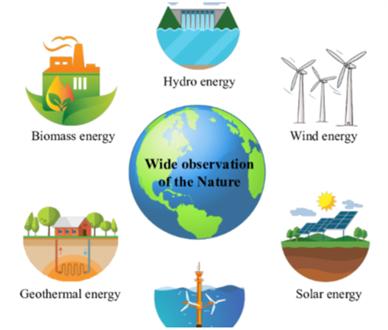
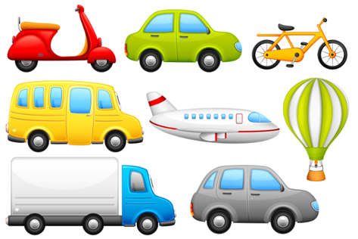
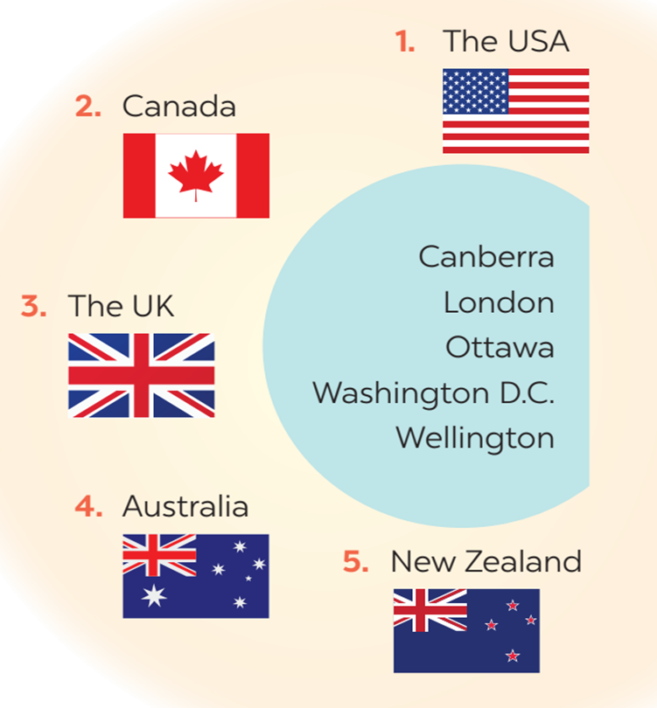
Review
4
UNIT 10- 11 - 12
LESSON 1: LANGUAGE

Slide 5

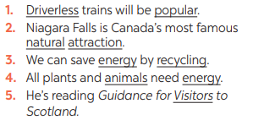
* PRONUNCIATION
1
Mark (') the stressed syllables in the underlined words. Then listen, check, and repeat.
1. 'Driverless trains will be 'popular.
2. Niagara Falls is Canada’s most famous ‘natural at’traction.
3. We can save 'energy by re'cycling.
4. All plants and ‘animals need ‘energy
5. He’s reading Guidance for ‘Visitors to
Scotland.

Slide 6
* VOCABULARY
2
Write the words in the box next to their defini-tions.
source symbol coal attraction bamboo-copter
1. It is a place or thing that you get something from.
2. This means of transport is eco-friendly.
3. It is a person or an object that represents a place.
4. It is a non-renewable source of energy.
5. An object or a place many visitors want to see.
source
bamboo - copter
tour
coal
attraction

Slide 7
3
Complete the sentences with the words below.
national native renewable electrical public natural
1. SkyTrans and driverless buses will be popular _______ means of transport.
2. Niagara Falls is a ___________wonder of both the USA and Canada.
3. The colours of the UK’s ___________ flag are red, white, and blue.
4. Solar energy and hydro energy are ____________sources.
5. The kangaroo is _____________ to Australia.
6. We can save electricity by using fewer ____________appliances.
Game

Slide 8
LUCKY NUMBERS
1
2
3
4
5
6
7
8
A
2
4
6
8
10
12
14
B
2
4
6
8
10
12
14

Slide 9
3
Complete the sentences with the words below.
national native renewable electrical public natural
1. SkyTrans and driverless buses will be popular _________ means of transport.
public

Slide 10
3
Complete the sentences with the words below.
national native renewable electrical public natural
2. Niagara Falls is a ___________wonder of both the USA and Canada.
natural

Slide 11
3
Complete the sentences with the words below.
national native renewable electrical public natural
3. The colours of the UK’s ___________ flag are red, white, and blue.
national

Slide 12
3
Complete the sentences with the words below.
national native renewable electrical public natural
4. Solar energy and hydro energy are ____________sources.
renewable

Slide 13
3
Complete the sentences with the words below.
national native renewable electrical public natural
5. The kangaroo is _____________ to Australia.
native

Slide 14
3
Complete the sentences with the words below.
national native renewable electrical public natural
6. We can save electricity by using fewer ____________ appliances.
electrical

Slide 15



Slide 17
3
Complete the sentences with the words below.
national native renewable electrical public natural
1. SkyTrans and driverless buses will be popular _______ means of transport.
2. Niagara Falls is a ___________wonder of both the USA and Canada.
3. The colours of the UK’s ___________ flag are red, white, and blue.
4. Solar energy and hydro energy are ____________sources.
5. The kangaroo is _____________ to Australia.
6. We can save electricity by using fewer ____________appliances.
public
natural
national
renewable
native
electrical

Slide 18
* GRAMMAR
4
Use the correct tense and form of each verb in brackets to complete the sentence.
1. At present, our class (do) ____________ a big project on how to save energy in our school.
2. My biggest dream is that I (visit) ____________ Edinburgh one day.
3. At present, my city (build) ______________ stations for skyTrans.
4. In the future, we (use) _______________ more renewable energy in our daily life.
5. I hope that we (have) _____________ flying cars for faster travel soon.
is doing
will visit
is building
will use
will have

Slide 19
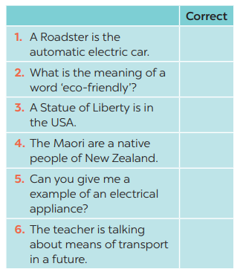
5
Find and cross (––) ONE incorrect article in each sentence and write the correct one.
the → an
a → the
A → The
a → the
a → an
a → the

Slide 20
* CONSOLIDATION
Pronunciation review
Vocabulary review
Grammar review

Slide 21
* HOMEWORK
- Do exercises in the workbook
- Prepare for the next lesson: Review 3 - Skills

Slide 22

Thanks for your atendance!
Goodbye. See you again
Notes:
22

Slide 23


