Slide 1

Hello every one !!!

Slide 2
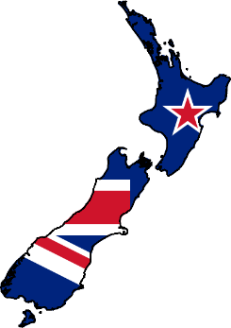
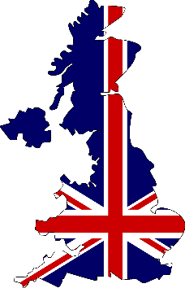
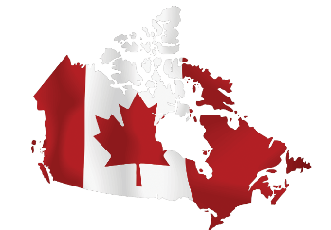

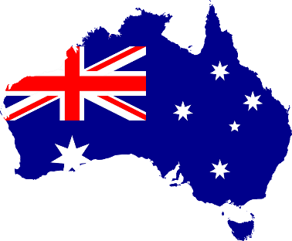
* WARM-UP
matching
Match the flag with names of the countries.
The UK
New Zealand
Canada
Australia
The USA

Slide 3
* WARM-UP
Match the flag with names of the countries.
Canada
New Zealand
The UK
The USA
Australia

Slide 4


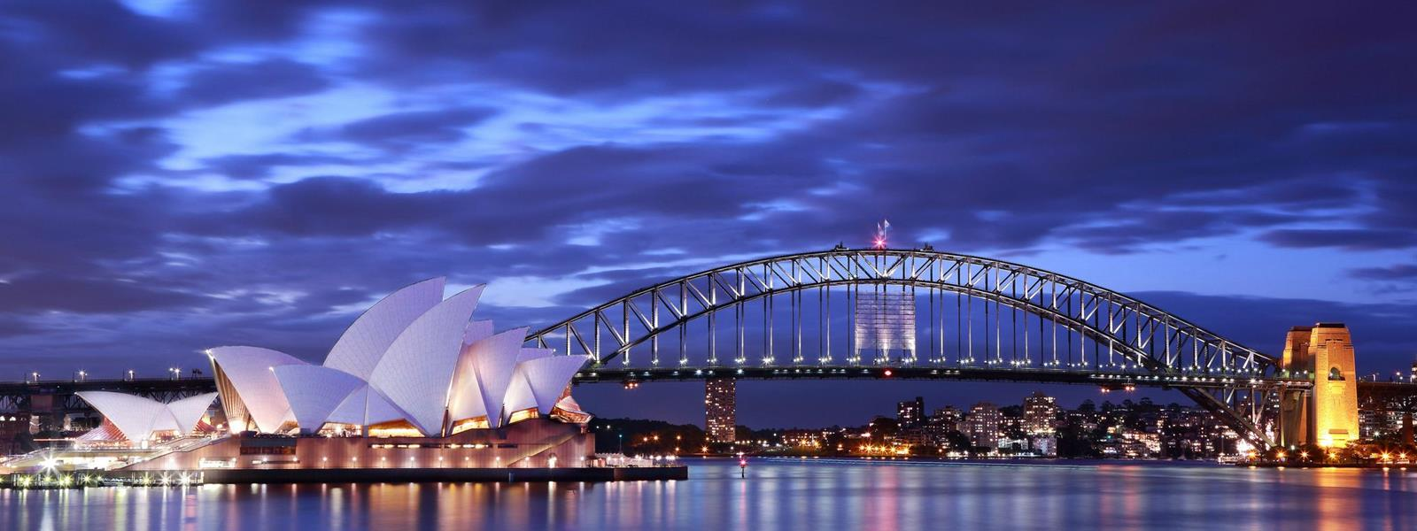
Unit
12
ENGLISH-SPEAKING COUNTRIES
LESSON 1: GETTING STARTED
A holiday in Australia

Slide 5
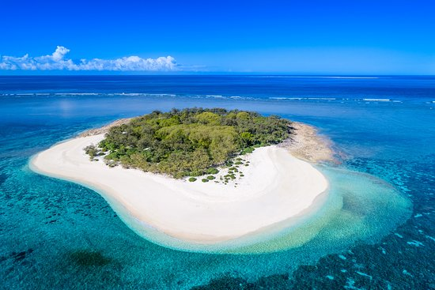

* Vocabulary
- island (n):
Hòn đảo
/ˈaɪ.lənd/

Slide 6
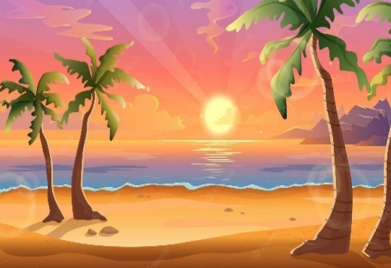
* Vocabulary
- sunset (n):
Hoàng hôn
/ˈsʌn.set/

Slide 7

* Vocabulary
- landscape (n):
Phong cảnh
/ˈlænd.skeɪp/

Slide 8
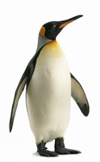
* Vocabulary
- penguin (n)
Chim cánh cụt
/ˈpeŋ.ɡwɪn/

Slide 9
* Vocabulary
New words | Pronunciation | Meaning
island (n) | /ˈaɪ.lənd/ | Hòn đảo
sunset (n) | /ˈsʌn.set/ | Hoàng hôn
landscape (n) | /ˈlænd.skeɪp/ | Phong cảnh
penguin (n) | /ˈpeŋ.ɡwɪn/ | Chim cánh cụt

Slide 10
* Checking vocabulary
New words | Meaning
 | Hòn đảo
 | Hoàng hôn
 | Phong cảnh
 | Chim cánh cụt
island (n)
sunset (n)
landscape (n)
penguin (n)

Slide 11
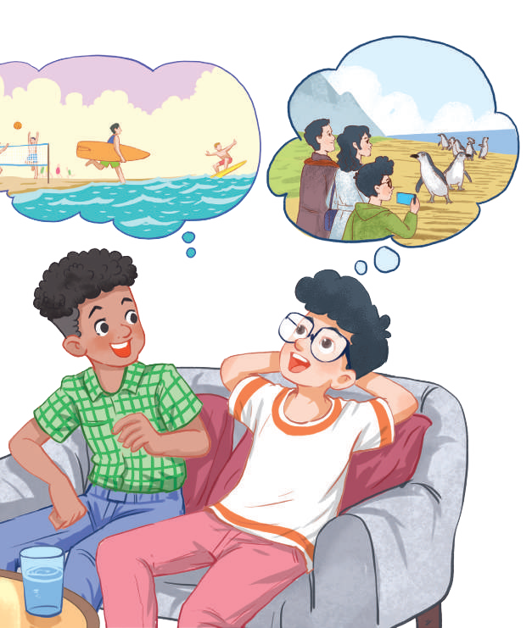
1
Listen and read.
1. Who are they in the picture?
→ They are Mark and Phong
2. What activities are they talking about?
→ surfing, penguin watching
3. In what English-speaking country can they do these activities?
→ Australia

Slide 12
1
Listen and read.
Mark: How was your holiday in Australia, Phong?
Phong: It was fantastic! I got to use my English in real life: asking for directions, reading maps, talking to local people ...
Mark: Oh … Your English is much better.
Phong: Thanks.
Mark: Did you travel a lot?
Phong: Just around Melbourne, the city with four seasons in a day.
Mark: Wow ... I didn’t know that. How was it?
Phong: It was great! We took a tour to Phillip Island.
Mark: What did you see?
Phong: We went penguin watching.
Mark: It sounds pretty exciting.
Phong: It was. Australia has amazing landscapes.
Mark: Yes, and Australians love outdoor activities.
Phong: Right. There were plenty of people enjoying the parks and beaches.
Mark: I’m glad that you had a wonderful time there.
Phong: Thanks, Mark.

Slide 13
2
What are Phong and Mark talking about?
A. Phong’s holiday in Australia B. English-speaking countries C. The tour to Phillip Island

Slide 14

3
Read again and tick the information you can find in the
conversation.
1. In Australia, Phong used English in real life. 2. Phong visited some museums. 3. Phillip Island is far from Melbourne. 4. Australia is beautiful. 5. Australians love outdoor activities.




Slide 15
4
Complete the sentences with the words and phrases from the box.
island, sunset, landscape, Australians, penguin watching
1. This is a picture of the __________________ in my village. 2. – Where did you go _________________________? – On the beach. 3. – Is Phu Quoc a(n) __________________? – Yes, it is. 4. We had dinner on the beach after __________________. 5. Most __________________ like outdoor sports and games.
landscape
penguin watching
island
sunset
Australians

Slide 16
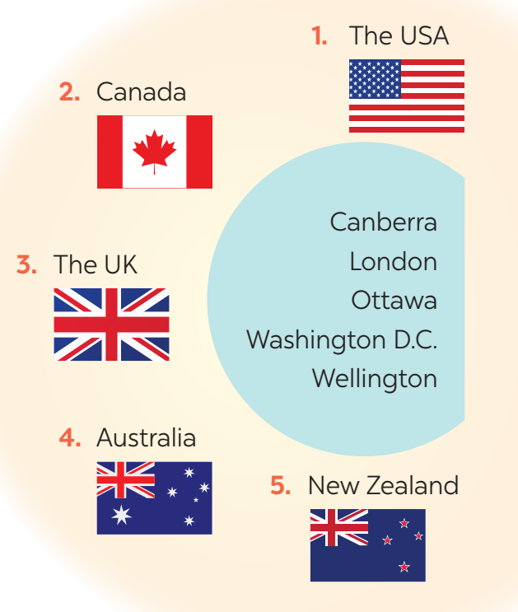
* PRODUCTION
5
Matching game: What’s its capital city?
1. Washington D.C.
2. Ottawa
3. London
4. Canberra
5. Wellington

Slide 17

*CONSOLIDATION
What have we learnt in this lesson?
- Some new words
- Read and understand content of the conversation

Slide 18



HOMEWORK
Find more English-speaking countries.
Learn by heart all the new words.
Read the dialogue again.
Prepare lesson 2 ( A closer look 1).

Slide 19

Thank you!
Have a nice day!

