Slide 1
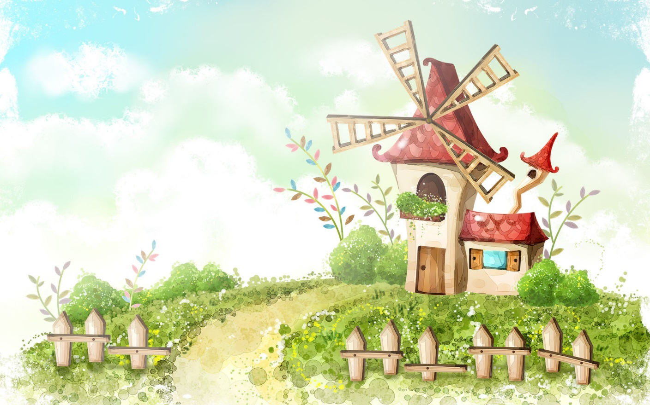
Welcome to our class

Slide 2
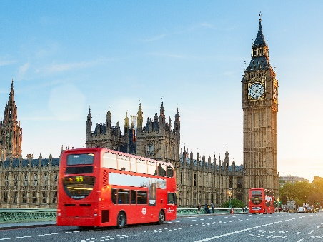
WARM-UP
Picture drescribing
Describe the picture
I see a clock. The clock is The Big Ben Clock Tower.
I see two buses. The buses are double-decker ones.

Slide 3




Unit
12
ENGLISH-SPEAKING COUNTRIES
LESSON 3: A CLOSER LOOK 2

Slide 4
Review
* Articles “a/an”
+ Indefinite article: a/ an
- We use a/an with singular countable nouns when we are talking about them in general.
Example: An ant is a tiny animal.
- after the verbs to be and to have.
Example: I'm a student. / I have an eraser.
* a + consonant sound
Eg: a bag , a pen,…
* an + vowel sound (u, e, o,a,i) ( uể oải)
Eg. an apple. an island,…
Notes:
https://www.youtube.com/watch?v=drTyYqbz6Xk

Slide 5
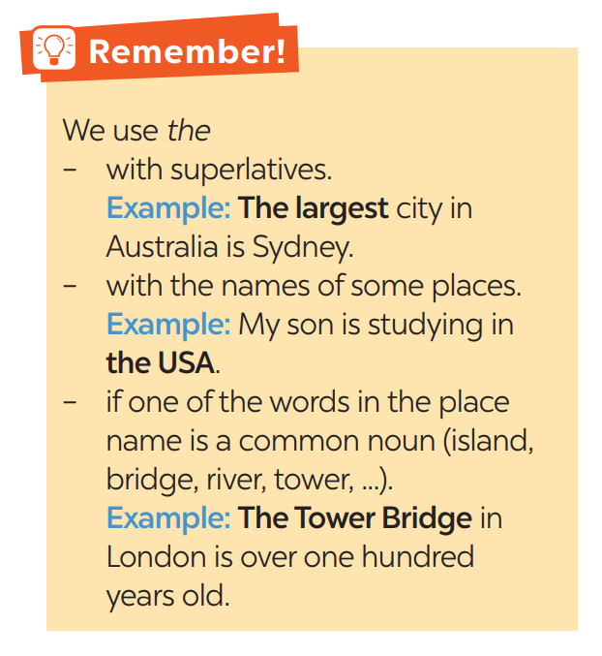
* Article “the”
+ Definite article: the
+ We use the with singular or plural nouns when we already know them or when they are mentioned for the second time.
Example:
The bike in front of her house is nice.

Slide 6
1
Complete the sentences with “a / an” or “the”
1. Is Washington D.C. __________ capital of the USA?
2. Can you give me __________example of an English-speaking country?
3. The London Eye is __________ great attraction in London.
4. Canada is __________ very cold country.
5. I love __________ New Zealand’s countryside.
the
an
a
a
the

Slide 7
2
Put in "the" where necessary.
1. __________Statue of Liberty is in ________ New York.
2. ________ Scotland is a part of ________ UK.
3. New Zealand consists of ________ North Island and _________South Island.
4. Disneyland in California is one of _______ biggest entertainment centers in the world.
5. Bangkok is ________ most popular city for tourists in _________ Kingdom of Thailand.
The
x
x
the
the
the
the
the
the

Slide 8
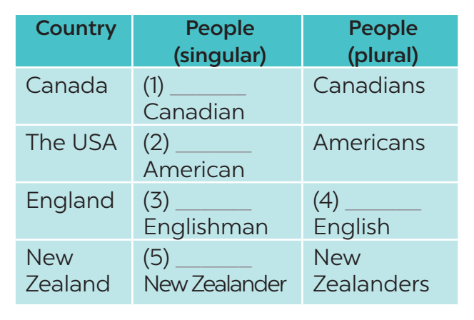
3
Put in a / an or the.
a
an
an
the
a

Slide 9
4
Complete the sentences with “a / an”, or “the”
1. The man sitting next to her is ____________ Englishman.
2. ____________ River Thames runs through London.
3. Here is ____________ map of the city of Edinburgh.
4. What is ____________ most popular sport in Canada?
5. We want to visit ____________ attraction in Sydney.
6. ____________ Statue of Liberty was a present from France.
an
The
the
the
an
The

Slide 10

5
Game – Faster detective.
Nhờ BTV xem lại câu 4+5
Tick if the underlined articles are correct. If they aren’t, write the correct ones in the space provided.
1. “What do you call a person from England?” – “The Englishman.” ______________
2. Edinburgh is a capital city of Scotland. ________________
3. Queenstown is a amazingly beautiful town. ________________
4. Are ancient castles an attraction of Scotland? ________________
5. Where can you see a red telephone box? ________________
the
an

Slide 11

* CONSOLIDATION
In this lesson, students have:
understood the use of use articles
practiced using articles correctly

Slide 12

* HOMEWORK
- Complete exercises in the Workbook.
- Prepare lesson 4: Communication

Slide 13




