Slide 1
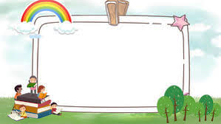
GOOD MORNING CLASS!!!

Slide 2
* Game: Sentence puzzling.
1. learn | She | will | English | next year
2. His | work | will | father | overnight.
3. Phong | will | come | and | Nick.
4.homewwork | won’t | his | finish | Sam
* Suggested answers:
1. She will learn English next year
2. His father will work overnight.
3. Phong and Nick will come.
4. Sam won’t finish his homework

Slide 3



LESSON 3
Grammar
Future simple
Might for future possibility

Slide 4
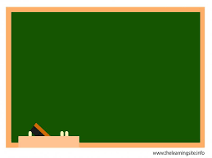
Grammar 1:
Future simple : (tương lại đơn)
FORM:
(+)
S + WILL + V-bare inf …
( -)
S + WILL + NOT + V-bare inf …
( ?)
WILL + S + V-bare inf…. ?
Yes, S + will. / No, S + won’t.

Slide 5
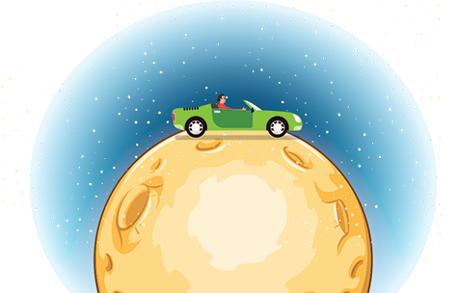

* Grammar 1:
Future simple
We use the future simple to talk about an action that happens in the future.
Example:
My father will travel on the Moon in a super car in the future.
We’ll live in that cottage next year. (’ll is the short form of will)
We won’t live in that cottage anytime soon. (won’t is the short form of will not)
Will they live on the Moon?
Yes, they will.
No, they won’t.

Slide 6


Fill the blanks with will ('ll) or won’t to make the sentences true for you.
Example:
I think I’ll listen to music in the afternoon.
1.
I think I _______ stay at home tonight.
2.
My friends _______ go to the library this afternoon.
3.
My mum _______ make a cake today.
4.
I _______ have an English test tomorrow.
5.
Our family _______ move to the new house next week.

Slide 7

Complete the conversation with will ('ll) or won’t.
A: Oh, no. The dog ran away again!
B: Don't worry - he (1) ............... come back.
A: Are you sure he (2) .................... ?
B: OK, he might not come back today. But I’m sure he (3) ............. come back tomorrow.
A: I don't believe you! He (4).............. come back. We (5) …..... never see him again. I'm sure.
B: Oh, look ... Here he is!
will / ‘ll
will (‘ll)
will (‘ll)
won’t
will (‘ll)

Slide 8

Write sentences, using will ('ll) or won't and the words given.
1. computer/do/housework
2. robot/water/flowers.
3. smart TV/cook/meals.
4. washing machine/iron/clothes
5. smartphone/take care/children
6. modern fridge / cook/ meals

Slide 9
Game: Lucky numbers
1
2
3
4
5
6
7
8
Team A
Team B
2
8
2
10
8
4
4
6
6
10

Slide 10
Write sentences, using will ('ll) or won't and the words given.
1. computer/do/housework
→ ………………………………………………
A computer will / won’t help me to do my housework.

Slide 11
Write sentences, using will ('ll) or won't and the words given.
2. robot/water/flowers.
→ ………………………………………………
A robot will help me to water the flowers.

Slide 12
Write sentences, using will ('ll) or won't and the words given.
3. smart TV/cook/meals.
→ ………………………………………………
A smart TV won’t help me to cook meals.

Slide 13
Write sentences, using will ('ll) or won't and the words given.
4. washing machine/iron/clothes
→ ………………………………………………
A washing machine will / won’t help me to iron the clothes.

Slide 14
Write sentences, using will ('ll) or won't and the words given.
5. smartphone/take care/children
→ ………………………………………………
A smartphone won’t help me to take care of the children.

Slide 15
Write sentences, using will ('ll) or won't and the words given.
6. modern fridge / cook/ meals
→ ………………………………………………
A modern will help me to cook meals.

Slide 16

LUCKY NUMBER!

Slide 17
LUCKY NUMBER!

Slide 18
Write sentences, using will ('ll) or won't and the words given.
1.
computer / do / housework
A computer will / won’t help me to do my housework.
2.
robot / water / ﬂowers
A robot will help me to water the flowers.
3.
smart TV / cook / meal
A smart TV won’t help me to cook meals.
4.
washing machine / iron / clothes
A washing machine will / won’t help me to iron the clothes.
5.
smartphone / take care / children
A smartphone won’t help me to take care of the children.

Slide 19
* Grammar 2
Might for future possibility
+ Form:
+
S + might + V-bare inf …
-
S + might not + V-bare inf ….

Slide 20

Grammar 2
Might for future possibility
We use might + V to talk about actions that are possible in the future (We are not sure if they will happen or not).
Example:
We might live in a UFO.
They might not travel in cars.

Slide 21


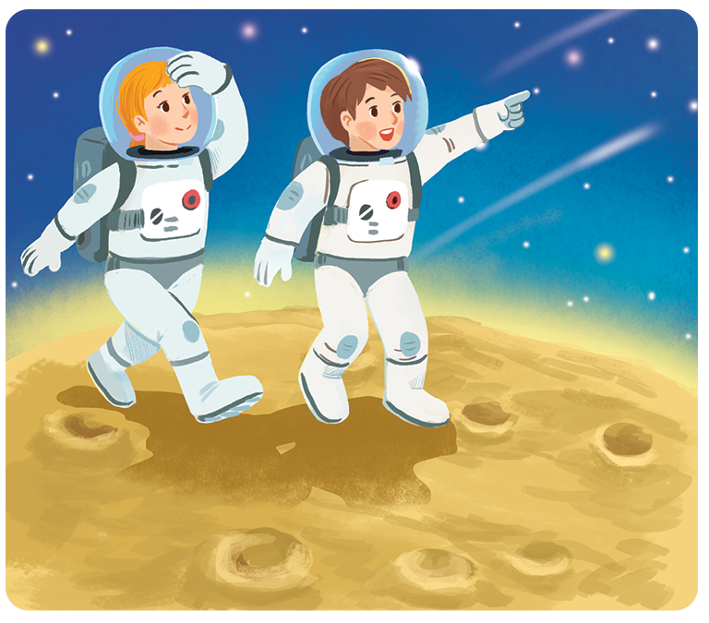
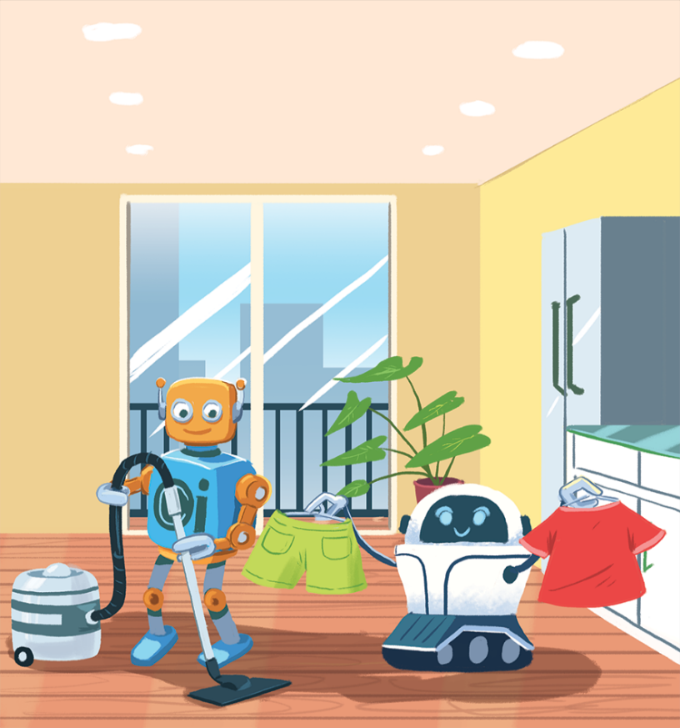
Read the two poems. Tick () T (True) or F (False).
In the future
We might live with robots.
They might clean our houses.
They might wash our clothes.
They might not talk to us.
Jenny, aged 12
In the future
We might go on holiday to the Moon.
We might stay there for a long time.
We might have a great time.
We might come home soon.
Henry, aged 11

Slide 22

Read the two poems. Tick () T (True) or F (False).
In the future
We might live with robots.
They might clean our houses.
They might wash our clothes.
They might not talk to us.
Jenny, aged 12
In the future
We might go on holiday to the Moon.
We might stay there for a long time.
We might have a great time.
We might come home soon.
Henry, aged 11

Slide 23
 | T | F
1. Jenny thinks we might live with robots.
2. Henry thinks we might travel to the Moon.
3. Jenny thinks robots might not clean our houses.
4. Henry thinks we will stay on the Moon for a short time.
5. Jenny thinks robots might help us to do the housework.
6. Henry thinks we might not have a great time on the Moon.







Slide 24
Unit 10 : Houses in the future Lesson 3: A closer look 2
IV. Consolidation
A closer look 2
Future simple
Might for future possibility
S + will + V
S + might + V
We use the future simple to about an action that happens in the future.
We use might + V to talk about actions that are possible in the future (We are not sure if they will happen or not)

Slide 25


homework
- Revise grammars.
- Do exercises in the workbook.
- Prepare lesson 4 ( communication)

Slide 26




