Slide 1


Slide 2


Unit
6
LIFESTYLES
LESSON 6: SKILLS 2
1

Slide 3
LESSON 6: SKILLS 2
WARM-UP
Warm up
Task 1: Work in pairs. Discuss the following question.
PRE-LISTENING
Task 2: ﻿Listen to the conversation and tick (✓) T (True) or F (False).
﻿Task 3: ﻿Listen again and choose the correct answer to each question.
LISTENING
Task 4: ﻿Look at the list below. Put the ideas about online learning in the correct columns.
Task 5: ﻿Write a paragraph (80 – 100 words) about the advantages or disadvantages of online learning. You can refer to the listening and the ideas in 4.
WRITING
CONSOLIDATION
Wrap-up
Homework

Slide 4
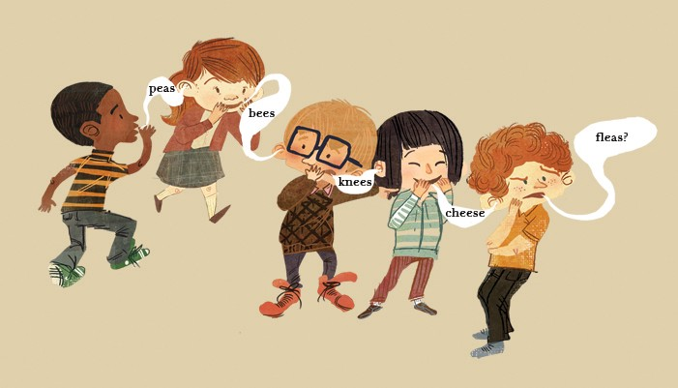
WARM-UP
BROKEN TELEPHONE

Slide 5

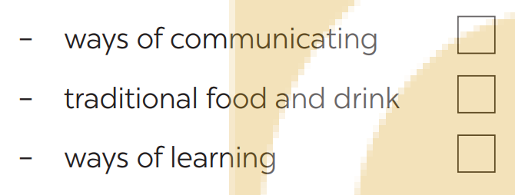


PRE-LISTENING
1
﻿Work in groups. Which of the following do you think is more influenced by modern technology? Tick (﻿✓) your choice(s).

Slide 6
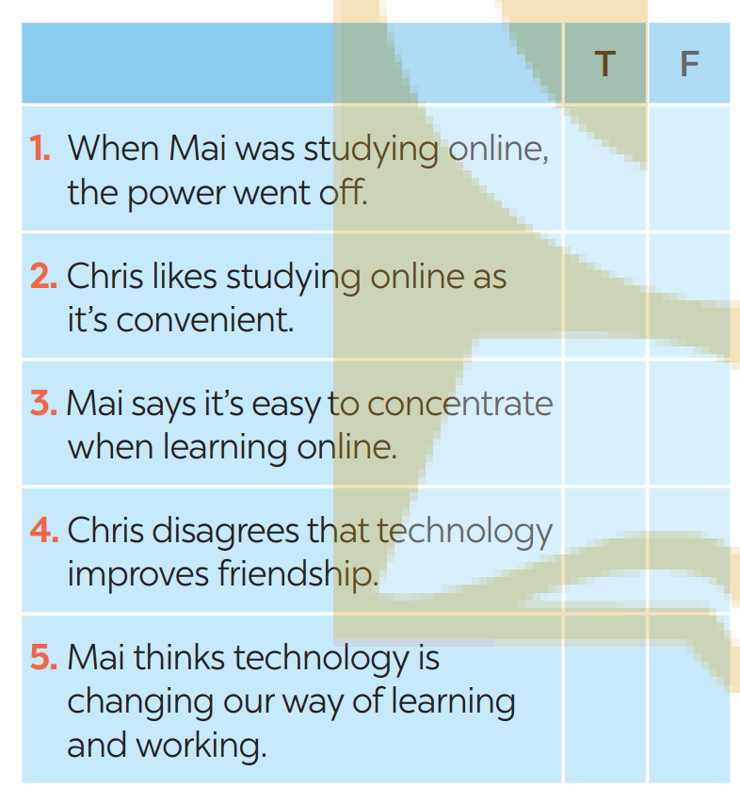
LISTENING
2
﻿Listen to the conversation and tick (✓) T (True) or F (False).
✓
✓
✓
✓
✓

Slide 7
LISTENING
3
﻿Listen again and choose the correct answer to each question.
﻿1. The talk is generally about ______.
A. the impact of modern technology
B. the good points of online learning
C. the weak points of online learning
﻿2. Both Mai and Chris think that modern technology is ______.
A. changing greatly B. changing our lifestyle C. entertaining us
3. Mai wants to go to class because ______.
A. online learning doesn’t work for her
B. she likes to get up early
C. she wants to interact with her teachers and friends
4. Which of the following is true?
A. Mai and Chris are classmates.
B. Mai and Chris have similar ideas about online learning.
C. Mai thinks online learning has some weak points.
1. A
2. B
3. C
4. C

Slide 8
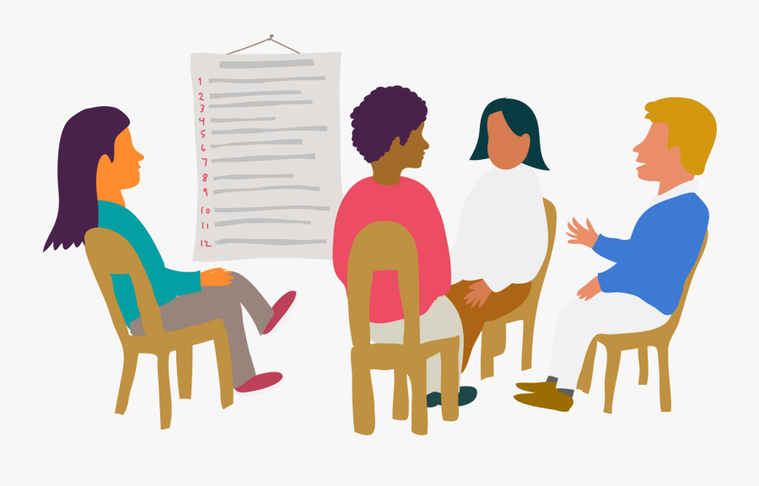
WRITING
4
﻿Look at the list below. Put the ideas about online learning in the correct columns.
ADVANTAGES | DISADVANTAGES
﻿- convenient
- comfortable
- more freedom
- independent
﻿- difficult to concentrate
- no real interaction
- harmful to our eyes
- expensive equipment

Slide 9

WRITING
5
﻿Write a paragraph (80 – 100 words) about the advantages OR disadvantages of online learning. You can refer to the listening and the ideas in 4.
Online learning has a lot of benefits. First, .................................................. ............................................................
............................................................
............................................................
............................................................
............................................................

Slide 10

CONSOLIDATION
1
Wrap-up
What have we learnt in this lesson?
Listen to someone’s opinion about the impact of modern technology
Write a paragraph about the advantages or disadvantages of online learning

Slide 11

CONSOLIDATION
2
Homework
Students’ workbook

Slide 12

Website: hoclieu.vn
Fanpage: facebook.com/sachmem.vn/

