Slide 1


Slide 2



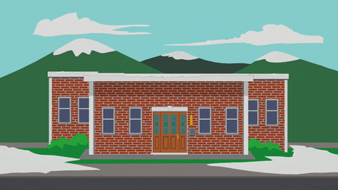
Unit
6
A VISIT TO A SCHOOL
LESSON 6: SKILLS 2

Slide 3

OBJECTIVES
By the end of the lesson, students will be able to:
listen for general and special information about school activities
write a short paragraph about outdoor activities at one’s school

Slide 4
LESSON 6: SKILLS 2
WARM-UP
Game: The hidden word
Task 1: Work in pairs. Look at the pictures and discuss the questions.
Task 2: Listen to an interview between a reporter and two students. Circle the appropriate option (A, B, or C) to complete each sentence.
Task 3: Listen again and answer the questions.
LISTENING
Task 4: Work in pairs. Ask and answer questions about your school’s outdoor activities.
Task 5: Write a paragraph of about 70 words about an outdoor activity at your school.
WRITING
POST-LISTENING
& WRITING
Task 6: Class gallery
CONSOLIDATION
Wrap-up
Homework

Slide 5

LESSON 6: SKILLS 2
WARM-UP
Game: The hidden word
Aims of the stage:
to waken up students’ interest

Slide 6
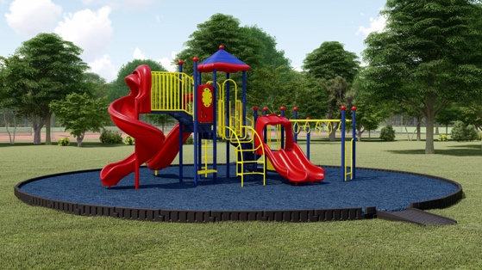
WARM-UP
1. What is this?
PLAYGROUND
_ _ _ _ _ _ _ _ _ _
SUBJECT
2. My favourite _ _ _ _ _ _ _ is Maths.
CLUB
3. My and Phong are members of “Go Green _ _ _ _ .”
FOUNDED
4. Quoc Hoc – Hue was _ _ _ _ _ _ _ in 1986.
ON
5. The school year usually begins _ _ September 5th every year.

Slide 7
WARM-UP
The hidden word:
ROTUODO
OUTDOOR
_ _ _ _ _ _ _

Slide 8

LESSON 6: SKILLS 2
WARM-UP
Game: The hidden word
Task 1: Work in pairs. Look at the pictures and discuss the questions.
Task 2: Listen to an interview between a reporter and two students. Circle the appropriate option (A, B, or C) to complete each sentence.
Task 3: Listen again and answer the questions.
LISTENING
Aims of the stage:
to help students develop listening skills for general and specific information

Slide 9

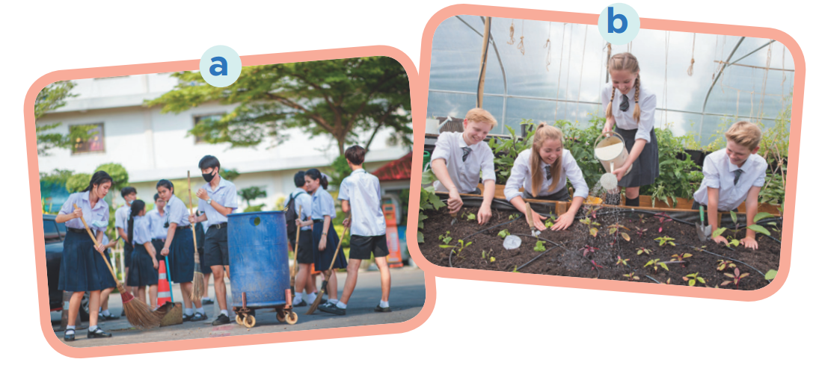
PRE-LISTENING
1
Work in pairs. Look at the pictures and discuss the questions.
What outdoor activities do they take part in?
Why do they do these activities?

Slide 10

WHILE-LISTENING
2
Listen to an interview between a reporter and two students. Circle the appropriate option (A, B, or C) to complete each sentence.
1. Trang and Phong are talking about _____. A. school subjects B. school timetables C. outdoor activities 2. They are members of _____ club(s). A. one B. two C. three 3. The Go Green Club cleans streets on _____.
A. Saturday afternoons B. Saturday mornings C. Sunday afternoons 4. They grow _____ in the school garden. A. vegetables B. flowers C. trees

Slide 11
WHILE-LISTENING
3
Listening to the interview again and answer the questions.
1. What do Trang’s club members encourage their classmates to do? 2. What does the reporter think about their activities? 3. When and where do Nam’s club members grow vegetables?
They encourage their classmates to recycle glass, cans and paper.
The reporter thinks their activities protect the environment.
They grow vegetables in the school garden after school.

Slide 12

LESSON 6: SKILLS 2
WARM-UP
Game: The hidden word
Task 1: Work in pairs. Look at the pictures and discuss the questions.
Task 2: Listen to an interview between a reporter and two students. Circle the appropriate option (A, B, or C) to complete each sentence.
Task 3: Listen again and answer the questions.
LISTENING
Task 4: Work in pairs. Ask and answer questions about your school’s outdoor activities.
Task 5: Write a paragraph of about 70 words about an outdoor activity at your school.
WRITING
Aims of the stage:
to teach students how to write school’s outdoor activities

Slide 13
PRE-WRITING
4
Work in pairs. Ask and answer questions about your school’s outdoor activities.
1. What outdoor activities do you take part in at school? 2. Which outdoor activity do you like the best?
3. Why do you like doing it?

Slide 14

WHILE-WRITING
5
Write a paragraph of about 70 words about an outdoor activity at your school. You can use the information in Task 4.

Slide 15
LESSON 6: SKILLS 2
WARM-UP
Game: The hidden word
Task 1: Work in pairs. Look at the pictures and discuss the questions.
Task 2: Listen to an interview between a reporter and two students. Circle the appropriate option (A, B, or C) to complete each sentence.
Task 3: Listen again and answer the questions.
LISTENING
Task 4: Work in pairs. Ask and answer questions about your school’s outdoor activities.
Task 5: Write a paragraph of about 70 words about an outdoor activity at your school.
WRITING
POST-LISTENING
& WRITING
Task 6: Class gallery

Slide 16
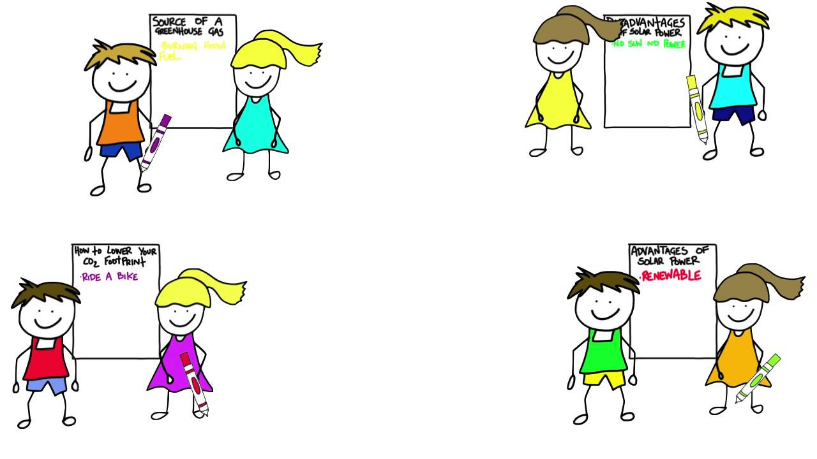
POST-LISTENING & WRITING
CLASS GALLERY
Students can:
go and see others’ work
give comments to one another

Slide 17
LESSON 6: SKILLS 2
WARM-UP
Game: The hidden word
Task 1: Work in pairs. Look at the pictures and discuss the questions.
Task 2: Listen to an interview between a reporter and two students. Circle the appropriate option (A, B, or C) to complete each sentence.
Task 3: Listen again and answer the questions.
LISTENING
Task 4: Work in pairs. Ask and answer questions about your school’s outdoor activities.
Task 5: Write a paragraph of about 70 words about an outdoor activity at your school.
WRITING
POST-LISTENING
& WRITING
Task 6: Class gallery
CONSOLIDATION
Wrap-up
Homework

Slide 18

CONSOLIDATION
1
WRAP-UP
In this lesson, we have learnt to:
listen for general and special information about school activities
write a short paragraph about outdoor activities at one’s school

Slide 19
CONSOLIDATION
2
HOMEWORK
Prepare for the next lesson: Looking back & Project

Slide 20

Website: sachmem.vn
Fanpage: facebook.com/sachmem.vn/

