Slide 1


Slide 2



Unit
6
A VISIT TO A SCHOOL
LESSON 7: LOOKING BACK & PROJECT
Vocabulary review
Grammar review
Unit
Project: My favourite school

Slide 3

OBJECTIVES
By the end of the lesson, students will be able to:
review the vocabulary and grammar of Unit 6
apply what they have learnt (vocabulary and grammar) into practice through a project

Slide 4
LESSON 7: LOOKING BACK & PROJECT
WARM-UP
Brainstorming
Task 1: Find the words and phrases that match the definitions.
Task 2: Complete the sentences with the words and phrases in task 1.
VOCABULARY REVIEW
Task 3: Complete the sentences with appropriate prepositions of place or time.
Task 4: Read the passage and fill in the gaps with prepositions of time or place.
GRAMMAR REVIEW
PROJECT
Project: My favourite school
CONSOLIDATION
Wrap-up
Homework

Slide 5

LESSON 7: LOOKING BACK & PROJECT
WARM-UP
Brainstorming
Aims of the stage:
to revise the vocabulary related to the topic and lead in the next part of the lesson
to enhance students’ skills of cooperating with team mates

Slide 6
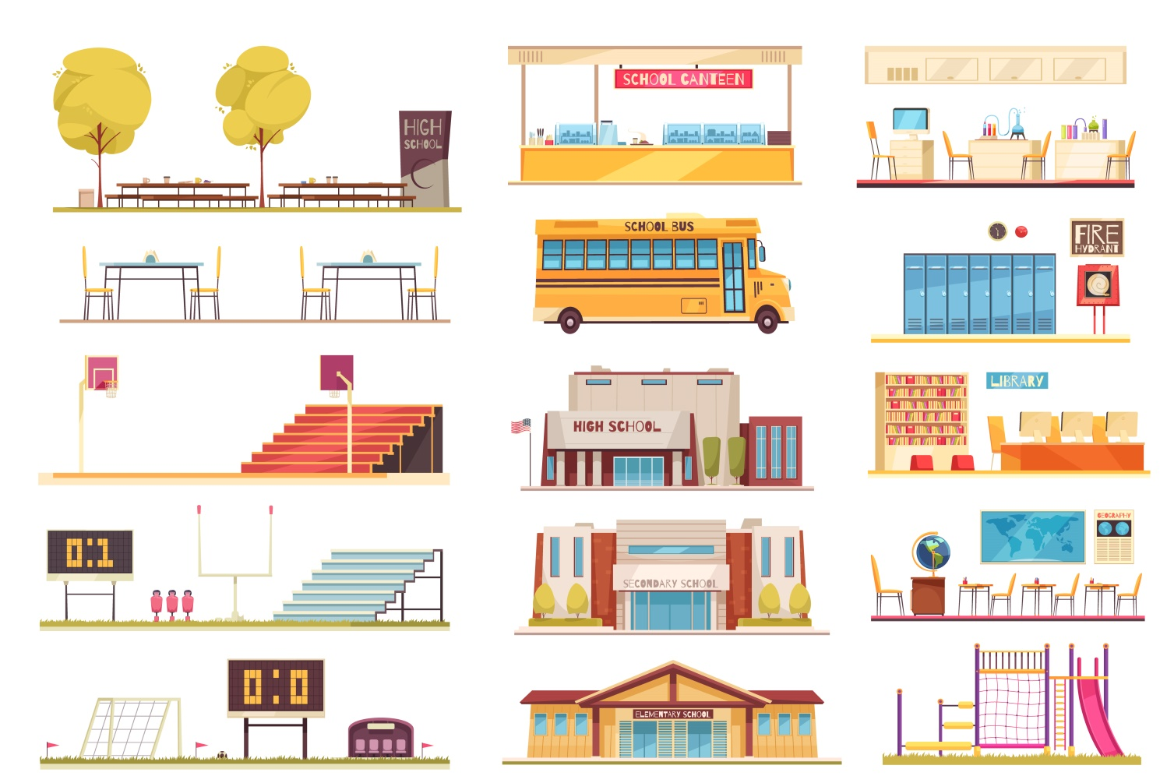
WARM-UP
BRAINSTORMING: SCHOOL FACILITIES
Write as many school facilities as possible in 2 minutes.

Slide 7
LESSON 7: LOOKING BACK & PROJECT
WARM-UP
Brainstorming
Task 1: Find the words and phrases that match the definitions.
Task 2: Complete the sentences with the words and phrases in Task 1.
VOCABULARY REVIEW

Slide 8
VOCABULARY REVIEW
1
Find the words and phrases from this unit that match these definitions.
1. known by many people
2. buildings, services, equipment, etc. at a school
3. an exam taken to enter a school
4. intelligent and / or talented students
5. extra activities that students do at school
well-known
(school) facilities
an entrance exam
gifted students
outdoor activities

Slide 9
VOCABULARY REVIEW
2
Complete the sentences with the words and phrases in Task 1.
gifted students
The school is free for _____________ who pass some exams.
The students in the school find _______________ useful and enjoyable.
Chu Van An Lower Secondary School is famous for its intelligent students and modern ______________.
Students have to pass a difficult _______________ to attend that school.
The most ____________ teacher of Van Mieu – Quoc Tu Giam was Chu Van An.
outdoor activities
(school) facilities
entrance exam
well-known

Slide 10
LESSON 7: LOOKING BACK & PROJECT
WARM-UP
Brainstorming
Task 1: Find the words and phrases that match the definitions.
Task 2: Complete the sentences with the words and phrases in task 1.
VOCABULARY REVIEW
Task 3: Complete the sentences with appropriate prepositions of place or time.
Task 4: Read the passage and fill in the gaps with prepositions of time or place.
GRAMMAR REVIEW

Slide 11
GRAMMAR REVIEW
3
Complete the sentences with appropriate prepositions of place or time.
The members of the club clean the school playground ___ Saturday mornings.
The students have to sit for the final exam ___ June.
Chu Van An Lower Secondary School is one of the most famous schools ___ Ha Noi.
The school canteen is ___ the second floor.
Which subjects do you like to study ___ school?
on
in
in
on
at

Slide 12
GRAMMAR REVIEW
4
Read the passage and fill in the gaps with prepositions of time or place.
Tom is a student (1) ______ a private school in the suburbs of Manchester. He lives with his parents (2) ______ a small house near his school. He usually studies at school (3) ______ the mornings. (4) ______ Monday and Thursday afternoons, he joins different outdoor activities with his schoolmates. He sings
(5) ______ the Little Bees’ Club on Tuesdays and Fridays. He goes to the cinema with his friends (6) ______ the weekend. He finds his studies and outdoor activities enjoyable.
at
in
in
On
in
at

Slide 13
LESSON 7: LOOKING BACK & PROJECT
WARM-UP
Brainstorming
Task 1: Find the words and phrases that match the definitions.
Task 2: Complete the sentences with the words and phrases in task 1.
VOCABULARY REVIEW
Task 3: Complete the sentences with appropriate prepositions of place or time.
Task 4: Read the passage and fill in the gaps with prepositions of time or place.
GRAMMAR REVIEW
PROJECT
Project: My favourite school

Slide 14
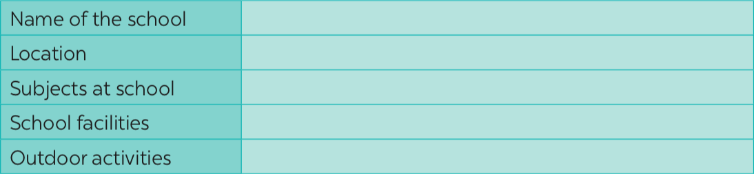
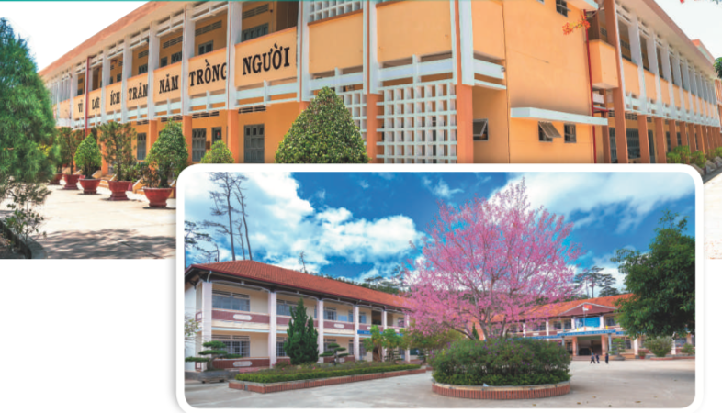
PROJECT
1
5
Search for a school you would like to study at. Then find information about that school to complete the table.
2
Look at the table and tell the class about that school.
3
Vote for the best presentation.

Slide 15
LESSON 7: LOOKING BACK & PROJECT
WARM-UP
Brainstorming
Task 1: Find the words and phrases that match the definitions.
Task 2: Complete the sentences with the words and phrases in task 1.
VOCABULARY REVIEW
Task 3: Complete the sentences with appropriate prepositions of place or time.
Task 4: Read the passage and fill in the gaps with prepositions of time or place.
GRAMMAR REVIEW
PROJECT
Project: My favourite school
CONSOLIDATION
Wrap-up
Homework

Slide 16
CONSOLIDATION
1
WRAP-UP
Vocabulary review
Grammar review
Project: My favourite school

Slide 17

CONSOLIDATION
2
HOMEWORK
Prepare for the next lesson: Review 2

Slide 18

Website: sachmem.vn
Fanpage: facebook.com/sachmem.vn/

