Slide 1


Slide 2

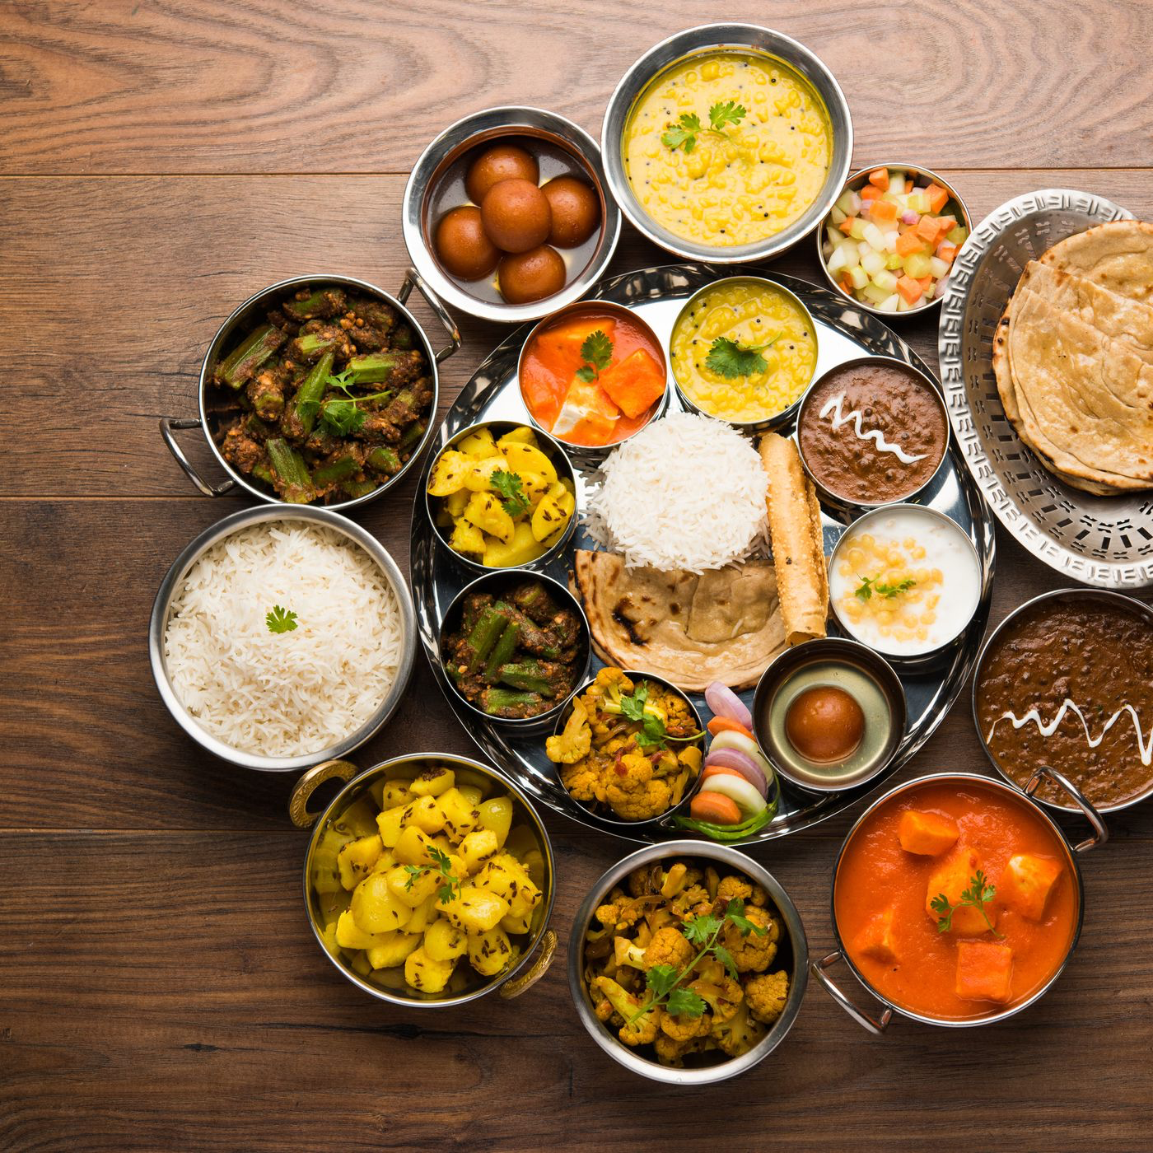
LESSON 3: A CLOSER LOOK 2
WARM-UP
Mini game
Stage aims:
To activate students’ knowledge using some and a lot of / lots of
To get students interested in the topic

Slide 3


MINI GAME
2 groups: Mango & Orange
Listen to the words the teacher says
Members of Mango stand up if the word is countable.
Members of Orange stand up if the word is uncountable.
apple
chicken
carrot
salt
meal
pepper
star
sugar
meat
cucumber

Slide 4

LESSON 3: A CLOSER LOOK 2
WARM-UP
Mini game
PRESENTATION
Measurement words/phrases: some, a lot of / lots of
Stage aim:
To help Ss understand and know how to use some, a lot of / lots of

Slide 5
PRESENTATION
Remember!
We use some, a lot of, lots of with both countable nouns and uncountable nouns to describe quantities.
Example:
- I need some apples for this recipe.
- There's some water in the bottle.
- There are a lot of/ lots of people in the room.
- She likes coffee with a lot of / lots of sugar.

Slide 6
PRESENTATION
Vocabulary:
1.countable /ˈkaʊntəbəl/:
2.quantity /ˈkwɒntəti/:
3.describe /dɪˈskraɪb/ :
4.popular /ˈpɒpjələr/:
5.cartoon /kɑːˈtuːn/ :
đếm được:
số lượng:
miêu tả:
được nhiều người biết đến:
hoạt hình:

Slide 7
LESSON 3: A CLOSER LOOK 2
WARM-UP
Mini game
PRESENTATION
Measurement words/phrases: some, a lot of / lots of
Task 1: Circle the correct words or phrases to complete the sentences.
Task 2: Look at the pictures and complete each sentence. Write some, any or a lot of/lots of in the blanks
Task 3: Fill in each blank with How many or How much. Answer the questions, using the pictures.
Task 4: Work in pairs. Ask and answer, using the questions in 3.
PRACTICE
Stage aims
To give Ss further practice on using some and a lot of / lots of
To help Ss revise the use of any, How many, How much & practise using them for asking and answering about quantities

Slide 8
PRACTICE
1
Circle the correct words or phrases to complete the following sentences.
1. Minh is very popular. He has got some / a lot of friends.
2. Linh is very busy. She has got some / lots of homework.
3. Put some / a lot of sugar in my tea. But not too much.
4. There are some / a lot of cars in our city. Too many. I don't like it.
5. There is some / lots of rice left. Not much but just enough for our breakfast.
a lot of
lots of
some
a lot of
some

Slide 9

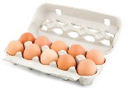



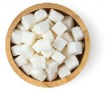
PRACTICE
1
2
Look at the pictures and complete each sentence. Write some, any or a lot of/ lots of in the blanks.
Example: There is some orange juice in the glass.
1. There are _____________ eggs in the carton.
2. There aren't _________ biscuits on the plate.
3. Susie went to the cinema with _________ friends.
4. I'd like a pizza with ____________ cheese.
5. There is _____________ sugar in the bowl.
a lot of/ lots of
any
some
a lot of/ lots of
a lot of/ lots of

Slide 10




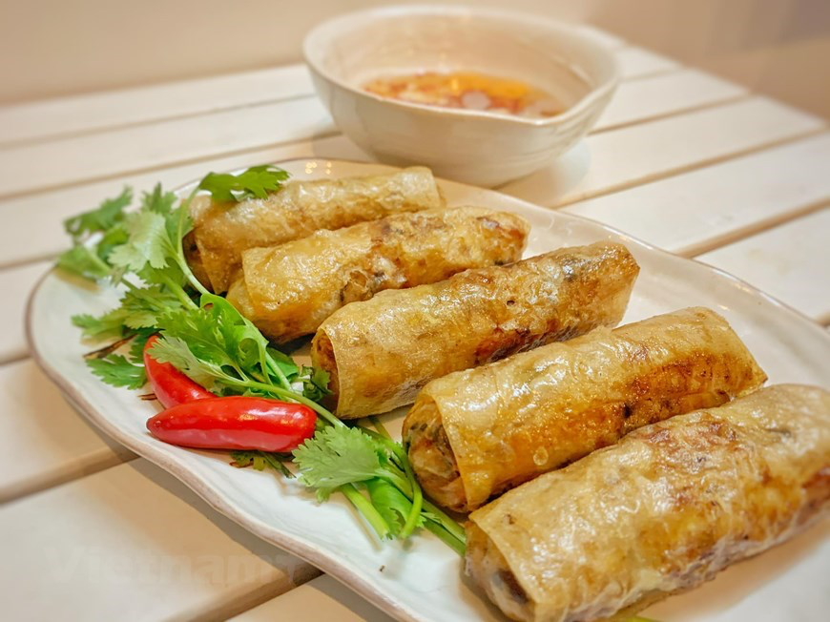
PRACTICE
3
Fill in each blank with How many or How much. Answer the questions, using the pictures.
1. __________ water do you drink every day? _________
2. ___________ books did you read last month? _________
3. ___________ films did you watch last year? ________
4. ___________ bananas do you eat every week? ___________
5. ___________ spring rolls did your mother cook last month? ___________
2L
How much
2 litters
How many
2 books
How many
2 films
How many
3 bananas
How many
5 spring rolls

Slide 11
PRACTICE
4
Work in pairs. Ask and answer, using the questions in 3.
1
1. How much water do you drink everyday?
2. How many books did you read last month?
3. How many films did you watch last year?
4. How many bananas do you eat every week?
5. How many spring rolls did your mother cook last month?
…

Slide 12
LESSON 3: A CLOSER LOOK 2
WARM-UP
Mini game
PRESENTATION
Measurement words/phrases: some, a lot of / lots of
Task 1: Circle the correct words or phrases to complete the sentences.
Task 2: Look at the pictures and complete each sentence. Write some, any or a lot of/lots of in the blanks
Task 3: Fill in each blank with How many or How much. Answer the questions, using the pictures.
Task 4: Work in pairs. Ask and answer, using the questions in 3.
PRACTICE
PRODUCTION
Task 5: Work in pairs. Take turns to ask and answer about the recipes.
Stage aim
To get Ss to practise using measurement words and phrases, words of dishes and ingredients, How many and How much in context.

Slide 13
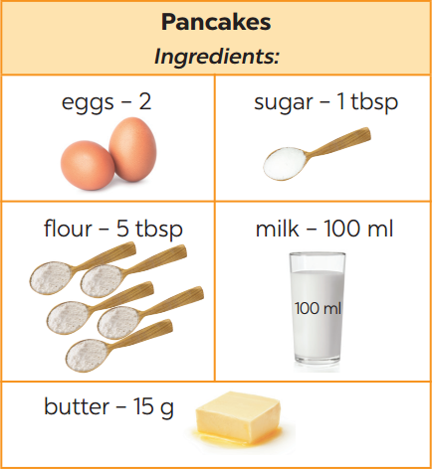
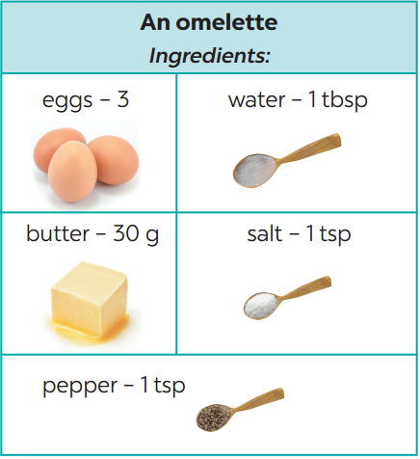
PRODUCTION
4
Example:
A: What do we need to make pancakes?
B: We need eggs, sugar, flour, milk, and butter.
A: How many eggs do we need?
B: Two.
Work in pairs. Take turns to ask and answer about the recipes.
1

Slide 14
LESSON 3: A CLOSER LOOK 2
WARM-UP
Mini game
PRESENTATION
Measurement words/phrases: some, a lot of / lots of
Task 1: Circle the correct words or phrases to complete the sentences.
Task 2: Look at the pictures and complete each sentence. Write some, any or a lot of/lots of in the blanks
Task 3: Fill in each blank with How many or How much. Answer the questions, using the pictures.
Task 4: Work in pairs. Ask and answer, using the questions in 3.
PRACTICE
PRODUCTION
Task 5: Work in pairs. Take turns to ask and answer about the recipes.
CONSOLIDATION
Wrap-up
Homework

Slide 15
CONSOLIDATION
1
WRAP-UP
- Review the measurement words and phrases such as some and a lot of / lots of used with countable and uncountable nouns.
- Understand and use the How many/ How much to ask and answer about quantities.

Slide 16
CONSOLIDATION
2
HOMEWORK
Make questions and sentences about quantities, using some, a lot of / lots of, any, How much and How many.
Preparation for Unit 5 project
- Prepare for the project (the eating habits, pictures or photos and responsibilities of each member)

Slide 17

Website: sachmem.vn Fanpage: www.facebook.com/sachmem.vn

