Slide 1


Slide 2


Unit
7
ENVIRONMENTAL PROTECTION
LESSON 2: A CLOSER LOOK 1
1

Slide 3
WARM-UP
AHTTABI
PLTINOOLU
XEOGYN
EEERLAS
BBSOAR
MECYSSOET
-> HABITAT
-> POLLUTION
-> OXYGEN
-> RELEASE
-> ABSORB
-> ECOSYSTEM
JUMBLED WORDS

Slide 4
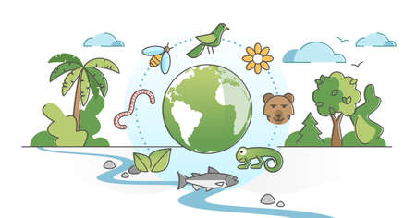
VOCABULARY
ecosystem (n)
/ˈēkōˌsistəm/
hệ sinh thái

Slide 5
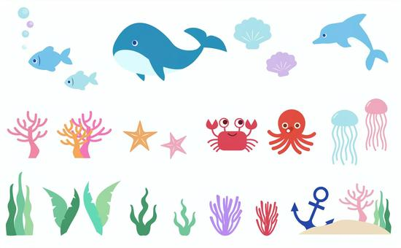
VOCABULARY
marine life (n)
/ məˈriːn laɪf/
hệ sinh thái nước

Slide 6
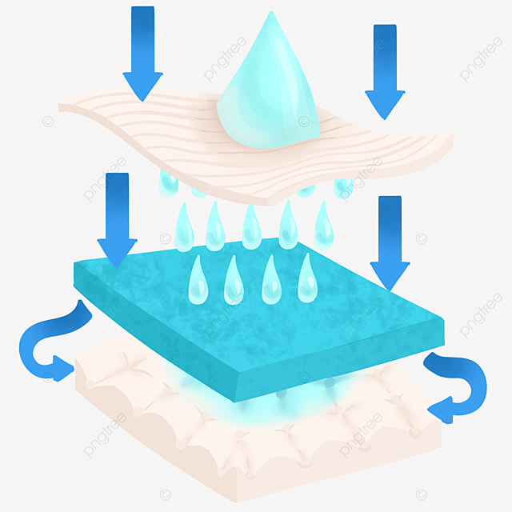
VOCABULARY
absorb (v)
/ əbzɔːʳb /
thẩm thấu

Slide 7
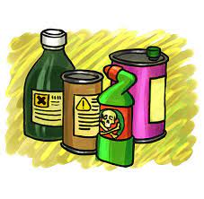
VOCABULARY
harmful substance (n)
/ˈhɑːmfl ˈsʌbstəns/
tác nhân gây hại

Slide 8

VOCABULARY
extinction (n)
/ ɪkˈstɪŋkʃn/
sự tuyệt chủng

Slide 9
VOCABULARY
Vocabulary | Pronunciation | Meaning
1. ecosystem (n) | /ˈēkōˌsistəm/ | hệ sinh thái
2. marine life (n) | / məˈriːn laɪf/ | hệ sinh thái nước
3. absorb (v) | / əbzɔːʳb / | thẩm thấu
4. harmful substance (n) | /ˈhɑːmfl ˈsʌbstəns/ | tác nhân gây hại
5. extinction (n) | / ɪkˈstɪŋkʃn/ | sự tuyệt chủng

Slide 10
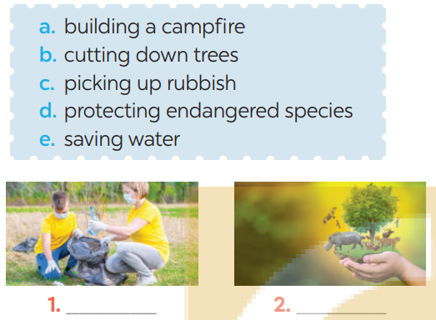
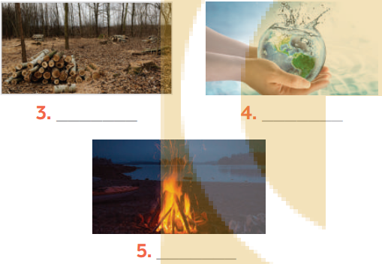
1
PRACTICE
Label each picture with a phrase from the list.
cutting down trees
saving water
picking up rubbish
protecting endangered species
building campfire
Tick (✓) the actions above that protect the environment.

Slide 11
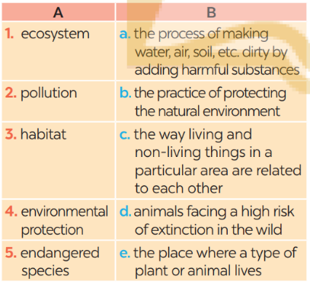
PRACTICE
2
Match each word or phrase in column A with its meaning in column B.
1. c
2. a
3. e
4. b
5. d

Slide 12
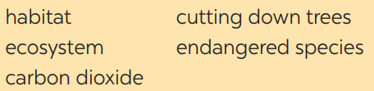
PRACTICE
3
Complete each sentence with a word or phrase from the box
ENDANGERED SPECIES
1. People in my neighbourhood are doing a lot to save ____________.
2. Con Dao National Park provides a rich ____________ for marine life.
3. Forests help release oxygen and absorb ______________; they also provide homes for many species.
4._____________________ is a serious environmental concern as it harms natural habitats.
5. An _____________ may be a whole forest, or a small pond, and it can be of any size.
HABITAT
CARBON DIOXIDE
CUTTING DOWN TREES
ECOSYSTEM

Slide 13
PRONUNCIATION
4
Listen and repeat the words. Pay attention to the sounds /bl/ and /kl/
/bl/ | /kl/
block blast blanket black problem | clean clown club class clear

Slide 14
PRONUNCIATION
5
Listen and practise the sentences. Underline the words with /bl/, and circle the words with /kl/.
1. Look! There are black clouds all over!
2. A truck blocked the way to the club.
3. The students painted the classroom blue.
4. The wind blew the clock down.
5. We cleaned up the environment after the blast.

Slide 15

CONSOLIDATION
1
Wrap-up
What have we learnt in this lesson?
Vocabulary: The lexical items related to Environmental Protection
Pronunciation: Correctly pronounce words that contain the sounds: /bl/ and /kl/

Slide 16

CONSOLIDATION
2
Home Assignments
- Make sentences using the vocabulary
- Do EX in part A in Workbook

Slide 17

Website: hoclieu.vn
Fanpage: facebook.com/sachmem.vn/

