Slide 1


Slide 2

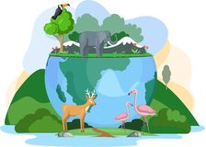
Unit
7
ENVIRONMENTAL PROTECTION
LESSON 3: A CLOSER LOOK 2 p.75
1

Slide 3
LESSON 1: GETTING STARTED
WARM-UP
Asking questions
Vocabulary
PRESENTATION
Task 1: Read the sentences and write I.C if the underlined clause is an independent clause or D.C if it is a dependent clause.
Task 2: Choose A, B, or C to complete each sentence.
Task 3. Match the clauses in the two columns to form complex sentences.
Task 4: Combine each pair of sentences, using the conjunction in brackets.
PRACTICE
PRODUCTION
Task 5: Matching game.
CONSOLIDATION
Wrap-up
Homework

Slide 4
WARM-UP
I always take a bath before I go to bed.
Will you wait here until I am ready?
I was not at home when he came to see me.
Do not disturb me when I am busy with my work.
As soon as she finished that project, she started working on the next.
After I have finished my work, I will accompany you to the park.
ADVERB CLAUSES OF TIME

Slide 5
PRESENTATION
Complex sentences with
Adverb clauses of time
– A complex sentence contains one independent clause and at least one dependent clause.
Example:
The roads were slippery when it rained.
independent clause dependent clause
– An adverb clause is a dependent clause.
– An adverb clause of time shows when something happens. It is usually introduced by time connectors: before, after, when, while, till / until, as soon as, …

Slide 6
PRESENTATION
1
Read the sentences and write I.C if the underlined clause is an independent clause or D.C if it is a dependent clause
Example:
You must be careful when you cross the street.
1. I’ll wait for you here until you get back.
2. Make sure you lock the door when you go out.
3. You must get a permit before you build a campfire at a national park.
4. Don’t use too much water while you are having a shower.
5. As soon as my friends come, we will pick up rubbish on the beach.
DC
IC
DC
IC
DC
DC

Slide 7
PRACTICE
2
Choose A, B, or C to complete each sentence.
1. I was not at home ______ he came to see me yesterday.
A. when B. until C. as soon as
2. We called the forest guard unit ______ we saw the bush fire.
A. as soon as B. while C. until
3. I went straight to the gym ______ I left home.
A. while B. before C. after
4. You can stay with us ______ you find a suitable place to stay.
A. as soon as B. before C. until
5. We cleaned up everything at the campsite ______ we left.
A. until B. before C. while

Slide 8
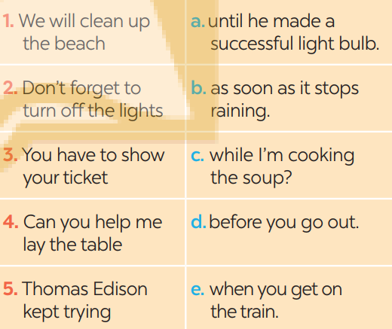
PRACTICE
3
Match the clauses in the two columns to form complex sentences
1. b
2. d
3. e
4. c
5. a

Slide 9
PRACTICE
4
Combine each pair of sentences, using the conjunction in brackets
1. I arrive at the station. I will call you right after. (as soon as)
_____________________________
2. Many Vietnamese women wear conical hats. They work in the field. (when)
_____________________________
3. My father taught me how to use the computer. Then he bought one for me. (before)
_____________________________
4. Nick is reading a novel. Jack is reading a cartoon. (while)
_____________________________
5. The tornado hit. There were only a few houses left standing. (After)
_____________________________
I will call you as soon as I arrive at the station.
We have to follow the steps when we make a conical hat
My father taught me how to use the computer before he bought one for me.
Nick is reading a novel while Jack is reading a cartoon.
After the tornado hit, there were only a few houses left standing.

Slide 10

PRODUCTION
Work in two groups, A and B.
5
Matching game:
Group A write main clauses.
Group B write adverb clauses of time.

Slide 11

CONSOLIDATION
1
Wrap-up
What have we learnt in this lesson?
use the Complex sentences with adverb clauses of time;

Slide 12

CONSOLIDATION
2
Home Assignments
-Review grammar
- Do EX in part B in Workbook

Slide 13

Website: hoclieu.vn
Fanpage: facebook.com/sachmem.vn/

