Slide 1
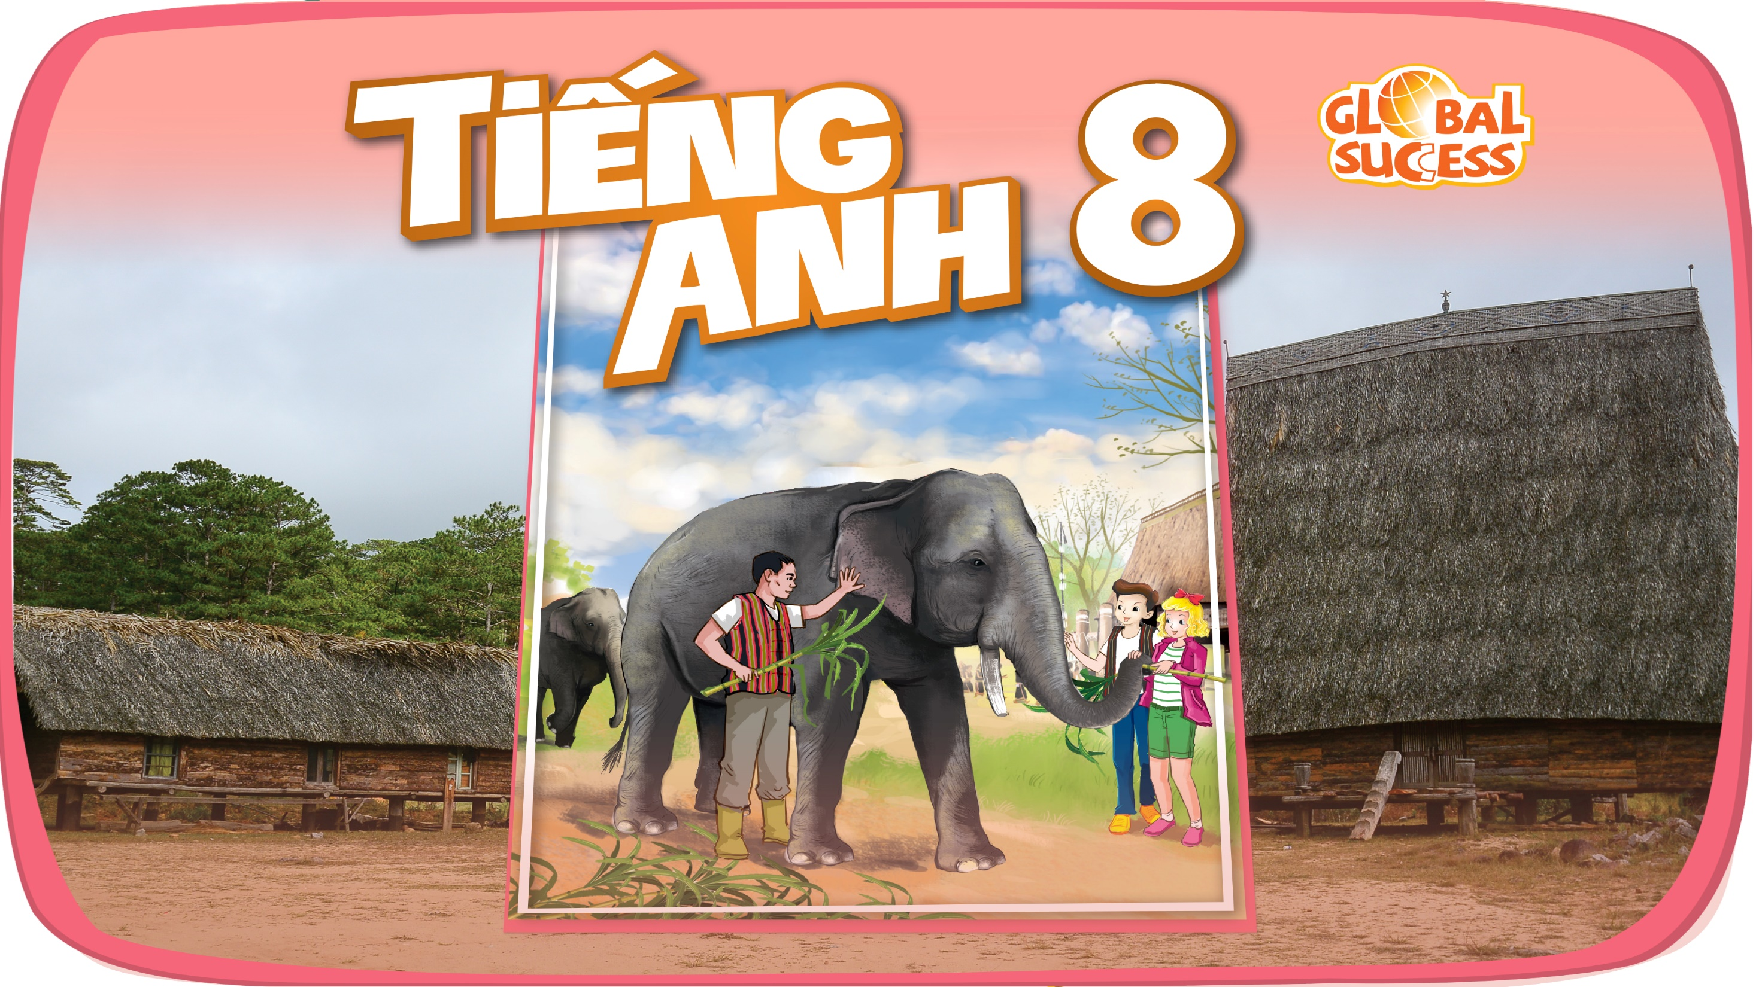

Slide 2


Unit
7
ENVIRONMENTAL PROTECTION
LESSON 1: GETTING STARTED
At the Go Green Club
1

Slide 3
LESSON 1: GETTING STARTED
WARM-UP
Asking questions
Vocabulary
PRESENTATION
Task 1: Listen ad read.
Task 2: Read the conversation again and match the two halves in the two columns.
Task 3: Complete each sentence with one word or phrase from the box.
Task 4: Write a phrase from the box under each picture.
PRACTICE
PRODUCTION
Task 5: Environment Quiz.
CONSOLIDATION
Wrap-up
Homework

Slide 4
WARM-UP
Answer the question:
WHAT ARE ENVIROMENTAL ISSUES IN OUR CITY?
ENVIROMENTAL PROTECTION

Slide 5
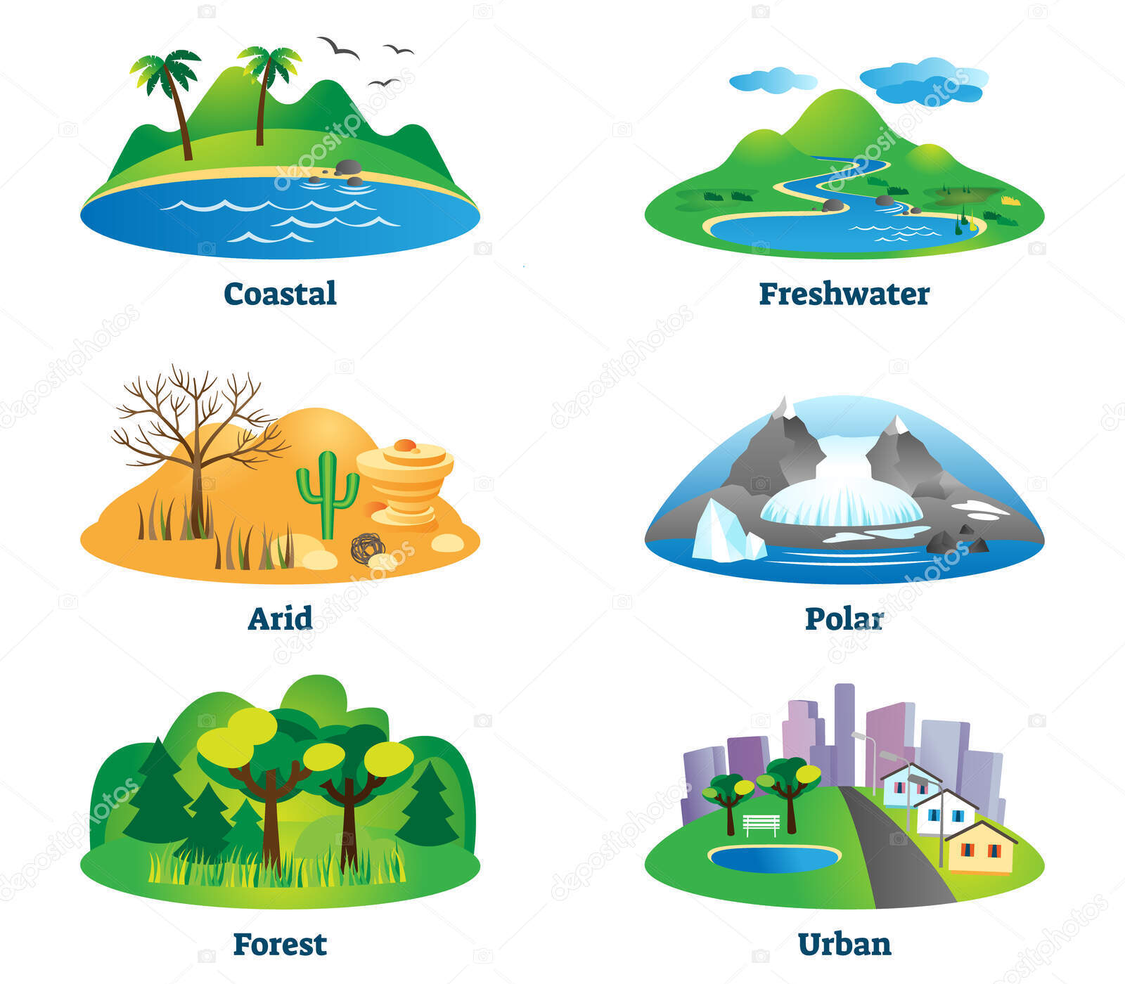
PRESENTATION
habitat (n)
/ˈhabəˌtat/
môi trường sống

Slide 6

PRESENTATION
endangered species (n)
/inˌdānjərd ˈspēSHēz/
động vật sách đỏ

Slide 7
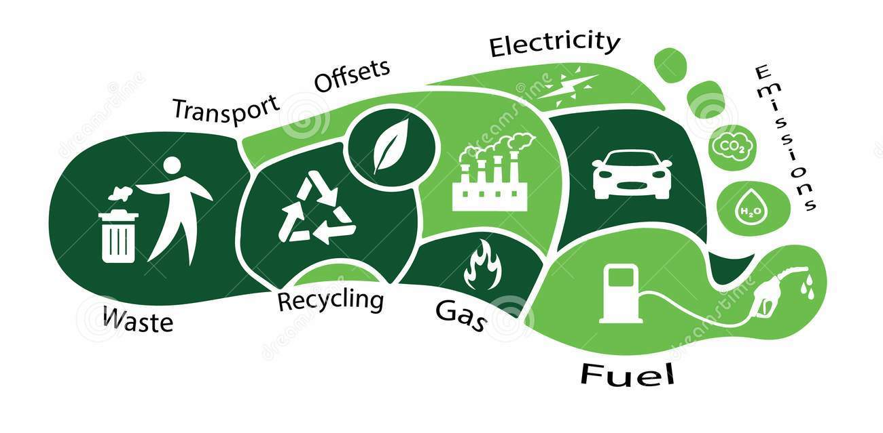
PRESENTATION
carbon footprint (n)
/ˌkärbən ˈfo͝otprint/
dấu chân cac-bon

Slide 8
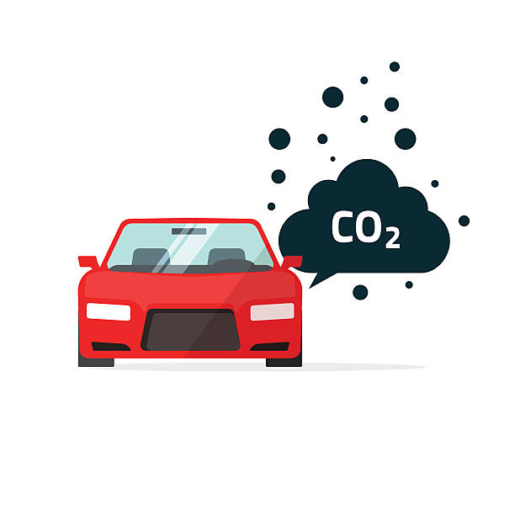
PRESENTATION
release (v)
/rəˈlēs/
thải ra

Slide 9
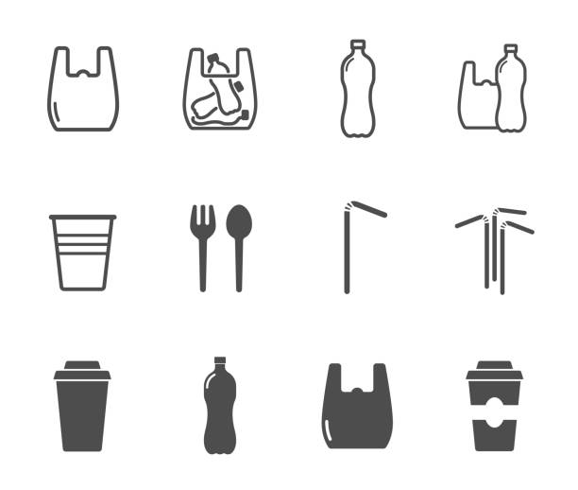
PRESENTATION
single-use (adj)
/ ˈsiNGɡ(ə)l yo͞os/
dùng một lần

Slide 10
PRESENTATION
New words | Pronunciation | Meaning
1. habitat (n) | /ˈhabəˌtat/ | môi trường sống
2. Endangered species (n) | /inˌdānjərd ˈspēSHēz/ | động vật sách đỏ
3. carbon footprint (n) | /ˌkärbən ˈfo͝otprint/ | dấu chân cacbon
4. release (v) | /rəˈlēs/ | thải ra
5. single-use (adj) | / ˈsiNGɡ(ə)l yo͞os/ | dùng một lần

Slide 11


1
PRACTICE
Listen and read.
Club leader: Hello. Welcome back. Today we’re discussing environmental problems and environmental protection. What are our serious environmental problems now? Nam: Pollution and habitat loss, I think. Ann: I agree. The air and water quality are getting worse and worse. Club leader: Any others? Ann: Yes, I can think of some like global warming, endangered species loss, … Nam: So what should we do to help protect our environment? Club leader: We can reduce our carbon footprint even in our homes. Ann: What do you mean by ‘carbon footprint’? Club leader: It’s the amount of carbon dioxide we release into the environment. Ann: I see. So we can do things like turning off devices when we’re not using them. Club leader: Right … And there is much more we can do, like practising the 3Rs. Nam: We can plant more trees in our neighbourhood too. Ann: And try to avoid using single-use products, like plastic bags, and stop littering. Club leader: Yeah. And we can volunteer at some local environment programmes to save endangered species.

Slide 12
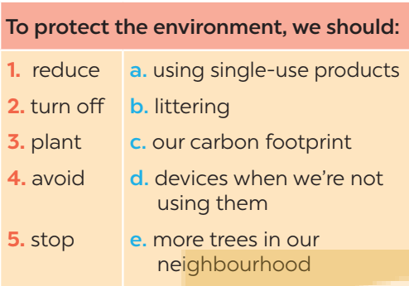
PRACTICE
2
Read the conversation again and match the two halves in the two columns
1. C
2. D
3. E
4. A
5. B

Slide 13
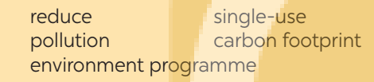
PRACTICE
3
Complete each sentence with one word or phrase from the box.
1. _______________ is a serious problem everywhere.
2. We should avoid dumping waste into lakes and rivers to _________________ water pollution.
3. We shouldn’t throw away ________________ products but recycle them.
4. _____________________ is the amount of carbon dioxide
we release into the environment.
5. We hope a lot more people join our ______________________.
POLLUTION
REDUCE
SINGLE-USE
CARBON FOOTPRINT
ENVIRONMENT PROGRAMME

Slide 14
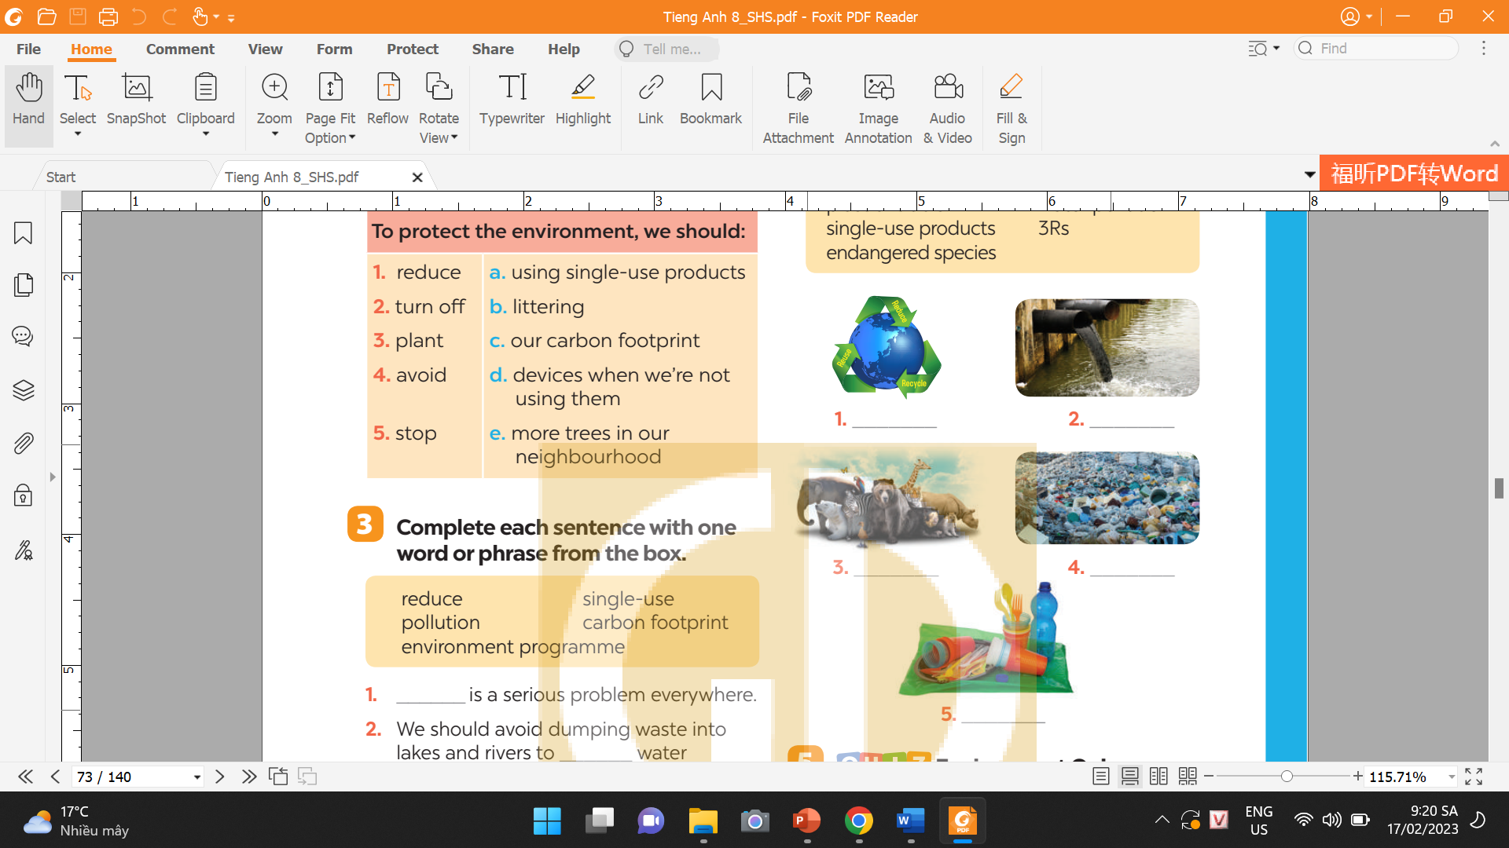
PRACTICE
4
Write a phrase from the box under each picture.
3Rs
water pollution
endangered species
plastic rubbish
single-use products

Slide 15

PRODUCTION
5
Environment Quiz
1. Which of the following is the greenest form of transport?
A. Motorbike. B. Bus. C. Bicycle.
2. Which of the following is a renewable source?
A. Coal. B. Oil. C. Wind.
3. What causes the most pollution?
A. Factories. B. Animals. C. Hospitals.
4. The surroundings in which we live are our ______.
A. habitat B. place C. environment
5. Which of these will reduce your carbon footprint?
Cutting down a lot of trees.
B. Recycling paper products.
C. Leaving the TV on all night.
1. C
2. C
3. A
4. C
5. B

Slide 16

CONSOLIDATION
1
Wrap-up
What have we learnt in this lesson?
identify the topic of the unit
use lexical items related to environment protections
identify the language features that are covered in the unit

Slide 17

CONSOLIDATION
2
Homework
Workbook

Slide 18

Website: hoclieu.vn
Fanpage: facebook.com/sachmem.vn/

