Slide 1

Good morning class!!!
ZALO: 0349895579

Slide 2

* WARM-UP
1. books/ I/ science/ read /.
___________________________________________
I read science books.
2. games/ children/ love/ outdoor /.
Children love outdoor games.
___________________________________________
3. their/ every day/ they/ clean/ house /.
They clean their house every day.
___________________________________________
4. night/ watched/ I/ T.V/ last /.
I watched T.V last night.
___________________________________________
5. learn/ words/ every day/ You/ should/ the/ new
You should learn the new words every day.
___________________________________________

Slide 3




Unit
2
HEALTHY LIVING
LESSON 3: A CLOSER LOOK 2
Grammar: Simple sentences
Unit
HOBBIES

Slide 4

OBJECTIVES
By the end of the lesson, students will be able to:
know how to recognize and write simple sentences

Slide 5
* Grammar: Simple sentences : (Câu đơn)
A subject and a verb ( một chủ ngữ và một động từ)
E.g: It rained.
S V
There are 3 types
of simple sentences
A subject, a verb and an object . ( một chủ ngữ , một động từ và một tân ngữ)
E.g: I read science books.
S V O
(Có 3 loại câu đơn)
A subject, a verb, and object and an adverb.
( một chủ ngữ, một động từ , một tân ngữ và một trạng từ)
E.g: I watched T.V last night.
S V O A
Simple sentence (câu đơn) là câu chỉ có 1 chủ ngữ và 1 động từ.

Slide 6

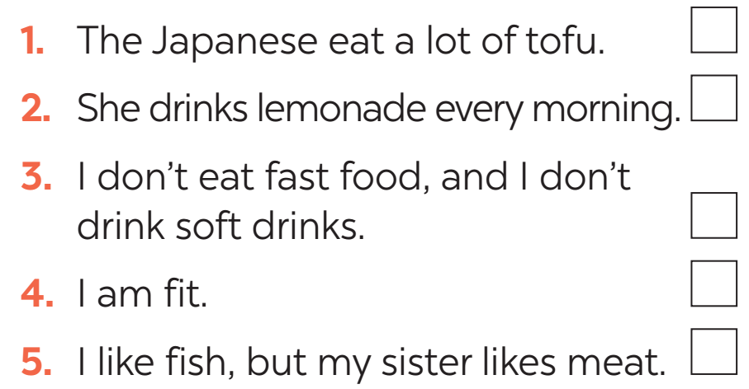

* PRACTICE
1
Tick the simple sentences.

Slide 7


PRACTICE
2
Underline and write S for the subject and V for the verb in each simple sentence.
Aim of the task:
to help students identify the missing part in a simple sentence.

Slide 8
PRACTICE
2
Underline and write S for the subject and V for the verb in each simple sentence.
1. Vegetarians eat a lot of vegetables and fruit.
2. Acne causes black and white pimples on the face.
3. On Saturdays, my brother often spends two hours exercising at the sports center.
4. My mother didn’t buy my favourite cheesecake.
5. We are not cleaning up our community library.
S
V
S
V
S
V
S
V
S
V

Slide 9

* PRACTICE
3
Rearrange the words and phrases to make simple sentences.
soft drinks/ never/ my sister/ drinks/.
affects/ acne/ 80% of young people/.
has/ he/ for breakfast/ bread and eggs/.
don’t eat/ we/ much fast food/.
a lot of vitamins/ fruit and vegetables/ have/.
→ My sister never drinks soft drinks.
→ Acne affects 80% of young people.
→ He has bread and eggs for breakfast.
→ We don’t eat much fast food.
→ Fruit and vegetable have a lot of vitamins.

Slide 10
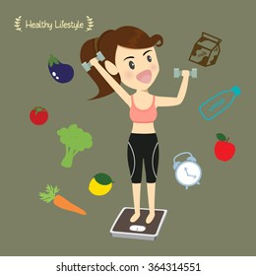
* PRODUCTION
4
Write complete sentences from the prompts. You may have to change the words or add some.
tofu/ be/ healthy
many/ Vietnamese/ drink/ green tea.
she/ not/ use/ suncream.
father/ not/ exercise/ every morning.
most children/ have/ chapped lips and skin/ winter.
→ Tofu is healthy.
→ Many Vietnamese drink green tea.
→ She does not use suncream.
→ My father does not exercise every morning.
→ Most children have chapped lips and skin in winter.

Slide 11
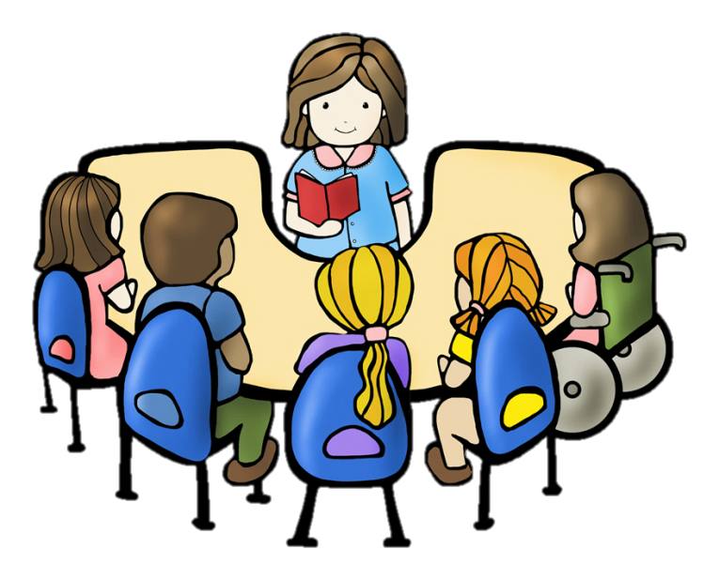
PRACTICE
5
Discuss and write a simple sentence from the two given sentences.
We avoid sweetened food. We avoid soft drinks.
→ We avoid _______________________________ .
2. My dad loves outdoor activities. I love outdoor activities.
→ My ____________ love outdoor activities
3. You should wear a hat. You should wear suncream.
→ You should wear ___________________________ .
4. My mother read the health tips. My mother downloaded the health tips.
→ My mother ________________________________.
sweetened food and soft drinks
dad and I
a hat and suncream
read and downloaded the health tips

Slide 12
CONSOLIDATION
1
WRAP-UP
Grammar: Simple sentences

Slide 13

CONSOLIDATION
2
HOMEWORK
Do exercises in the workbook.

Slide 14

Thank you!
Have a nice day!

