Slide 1
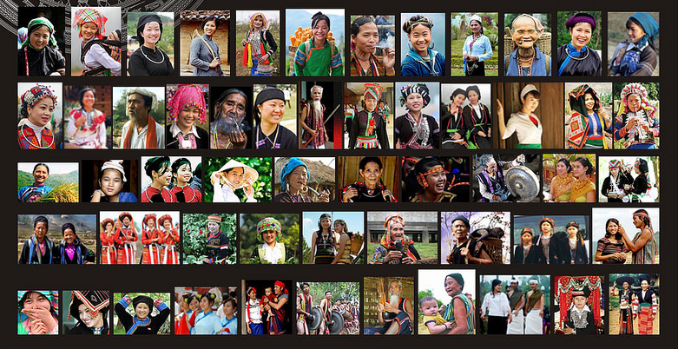
Who are they?
How many ethnic groups are there in Vietnam?
What is the topic today?

Slide 2
UNIT 4. ETHNIC GROUPS OF VIET NAM
LESSON 1. GETTING STARTED

Slide 3
By the end of this lesson, students will be able to:
01
Knowledge
- Gain an overview about the topic Ethnic groups of Viet Nam.
- Gain vocabulary to talk about Ethnic groups of Viet Nam.
Objectives
02
Competences
- Develop communication skills and creativity.
- Be collaborative and supportive in pair work and teamwork.
- Actively join in class activities.
03
Personal qualities
- Love our country and people, respect the diversity of our culture through knowledge and understanding about ethnic groups of Viet Nam.

Slide 4
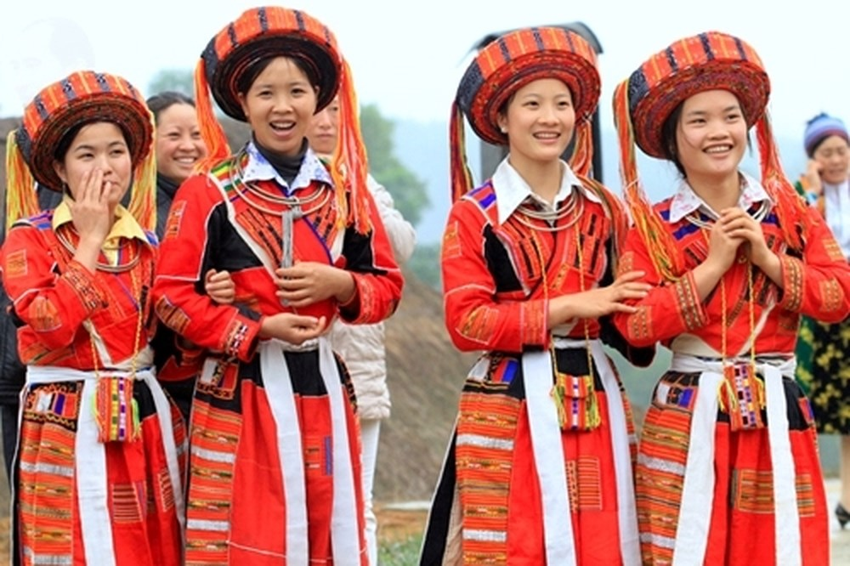

Vocabulary
ethnic (group) (adj)
/ˈeθnɪk / (/gru:p/)
(nhóm) dân tộc

Slide 5
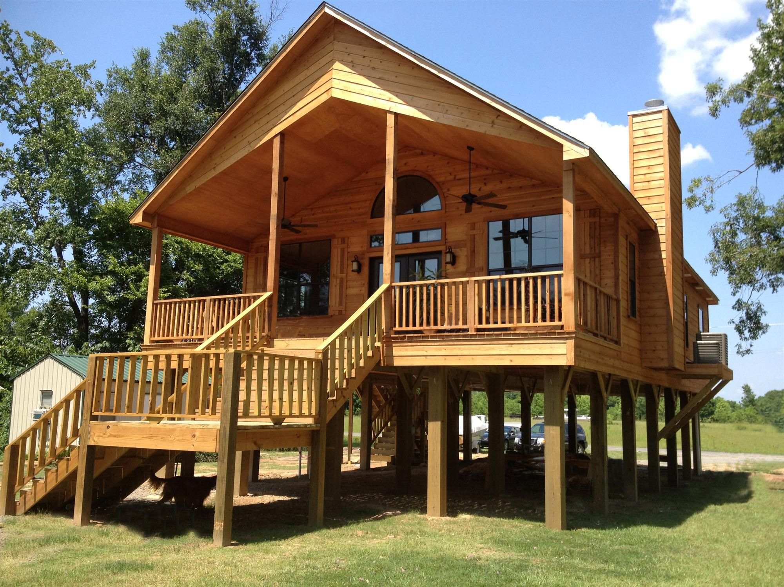
Vocabulary
stilt house (n)
/stilt haus/
nhà sàn

Slide 6

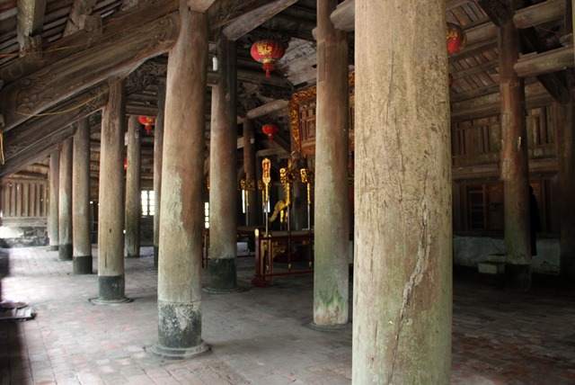
Vocabulary
post (n)
/pəʊst/
cột

Slide 7
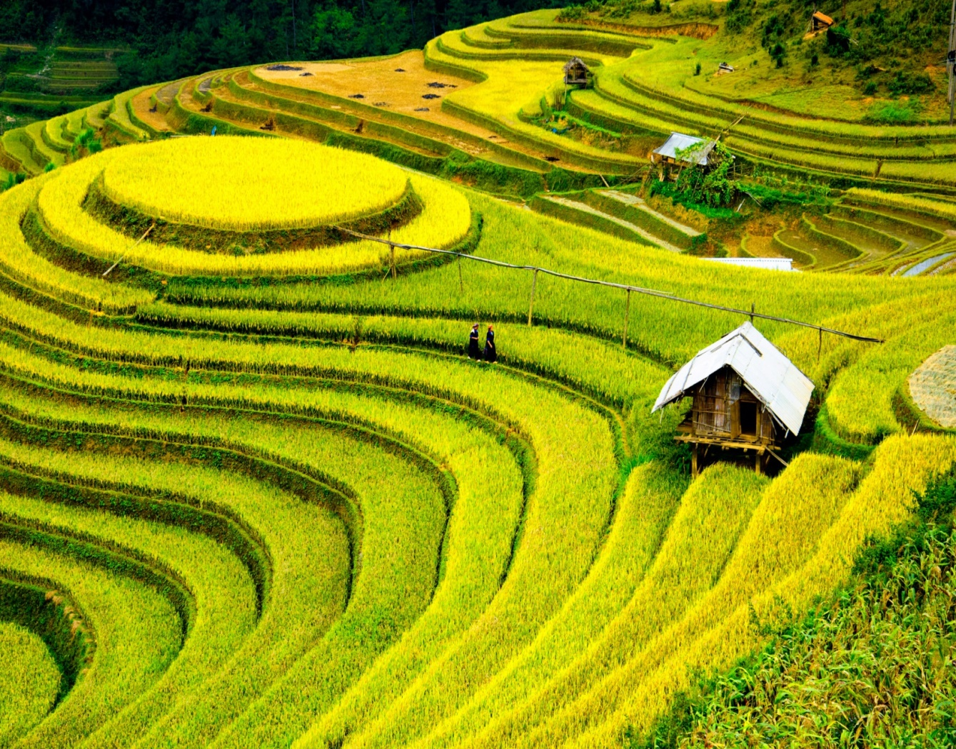
Vocabulary
terraced field (n)
/ˈterəst fiːld /
ruộng bậc thang

Slide 8
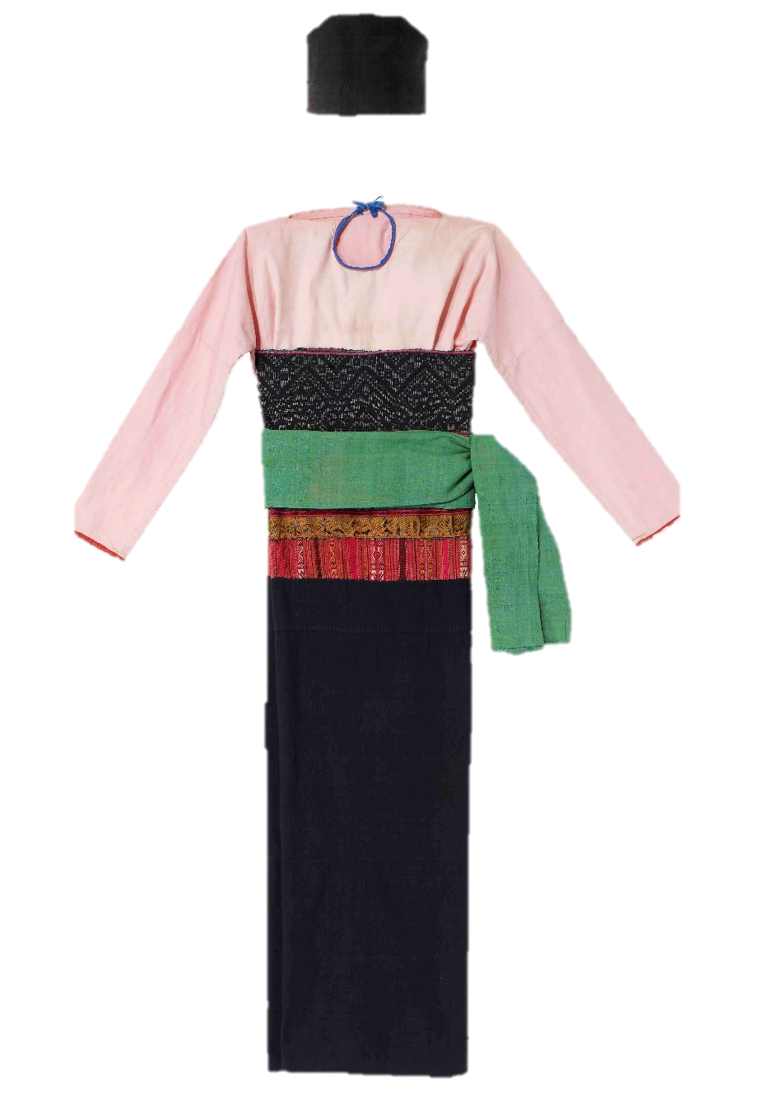
Vocabulary
costume (n)
/'kɔstju:m/
trang phục

Slide 9
Vocabulary
Form | Pronunciation | Meaning | Vietnamese equivalent
1. ethnic (adj) (group) | /ˈeθnɪk / (/gru:p/) | relating or belonging to a group of people who can be seen as different. | (nhóm) dân tộc
2. post (n) | /pəʊst/ | a vertical stick or pole stuck into the ground. | cột
3. overlook (v) | /ˌəʊ.vəˈlʊk/ | provide a view of something. | nhìn ra
4. stilt house (n) | /stilt haus/ | ​a house with a set of long pieces of wood or metal used to support it. | nhà sàn
5. costume (n) | /'kɔstju:m/ | the set of clothes typical of a particular country. | trang phục
6. terraced field (n) | /ˈterəst fiːld / | a row of fields like steps on a slope. | ruộng bậc thang

Slide 10
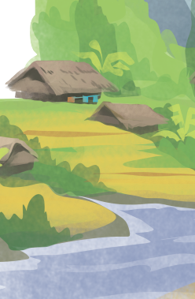
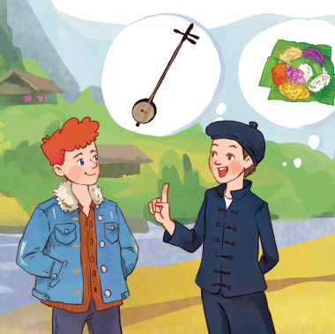
Look at the picture and answer these questions.
Ex 1 (p 40). Listen and read.
What do you think Lai and Tom talking about?
Do you know anything about the Tay ethnic group?
Tom
Lai

Slide 11
I’m from the Tay ethnic group
Ex 1 (p 40). Listen and read.
Tom: Hi, I’m Tom. You look new here.
Tom: Awesome. What is life in your village like?
Lai: I am. I’m Lai from Ha Giang.
Lai: It’s peaceful. There are 16 houses in my village. We live very close to nature.
Tom: Oh, I’ve heard about beautiful Ha Giang. Do you live in the mountains?
Tom: I love it. Can you tell me something about your culture?
Lai: Yes, I do. I’m from the Tay ethnic group. We are the second largest ethnic group in Viet Nam, only after the Kinh.
Lai: Certainly. We have our own culture. You can see it in our folk dances, musical instruments like the dan tinh, and our special five-colour sticky rice.
Tom: Oh … I once saw a bamboo house on high posts in a travel brochure. Do you live in a home like that?
Tom: It sounds interesting. I hope to visit Ha Giang one day.
Lai: Yes, we call it a “stilt house”. Our house overlooks terraced fields.

Slide 12
Ex 2 (p 41). Read the conversation again and circle the best answers.
1. What are Tom and Lai talking about?
A. Minority groups in Viet Nam.
B. Ha Giang.
C. Life of the Tay people.
2. A “stilt house” ______.
A. is a multi-storey home
B. is on high posts
C. always faces a field
3. Lai mentions ______ of the Tay people.
A. folk dances
B. popular festivals
C. costumes

Slide 13
Ex 2 (p 41). Read the conversation again and circle the best answers.
Question 1. What are Tom and Lai talking about?
Title: I’m from the Tay ethnic group.
Tom: Awesome. What is life in your village like?
Tom: I love it. Can you tell me something about your culture?
A. Minority groups in Viet Nam.
B. Ha Giang.
C. Life of the Tay people.

Slide 14
Ex 2 (p 41). Read the conversation again and circle the best answers.
Question 2. A “stilt house” ______.
Tom: Oh … I once saw a bamboo house on high posts in a travel brochure. Do you live in a home like that?
Lai: Yes, we call it a “stilt house”. Our house overlooks terraced fields.
A. is a multi-storey home
B. is on high posts
C. always faces a field

Slide 15
Ex 2 (p 41). Read the conversation again and circle the best answers.
Question 3. Lai mentions ______ of the Tay people.
Lai: Certainly. We have our own culture. You can see it in our folk dances, musical instruments like the dan tinh, and our special five-colour sticky rice.
A. folk dances
B. popular festivals
C. costumes

Slide 16
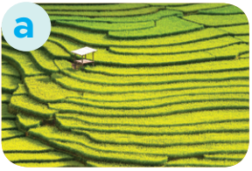
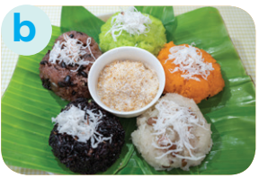

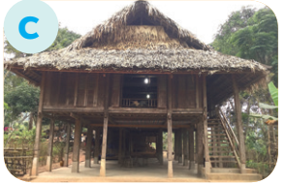

Ex 3 (p 41). Match the pictures with the word and phrases.
1. Stilt house
2. Terraced fields
3. Bamboo
4. Five-colour sticky rice

Slide 17
Ex 4 (p41). Complete the sentences with the words and phrases from the box.
overlooks
musical instrument
ethnic groups
folk dance
traditional
1. I love mua sap, a popular _________ of the Thai people.
2. Their beautiful stilt house _________ a large rice field.
3. A: What is the name of a popular Tay’s __________________? - B: It’s dan tinh.
4. Every ethnic group has their own __________ culture.
5. Of the 54 ______________ in Viet Nam, the Kinh is the largest

Slide 18
Can you list some ethnic groups in Vietnam?
Kinh
Tay
Ede
Dao
Nung
Muong
Khmer
Hmong

Slide 19

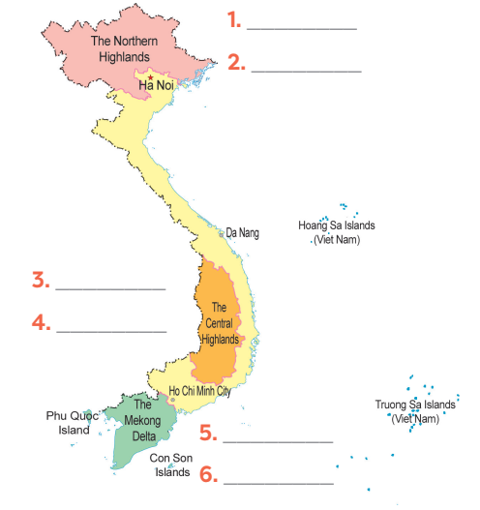

Ex 5 (p 41). Let’s guess. Where are they?
Hmong
Bahnar
Ede
Nung
Khmer
Cham

Slide 20

Which ethnic group is the most populous in Vietnam?
Nung
Hmong
Kinh
Muong

Slide 21
Arrange ethnic groups according to increasing population
Tay
Thai
Kinh

Slide 22
What province does Lai live in?
What ethnicity is Lai?
Ha Giang
Tay

Slide 23
Thank you!

