Slide 1
Unit 4:
Remembering the past
9th Grade
Lesson 3. A closer look 2

Slide 2
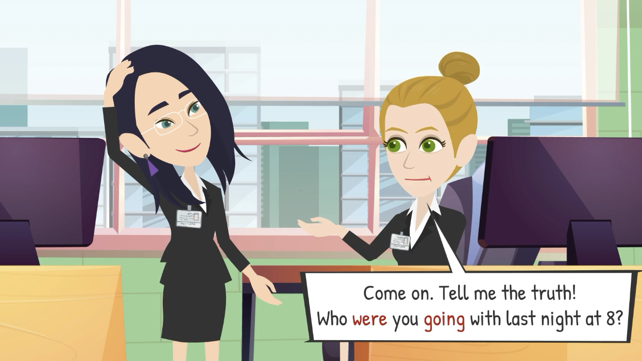

What will we learn of this lesson?
Recognise and use_____________ and _______________
past continuous
wish + past simple.

Slide 3
Past continuous
Form
(+) S + was/ were + V-ing + O
(-) S + was/ were + not + V-ing + O
(?) Wh + was/ were + V-ing + O?
Expressions
- all morning / week / year
- for hours / days / weeks / months / years
- When - While
- At that time - At that moment
- At + time + yesterday

Slide 4
Past continuous
Use
1. Describe an action happening at a particular time in the past.
Eg: At 7 p.m. last night, I was watching a movie.
2. Indicate a past action that was happening when another action interrupted it.
Eg: I was cooking dinner when the phone rang
3. Emphasise how long an action took and how much time somebody spent doing it
Eg: She was reading the book all morning.

Slide 5
Ex 1 (p 43). Put the verbs in brackets in the past continuous.
1. My dad first met my mum when he (visit) __________________ Hoi An Ancient Town.
was visiting
2. Tom had a nightmare while he (sleep) ______________ in the camp by the old castle.
was sleeping
3. David hurt his foot while he (go) ___________down the steps of the pagoda.
was going

Slide 6
Ex 1 (p 43). Put the verbs in brackets in the past continuous.
4. My brother was just sitting while I (look) _________________ around the weaving workshop.
was looking
5. ______ you (watch) __________ TV at 9 p.m. last night? There was a very good programme on Duong Lam Ancient Village preservation.
Were
watching

Slide 7
Ex 2 (p 43). Complete the sentences, using the past continuous forms of the given verbs.
live
preserve
make
build
work
1. People ______ the monument for years because it had great value.
2. When I finished school, my family ______ in the countryside.
3. People ______ the Taj Mahal – a World Heritage Site while Shah Jahan was emperor.
4. “______ you still ______ on the coffee farm when the war broke out, Grandpa?”
5. I ______ a presentation when the microphone stopped working.

Slide 8
Ex 2 (p 43). Complete the sentences, using the past continuous forms of the given verbs.
live
preserve
make
build
work
1. People _____________________ the monument
for years because it had great value.
2. When I finished school, my family _____________
in the countryside.
3. People _____________________ the Taj Mahal – a World Heritage Site while Shah Jahan was emperor.
were preserving
was living
were building

Slide 9
Ex 2 (p 43). Complete the sentences, using the past continuous forms of the given verbs.
live
preserve
make
build
work
4. “______ you still _____________ on the coffee farm when the war broke out, Grandpa?”
5. I __________________ a presentation when the microphone stopped working.
Were
working
was making

Slide 10
WISH + PAST SIMPLE

Slide 11

When do we use “wish + past simple”?

Slide 12
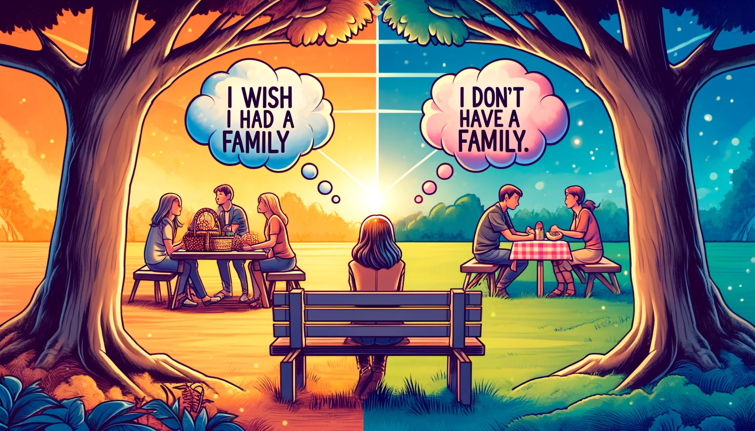
We use wish + past form verb when:
- We want something now or in the future to be different.
- We talk about situations that are contrary to the present reality.

Slide 13
Structure
Reality:
He don’t have a family.
Present simple
Wish:
He wishes he had a family.
Past simple
S + wish (es) + S + past simple

Slide 14
Ex 3 (p 43). Put the verbs in brackets in the correct forms.
got
1. The children wish they (get) _______ more presents every Christmas.
2. I wish I (have) _______ enough money to visit London and Windsor Castle.
3. Do you wish we (have) _______ a swimming pool in our school?
4. We wish we (can spend) _____________ our summer holiday on the seaside.
5. I wish I (can go) _____________ back to
my grandparents' time.
had
had
could spend
could go

Slide 15
Ex 4 (p 43). Read the passage and write down five things that Jenny might wish for. Look at the example.
Eg:
Jenny wishes (that) her sister Jane was tidier.

Slide 16
Ex 4 (p 43). Read the passage and write down five things that Jenny might wish for. Look at the example.
She and I share the same room.
Jenny wishes (that) she didn’t have to share the room with her sister.
I have to clean it every day.
Jenny wishes (that) she didn’t have to clean the room every day.
She wishes (that) her sister Jane didn’t lie in bed reading or playing computer games.
She lies in bed reading or playing computer games.

Slide 17
Ex 4 (p 43). Read the passage and write down five things that Jenny might wish for. Look at the example.
She often puts her dirty clothes on my bed
She wishes (that) her sister Jane didn’t put dirty clothes on her bed.
I'd like to have my own room, but it's impossible now.
She wishes (that) she had her own room.

Slide 18

Ex 5 (p 43). Work in pairs. Tell your partner three wishes.
You can refer to the following:
- Your everyday life
- Your study at school
- Your family (family members, relationship, ...)
- Your friends
I wish I got a high score in the final exam.
Eg:

Slide 19


RECAP: True or false?
Reality: My boyfriend doesn’t call me back. Wish: I wish my boyfriend didn’t call me back.
 | True
 | False

Slide 20

RECAP: True or false?
Reality: We want play game on laptop now. Wish: I wish we played a game on the laptop now.
 | True
 | False

Slide 21



RECAP: True or false?
1. I read a book when she was calling me.
Correct: I was reading book when she called me
2. While I was playing a game on the laptop, the power went out.

Slide 22
Thank you!

