Slide 1


Slide 2
WARM-UP
Fill in each blank with the correct word: a/ an/ some/ any.
1. There isn’t _______________plum jam.
2. She’d like _______________apple.
3. There are _______________bananas.
4. Is there _______________pork?
5. There aren’t _______________beef noodles.
6. There are _______________sandwiches for lunch.
7. Is there _______________water in fridge?
8. I have _______________bread for you.
9. He eats _______________banana after his dinner.
10. Would you like _______________orange juice, please?
1. There isn’t _____any____plum jam.
2. She’d like ________an_______apple.
3. There are _______some___bananas.
4. Is there ______any_________pork?
5. There aren’t _____any____beef noodles.
6. There are ____some____sandwiches for lunch.
7. Is there _____any___water in fridge?
8. I have _______some__bread for you.
9. He eats __a___banana after his dinner.
10. Would you like _some___orange juice, please?

Slide 3



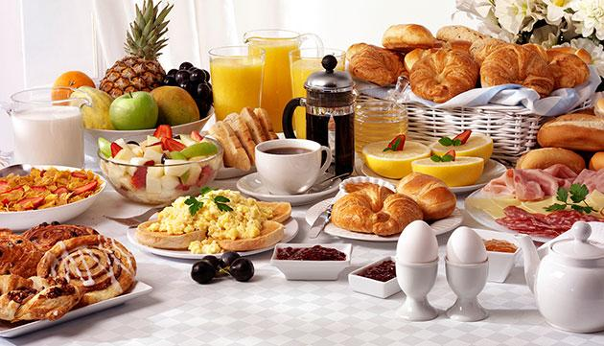
Unit
5
FOOD AND DRINK
LESSON 4: COMMUNICATION

Slide 4

OBJECTIVES
By the end of this lesson, Ss will be able to:
1. Knowledge
Use lexical items related to the favourite food and drink in everyday life
Understand and use ways to ask and answer about prices in English
2. Core competence
Develop communication skills
Be collaborative and supportive in pairwork and teamwork
Actively join in class activities
3. Personal qualities
Promote pride in the values ​​of Vietnamese culture
Develop love for family

Slide 5
LESSON 4: COMMUNICATION
WARM-UP
Restaurant
VOCABULARY
Vocabulary
Task 1: Listen and read the conversation.
Task 2: Work in pairs. Take turns to ask and answer about the prices of the food and drink on the menu.
EVERYDAY ENGLISH
Task 3: Listen to the conversation and answer the questions.
Task 4: Work in groups. Interview two friends about their favourite food and drink. Write their answers in the table.
YOUR FAVOURITE FOOD & DRINK
CONSOLIDATION
Wrap-up
Homework

Slide 6
LESSON 4: COMMUNICATION
WARM-UP
Restaurant
VOCABULARY
Vocabulary
Aims of the stage:
To help students use key language more appropriately.

Slide 7
VOCABULARY
New words | Pronunciation | Meaning
1. eel (n) | /iːl/ | con lươn
2. foreign (adj) | /ˈfɒr.ən/ | ngoại quốc
3. favourite (adj) | /ˈfeɪ.vər.ɪt/ | ưa thích
4. interview (n) | /ˈɪn.tə.vjuː/ | cuộc phỏng vấn
5. try (v) | /traɪ/ | thử làm

Slide 8

EVERYDAY ENGLISH
1
Listen and repeat the conversation. Pay attention to the questions and answers.
Mark: How much is a bottle of mineral water?
Mi: It's 5,000 dong.
Mark: And how much are two kilos of apples?
Mi: They're 50,000 dong.

Slide 9
EVERYDAY ENGLISH
1
Work in pairs. Take turns to ask and answer about the prices of the food and drink on the menu.
2
LY'S RESTAURANT Breakfast Menu
Food
bowl of beef noodle soup | 30,000 dong
bowl of eel soup | 35,000 dong
toast | 20,000 dong
Drink
glass of milk | 9,000 dong
bottle of mineral water | 8,000 dong
cup of green tea | 5,000 dong
Sample:
A: How much is a bowl of beef noodle soup?
B: It’s 30,000 dong.

Slide 10
YOUR FAVOURITE FOOD AND DRINK
3
Listen to the conversation and answer the following questions.
2
1. What's Nam's favourite food?
2. What's his favourite drink?
3. What foreign food does he like?
4. What food does he want to try?
5. What food can he cook?
Spring rolls.
Lemonade.
Apple pie and pancakes.
Hu tieu (in Ho Chi Minh City).
Omelettes, rice, and spring rolls.

Slide 11
YOUR FAVOURITE FOOD AND DRINK
2
Work in groups. Interview two of you friends about their favourite food and drink. Write their answers in the table below.
4
Questions | Student 1 | Student 2
1. What's your favourite food? | beef noodles soup (phở bò) | fried rice (cơm chiên/ rang
2. What's your favourite drink? | fruit juice (nước ép trái cây) | cola
3. What food or drink do you want to try? | spaghetti (mì ống) | beefsteak (bò tái)
4. What foreign food or drink do you like? | Korea Kimbap (kimbap Hàn Quốc) | hamburgers (bánh mì hăm-bơ-gơ)
5. What can you cook? | omelette and noodles (trứng ốp và mì) | fried rice (cơm chiên)

Slide 12
Fill in each blank with the correct word: How much or How many.
1. ____________________ beer is there in the fridge?
2. ____________________ eggs do you want?
3. ____________________ languages do you speak?
4. ____________________ people are there in the class?
5. ____________________ days are there in a week?
6. ____________________ milk do you drink every day?
7. ____________________ kilos of rice do you want?
8. ____________________ soda does she want?
9. ____________________ soup is there in the fridge?
10. ____________________ tomatoes do you want?
How much
How many
How many
How many
How many
How much
How many
How much
How much
How many

Slide 13
CONSOLIDATION
2
HOMEWORK
Make a conversation, record a video and upload on a given drive link.
Prepare for the next lesson: Skills 1

Slide 14

Website: sachmem.vn
Fanpage: www.facebook.com/sachmem.vn

