Slide 1

Warm-up | Stop the bus
- Work in groups
- Think of a word/phrase about topic “Customs and Festivals”, starting with a given letter.
- First student to get a word for each, say “STOP THE BUS!”
For example:
F | food offerings, feast, folk dance, firework, family gathering…

Slide 2
Warm-up | Stop the bus
F | food offerings, feast, folk dance, festival goers, …
E
event, entertainment, exhibition, Easter, …
S
song, symbol, seasonal, supertitious, special,…
T
Thanksgiving, together, traditional, theme, …
I
important, incense, inspiring, …
V
village, valuable, various, vacation,…
A
activity, annual, amazing, …
L
lantern, lucky money, local festival,…
Notes:
VILLAGE

Slide 3
Unit 5 Our customs and traditions
Lesson 5: Skills 1
(page 55,56)

Slide 4
After this unit, students will be able to:
01.
READING
read for general and specific information about a local festival
SPEAKING
02.
talk about a normal family event that they take part in

Slide 5
READING
01.

Slide 6
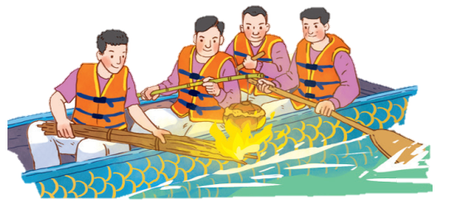
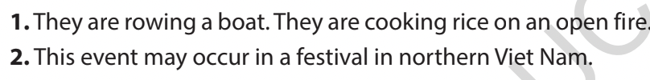
Ex 1. Look at the picture and answer the following questions.
1. What are the men doing?
They are rowing a boat. They are cooking rice on an open fire.
2. When do you think this event occurs?
This event may occur in a festival in northern Viet Nam.

Slide 7
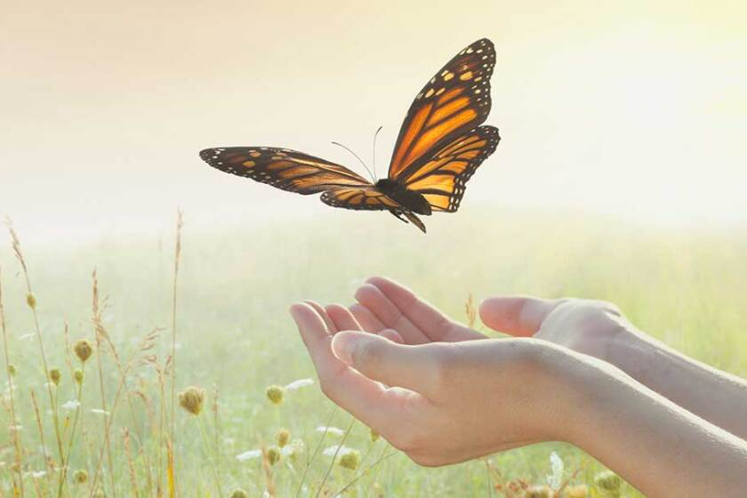

New words
release (v)
/ rɪˈliːs/
thả

Slide 8
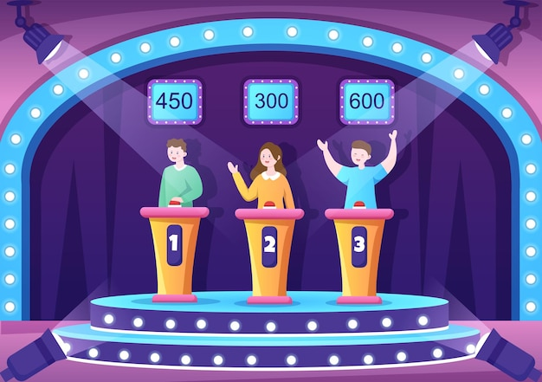
New words
contestant(n)
/kənˈtestənt/
thí sinh,
người thi đấu

Slide 9
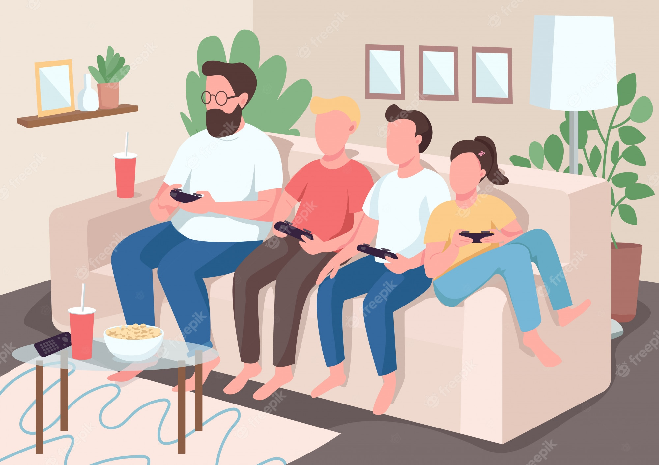
New words
family bonding
/ ˈfæməli ˈbɒndɪŋ /
sự gắn kết
tình cảm gia đình

Slide 10
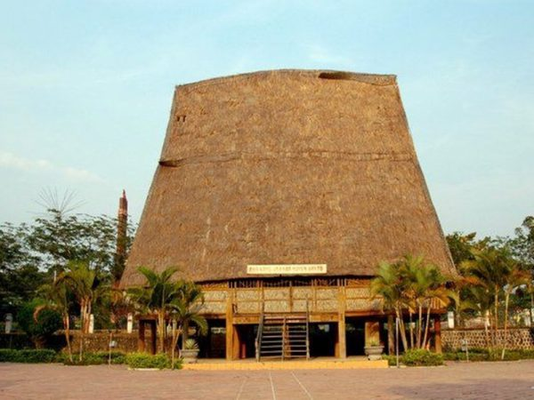
New words
communal house
/kəˈmjuːnl
haʊs/
nhà rông

Slide 11
Ex 2. Read the text. Choose the correct answer A, B, or C.
I live in a small village in northern Viet Nam. Every year, people in my village look forward to the third day of Tet. It is one of our most important festival days.
In the morning, we gather along the riverside to watch some competitions. First, there is a special boat race. Some team members cook rice on the boat while others row the boat as fast as they can. The fastest team with well-cooked rice wins the race. Then, the referee releases a duck into the middle of the river. Contestants jump into the river to catch it. The atmosphere becomes loud with the sound of drums and cheers of festival goers.
At noon, there is a village party at the communal house for the elders. Each family also holds a home party. We cook traditional dishes like sticky rice and steamed chicken. Sometimes, we include food that children love, such as bun cha or even pizzas!
The village festival helps us maintain our traditions, connect with other people, and strengthen our family bonds.
1. What is the text mainly about?
A. A local tradition.
B. A family tradition.
C. A cooking contest.
2. To win the boat race, a team must ______.
A. row the boat more quickly than the other teams
B. row the boat the fastest and properly cook the rice
C. cook rice properly and catch the duck

Slide 12
Ex 2. Read the text. Choose the correct answer A, B, or C.
I live in a small village in northern Viet Nam. Every year, people in my village look forward to the third day of Tet. It is one of our most important festival days.
In the morning, we gather along the riverside to watch some competitions. First, there is a special boat race. Some team members cook rice on the boat while others row the boat as fast as they can. The fastest team with well-cooked rice wins the race. Then, the referee releases a duck into the middle of the river. Contestants jump into the river to catch it. The atmosphere becomes loud with the sound of drums and cheers of festival goers.
At noon, there is a village party at the communal house for the elders. Each family also holds a home party. We cook traditional dishes like sticky rice and steamed chicken. Sometimes, we include food that children love, such as bun cha or even pizzas!
The village festival helps us maintain our traditions, connect with other people, and strengthen our family bonds.
3. The phrase “releases a duck” in the text means ______.
A. gives it freedom
B. catches it
C. takes it home
4. Why is the festival important?
A. Because it is exciting.
B. Because people win valuable prizes.
C. Because it keeps some village traditions alive.

Slide 13
Ex 2. Read the text. Choose the correct answer A, B, or C.
I live in a small village in northern Viet Nam. Every year, people in my village look forward to the third day of Tet. It is one of our most important festival days.
In the morning, we gather along the riverside to watch some competitions. First, there is a special boat race. Some team members cook rice on the boat while others row the boat as fast as they can. The fastest team with well-cooked rice wins the race. Then, the referee releases a duck into the middle of the river. Contestants jump into the river to catch it. The atmosphere becomes loud with the sound of drums and cheers of festival goers.
At noon, there is a village party at the communal house for the elders. Each family also holds a home party. We cook traditional dishes like sticky rice and steamed chicken. Sometimes, we include food that children love, such as bun cha or even pizzas!
The village festival helps us maintain our traditions, connect with other people, and strengthen our family bonds.
1. What is the text mainly about?
A. A local tradition.
B. A family tradition.
C. A cooking contest.

Slide 14
Ex 2. Read the text. Choose the correct answer A, B, or C.
I live in a small village in northern Viet Nam. Every year, people in my village look forward to the third day of Tet. It is one of our most important festival days.
In the morning, we gather along the riverside to watch some competitions. First, there is a special boat race. Some team members cook rice on the boat while others row the boat as fast as they can. The fastest team with well-cooked rice wins the race. Then, the referee releases a duck into the middle of the river. Contestants jump into the river to catch it. The atmosphere becomes loud with the sound of drums and cheers of festival goers.
At noon, there is a village party at the communal house for the elders. Each family also holds a home party. We cook traditional dishes like sticky rice and steamed chicken. Sometimes, we include food that children love, such as bun cha or even pizzas!
The village festival helps us maintain our traditions, connect with other people, and strengthen our family bonds.
1. What is the text mainly about?
A. A local tradition.
B. A family tradition.
C. A cooking contest.
2. To win the boat race, a team must ______.
A. row the boat more quickly than the other teams
B. row the boat the fastest and properly cook the rice
C. cook rice properly and catch the duck

Slide 15
Ex 2. Read the text. Choose the correct answer A, B, or C.
I live in a small village in northern Viet Nam. Every year, people in my village look forward to the third day of Tet. It is one of our most important festival days.
In the morning, we gather along the riverside to watch some competitions. First, there is a special boat race. Some team members cook rice on the boat while others row the boat as fast as they can. The fastest team with well-cooked rice wins the race. Then, the referee releases a duck into the middle of the river. Contestants jump into the river to catch it. The atmosphere becomes loud with the sound of drums and cheers of festival goers.
At noon, there is a village party at the communal house for the elders. Each family also holds a home party. We cook traditional dishes like sticky rice and steamed chicken. Sometimes, we include food that children love, such as bun cha or even pizzas!
The village festival helps us maintain our traditions, connect with other people, and strengthen our family bonds.
3. The phrase “releases a duck” in the text means ______.
A. gives it freedom
B. catches it
C. takes it home
4. Why is the festival important?
A. Because it is exciting.
B. Because people win valuable prizes.
C. Because it keeps some village traditions alive.

Slide 16
Ex 2. Read the text. Choose the correct answer A, B, or C.
I live in a small village in northern Viet Nam. Every year, people in my village look forward to the third day of Tet. It is one of our most important festival days.
In the morning, we gather along the riverside to watch some competitions. First, there is a special boat race. Some team members cook rice on the boat while others row the boat as fast as they can. The fastest team with well-cooked rice wins the race. Then, the referee releases a duck into the middle of the river. Contestants jump into the river to catch it. The atmosphere becomes loud with the sound of drums and cheers of festival goers.
At noon, there is a village party at the communal house for the elders. Each family also holds a home party. We cook traditional dishes like sticky rice and steamed chicken. Sometimes, we include food that children love, such as bun cha or even pizzas!
The village festival helps us maintain our traditions, connect with other people, and strengthen our family bonds.
3. The phrase “releases a duck” in the text means ______.
A. gives it freedom
B. catches it
C. takes it home
4. Why is the festival important?
A. Because it is exciting.
B. Because people win valuable prizes.
C. Because it keeps some village traditions alive.

Slide 17
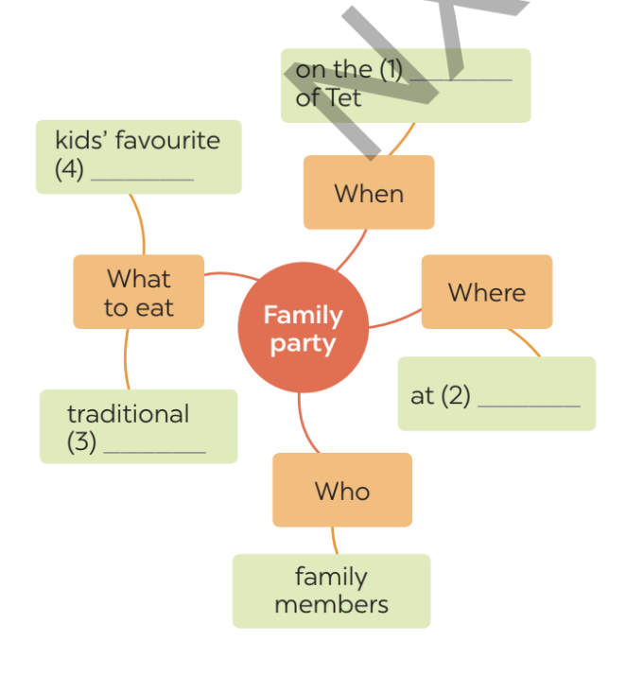
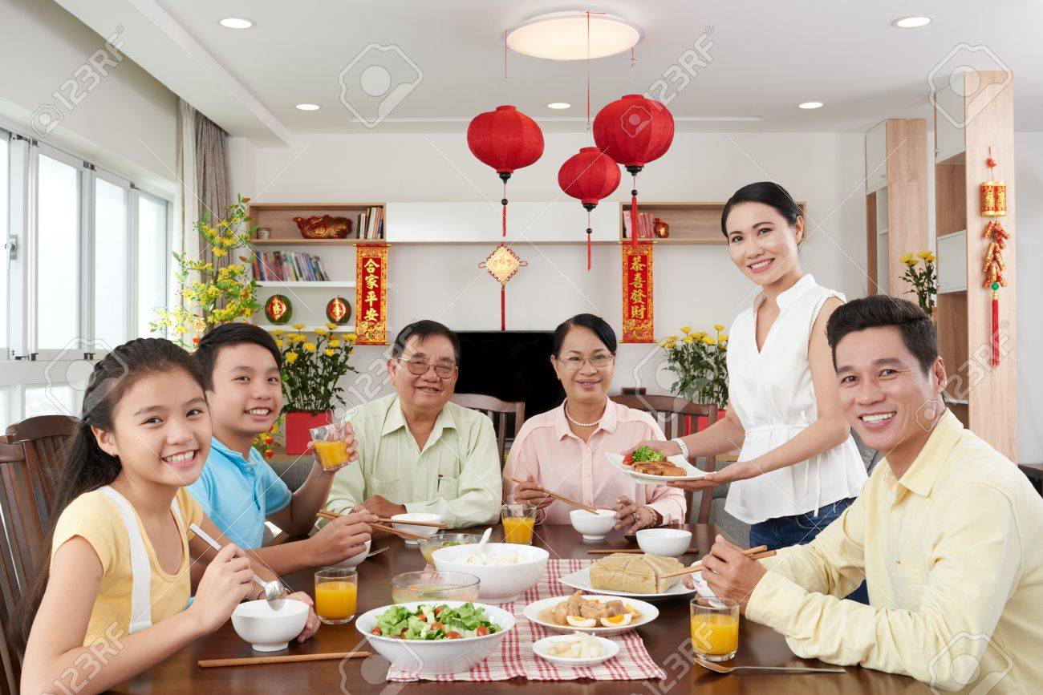
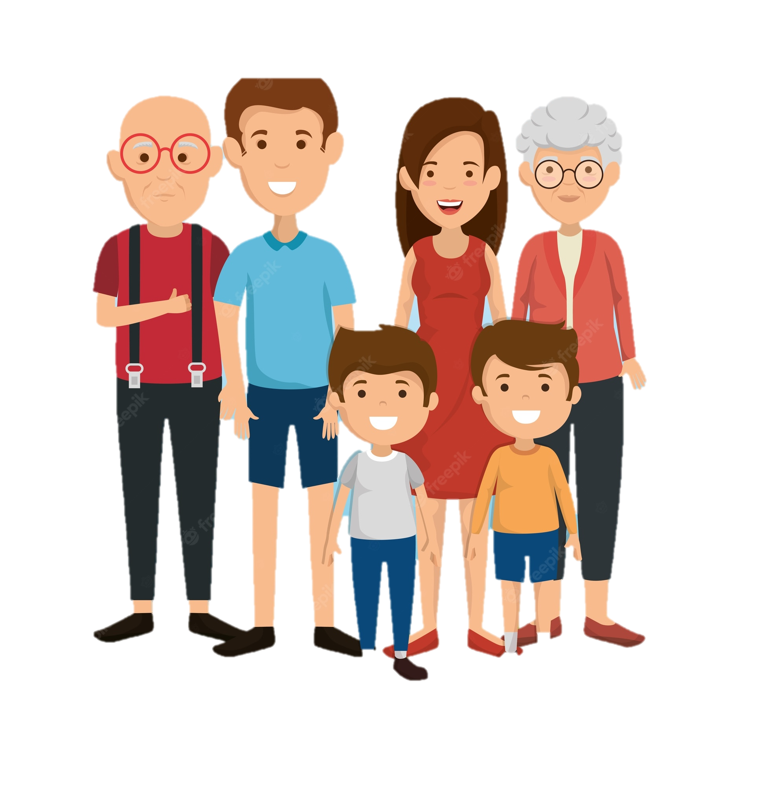
Ex 3. Check your memory
When
Where
On the (1) __________ of Tet
at (2) __________
traditional (3) _______________
A family party
family members
What to eat
Who

Slide 18

Ex 3. Read the text again and complete the mind map.
I live in a small village in northern Viet Nam. Every year, people in my village look forward to the third day of Tet. It is one of our most important festival days.
In the morning, we gather along the riverside to watch some competitions. First, there is a special boat race. Some team members cook rice on the boat while others row the boat as fast as they can. The fastest team with well-cooked rice wins the race. Then, the referee releases a duck into the middle of the river. Contestants jump into the river to catch it. The atmosphere becomes loud with the sound of drums and cheers of festival goers.
At noon, there is a village party at the communal house for the elders. Each family also holds a home party. We cook traditional dishes like sticky rice and steamed chicken. Sometimes, we include food that children love, such as bun cha or even pizzas!
The village festival helps us maintain our traditions, connect with other people, and strengthen our family bonds.

Slide 19
Ex 3. Check your answers.
When
Where
On the (1) __________ of Tet
home
at (2) __________
3rd/third day
traditional (3) _______________
A family party
dishes
family members
What to eat
Who

Slide 20
SPEAKING
02.

Slide 21
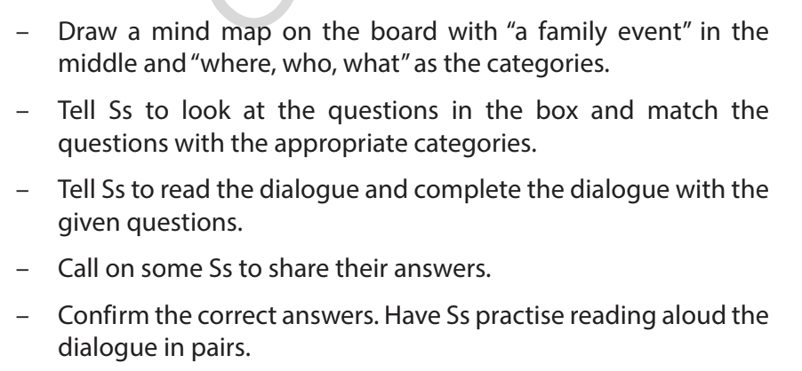
Match the questions with the appropriate categories.
A family event
A. And what do you do at parties?
B. Lan, what family event do you often take part in?
Where
C. Do you like these parties?
Who
D. Where do you hold these parties?
What
E. Who joins you at these parties?

Slide 22
Ex 4. Work in pairs. Put the questions (A - E) in the correct blanks (1 - 5) to make a complete dialogue.
Nick: (1) ______ Lan: Well, I join birthday parties of all my family members. Nick: (2) ______ Lan: In a Vietnamese restaurant. But sometimes we break with tradition by going to a Western one. Nick: (3) ______ Lan: Everyone in my family.
Nick: (4) ______ Lan: Well, the birthday person opens the gifts. and everyone has some good food. Nick: (5) ______ Lan: Yes, I always look forward to them. They are a great time for family bonding.
A. And what do you do at parties?
B. Lan, what family event do you often take part in?
C. Do you like these parties?
D. Where do you hold these parties?
E. Who joins you at these parties?

Slide 23
Ex 4. Work in pairs. Put the questions (A - E) in the correct blanks (1 - 5) to make a complete dialogue.
Nick: (1) ______ Lan: Well, I join birthday parties of all my family members. Nick: (2) ______ Lan: In a Vietnamese restaurant. But sometimes we break with tradition by going to a Western one. Nick: (3) ______ Lan: Everyone in my family.
Nick: (4) ______ Lan: Well, the birthday person opens the gifts. and everyone has some good food. Nick: (5) ______ Lan: Yes, I always look forward to them. They are a great time for family bonding.
A. And what do you do at parties?
B. Lan, what family event do you often take part in?
B. Lan, what family event do you often take part in?
C. Do you like these parties?
D. Where do you hold these parties?
E. Who joins you at these parties?

Slide 24
Ex 4. Work in pairs. Put the questions (A - E) in the correct blanks (1 - 5) to make a complete dialogue.
Nick: (1) ______ Lan: Well, I join birthday parties of all my family members. Nick: (2) ______ Lan: In a Vietnamese restaurant. But sometimes we break with tradition by going to a Western one. Nick: (3) ______ Lan: Everyone in my family.
Nick: (4) ______ Lan: Well, the birthday person opens the gifts. and everyone has some good food. Nick: (5) ______ Lan: Yes, I always look forward to them. They are a great time for family bonding.
A. And what do you do at parties?
B. Lan, what family event do you often take part in?
D. Where do you hold these parties?
C. Do you like these parties?
D. Where do you hold these parties?
E. Who joins you at these parties?

Slide 25
Ex 4. Work in pairs. Put the questions (A - E) in the correct blanks (1 - 5) to make a complete dialogue.
Nick: (1) ______ Lan: Well, I join birthday parties of all my family members. Nick: (2) ______ Lan: In a Vietnamese restaurant. But sometimes we break with tradition by going to a Western one. Nick: (3) ______ Lan: Everyone in my family.
Nick: (4) ______ Lan: Well, the birthday person opens the gifts. and everyone has some good food. Nick: (5) ______ Lan: Yes, I always look forward to them. They are a great time for family bonding.
A. And what do you do at parties?
B. Lan, what family event do you often take part in?
D. Where do you hold these parties?
E. Who joins you at these parties?
C. Do you like these parties?
E. Who joins you at these parties?

Slide 26
Ex 4. Work in pairs. Put the questions (A - E) in the correct blanks (1 - 5) to make a complete dialogue.
Nick: (1) ______ Lan: Well, I join birthday parties of all my family members. Nick: (2) ______ Lan: In a Vietnamese restaurant. But sometimes we break with tradition by going to a Western one. Nick: (3) ______ Lan: Everyone in my family.
Nick: (4) ______ Lan: Well, the birthday person opens the gifts, and everyone has some good food. Nick: (5) ______ Lan: Yes, I always look forward to them. They are a great time for family bonding.
A. And what do you do at parties?
B. Lan, what family event do you often take part in?
D. Where do you hold these parties?
E. Who joins you at these parties?
C. Do you like these parties?
A. And what do you do at parties?

Slide 27
Ex 4. Work in pairs. Put the questions (A - E) in the correct blanks (1 - 5) to make a complete dialogue.
Nick: (1) ______ Lan: Well, I join birthday parties of all my family members. Nick: (2) ______ Lan: In a Vietnamese restaurant. But sometimes we break with tradition by going to a Western one. Nick: (3) ______ Lan: Everyone in my family.
Nick: (4) ______ Lan: Well, the birthday person opens the gifts, and everyone has some good food. Nick: (5) ______ Lan: Yes, I always look forward to them. They are a great time for family bonding.
B. Lan, what family event do you often take part in?
D. Where do you hold these parties?
E. Who joins you at these parties?
C. Do you like these parties?
A. And what do you do at parties?
C. Do you like these parties?

Slide 28
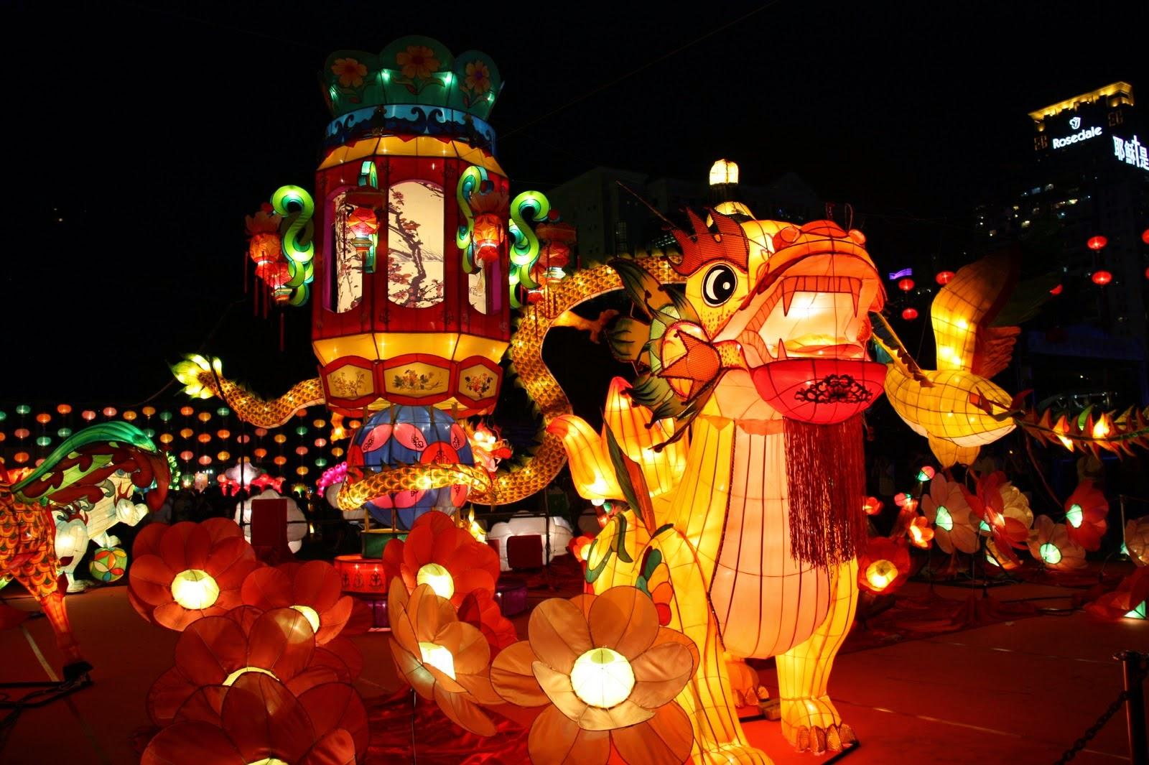
Ex 5. Make notes about a normal family event that you take part in. Use the questions below as cues.
A family event
Full Moon festival
Where does it happen?
In Asia
When does it happen?
On the 15th day of the 8th Lunar Month
Who joins with you?
My family, my friends,…
What do you often do?
Eat moon cake, hang lantern....
Do you like it or not?
Why/ Why not?
Yes, I do.
Because I can celebrate it with my family.

Slide 29

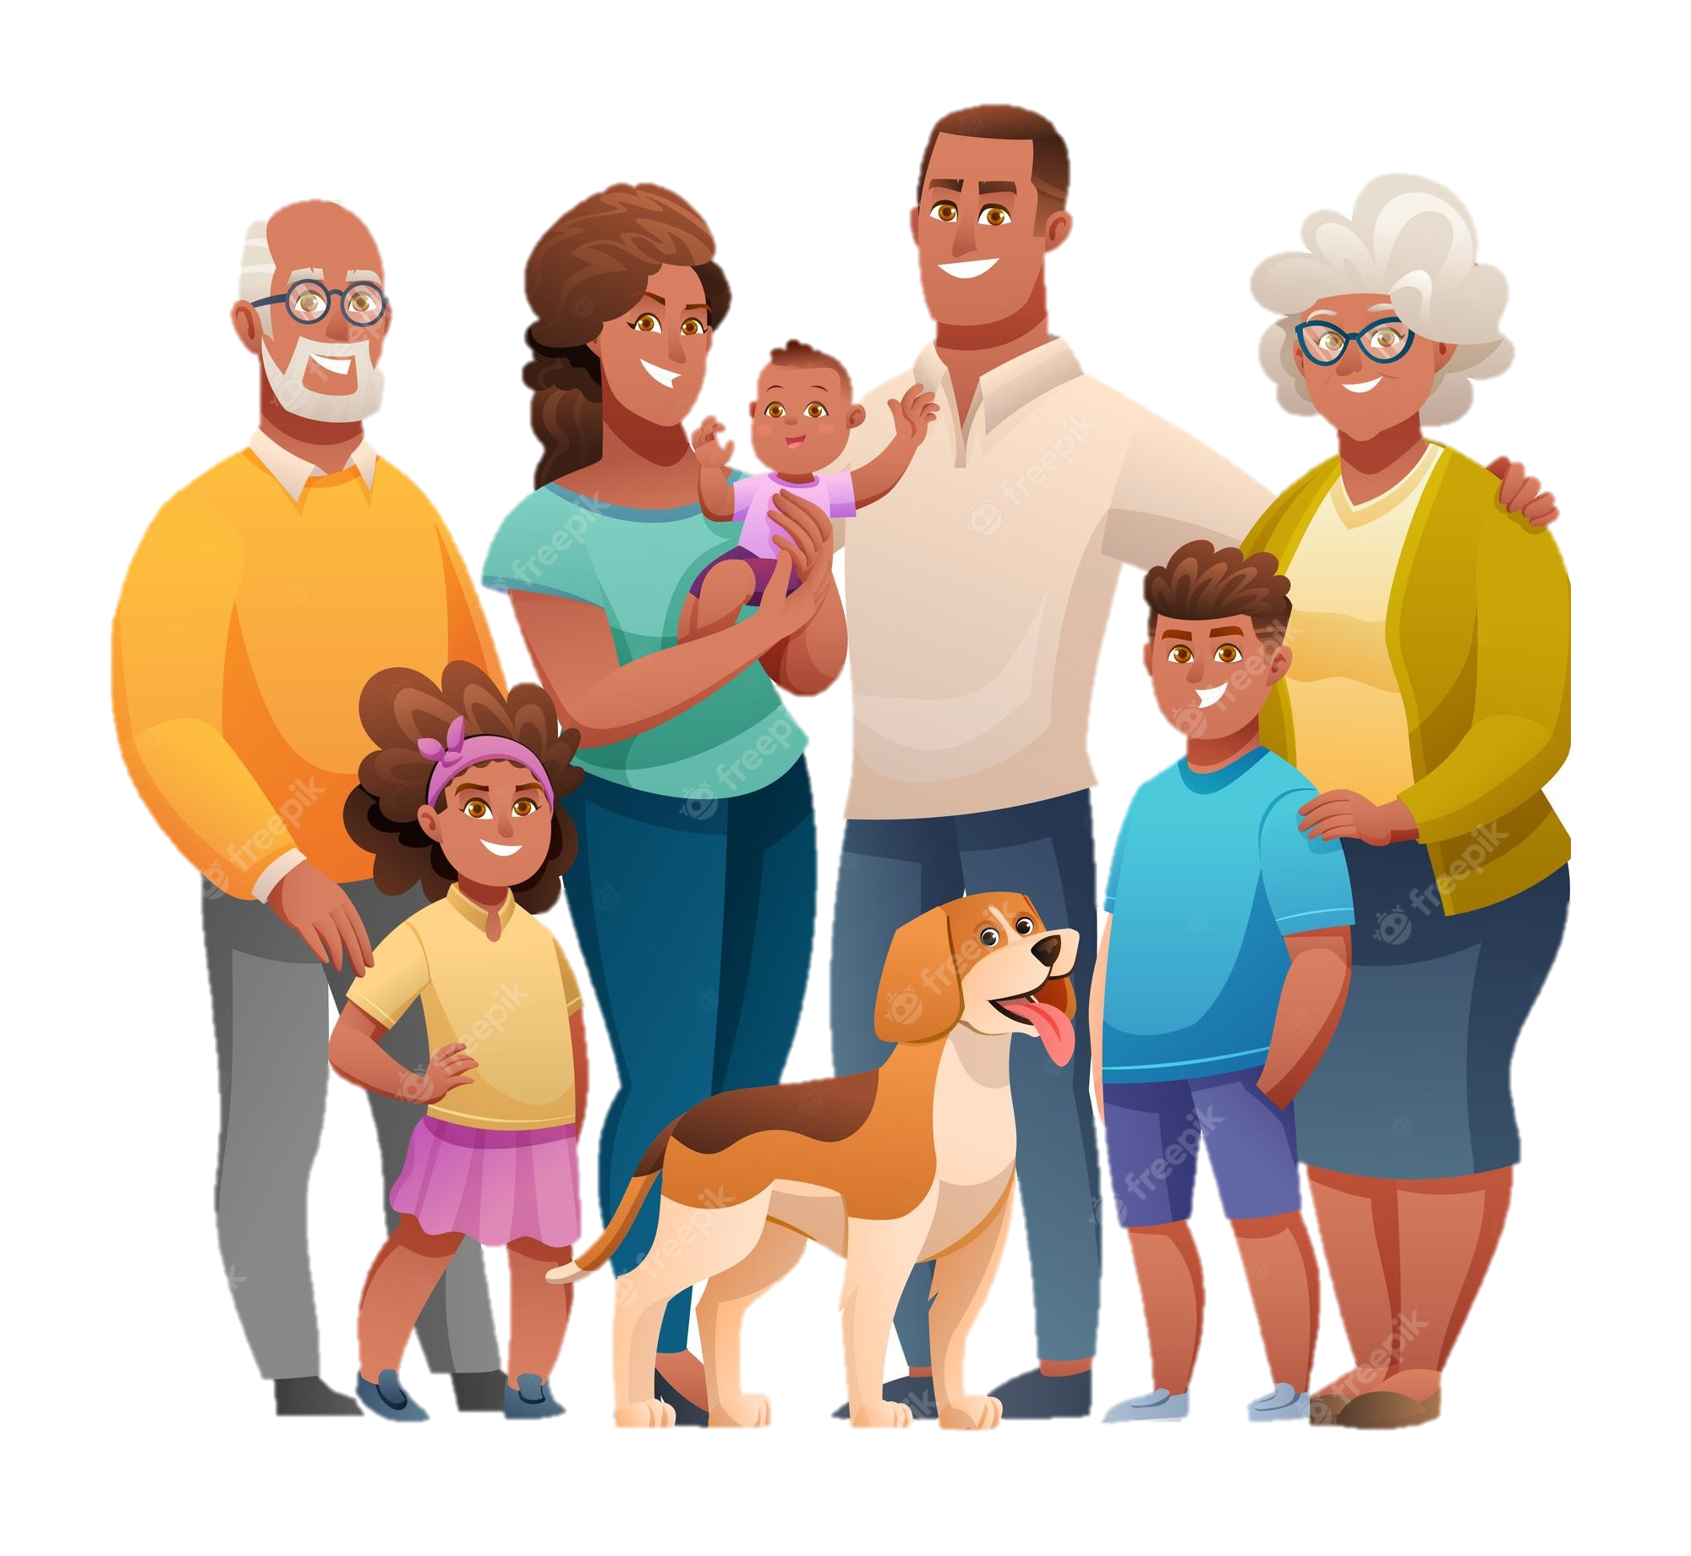
Ex 5. Make notes about a normal family event that you take part in. Use the questions below as cues.
A family event
Where does it happen?
When does it happen?
Who joins with you?
What do you often do?
Do you like it or not?
Why/ Why not?

Slide 30
Show time!
Assess your speaking
Did he/she introduce about his/her name?
Did he/she answer all the questions?
Did he/she have any grammatical errors?
Did he/she speak without any hesitation?

Slide 31
Consolidation / Wrap up
Reading
Speaking
to read about
A village festival
to talk about
A family event

Slide 32
Thanks!
Does anyone have any questions?
addyouremail@freepik.com +91 620 421 838 yourcompany.com
Please keep this slide for attribution

Slide 33
Icon

Slide 34
Alternative Resources

