Slide 1


Slide 2

Unit
8
SHOPPING
LESSON 3: A closer look 2 p.85
1

Slide 3
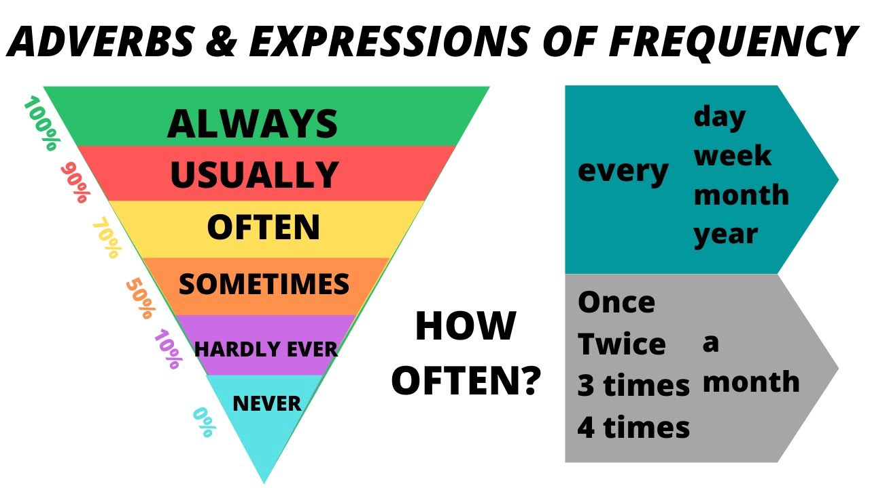
BRAIN STORMING
WARM-UP

Slide 4
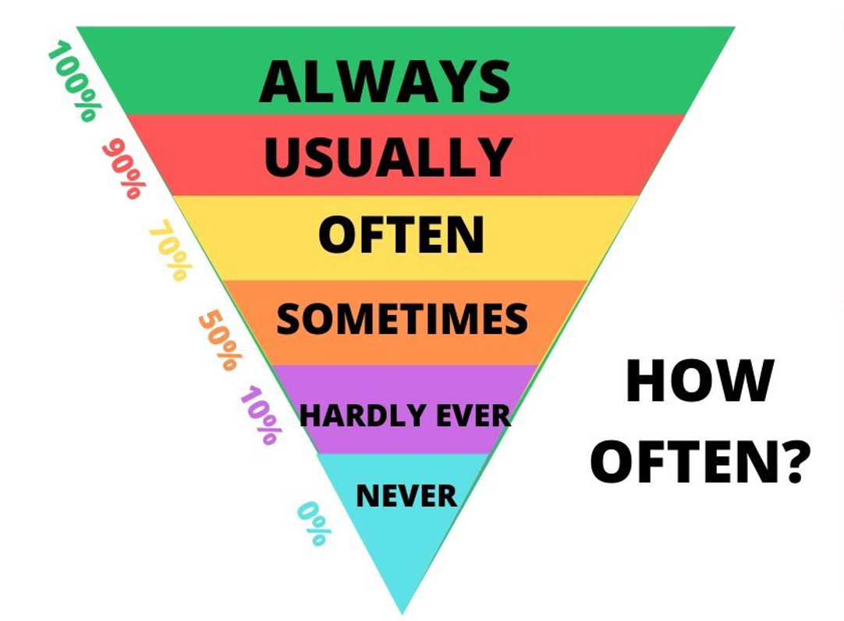
ADVERBS OF FREQUENCY
PRESENTATION

Slide 5
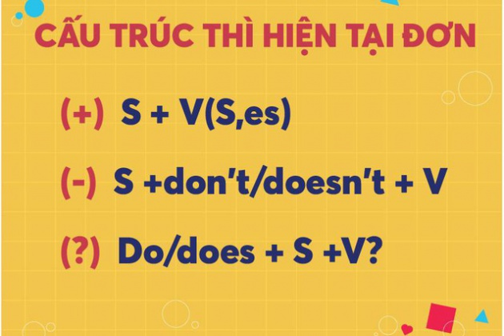
PRESENTATION
SIMPLE PRESENT FOR FUTURE EVENTS
USES
- Facts
- Habitual actions
- Future events

Slide 6
Adverbs of frequency
PRACTICE
1
Complete the sentences with the adverbs of frequency from the box.
always
often
sometimes
rarely
never
My mother__________shops at the supermarket. She never shops anywhere else.
I________buy things online, just once or twice a year. I prefer to shop at the shopping mall.
You can_________ bargain at a supermarket because the prices are fixed.
How_________ do you return things you buy online?
I don’t often buy things at the dollar store. My mother only takes me there___________.

Slide 7
PRACTICE
Present simple for future events
2
Read the schedule for the grade 8 field trip tomorrow, and underline the verbs in the sentences. Then answer the questions.
Field trip to the Double Dragon Chocolate Factory. 30 February
9:00 | The bus leaves.
10:00 | Students arrive at the factory
10:10 | Students watch a documentary introducing the factory.
10:30 | The tour of the factory starts.
12:10 | Students return to school to write the trip reports.
What tense are the verbs in the sentences?
Are the sentences about habits or future activities?
Present simple
Future activities

Slide 8
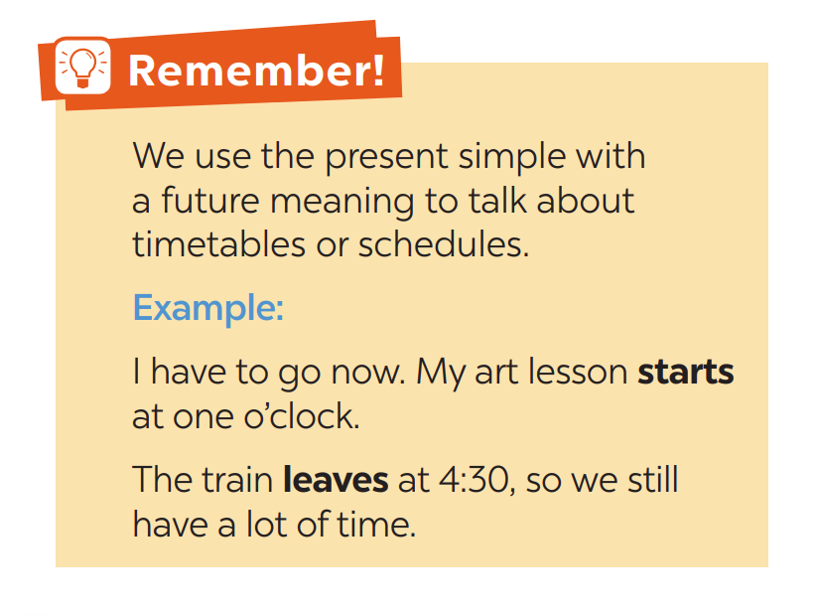
PRACTICE
Present simple for future events

Slide 9
PRACTICE
Present simple for future events
3
Write A next to a sentence if it relates to a timetable, schedule or plan, and B if it is an unplanned future action.
We’ll go to Costco to return this suitcase.
Look! We have a whole afternoon for shopping on the second day of our tour.
The summer sales end next Sunday.
Listen to the announcement. The train doesn’t leave till 12:00.
I’m too busy today, so we’ll go shopping on Tuesday.
B
A
A
A
B

Slide 10
PRACTICE
Present simple for future events
4
Choose the correct answer to complete each sentence.
The supermarket in my neighbourhood opens/ will open longer hours than the one in yours.
Don’t worry. I make/will make a shopping list, and you just give it to the shop owner.
We don’t buy/ won’t buy a birthday cake this year. We can bake one at home.
The bus schedule says that there is/ will be a bus to Aeon at 10:05.
Look at the advertisement. Does/ Will the big sale start next Friday?

Slide 11
PRACTICE
Present simple for future events
5
In pairs, ask and answer to check planning events for the community fair next month.
Community Fair 01 April
Time | Events
01 March | Preparing for the fair
03 March | Calling for volunteers
01 April | - 8:30: Opening - 11:00: Holding food competition
02 April | Cleaning up by volunteers.
Example: A: When do we start preparing for the fair?
B: We start on the first of March.

Slide 12
PRODUCTION
6
Report the events for the community fair.
Community Fair 01 April
Time | Events
01 March | Preparing for the fair
03 March | Calling for volunteers
01 April | - 8:30: Opening - 11:00: Holding food competition
02 April | Cleaning up by volunteers.
- We start preparing for the fair on March 1. We call for volunteers on…

Slide 13
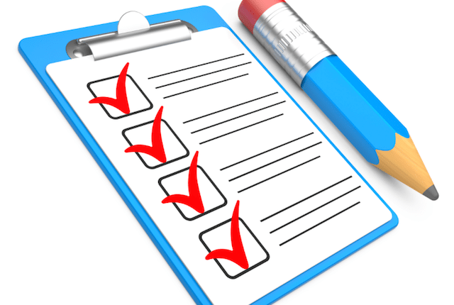
CONSOLIDATION
1
Wrap-up
What have we learnt in this lesson?
Reviewing adverbs of frequency
Present simple for future uses.

Slide 14
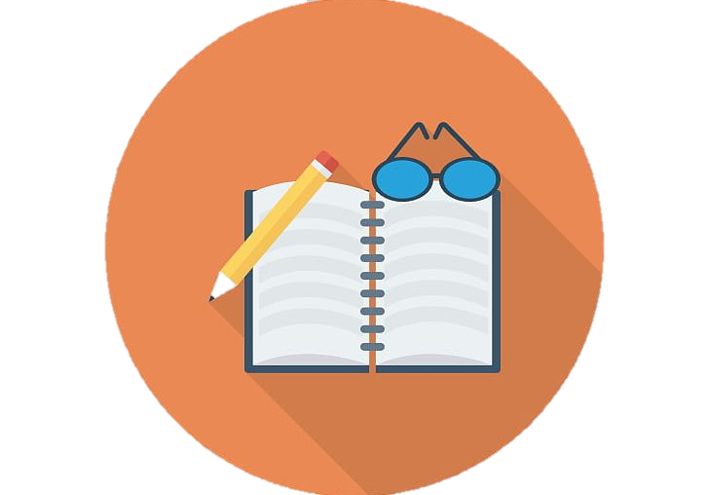
CONSOLIDATION
2
Home Assignments
Learn the use of adverbs of frequency by heart.
Make 5 sentences of the simple present for future meaning
Do Exercise in part B in Unit 8/Workbook

Slide 15

Website: hoclieu.vn
Fanpage: facebook.com/sachmem.vn/

