Slide 1


Slide 2







Unit
10
ENERGY SOURCES
LESSON 1: GETTING STARTED
Types of energy sources
HOBBIES

Slide 3

OBJECTIVES
By the end of the lesson, students will be able to:
An overview about the topic “Energy sources”.
Vocabulary to talk about types of energy.

Slide 4
LESSON 1: GETTING STARTED
WARM-UP
BRAIN STORMING
PRESENTATION
Vocabulary
Listen and read
Task 1: Read for main ideas: What are Lan and her father talking about?
Task 2: Read the conversation again and answer the questions.
Task 3: Match the words / phrases in the box with the correct pictures.
Task 4: Complete each of the sentences with the correct word from the conversation
PRACTICE
PRODUCTION
GROUP DISCUSSION
CONSOLIDATION
Wrap-up
Home work

Slide 5
LESSON 1: GETTING STARTED
WARM-UP
BRAIN STORMING
Aims of the stage:
- To activate students’ knowledge on the topic of the unit
- To enhance students’ skills of cooperating with team mates

Slide 6

LESSON 1: GETTING STARTED
WARM-UP
BRAIN STORMING
PRESENTATION
Vocabulary
Listen and read
Aims of the stage:
To provide students with vocabulary.
To help students well-prepared for the listening and reading tasks.

Slide 7
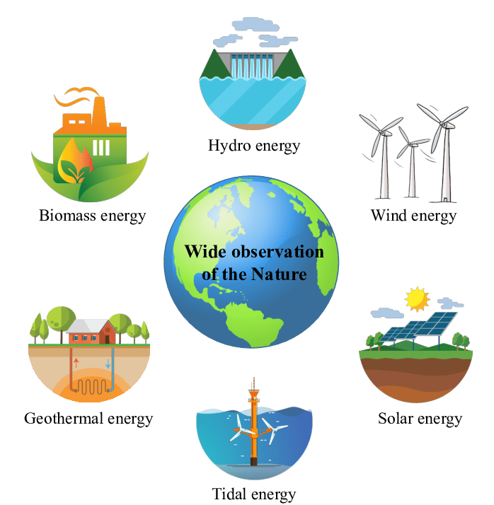
PRESENTATION
energy source (n)
/ˈenədʒi sɔːs/
NGUỒN NĂNG LƯỢNG

Slide 8
PRESENTATION
coal (n)
/kəʊl/
THAN ĐÁ

Slide 9
PRESENTATION
renewable (a)
/rɪˈnjuːəbl/
CÓ THỂ TÁI TẠO ĐƯỢC

Slide 10
PRESENTATION
run out (phr v)
/rʌn aʊt/
CẠN KIÊT

Slide 11
PRESENTATION
New words | Pronunciation | Meaning
energy sources (n) |  | nguồn năng lượng
coal (n) |  | than đá
renewable (adj) |  | có thể tái tạo được
run out (phr v) |  | cạn kiệt
/ˈenədʒi sɔːs/
/kəʊl/
/rɪˈnjuːəbl/
/rʌn aʊt/

Slide 12
LESSON 1: GETTING STARTED
WARM-UP
BRAIN STORMING
PRESENTATION
Vocabulary
Listen and read
Task 1: Read for main ideas: What are Lan and her father talking about?
Task 2: Read the conversation again and answer the questions.
Task 3: Match the words / phrases in the box with the correct pictures.
Task 4: Complete each of the sentences with the correct word from the conversation
PRACTICE

Slide 13
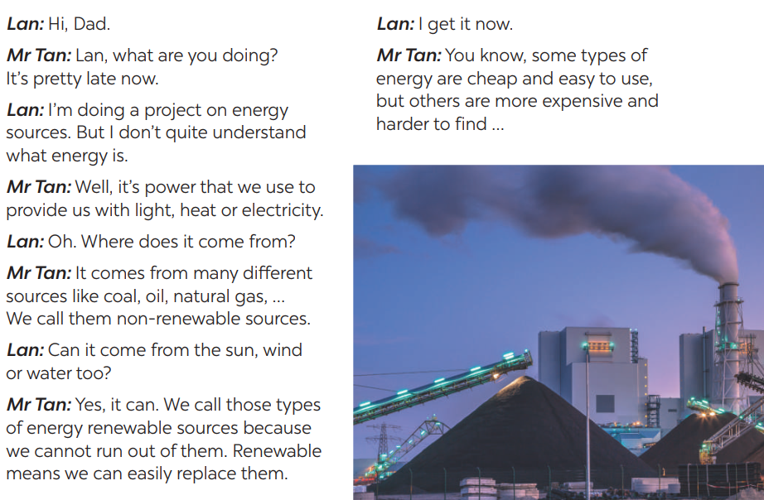

PRESENTATION: LISTEN AND READ
1
Listen and read
Aim of the task:
To get students interested in the topic
To set the context
To help Ss understand the main idea of the text

Slide 14
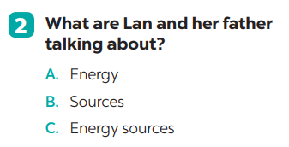

PRACTICE

Slide 15
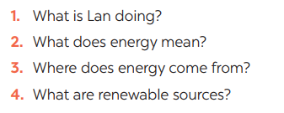
PRACTICE
3
Read the conversation and answer the questions
ANSWERS
1. Lan is doing a project on energy sources.
2. It’s power that we use to provide us with light, heat or electricity.
3. It comes from many different sources like coal, oil, natural gas, … and renewable sources
4. Renewable sources are those we can easily replace them such as: water, sun,…

Slide 16
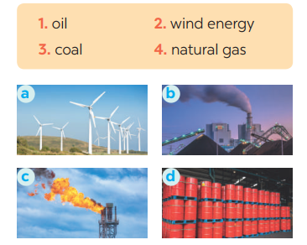
PRACTICE
4
Match the words / phrases in the box with the correct pictures.
Aim of the task:
To help student develop the vocabulary about the topic
1. c 2. a 3. b 4. d
KEY

Slide 17
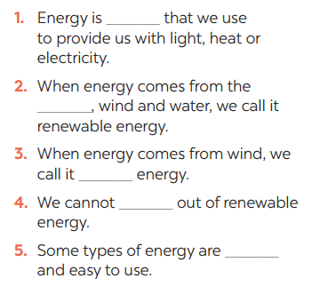
PRACTICE
bicycle
5
Complete each of the sentences with the correct word from the conversation
Answers
1. power
2. sun
3. wind
4. run
5. cheap

Slide 18
LESSON 1: GETTING STARTED
WARM-UP
BRAIN STORMING
PRESENTATION
Vocabulary
Listen and read
Task 1: Read for main ideas: What are Lan and her father talking about?
Task 2: Read the conversation again and answer the questions.
Task 3: Match the words / phrases in the box with the correct pictures.
Task 4: Complete each of the sentences with the correct word from the conversation
PRACTICE
PRODUCTION
GROUP DISCUSSION

Slide 19

PRODUCTION
Group discussion
1. What is the best source of energy?
2. Why do you think it is the best one?
Aim of the task:
To help Ss practising talking about energy
To practise team working
To give students authentic practice in using target language

Slide 20
LESSON 1: GETTING STARTED
WARM-UP
BRAIN STORMING
PRESENTATION
Vocabulary
Listen and read
Task 1: Read for main ideas: What are Lan and her father talking about?
Task 2: Read the conversation again and answer the questions.
Task 3: Match the words / phrases in the box with the correct pictures.
Task 4: Complete each of the sentences with the correct word from the conversation
PRACTICE
PRODUCTION
GROUP DISCUSSION
CONSOLIDATION
Wrap-up
Home work

Slide 21
CONSOLIDATION
1
WRAP-UP
ENERGY SOURCES
TYPES OF ENERGY
SOURCES OF ENERGY
Topic of the unit
Vocabulary

Slide 22
CONSOLIDATION
HOMEWORK
Exercises in your workbook
Prepare the vocabulary for the next lesson: A closer look 1.

Slide 23


