Slide 1


Slide 2

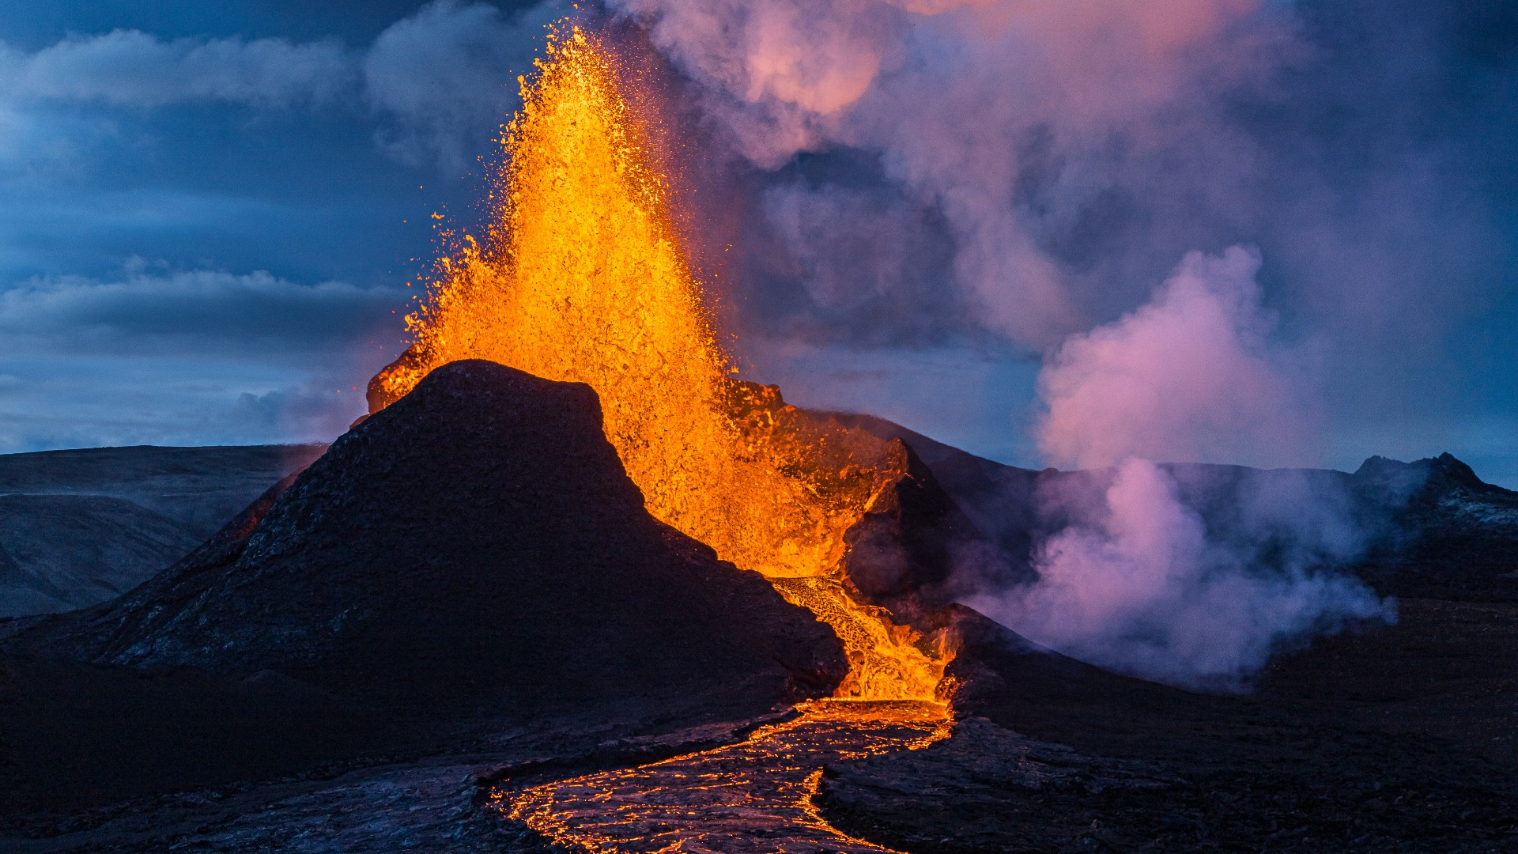
Unit
9
NATURAL DISASTERS
Unit
ETHNIC GROUPS OF VIET NAM
LESSON 5: SKILLS 1
LESSON 3: A CLOSER LOOK 2
Unit
HOBBIES

Slide 3

OBJECTIVES
By the end of the lesson, you will be able to:
Use the lexical items related to natural disasters.
Further understand about natural disasters through the two articles.
Prepare a short piece of news about natural disasters.

Slide 4
LESSON 5: SKILLS 1
WARM-UP
Who’s faster?
* Vocabulary
Task 1: Match the headlines (1 – 2) with the natural disasters (A – B).
Task 2: Read the two news articles. Match the highlighted words with their meanings.
Task 3: Read the articles again and answer the questions.
READING
Task 4: Work in pairs. Match the questions with the answers.
Task 5: Work in groups. Prepare a short piece of news about the natural disaster in 4 or one you know of. Report the news to the class.
SPEAKING
CONSOLIDATION
Wrap-up
Homework

Slide 5

LESSON 5: SKILLS 1
WARM-UP
Who’s faster?
Aims of the stage:
To review words related to natural disasters and introduce the new lesson.

Slide 6
WARM-UP
Erupt
Natural disasters

Slide 7

LESSON 5: SKILLS 1
WARM-UP
Who’s faster?
* Vocabulary
Task 1: Match the headlines (1 – 2) with the natural disasters (A – B).
Task 2: Read the two news articles. Match the highlighted words with their meanings.
Task 3: Read the articles again and answer the questions.
READING
Aims of the stage:
To introduce the new words related to natural disasters.
- To activate Ss’ knowledge of the topic of the reading text.
- To help Ss develop the skill of guessing the meaning of new words in context.
- To help Ss develop the skill of reading for specific information.

Slide 8
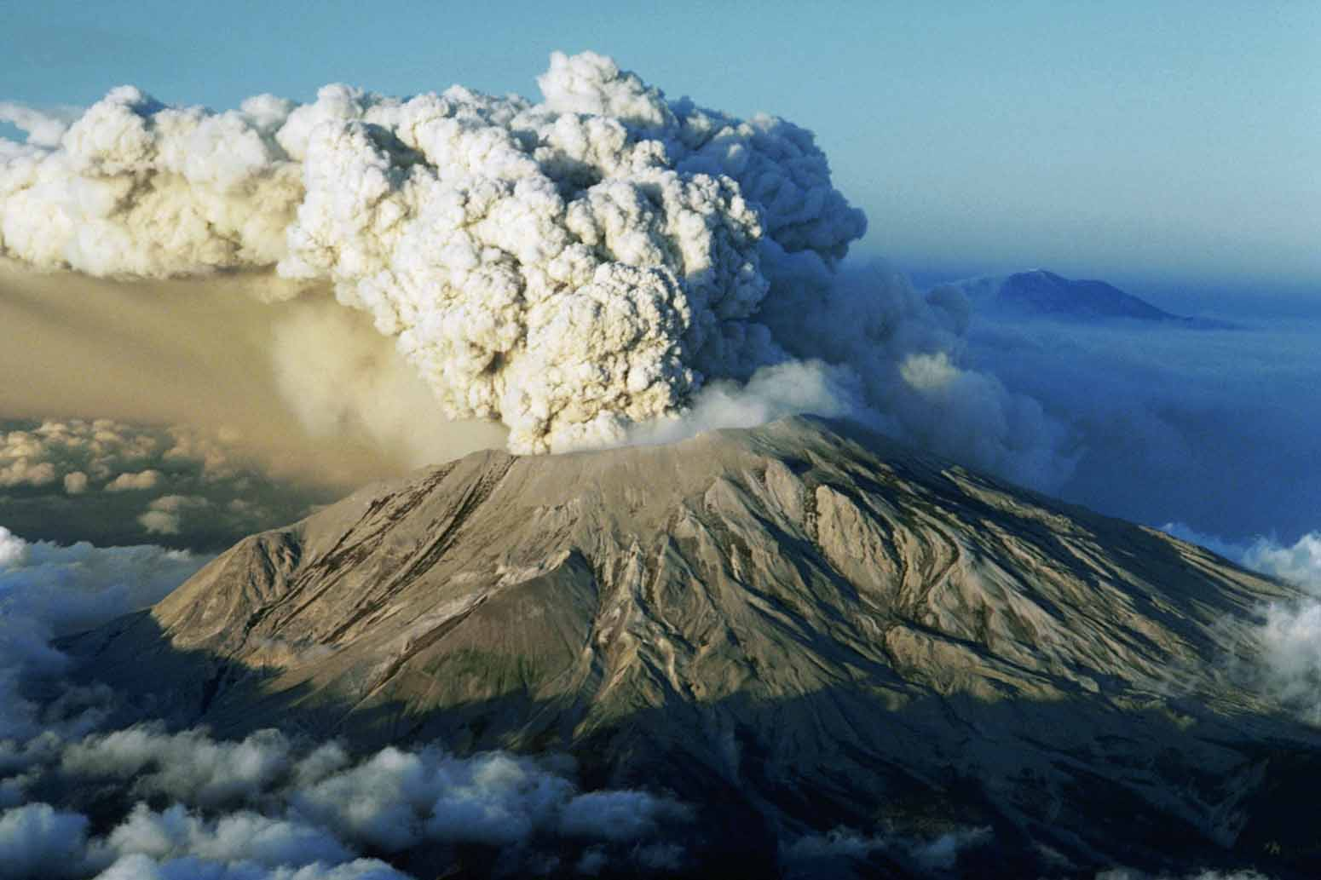
VOCABULARY
Ash (n)
/æʃ/
Tro

Slide 9
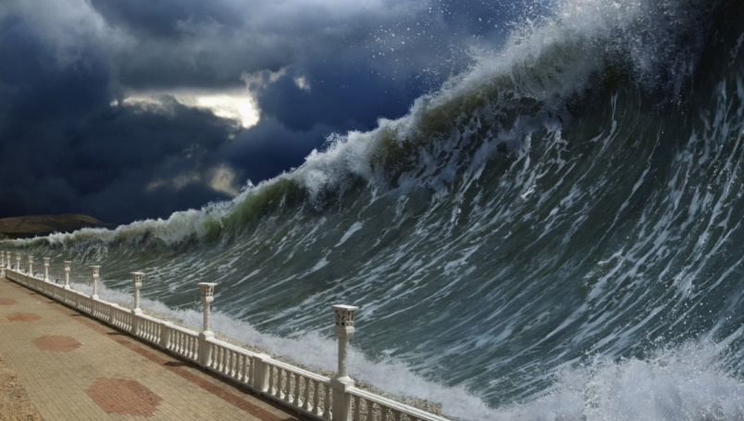
VOCABULARY
Tsunami (n)
/tsuːˈnɑː.mi/
Trận sóng thần

Slide 10
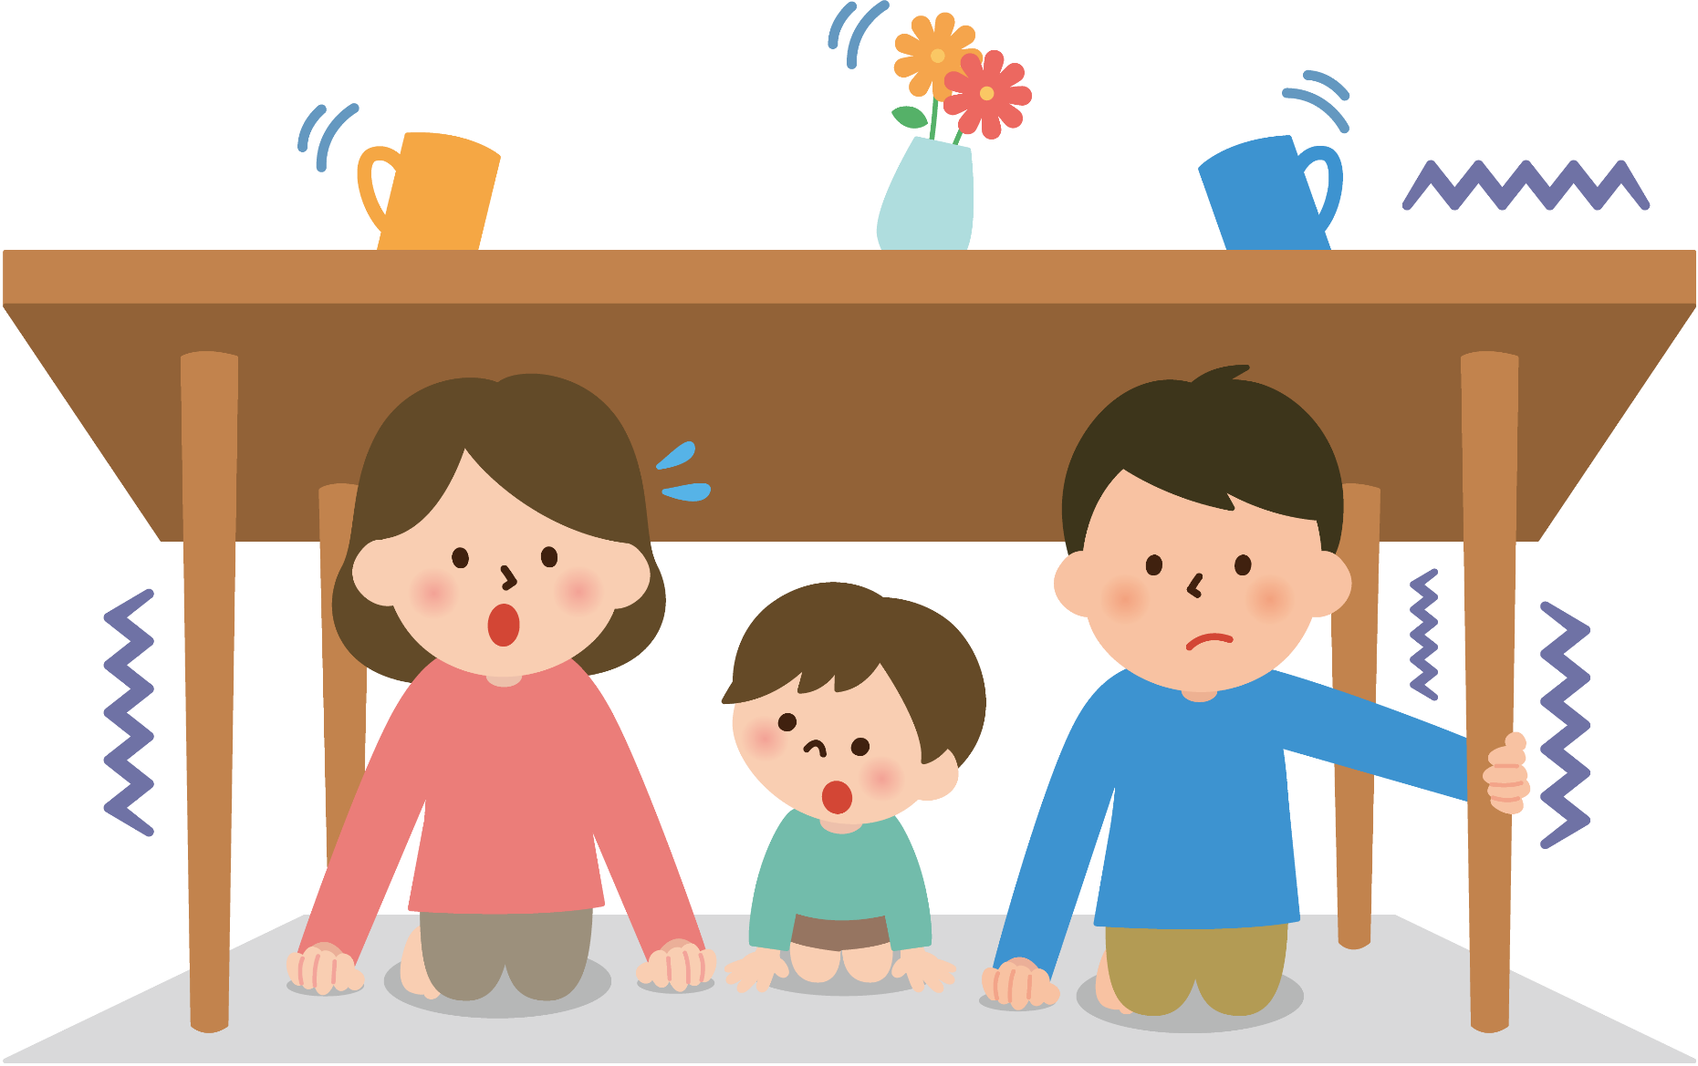
VOCABULARY
Tremble (v)
/ˈtrembəl/
Rung lắc

Slide 11
VOCABULARY
New words | Pronunciation | Meaning
1. Ash (n) | /æʃ/ | Tro
2. Tsunami (n) | /tsuːˈnɑː.mi/ | Trận sóng thần
3. Tremble (v) | /ˈtrembəl/ | Rung lắc

Slide 12
VOCABULARY
New words |  | Meaning
1. Ash (n)
2. Tsunami (n)
3. Tremble (v)
Trận sóng thần
Rung lắc
Tro

Slide 13
READING
1
Match the headlines (1 – 2) with the natural disasters (A – B).
Headlines |  | Natural disasters
1. 30 seconds of a slight shaking in Ha Noi.
2. A thick layer of ash covers Tonga.
A. volcanic eruption
B. earthquake

Slide 14
READING
2
Read the two news articles. Match the highlighted words with their meanings.
Highlighted words |  | Meanings
1. violently
2. tsunami
3. missing
4. trembling
5. fear
a. not yet found
b. slightly shaking
c. the bad feeling you have when you are frightened
d. very strongly
e. very large waves in the sea

Slide 15
READING
3
Read the articles again and answer the questions.
Where and when did the eruption happen?
=> ___________________________________________________________
2. What did the eruption cause?
=> ___________________________________________________________
3. What were the other effects of the eruption?
___________________________________________________________
___________________________________________________________
4. How long did the buildings shake?
=> ___________________________________________________________
5. What caused the shaking?
=> ___________________________________________________________
In the South Pacific last Saturday.
A tsunami.
It destroyed hundreds of homes on some small islands, and more than twenty people on these islands are missing.
For about 30 seconds.
A strong earthquake in China.

Slide 16
LESSON 5: SKILLS 1
WARM-UP
Who’s faster?
* Vocabulary
Task 1: Match the headlines (1 – 2) with the natural disasters (A – B).
Task 2: Read the two news articles. Match the highlighted words with their meanings.
Task 3: Read the articles again and answer the questions.
READING
Task 4: Work in pairs. Match the questions with the answers.
Task 5: Work in groups. Prepare a short piece of news about the natural disaster in 4 or one you know of. Report the news to the class.
SPEAKING

Slide 17
SPEAKING
4
Work in pairs. Match the questions with the answers.
Questions | Answers
1. What kind of natural disaster was it? | a. Five days of heavy rain caused it.
2. When and where did it happen? | b. Many houses were flooded, two villagers died, and five others were missing.
3. What caused it? | c. It was a serious flood.
4. What were its effects? | d. Rescue workers looked for the missing people, and volunteers gave food and drinks to the victims.
5. How did people help the victims? | e. It happened in a village in Phu Yen last week.
1. c 2. e 3. a 4. b 5. d

Slide 18
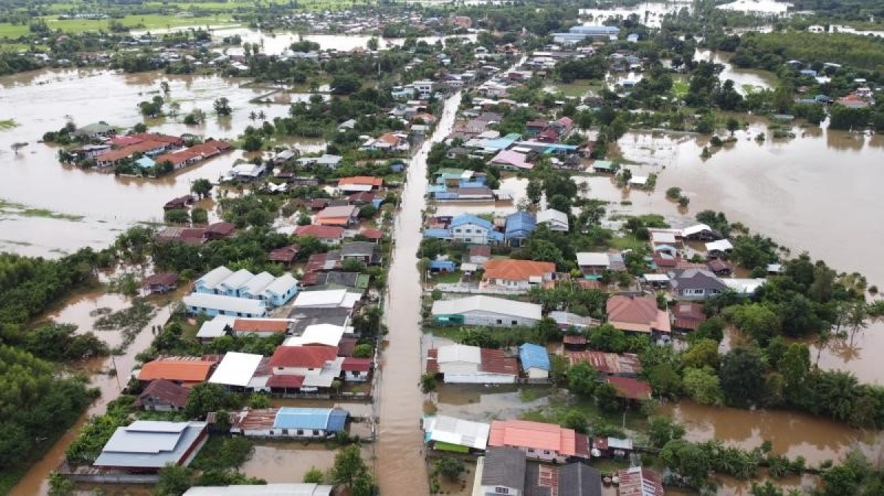
SPEAKING
5
Work in groups. Prepare a short piece of news about the natural disaster in 4 or one you know of. Report the news to the class.
Example:
Five days of heavy rain caused a serious flood in a village in Phu Yen. The flood happened last week. …

Slide 19
LESSON 5: SKILLS 1
WARM-UP
Who’s faster?
* Vocabulary
Task 1: Match the headlines (1 – 2) with the natural disasters (A – B).
Task 2: Read the two news articles. Match the highlighted words with their meanings.
Task 3: Read the articles again and answer the questions.
READING
Task 4: Work in pairs. Match the questions with the answers.
Task 5: Work in groups. Prepare a short piece of news about the natural disaster in 4 or one you know of. Report the news to the class.
SPEAKING
CONSOLIDATION
Wrap-up
Homework

Slide 20

CONSOLIDATION
1
WRAP-UP
In this lesson, you have:
learnt new words related to natural disasters.
read 2 passages about volcano and earthquake.
Write a short piece of news about the natural disaster.

Slide 21

CONSOLIDATION
2
HOMEWORK
Learn by heart all the words.
Do exercises in the workbook.
Prepare for Lesson 6 – Skills 2.

Slide 22

Website: hoclieu.vn
Fanpage: facebook.com/sachmem.vn/

