Slide 1


Slide 2



Unit
11
TRAVELLING IN THE FUTURE
LESSON 2: A CLOSER LOOK 1
VOCABULARY
PRONUNCIATION
Unit
HOBBIES

Slide 3

OBJECTIVES
By the end of the lesson, students will be able to:
Vocabulary:
use the lexical items related to the topic Travelling in the future.
Pronunciation: say sentences with correct stress

Slide 4
LESSON 2: A CLOSER LOOK 1
WARM-UP
Game: Miming
VOCABULARY
Vocabulary
Task 1: Write the words or phrases under the correct pictures. Then listen, check, and repeat.
Task 2: Write words or phrases from 1 in the correct columns.
Task 3: Complete the sentences, using the words from the box.
PRONUNCIATION
Pronunciation
Task 4: Listen to the sentences and repeat. Pay attention to the bold syllables.
PRODUCTION
* Task 5: Listen to the sentences and repeat. How many stresses are there in each sentence?
CONSOLIDATION
Wrap-up
Home work

Slide 5
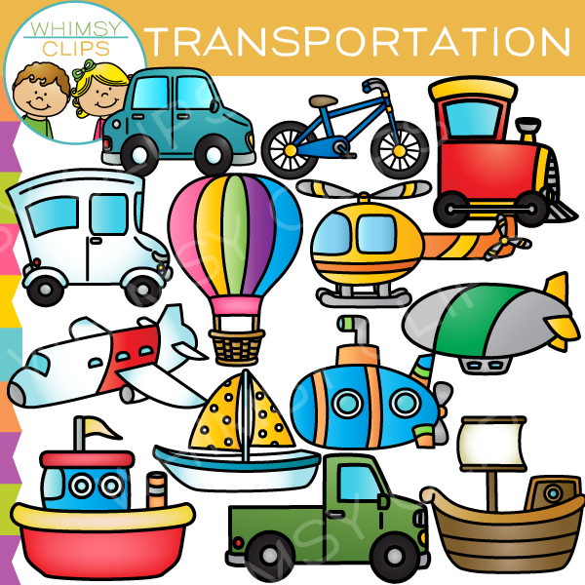
LESSON 2: A CLOSER LOOK 1
WARM-UP
Game: Miming
Aims of the stage:
To help Ss review the previous lesson.
– To create a fun atmosphere in the class.

Slide 6

LESSON 2: A CLOSER LOOK 1
WARM-UP
Game: Miming
VOCABULARY
Vocabulary
Task 1: Write the words or phrases under the correct pictures. Then listen, check, and repeat.
Task 2: Write words or phrases from 1 in the correct columns.
Task 3: Complete the sentences, using the words from the box.
Aims of the stage:
To introduce visually some nouns related to the topic

Slide 7
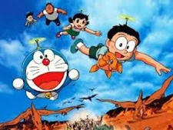
PRESENTATION
bamboo - copter (n)
/bæmˈbuːˈkɒp.tər/
chong chóng tre

Slide 8
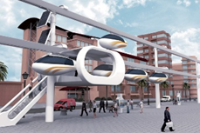
PRESENTATION
skyTran (n)
/skaɪtræn/
hệ thống tàu điện trên không

Slide 9
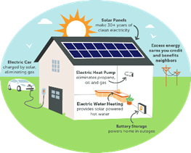
PRESENTATION
solar - powered (a)
/ˌsəʊ.lə -ˈpaʊər/
chạy bằng năng lượng mặt trời

Slide 10

PRESENTATION
(to) sail
/seɪl/
lướt buồm

Slide 11
PRESENTATION
New words | Pronunciation | Meaning
1. bamboo - copter (n) | /bæmˈbuːˈkɒp.tər/ | chong chóng tre
2. skyTran (n) | /skaɪtræn/ | hệ thống tàu điện trên không
3. solar- powered (a) | /ˌsəʊ.lə -ˈpaʊər/ | chạy bằng năng lượng mặt trời
4. (to) sail | /seɪl/ | lướt buồm

Slide 12
LESSON 2: A CLOSER LOOK 1
WARM-UP
Game: Miming
VOCABULARY
Vocabulary
Task 1: Write the words or phrases under the correct pictures. Then listen, check, and repeat.
Task 2: Write words or phrases from 1 in the correct columns.
Task 3: Complete the sentences, using the words from the box.

Slide 13

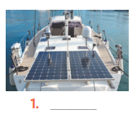
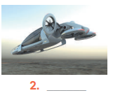
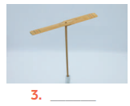
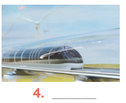
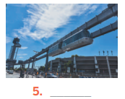
VOCABULARY
1
Write the words or phrases under the correct pictures. Then listen, check, and repeat.
flying car bamboo – copter hyperloop skyTran solar – powered ship
solar – powered ship
flying car
bamboo - copter
hyperloop
skyTran

Slide 14

VOCABULARY
2
Write words or phrases from 1 in the correct columns.
flying car bamboo – copter hyperloop skyTran solar – powered ship
skyTran
hyperloop
bamboo- copter
flying car
solar – powered ship

Slide 15
VOCABULARY
3
1
Complete the sentences, using the words from the box.
eco- friendly fly ride bamboo – copter hyperloop
bamboo - copter
1. Travelling by ________________ is simple. You just put it on and fly away.
2. People will soon ______________ in flying cars instead of driving normal cars.
3. It will be fun to ______________ a skyTran to work.
4. Travelling by ________________ will be faster than by airplane.
5. Solar-powered ships are ________________. They will not cause pollution
fly
ride
hyperloop
eco- friendly

Slide 16
LESSON 2: A CLOSER LOOK 1
WARM-UP
Game: Miming
VOCABULARY
Vocabulary
Task 1: Write the words or phrases under the correct pictures. Then listen, check, and repeat.
Task 2: Write words or phrases from 1 in the correct columns.
Task 3: Complete the sentences, using the words from the box.
PRONUNCIATION
Pronunciation
Task 4: Listen to the sentences and repeat. Pay attention to the bold syllables.

Slide 17

PRONUNCIATION
SENTENCE STRESS
Aims of the stage:
To help Ss be aware of which words in a sentence should be stressed, which are not;
To help Ss say sentences with correct stress

Slide 18


PRONUNCIATION

Slide 19
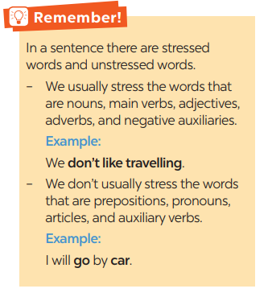
PRONUNCIATION

Slide 20
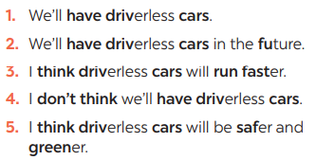

PRONUNCIATION
4
Listen to the sentences and repeat. Pay attention to the bold syllables.

Slide 21
LESSON 2: A CLOSER LOOK 1
WARM-UP
Game: Miming
VOCABULARY
Vocabulary
Task 1: Write the words or phrases under the correct pictures. Then listen, check, and repeat.
Task 2: Write words or phrases from 1 in the correct columns.
Task 3: Complete the sentences, using the words from the box.
PRONUNCIATION
Pronunciation
Task 4: Listen to the sentences and repeat. Pay attention to the bold syllables.
PRODUCTION
* Task 5: Listen to the sentences and repeat. How many stresses are there in each sentence?

Slide 22

PRODUCTION
Aims of the stage:
To help Ss be aware of the words they have to stress in a sentence
To help Ss practise saying sentences with correct stress

Slide 23
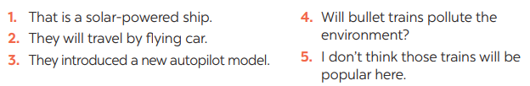
PRONUNCIATION
Listen to the sentences and repeat. How many stresses are there in each sentence?
5

Slide 24
CONSOLIDATION
1
WRAP-UP
VOCABULARY
PRONUNCIATION

Slide 25
CONSOLIDATION
2
HOMEWORK
Practice saying the sentences at home.

Slide 26


