Slide 1


Slide 2

Unit
8
SHOPPING
LESSON 3: A closer look 2
1

Slide 3
WARM-UP
GAME: MEMORIZING
RULE:
Work in 4 groups
Look at the pictures in 30 seconds and try to remember what each people said.
Write down on the posters what each of the people in the picture said.
The group with the most correct answers is the winner.

Slide 4

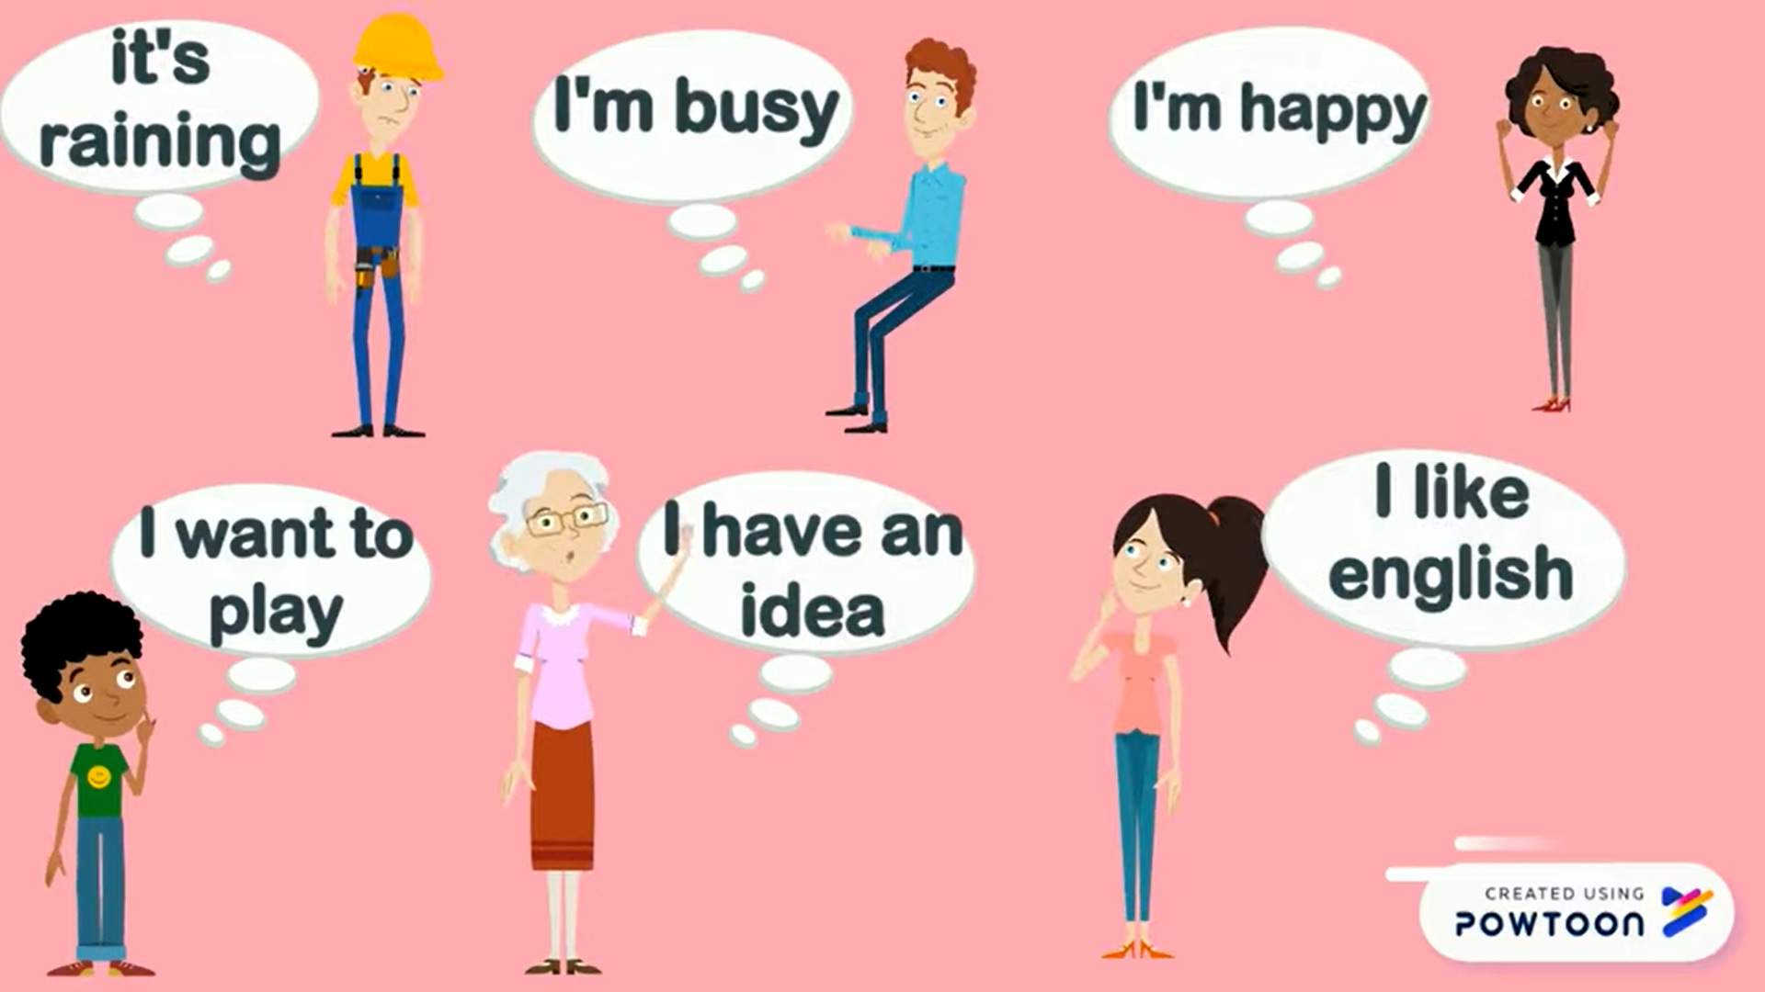
WARM-UP
GAME: MEMORIZING
David
Peter
Linda
Ms. Brown
Sarah
Tom

Slide 5
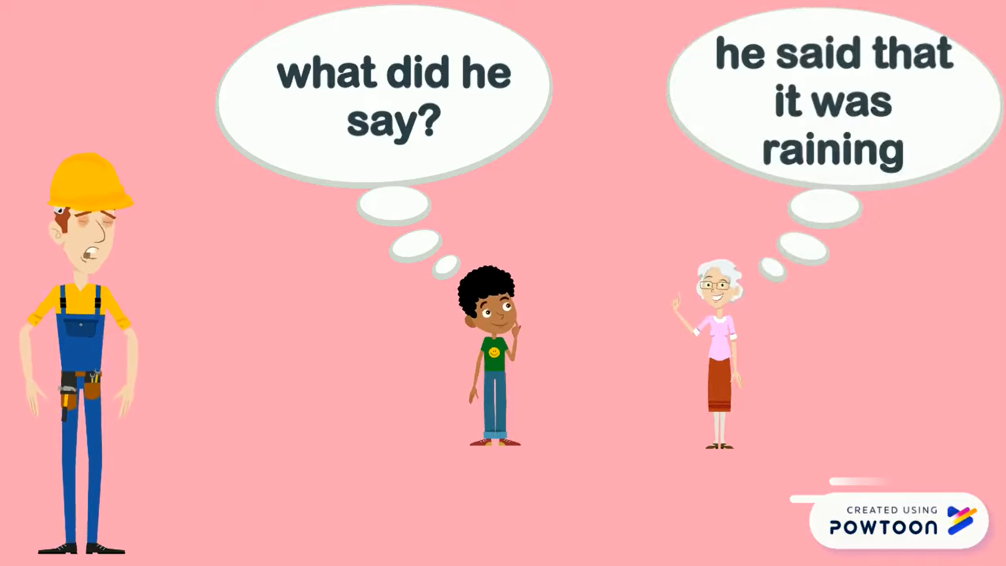
WARM-UP
GAME: MEMORIZING
David

Slide 6
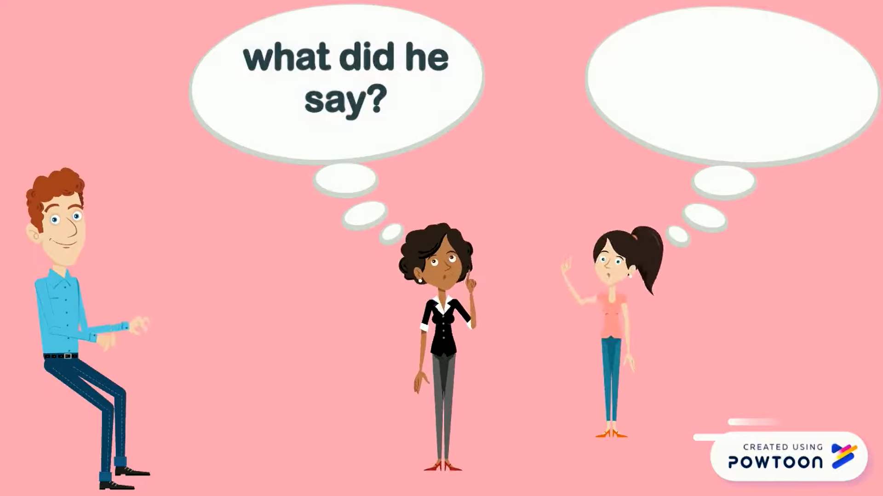
WARM-UP
GAME: MEMORIZING
Peter

Slide 7
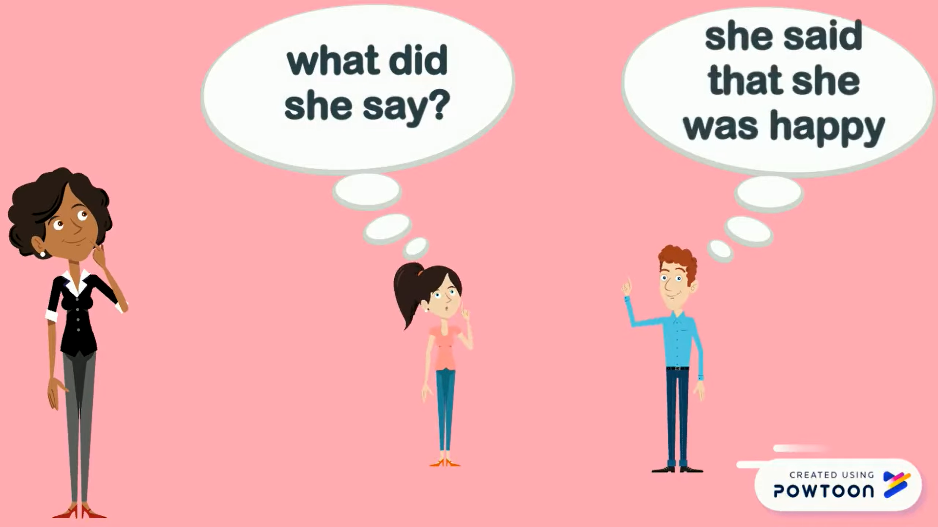
WARM-UP
GAME: MEMORIZING
Linda

Slide 8
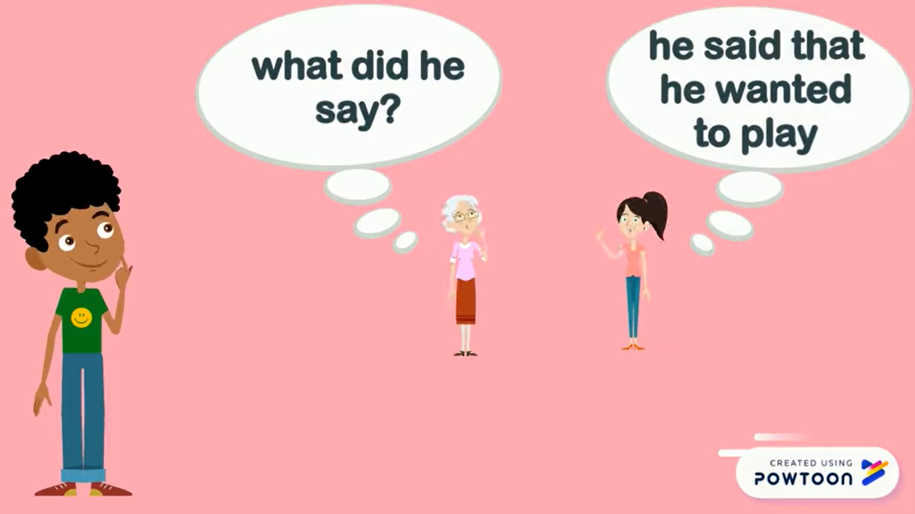
WARM-UP
GAME: MEMORIZING
Tom

Slide 9
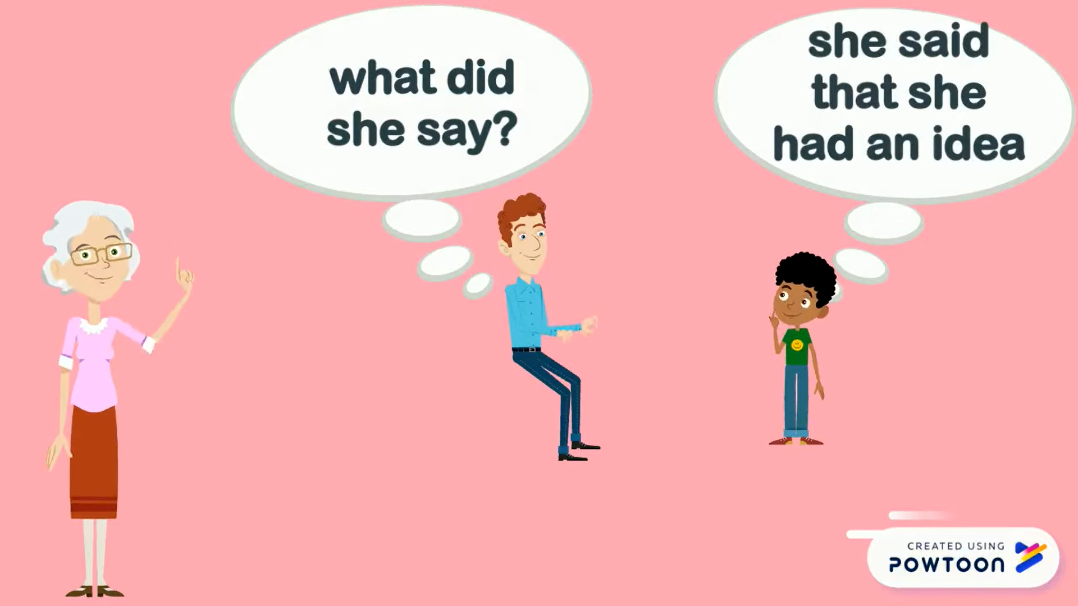
WARM-UP
GAME: MEMORIZING
Ms. Brown

Slide 10
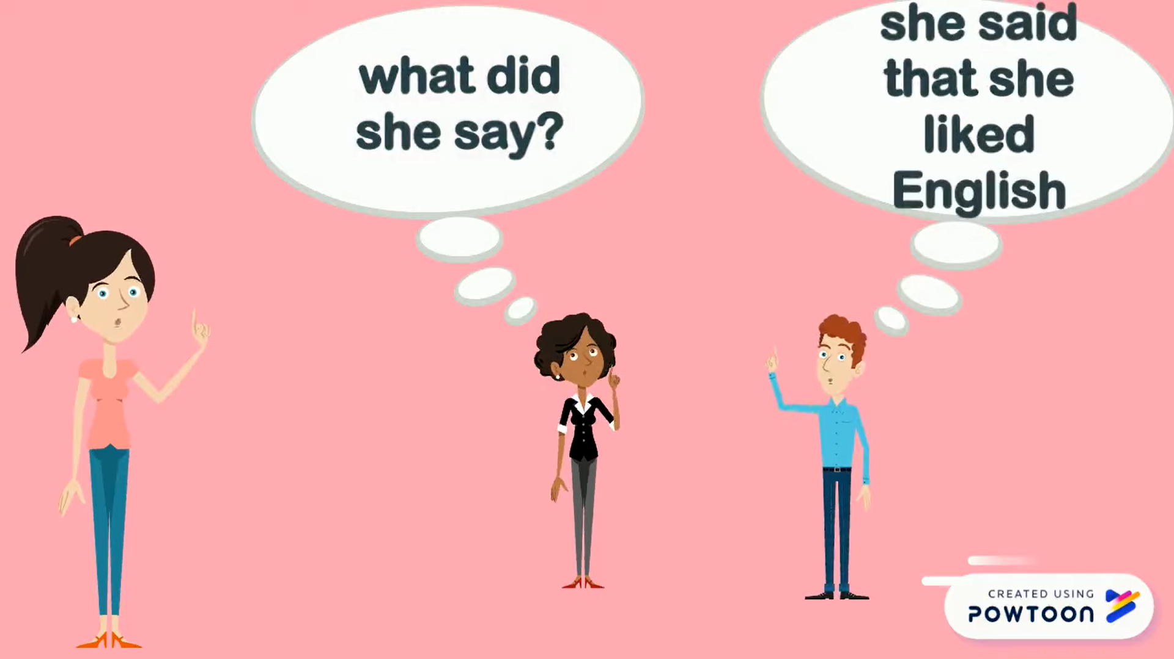
WARM-UP
GAME: MEMORIZING
Sarah

Slide 11

PRESENTATION
REPORTED SPEECH (STATEMENTS)
1
Look at part of the conversation in GETTING STARTED again. Then match Minh’s uncle’s direct speech with his reported speech.
Reported speech
A. My uncle said the robots would be able to give us feedback too.
B. My uncle said the robots will be able to mark our work.
Minh: …My uncle said the robots would be able to mark our work and give us feedback too.
Direct speech
1. The robots will be able to mark our work.
2. The robots will be able to give us feedback too.
1. B
2. A

Slide 12
PRESENTATION
REPORTED SPEECH (STATEMENTS)
REMEMBER
Reported speech is used to report what someone said.
1. Change the verb form | Present simple | Past simple
 | Present continuous | Past continuous
 | Will | would
2. Change time and place expressions | now | Then
 | Today/ this week | That day/ that week
 | tomorrow | The following day
 | here | There
3. Change pronouns | I | He/ She
 | we | They
 | me | Him/her

Slide 13
PRACTICE
REPORTED SPEECH (STATEMENTS)
1
Complete the second sentences using the correct verb form.
“I am a member of the IT club.”
=> Minh said that he _______ a member of the IT club.
2. “Mai will take an online course to improve her speaking.”
=> Nam said Mai________ take an online course to improve her speaking.
3. “I am talking to Phong on the phone.”
=> Tom said he ___________ to Phong on the phone.
4. “They are going to send me an email.”
=> He said they _________ to send me an email.
5. “I don’t have an iPod to listen to music.”
She said that she___________an iPod to listen to music.
was
would
was walking
was going
didn’t have

Slide 14
PRACTICE
REPORTED SPEECH (STATEMENTS)
3
Complete the second sentences with the words and phrases from the box.
there
that year
that day
then
the next day
“I am having a science test tomorrow,” Mary said
=> Minh said she was having a science test _____________.
2. “The group is working on their project now,” Tom said
=> Tom said the group was working on their project ________.
3. “Mai is reading about Thomas Edison today,” the teacher said
=> The teacher said that Mai was reading about Thomas Edison ___________.
4. “They will invent a smart cooker this year, ” my mom said.
=> My mum said that they would invent a smart cooker____________.
5. “My teacher will park her car here,” said Mi
Mi said her teacher would park her car________.

Slide 15
PRACTICE
REPORTED SPEECH (STATEMENTS)
4
Complete the second sentence in each pair so that it means the same as the first one.
1. “We will live much longer in the future,” said the scientist.
=> Our scientist said that _________________________________________________
2. “Our school is going to have a new laboratory here, ”said our teacher.
=> Our teacher said that _________________________________________________
3. “They are developing technology to monitor students better,” my dad said.
=> My dad said that _____________________________________________________
4. “There are no classes tomorrow because our teacher is ill,” Tom said.
=> Tom said that ________________________________________________________
5. “We want some students to join the science club next semester,” the teacher said.
=> The teacher said that__________________________________________________
we would live much longer in the future.
our school was going to have a new laboratory there.
they were developing technology to monitor students better.
there were no classes the next day because their teacher was ill.
they wanted some students to join the science club the next semester.

Slide 16
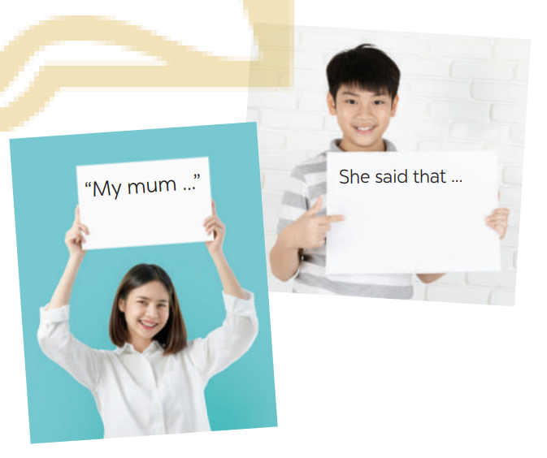
PRODUCTION
REPORTED SPEECH (STATEMENTS)
5
GAME: He/ She said that…
Work in pairs. One student says a sentence and the other changes that sentence into reported speech. Then swap roles.

Slide 17

CONSOLIDATION
1
Wrap-up
What have we learnt in this lesson?
What direct speech and reported speech are
Rules of changing direct speech to reported speech.

Slide 18

CONSOLIDATION
2
Home Assignments
Learn the rules of changing direct speech into reported speech by heart.
Do Exercise in part B ,E in Unit 11/Workbook

Slide 19

Website: hoclieu.vn
Fanpage: facebook.com/sachmem.vn/

