Slide 1
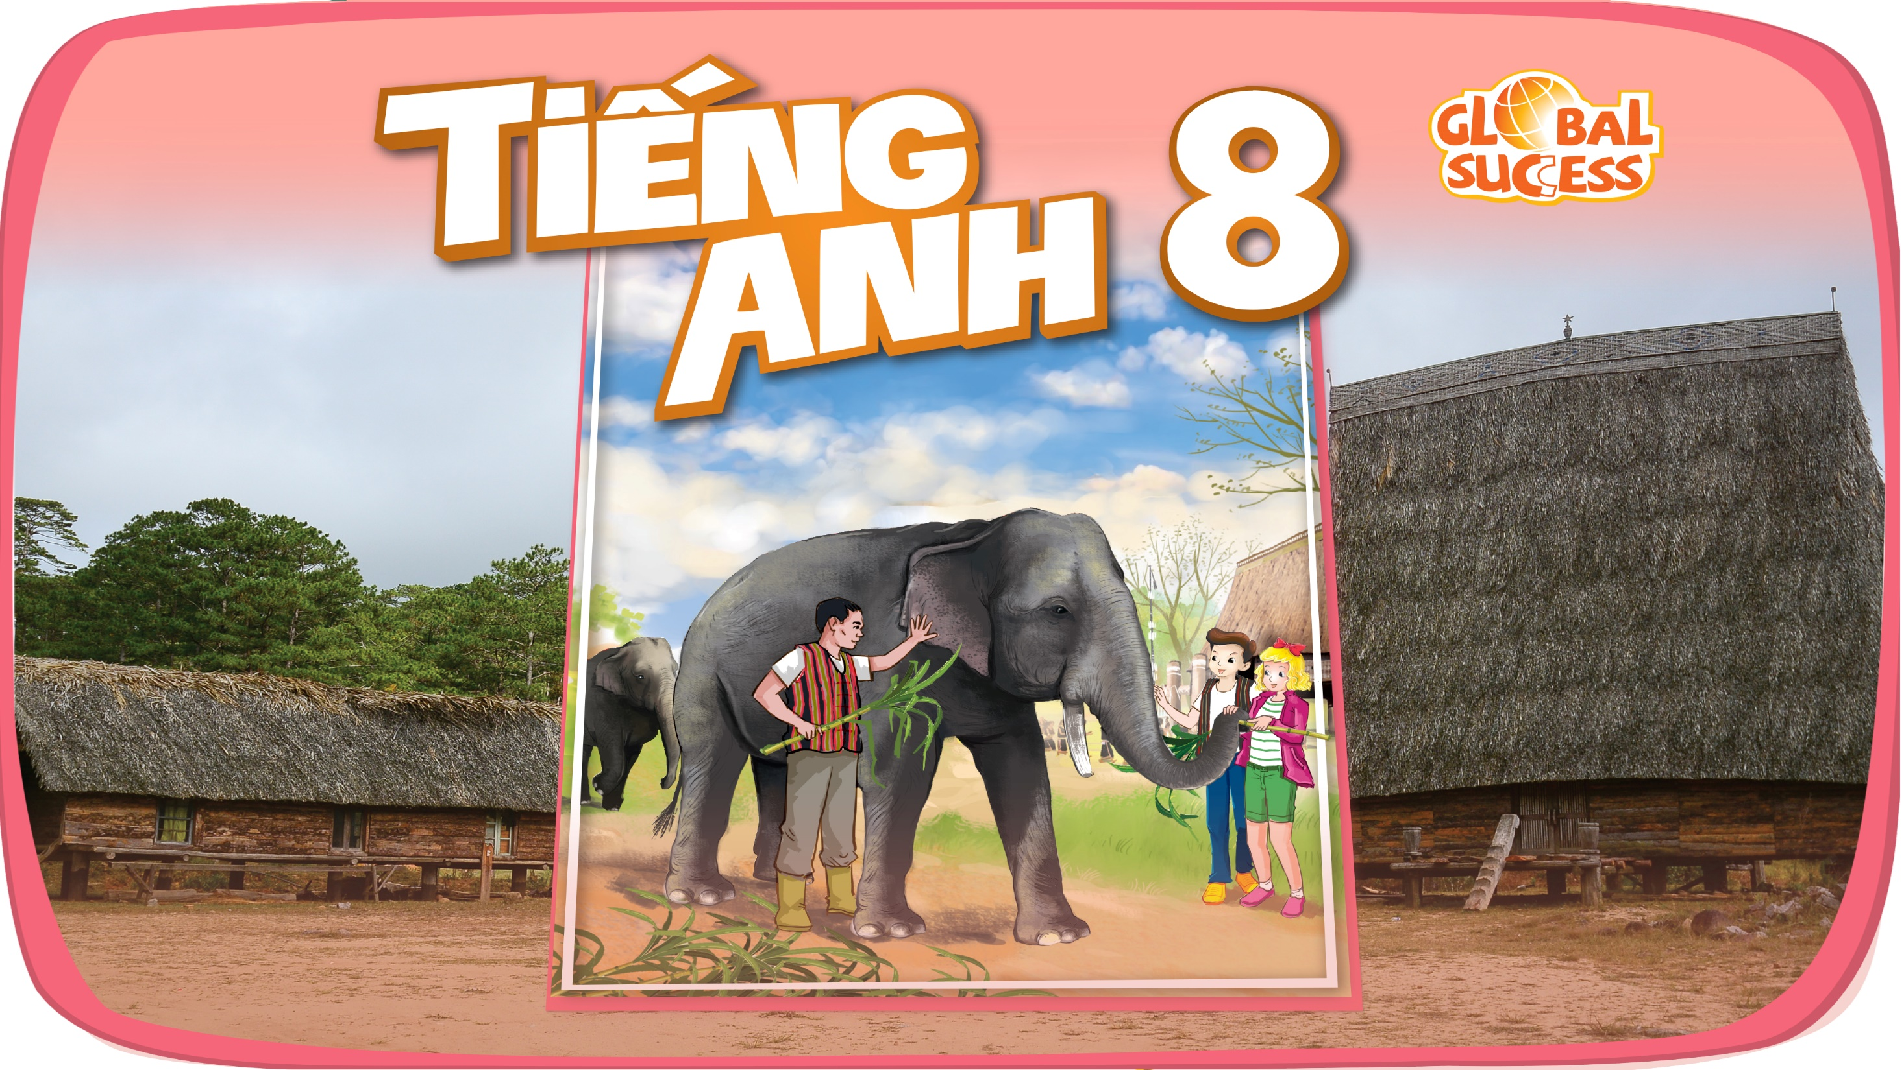

Slide 2

Unit
12
LIFE ON OTHER PLANETS
LESSON 7: LOOKING BACK & PROJECT
VOCABULARY REVIEW
1
GRAMMAR REVIEW
Unit
PROJECT: LOCAL CUSTOMS AND TRADITIONS

Slide 3

OBJECTIVES
By the end of the lesson, students will be able to:
Review the vocabulary and grammar of Unit 12
Apply what they have learnt (vocabulary and grammar) into practice through a project

Slide 4
LESSON 7: LOOKING BACK & PROJECT
WARM-UP
Brainstorming
Task 1: Write a word under each picture.
Task 2: Circle the correct words.
Task 3: Rewrite the sentences.
Task 4: Correct the mistakes
LOOKING BACK
PROJECT
Our Favorite Planet
CONSOLIDATION
Wrap-up
Homework

Slide 5
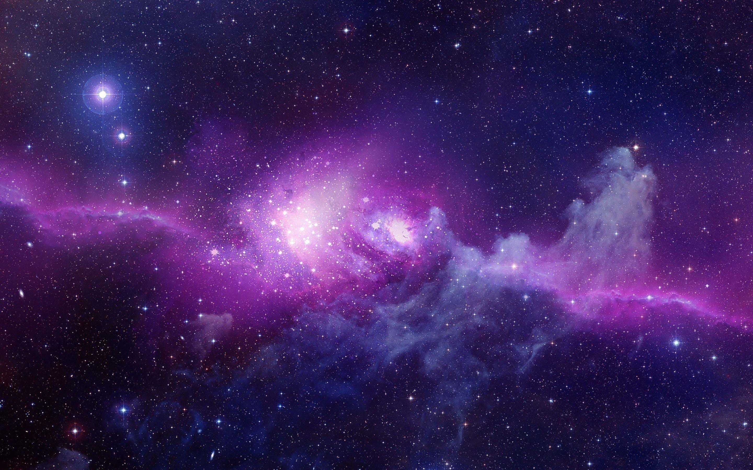
WARM UP
What you have learned from this Unit?
About Aliens, planets, solar system, atmosphere,…..

Slide 6
LESSON 7: LOOKING BACK & PROJECT
WARM-UP
Brainstorming
Task 1: Write a word under each picture.
Task 2: Circle the correct words.
Task 3: Rewrite the sentences.
Task 4: Correct the mistakes
LOOKING BACK

Slide 7
LESSON 6: SKILLS 2
WARM-UP
DRAWING
Task 1: Work in pairs. Look at the picture and answer the following questions
Task 2: Listen and choose the correct answer A, B or C
Task 3: Listen again and fill in the blanks
LISTENING

Slide 8
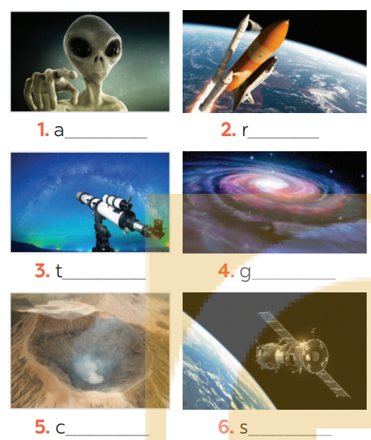
LOOKING BACK
1
Write a word under each picture
lien
ocket
elescope
alaxy
rater
paceship

Slide 9
LOOKING BACK
2
Circle the correct words to complete the sentences.
1. UFOs / Rockets are spaceships from another planet.
2. We have no possibility / condition of making our own spaceship.
3. We can’t find any living craters / creatures in the solar system except for us.
4. Scientists are working to find a habitat / habitable planet.
5. The gravity / atmosphere of the Earth makes things fall to the ground when we drop them.

Slide 10
LOOKING BACK
3
Rewrite each sentence so that it is closest in meaning to the original one.
1. “What is this novel about?” said Mary
-> Mary wanted to know .
2. “Who’s your favourite actor, Nick?” I said
-> I asked Nick .
3. “What time does the next train leave?” Mai said to me.
-> Mai asked me .
4. How do the scientists observe the other planets?” the students asked.
-> The students wondered .
5. Mai wondered, “Why can’t humans live on Mars?”
-> Mai wondered .
what that novel was about.
who his favourite actor was.
what time the next train left.
how the scientists observed the other planets.
why humans couldn’t live on Mars.

Slide 11
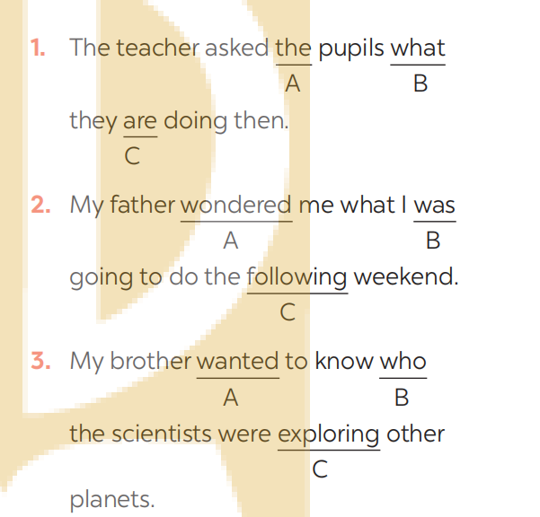
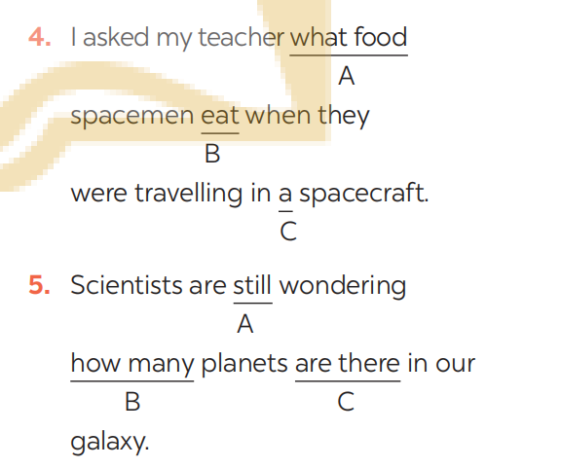
LOOKING BACK
4
Which of the underlined parts in each question is incorrect? Find and correct it.
were
ate
asked
there are
how/why

Slide 12
LESSON 7: LOOKING BACK & PROJECT
WARM-UP
Brainstorming
Task 1: Write a word under each picture.
Task 2: Circle the correct words.
Task 3: Rewrite the sentences.
Task 4: Correct the mistakes
LOOKING BACK
PROJECT
Our Favorite Planet

Slide 13

PROJECT
OUR FAVORITE PLANET
Work in groups.
Discuss and choose what planet you like.

Slide 14

PROJECT
OUR FAVORITE PLANET
Work in groups.
Choose information to write about (name, size, atmosphere, temperature, appearance,...)
You can illustrate by picture.

Slide 15

PROJECT
OUR FAVORITE PLANET
Work in groups.
Present your poster to the class

Slide 16
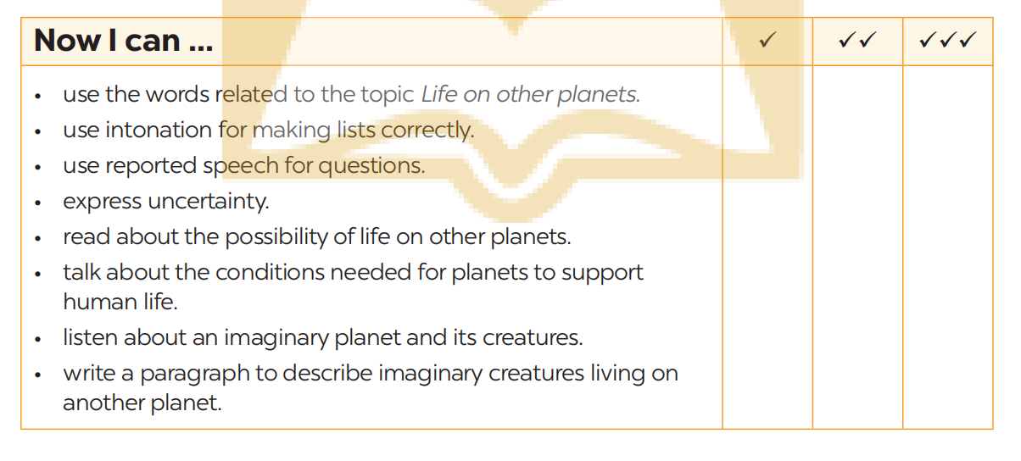
PROJECT
Complete the self-assessment table.

Slide 17
LESSON 7: LOOKING BACK & PROJECT
WARM-UP
Brainstorming
Task 1: Write a word under each picture.
Task 2: Circle the correct words.
Task 3: Rewrite the sentences.
Task 4: Correct the mistakes
LOOKING BACK
PROJECT
Our Favorite Planet
CONSOLIDATION
Wrap-up
Homework

Slide 18

CONSOLIDATION
1
Wrap-up
What have we learnt in this lesson?
Review the vocabulary and grammar of Unit 12.
Make a poster about the planet.

Slide 19

CONSOLIDATION
2
Homework
- Learn new words by heart.
- Prepare for the next lesson.

Slide 20

Website: hoclieu.vn
Fanpage: facebook.com/sachmem.vn/

