Slide 1


Slide 2


4
Units 10-11-12
REVIEW
LESSON 1: LANGUAGE
1

Slide 3

WARM-UP
- Work in teams.
- One students from each team comes to the board.
- Teacher gives them a sentence.
-That person will then whisper what she/he heard to the next person. (Each person can only say, "Can you please repeat that?" one time)
- The last student will speak out loud the sentence.
Write on the board the list of future technology you expect to see in the future in 2 minutes.
WHISPER GAME

Slide 4
WARM-UP
Write on the board the list of future technology you expect to see in the future in 2 minutes.
1.We can’t connect the Internet in this room.
WHISPER GAME

Slide 5
WARM-UP
Write on the board the list of future technology you expect to see in the future in 2 minutes.
2.There are eigth planets in our solar system.
WHISPER GAME

Slide 6
WARM-UP
Write on the board the list of future technology you expect to see in the future in 2 minutes.
3.I have one TV, one radio and two tables.
WHISPER GAME

Slide 7
PRONUNCIATION
1
Choose the word which has a different stress pattern from that of the others.
’
’
’
’
1 | A. referee | B. amazing | C. historic | D. invention
2. | A. digital | B. conference | C. Japanese | D. difficult
’
’
’
’

Slide 8

PRONUNCIATION
2
Read the sentences out loud with the correct stress. How many stressed words are there in each sentence? Listen, check, and repeat.
3. How will people travel to work in the future?
4. A: Will technology replace humans in the future?
B: No, it won’t.
=> 5 stressed words.
=> 4 stressed words.
=> 2 stressed words.

Slide 9
PRONUNCIATION
3.
Draw a suitable arrow above each underlined word to show intonation. Then listen and repeat.
5. I can remember the names of some planets,
such as Venus, Neptune, and Mars.
6. They have a TV, a fridge, a table, and four chairs.

Slide 10
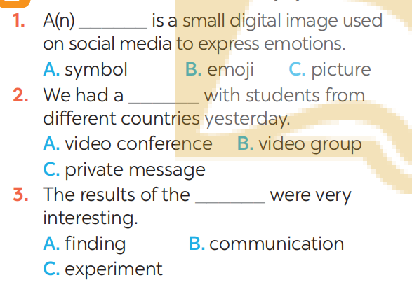
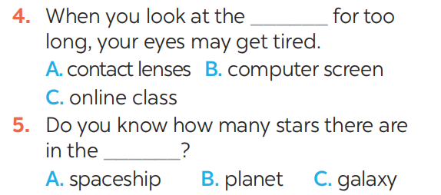
VOCABULARY
4
Choose the best answer A, B, or C.

Slide 11
VOCABULARY
5
Fill in each blank with the suitable form of the word given.
possibility
1. Scientists are interested in the of life on Mars. (possible)
2. We can use face to identify people. (recognise)
3. When we communicate using echnology, it is called digital . (communicate)
4. The Internet is slow here, so we can’t get in the chat room. (connect)
5. Do you think this machine will be cheaper in the future? (translate)
recognition
communication
connection
translation

Slide 12
GRAMMAR
7
Change these sentences into reported speech
1. “What planet do you want to visit?” my friend asked me.
_______________________________.
2. “I’m now reading a book about future ways of communication,” she told me.
_______________________________.
3. “How will teachers check attendance inthe future?” Lan asked Nam.
_______________________________.
My friend asked me what planet I wanted to visit.
She told me (that) she was reading a book about future ways of communication then.
Lan asked Nam how teachers would check attendance in the future.

Slide 13
GRAMMAR
7
Change these sentences into reported speech
4. “We are having a video conference with other clubs next week,” our club president said.
_______________________________.
5. I asked my mum, “When will there be a full moon?”
_______________________________.
Our club president said (that) we were having a video conference with other clubs the next/following week.
I asked my mum when there would be a full moon.

Slide 14

CONSOLIDATION
1
Wrap-up
What have we learnt in this lesson?
Review the language they have studied from Unit 10 to 12.

Slide 15

CONSOLIDATION
2
Home Assignments
- Review vocabulary & grammar (unit 10-12)
- Prepare for the next lesson.

Slide 16

Website: hoclieu.vn
Fanpage: facebook.com/sachmem.vn/

