Slide 1
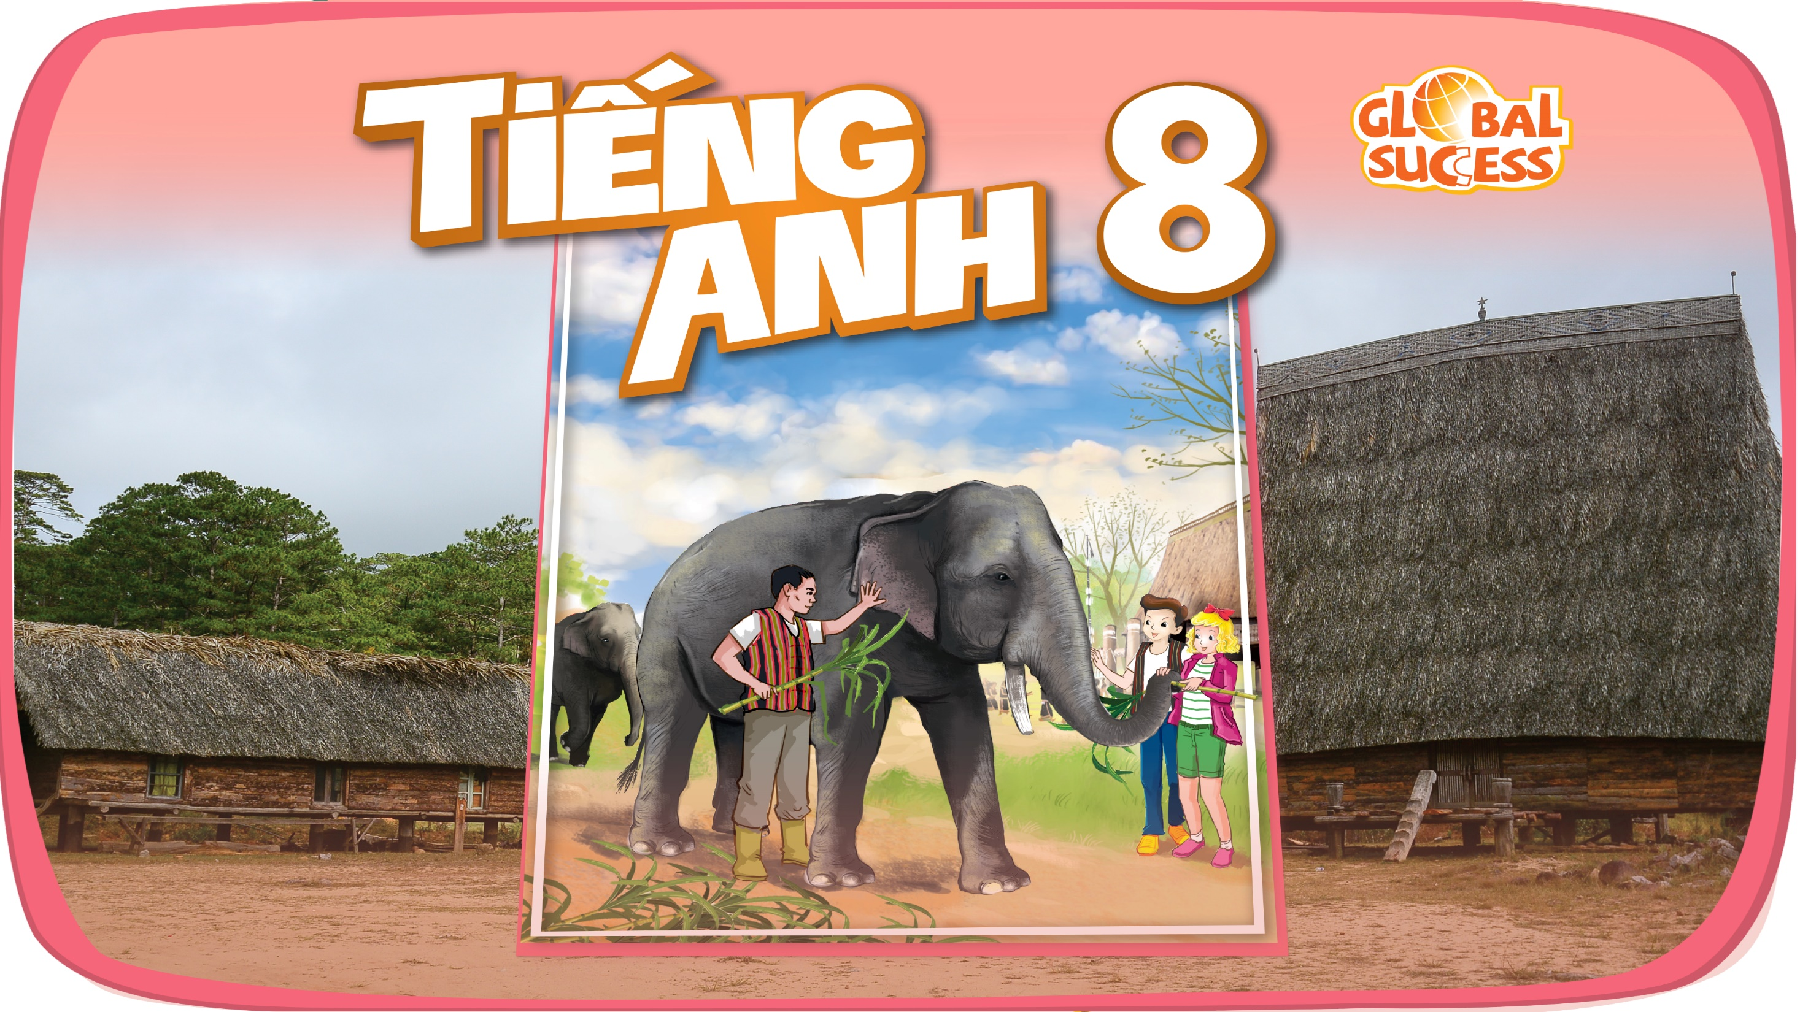

Slide 2

Unit
12
LIFE ON OTHER PLANETS
LESSON 4: COMMUNICATION
EVERYDAY ENGLISH
THREE PLANETS IN THE SOLAR SYSTEM.
1

Slide 3
WARM-UP
Questions:
1.Do you think Vietnam football team may take part in the World Cup?
-> I don’t know yet.
2. Do you think we can have anywhere door in the future?
-> I don’t think so.
-> If you aren’t sure about it, you can use express uncertainty

Slide 4

EVERYDAY ENGLISH
1
Listen and read the conversations. Pay attention to the highlighted sentences.
1.
Nick: Do you think Mars may support life?
Mark: I’m not sure about it. Scientists are trying to find life there.
2.
Mary: Do you think Ann will win tomorrow?
Tommy: I doubt it. She injured her arm in a match last week.

Slide 5
EVERYDAY ENGLISH
2
Work in pairs. Make similar conversations with the following situations.
A: Do you think Mars may have water?
B: I’m not sure about it. We haven’t seen water here yet.
A: Do you think…………….will get good marks on the English test?
B: I doubt it. She/he is lazy.
A: Do you think the weather will be fine tomorrow?
B: It’s very unlikely. It’s raining today.

Slide 6
THREE PLANETS IN THE SOLAR SYSTEM
3
Read the information below and answer the questions that follow.
Mercury
– smallest and closest to the sun with
no moon
– very hot in the daytime but very cold
at night
– no atmosphere → no wind or weather on it
Venus
– hottest planet with no moon
– nearly as big as Earth
– often very bright in the early morning
→ people call it the morning star
Jupiter
– largest planet with about 63 moons
– stormiest planet
– third brightest object in the night sky

Slide 7
THREE PLANETS IN THE SOLAR SYSTEM
3
Read the information below and answer the questions that follow.
1. What planets have no moon?
2. What planet is similar in size to Earth?
3. What planet is the smallest and closest to the sun?
4. What planet is called the morning star?
5. What is the largest and stormiest planet?
(They are) Mercury and Venus.
(It is) Venus.
(It is) Mercury.
(It is) Venus.
(It is) Jupiter

Slide 8
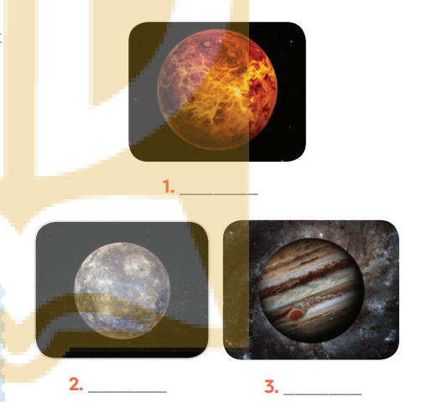
THREE PLANETS IN THE SOLAR SYSTEM
4
3
Work in pairs. Discuss and match the three planets in with the pictures (1 - 3) below.
Venus.
Mercury
Jupiter

Slide 9
THREE PLANETS IN THE SOLAR SYSTEM
5
3
Work in groups. Take turns to talk about one of the three planets in
You can begin with:
Today, I would like to tell you about……
In my talk, I’ll tell you about…..
Today I’m going to talk about…..
What I’d like to present to you today is…..
Example:
I would like to tell you about Mercury.
It is the smallest planet ...

Slide 10
THREE PLANETS IN THE SOLAR SYSTEM
5
Model Answers:
I would like to tell you about Mercury.
It is the smallest planet. It is the closest planet to the sun, and it doesn’t have any moons.
It is hot in the daytime but very cold at night.
Mercury doesn’t have atmosphere so there is no wind or weather.
In my talk I’ll tell you about Jupiter.
It is the largest planet with about 63 moons.
It is the stormiest planet.
Jupiter is third brightest object in the night sky.

Slide 11

CONSOLIDATION
1
Wrap-up
What have we learnt in this lesson?
Express uncertainty
Talk about the planet.

Slide 12

CONSOLIDATION
2
Home Assignments
Do exercise in workbook

Slide 13

Website: hoclieu.vn
Fanpage: facebook.com/sachmem.vn/

