Slide 1


Slide 2

Unit
12
LIFE ON OTHER PLANETS
LESSON 7: LOOKING BACK & PROJECT
VOCABULARY REVIEW
1
GRAMMAR REVIEW
Unit
PROJECT: LOCAL CUSTOMS AND TRADITIONS

Slide 3
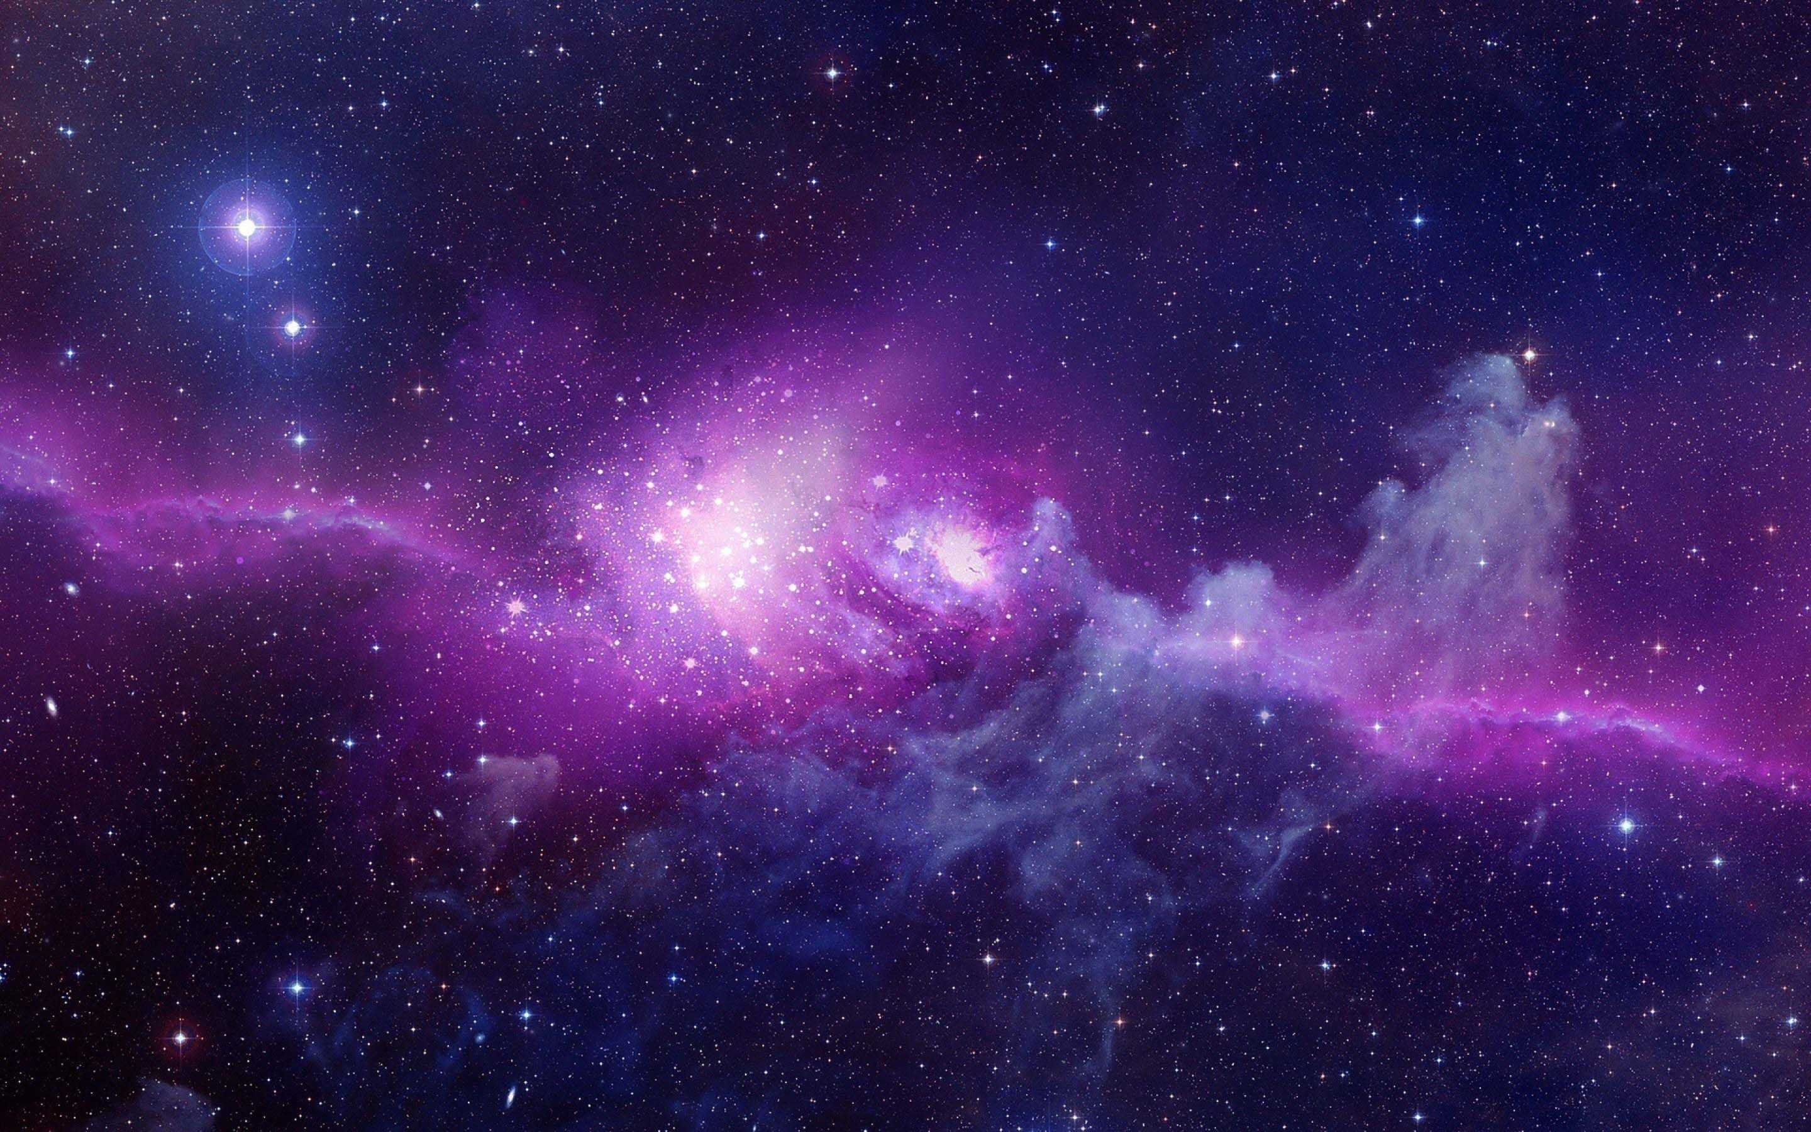
WARM UP
What you have learned from this Unit?
About Aliens, planets, solar system, atmosphere,…..

Slide 4
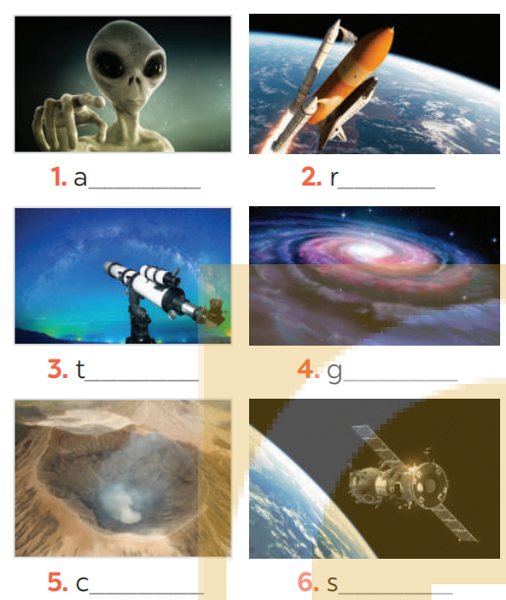
LOOKING BACK
1
Write a word under each picture
lien
ocket
elescope
alaxy
rater
paceship

Slide 5
LOOKING BACK
2
Circle the correct words to complete the sentences.
1. UFOs / Rockets are spaceships from another planet.
2. We have no possibility / condition of making our own spaceship.
3. We can’t find any living craters / creatures in the solar system except for us.
4. Scientists are working to find a habitat / habitable planet.
5. The gravity / atmosphere of the Earth makes things fall to the ground when we drop them.

Slide 6
LOOKING BACK
3
Rewrite each sentence so that it is closest in meaning to the original one.
1. “What is this novel about?” said Mary
-> Mary wanted to know .
2. “Who’s your favourite actor, Nick?” I said
-> I asked Nick .
3. “What time does the next train leave?” Mai said to me.
-> Mai asked me .
4. How do the scientists observe the other planets?” the students asked.
-> The students wondered .
5. Mai wondered, “Why can’t humans live on Mars?”
-> Mai wondered .
what that novel was about.
who his favourite actor was.
what time the next train left.
how the scientists observed the other planets.
why humans couldn’t live on Mars.

Slide 7
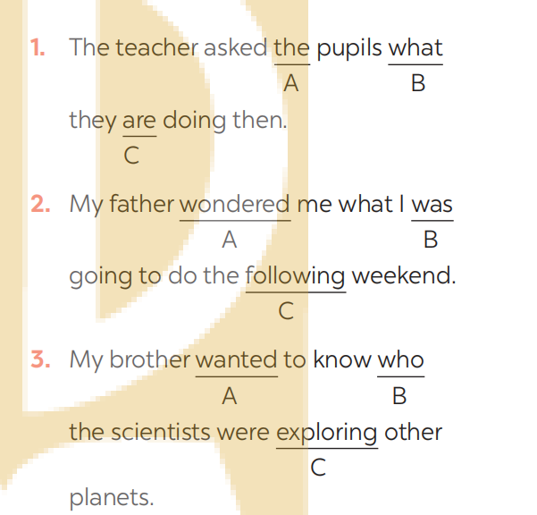
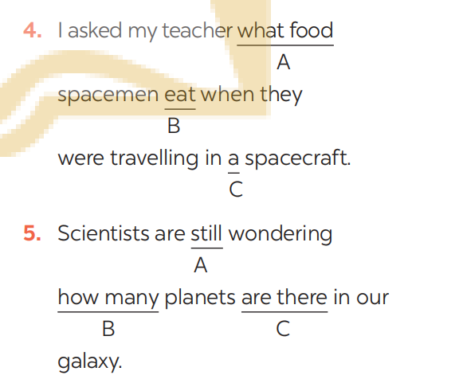
LOOKING BACK
4
Which of the underlined parts in each question is incorrect? Find and correct it.
were
ate
asked
there are
how/why

Slide 8

PROJECT
OUR FAVORITE PLANET
Work in groups.
Discuss and choose what planet you like.

Slide 9

PROJECT
OUR FAVORITE PLANET
Work in groups.
Choose information to write about (name, size, atmosphere, temperature, appearance,...)
You can illustrate by picture.

Slide 10

PROJECT
OUR FAVORITE PLANET
Work in groups.
Present your poster to the class

Slide 11
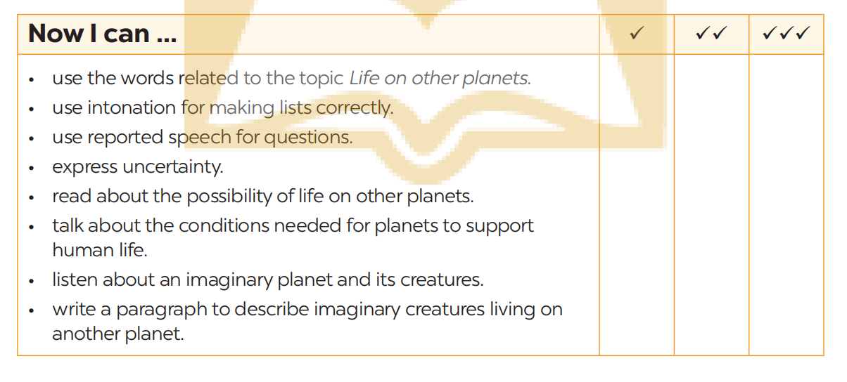
PROJECT
Complete the self-assessment table.

Slide 12

CONSOLIDATION
1
Wrap-up
What have we learnt in this lesson?
Review the vocabulary and grammar of Unit 12.
Make a poster about the planet.

Slide 13

CONSOLIDATION
2
Home Assignments
- Make sentences using the vocabulary.
- Prepare for the next lesson.

Slide 14

Website: hoclieu.vn
Fanpage: facebook.com/sachmem.vn/

