Slide 1


Slide 2


Unit
12
LIFE ON OTHER PLANETS
LESSON 1: GETTING STARTED
A Thrilling Science Fiction Novel
1

Slide 3

OBJECTIVES
By the end of the lesson, students will be able to:
Identify the topic of the unit.
Use lexical items related to outer space.
Identify the language features that are covered in the unit.

Slide 4
LESSON 1: GETTING STARTED
WARM-UP
Option 1:Brainstorming
Option 2: The one-word game
Vocabulary
PRESENTATION
Task 1: Listen and read.
Task 2: Read the conversation again and tick (√) T (True) or F (False)
Task 3: Match the words with their definitions.
Task 4: Complete the sentences with the words in task 3.
PRACTICE
PRODUCTION
Task 5: Discussion
CONSOLIDATION
Wrap-up
Homework

Slide 5
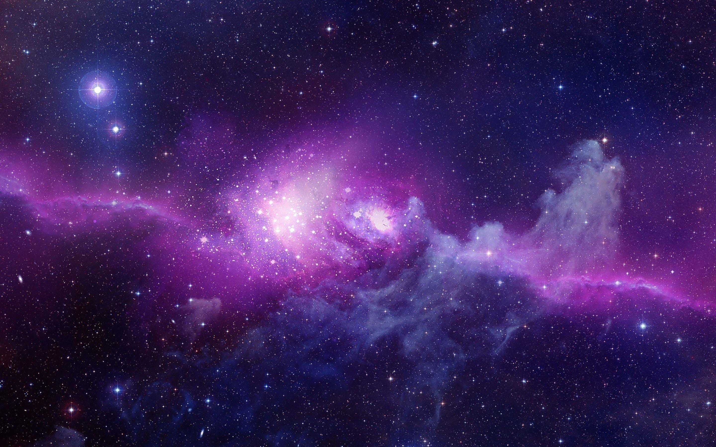
WARM-UP
OPTION 1
Write on the board the list of future technology you expect to see in the future in 2 minutes.
Science and Technology

Slide 6
WARM-UP
OPTION 1
Answer the questions:
1. Where and How fast do you think we can travel with those new technologies?
2. Can we travel to other planets with those technologies?
Science and Technology
LIFE ON OTHER PLANETS

Slide 7
WARM-UP
OPTION 2
Answer the questions with only one word:
1. What one word would you to describe the Earth?
The one-word game
Love, round, colorful, living, blue, beautiful....

Slide 8
WARM-UP
OPTION 2
2. What one word would you to describe the Space?
The one-word game
Enchanted, limitless, magical, immense, vast, dangerous...

Slide 9
WARM-UP
OPTION 2
3. What one word would you to describe the alien?
The one-word game
LIFE ON OTHER PLANETS
Unreal, mysterious, exotic, friendly, threatening.

Slide 10
LESSON 1: GETTING STARTED
WARM-UP
Option 1:Brainstorming
Option 2: The one-word game
Vocabulary
PRESENTATION

Slide 11
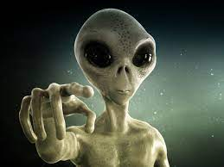

PRESENTATION
alien (n)
/ˈeɪliən/
người ngoài hành tinh

Slide 12
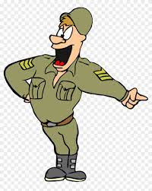
PRESENTATION
commander (n)
/kəˈmɑːndə/
người chỉ huy/ sĩ quan chỉ huy/ trung tá

Slide 13
PRESENTATION
creature (n)
/ˈkriːtʃə/
sinh vật.

Slide 14
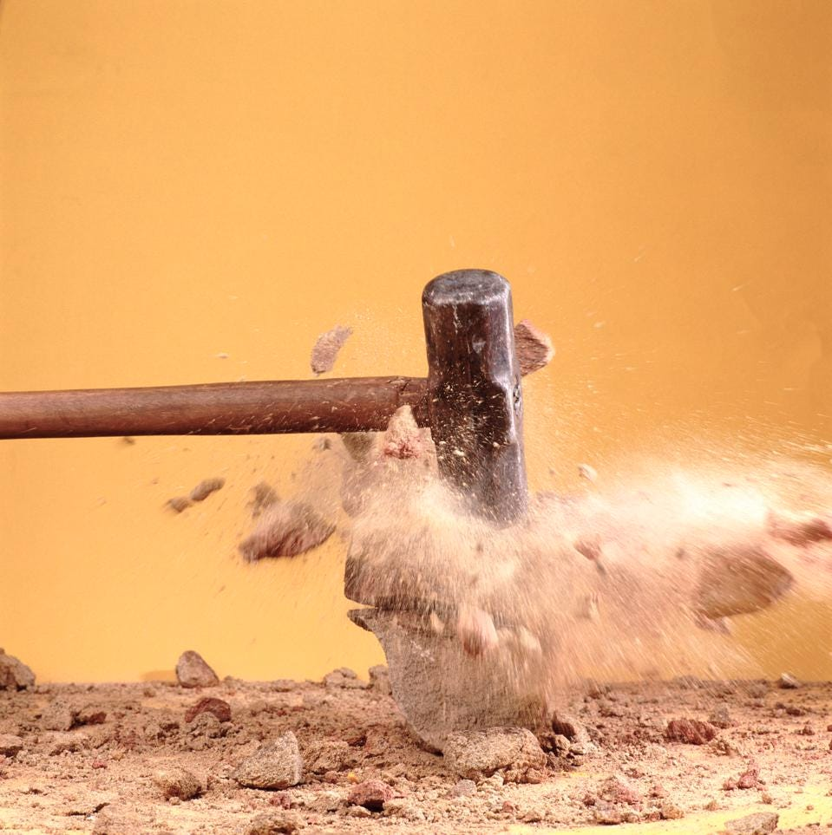
PRESENTATION
destroy (v)
/dɪˈstrɔɪ/
hủy diệt/ tàn phá

Slide 15

PRESENTATION
oppose (v)
/əˈpəʊz/
chiến đấu, đánh lại ai.

Slide 16
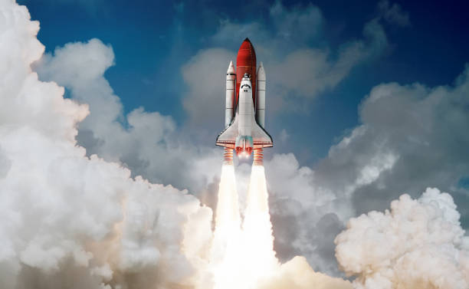
PRESENTATION
spaceship (n)
/ˈspeɪsʃɪp/
phi thuyền

Slide 17
PRESENTATION
thrilling (adj)
/ˈθrɪlɪŋ/
Kịch tính

Slide 18
PRESENTATION
New words | Pronunciation | Meaning
1. alien (n) | /ˈeɪliən/ | người ngoài hành tinh
2. commander (n) | /kəˈmɑːndə/ | người chỉ huy/ sĩ quan chỉ huy/ trung tá
3. creature (n) | /ˈkriːtʃə/ | sinh vật
4. destroy (v) | /dɪˈstrɔɪ/ | hủy diệt/ tàn phá
5. oppose (v) | /əˈpəʊz/ | chiến đấu, đánh lại ai.
6. spaceship (n) | /ˈspeɪsʃɪp/ | phi thuyền
7. thrilling (adj) | /ˈθrɪlɪŋ/ | kịch tính

Slide 19
LESSON 1: GETTING STARTED
WARM-UP
Option 1:Brainstorming
Option 2: The one-word game
Vocabulary
PRESENTATION
Task 1: Listen and read.
Task 2: Read the conversation again and tick (√) T (True) or F (False)
Task 3: Match the words with their definitions.
Task 4: Complete the sentences with the words in task 3.
PRACTICE

Slide 20
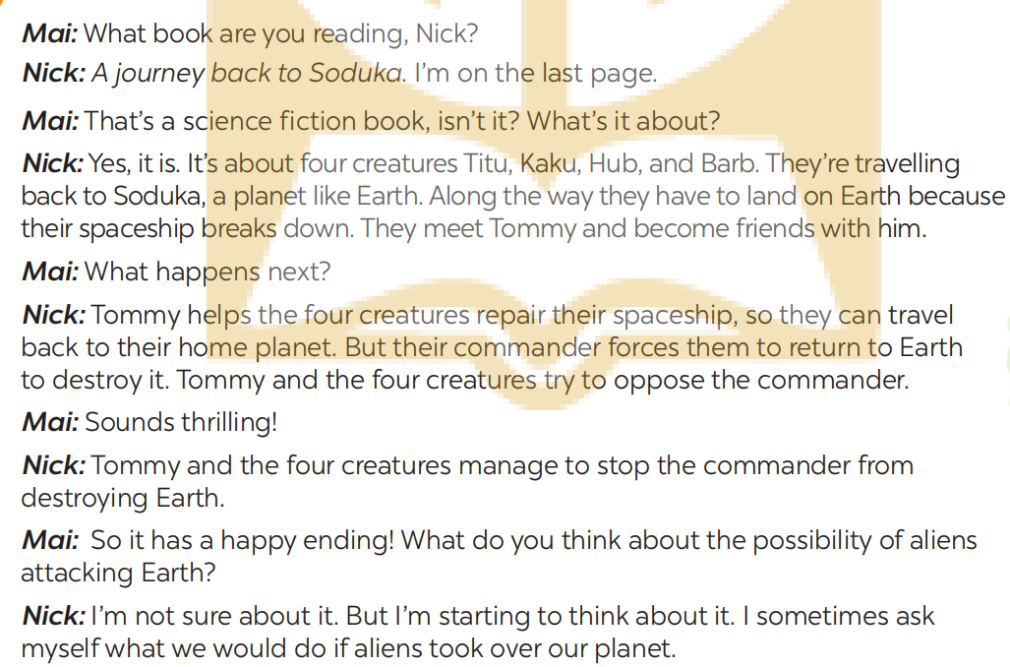
PRACTICE
1
Look at the conversation and answer questions:

Slide 21
PRACTICE
1
Look at the conversation and answer questions:
What are Nick and Mai talking about?
Who do you think the men in black are?
What are Nick and Mai talking about?
Who do you think the men in black are?

Slide 22
PRACTICE
1
Listen and read.

Slide 23
PRACTICE
What are Nick and Mai talking about?
They are talking about aliens creatures from another planet.
Who do you think the men in black are?
They are aliens / creatures from another planet.

Slide 24
PRACTICE
Where do you think the men in black are from?
He is from Earth.
What do you think the object above the men is?
It is a spaceship / flying saucer / UFO.

Slide 25
PRACTICE
2
Read the conversation again and tick (√) T (True) or F (False)
 | T | F
1. Soduka is a planet that is very different from Earth.
2. Titu, Kaku, Hub, and Barb have to land on Earth because their spaceship breaks down.
3. Tommy helps the four creatures make a new spaceship so that they can return to Soduka.
4. The four creatures travel to Earth again to visit Tommy.
5. The novel makes Nick and Mai think about the possibility that Earth might be attacked by aliens.
like
√
√
repair
√
√
protect the Earth/oppose the commander
√

Slide 26
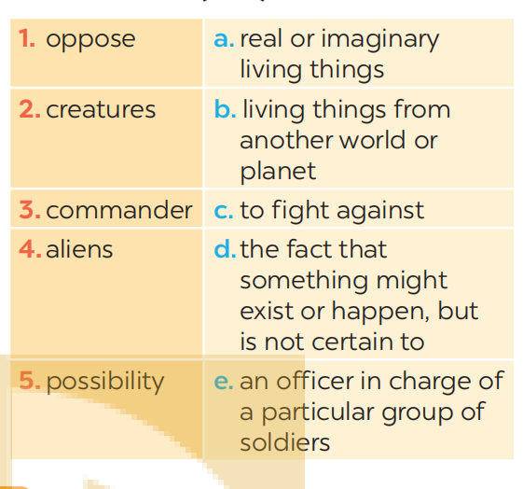
PRACTICE
3
Match the words (1 - 5) with their definitions (a - e).
c
1.
2.
3.
4.
5.
a
e
b
d

Slide 27
PRACTICE
4
Complete the sentences with the words in task 3
possibility
oppose
creatures
commander
aliens
possibility
1. | There is a ______ that we might visit Mars in the near future.
2. | The main character in the film is a boy who makes friends with some _______from a planet.
3. | Dogs are more social ______ than cats.
4. | These soldiers were punished because they didn’t obey their ________.
5. | Some people ______ sending spaceships to explore other planets.
aliens
creatures
commander
oppose

Slide 28
LESSON 1: GETTING STARTED
WARM-UP
Option 1:Brainstorming
Option 2: The one-word game
Vocabulary
PRESENTATION
Task 1: Listen and read.
Task 2: Read the conversation again and tick (√) T (True) or F (False)
Task 3: Match the words with their definitions.
Task 4: Complete the sentences with the words in task 3.
PRACTICE
PRODUCTION
Task 5: Discussion

Slide 29
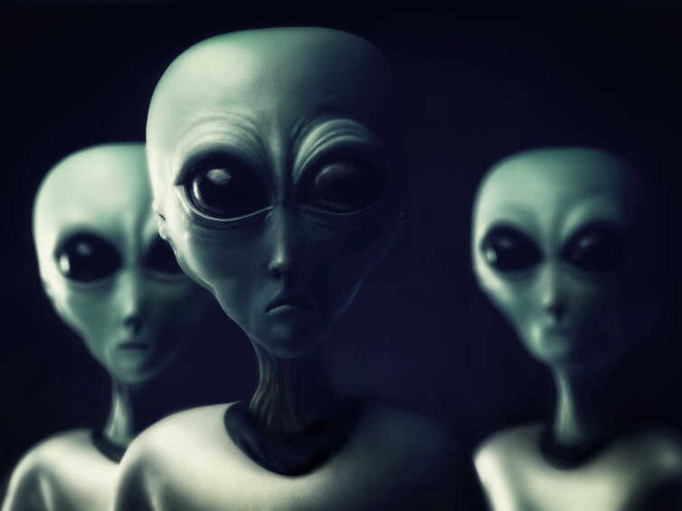
PRODUCTION
5
Work in groups. Discuss the following questions. Then report your group’s answers to the class.
Do you believe that there is life on other planets? Why / Why not?

Slide 30
LESSON 1: GETTING STARTED
WARM-UP
Option 1:Brainstorming
Option 2: The one-word game
Vocabulary
PRESENTATION
Task 1: Listen and read.
Task 2: Read the conversation again and tick (√) T (True) or F (False)
Task 3: Match the words with their definitions.
Task 4: Complete the sentences with the words in task 3.
PRACTICE
PRODUCTION
Task 5: Discussion
CONSOLIDATION
Wrap-up
Homework

Slide 31

CONSOLIDATION
1
Wrap-up
What have we learnt in this lesson?
identify the topic of the unit
use lexical items related to outer space
identify the language features that are covered in the unit

Slide 32
CONSOLIDATION
1
Wrap-up
Can you tell me some words in this lesson?

Slide 33

CONSOLIDATION
2
Homework
- Learn the new words by heart.
- Make sentences with new words.

Slide 34

Website: hoclieu.vn
Fanpage: facebook.com/sachmem.vn/

