Slide 1


Slide 2

Unit
12
LIFE ON OTHER PLANETS
LESSON 3: A CLOSER LOOK 2
GRAMMAR
1

Slide 3

OBJECTIVES
By the end of the lesson, students will be able to:
Use reported speech to report questions.

Slide 4
LESSON 3: A CLOSER LOOK 2
WARM-UP
Introduce reported speech (questions)
PRESENTATION
Task 1: Underline the correct word or phrase for each sentence.
Task 2: Put the words and phrases in the correct order to make reported questions.
Task 3: Change the following questions into reported questions.
Task 4: Report the conversation between An and Mai.
Task 5: Work in pairs.
PRACTICE
CONSOLIDATION
Wrap-up: Game: What did they ask you?
Homework

Slide 5
WARM-UP
OPTION 1
Questions:
“How often do you exercise in the morning?”
=> “I asked …. how often he/she did exercise in the morning.”
Present tense -> past tense
Now, look at the Remember box (p.127)

Slide 6
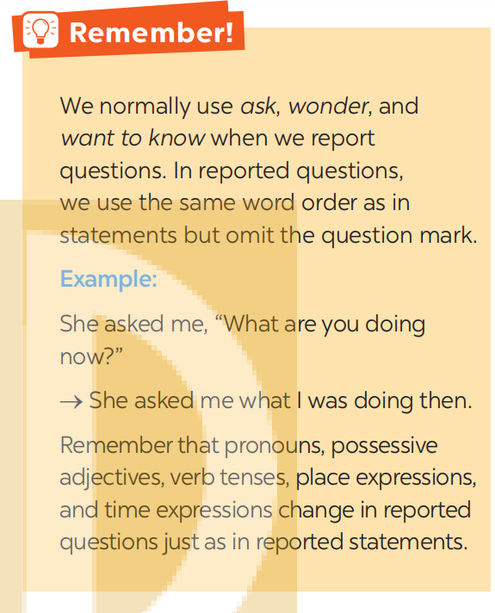
WARM-UP
Remember box (p.127)

Slide 7

WARM-UP
OPTION 2
https://www.youtube.com/watch?v=g2C7-nLkZ8I
Watch video clip:

Slide 8
WARM-UP
OPTION 2
https://www.youtube.com/watch?v=g2C7-nLkZ8I
How we use reported speech (Questions)?
Now, look at the Remember box (p.127)

Slide 9
WARM-UP
OPTION 1
Remember box (p.127)

Slide 10
LESSON 3: A CLOSER LOOK 2
WARM-UP
Introduce reported speech (questions)
PRESENTATION
Task 1: Underline the correct word or phrase for each sentence.

Slide 11
PRESENTATION
Structure:
S + 'ask' (wonder, want to know) + question word + clause.
Example:
”What time does the train leave?”
-> He asked me what time the train left.
“Where did he go?”
-> She wanted to know where he had gone
“When could you get this done by?”
-> He wondered when we could get it done by.

Slide 12
PRESENTATION
1
Underline the correct word or phrase for each sentence.
1. He phoned to ask his mother what she was doing now / then.
2. Ann wondered what plants Vietnamese people grow / grew for food.
3. Peter phoned the shop to ask what specialities they are selling there / here.
4. The student asked his professor what forms of life can / could exist on Mars.
5. He wanted to know how many planets there were / were there in our solar system.

Slide 13
LESSON 3: A CLOSER LOOK 2
WARM-UP
Introduce reported speech (questions)
PRESENTATION
Task 1: Underline the correct word or phrase for each sentence.
Task 2: Put the words and phrases in the correct order to make reported questions.
Task 3: Change the following questions into reported questions.
Task 4: Report the conversation between An and Mai.
Task 5: Work in pairs.
PRACTICE

Slide 14
PRACTICE
2
Put the words and phrases in the correct order to make reported questions.
1. how many moons / My little brother / asked me / had / Venus / .
-> My little brother asked me how many moons Venus had.
2. which / She / planet / the closest / wanted to know / was / to the sun / .
-> She wanted to know which planet was the closest to the sun.
3. asked the scientists / The journalist / what / for / were using / telescopes /
in space / they / .
-> The journalist asked the scientists what they were using telescopes in space for.
4. wanted to know / when / The scientists / travel to Mars / would be able to / humans / .
-> The scientists wanted to know when humans would be able to travel to Mars.
5. He / what / were / asked the professor / to have life / for a planet / the conditions /
on it / .
-> He asked the professor what the conditions were for a planet to have life on it.

Slide 15
PRACTICE
3
Change the following questions into reported questions.
1. “Who will be the first to step on Mars?” Mary asked the scientist.
-> Mary asked the scientist who would be the first to step on Mars.
2. “How fast can a UFO travel?” I asked my father.
-> I asked my father how fast a UFO could travel.
3. The student asked his friend, “How many craters does the moon have?”
-> The student asked his friend how many craters the moon had.
4. The pupils asked the teacher, “Where can we find information about the solar system?”
-> The pupils asked the teacher where they could find information about the solar system.
5. “What is the weather on Mars like?” I asked my teacher.
-> I asked my teacher what the weather on Mars was like.

Slide 16
PRACTICE
4
Report the conversation between An and Mai.
An: What are you reading, Mai?
Mai: I’m reading Aliens, and I’m almost done.
An: What kind of book is it?
Mai: It’s science fiction.
An: What’s it about?
Mai: It’s about three aliens who try to take over Earth.
Example:
An asked Mai what she was reading.
Mai told An that she was reading ...

Slide 17
PRACTICE
4
MODEL ANSWERS
An asked Mai what she was reading. Mai told An that she was reading Aliens and she was almost done. Next, An asked Mai what kind of book it was. Mai said to An that it was science fiction. And An asked Mai what it was about. Mai told An that it was about three aliens who tried to take over Earth.

Slide 18
PRACTICE
5
Work in pairs. Ask your partner five questions about his / her daily routine and make notes of his / her answers. Then report your questions and your partner’s answers to the class.
Example:
I asked ...........what time he/she got up in the morning and he told me (that) he got up at ...

Slide 19
LESSON 3: A CLOSER LOOK 2
WARM-UP
Introduce reported speech (questions)
PRESENTATION
Task 1: Underline the correct word or phrase for each sentence.
Task 2: Put the words and phrases in the correct order to make reported questions.
Task 3: Change the following questions into reported questions.
Task 4: Report the conversation between An and Mai.
Task 5: Work in pairs.
PRACTICE
CONSOLIDATION
Wrap-up: Game: What did they ask you?
Homework

Slide 20

CONSOLIDATION
1
Wrap-up
Game: What did they ask you?
- Making a list of people who might ask you questions and what those questions might be: a police officer, your mother/father, a teacher, a taxi driver, etc.,
- Then you report something that someone asked, without revealing
who it was:
+ This person asked me if I had my driver’s license.
- You must guess it was the police officer: The police officer asked you if you had your driver’s license.

Slide 21

CONSOLIDATION
2
Homework
Make 5 sentences by using reported speech (questions).

Slide 22

Website: hoclieu.vn
Fanpage: facebook.com/sachmem.vn/

