Slide 1


Slide 2

Unit 1:
MY NEW SCHOOL
Period 3 : A closer look 2

Slide 3



UNIT 1: MY NEW SCHOOL
LESSON 3
* Grammar
+ The present simple
We use the present simple to talk about actions or events that often happen, or are fixed.
Example:
We usually go to school by bus.
I don’t like school lunch very much.

Slide 4
The present simple tense:
1. Động từ tobe: “am, is, are”
+ Affimative: S + am,is,are + ……….
- Negative: S + am ,is ,are + not + ………
? Interrogative: Am/is/are + S + ……..?
Wh.. Question: Wh…+am/is ,are + S + …?
- Yes, S + am/is/are.
No, S + am/is/are +not.
Is not = isn’t
Are not = aren’t
Chia ngôi: I am
He, she, it, tên, N(số ít), … . Is
You, we, they, N(số nhiều:s/es) are
Yes, S + do/does.
– No, S + don’t/doesn’t
- do not= don’t
- Does not = doesn’t
2. Động từ thường:
+ Affimative: S + V (s/es) + ………….
- Negative: S + don’t / doesn’t + V ……….
? Interrogative: Do / Does + S + V ……..?
Wh.. Question: Wh…+ do / does + S + ……?
Adverbs: always, usually, sometimes, never, often, , seldom, rarely, today, every…
Chia ngôi You ,we, they N(s/es) V / have / do
He , she , it , N . V(s/es) / has / does
V + es khi cuối V là ( ch , o , x , s , sh )

Slide 5
1. Quy tắc thêm đuôi s/ es
- Động từ không có dấu hiệu đặc biệt: Thêm -s vào sau động từ Ví dụ: get - gets, take - takes
- Động từ kết thúc bằng các chữ cái -ss, -sh, -ch, -x, -o: Thêm -es Ví dụ: miss - misses, wash - washes, watch - watches, mix - mixes, do - does
- Động từ kết thúc bằng một phụ âm và -y: Bỏ -y và thêm -ies Ví dụ: study - studies
2. Cách phát âm đuôi s và es
- Phát âm là /s/ khi âm tận cùng của động từ nguyên thể là /p/, /t/, /k/, /f/ Ví dụ: stops , spots , looks , laughs
- Phát âm là /ɪz/ khi âm tận cùng của động từ nguyên thể là /s/, /z/, /ʃ/, /tʃ/, /dʒ/ Ví dụ: misses , rises , washes , watches , judges
- Phát âm là /z/ khi âm tận cùng của động từ nguyên thể là các âm còn lại Ví dụ: cleans , plays , clears , rides , comes
The present simple verbs with he / she / it need an s / es.

Slide 6

Choose the correct answer A, B, or C.
1.
We new subjects for this school year.
A.
B.
has
C.
having
have
2.
Duy to school every day.
A.
cycling
B.
cycle
C.
cycles
3.
My new school in the centre of the village.
B.
C.
doesn’t
A.
not
isn’t
4.
I live near here. Where live?
A.
B.
you
do you
C.
are you
5.
My friend has a sister, but she a brother.
B.
don’t have
A.
not has
C.
doesn’t have

Slide 7
2. Miss Nguyet is interviewing Duy for the school newsletter. Write the correct form of the verbs.
bản tin của trường
Miss Nguyet: Tell us about your new school, Duy.
Duy : Sure! My school (1. have) ……… a large playground.
Miss Nguyet: you (2. have) ………………… any new friends?
Duy : Yes. And I (3. like) ………. my new friends, Vy and Phong.
Miss Nguyet: Vy (4. walk) ……………… to school with you?
Duy : Well, we often (5. ride) ……… our bicycles to school.
Miss Nguyet: What time do you go home?
Duy : I (6. go) ……….. home at 4 p.m. everyday.
Miss Nguyet: Thank you!
has
Do you have
like
Does Vy walk
ride
go

Slide 8
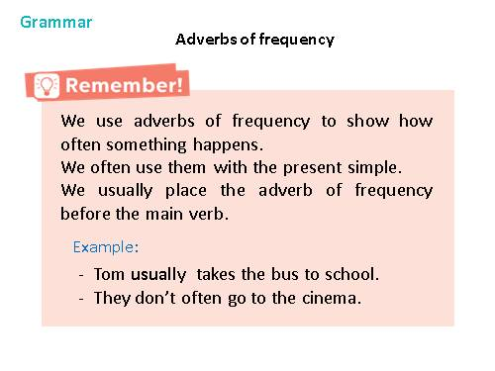

Slide 9
never
always
sometimes
Adverbs of frequency
usually
often

Slide 10

Fill the blanks with usually, sometimes or never.
1.
Always : luôn luôn
2.
Usually : thường xuyên
3.
Sometimes: thỉnh thoảng
4.
rarely: hiếm khi
5.
Never : không bao giờ

Slide 11
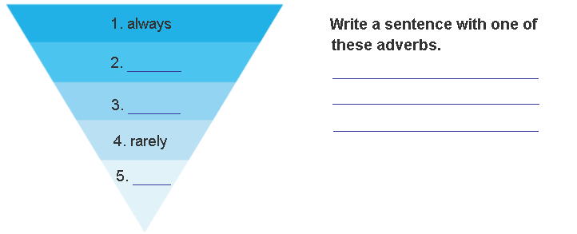
3. Fill the blanks with usually, sometimes or never.
Write a sentence with one of these adverbs.
Luôn luôn
+ Examples:
They always go to school.
usually
Thường xuyên
He usually plays football after school.
- I sometimes go fishing at the weekend.
sometimes
Thỉnh thoảng
- My father rarely goes shopping with my mother.
We are never late for school
Hiếm khi
The adverbs of frequency place before V and after to be ( Trạng thừ thường xuyên luôn đứng trước động từ thường và sau tobe )
never.
Không bao giờ

Slide 12
4. Choose the correct answer A or B to complete each sentence.
1. I __________ late on Saturdays.
A.get up usually B . usually get up
2.My mum __________ to work late.
A. rarely goes B. goes rarely
3. __________ at weekends?
A. Do you often travel B.Often do you travel
4.What kind of music __________?
A.usually does Susan listen to B. does Susan usually listen to
5. When __________ go on holiday each year?
A. do you usually B. you usually

Slide 13
5. Work in pairs. Make questions, and then interview your partner.
1. you / often / ride your bicycle / to school
2. you / sometimes / study / in the school library
3. you / like / your new school
4. your friends / always / go to school / with you
5. you / usually / do homework / after school
=> Do you often ride your bicycle to school?
=> Do you sometimes study in the school library?
=> Do you like your new school?
=> Do your friends always go to school with you?
=> Do you usually do homework after school?

Slide 14
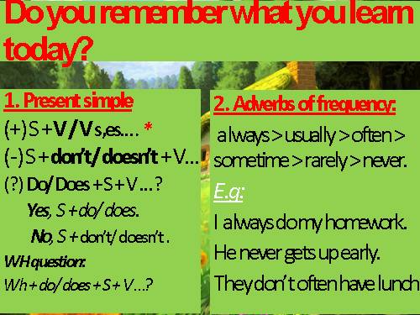

Slide 15
HOMEWORK
- Learn the lesson by heart.
Write them in your notebook.
Do exercises in workbook.
Prepare Unit 1: skills 2

