Slide 1


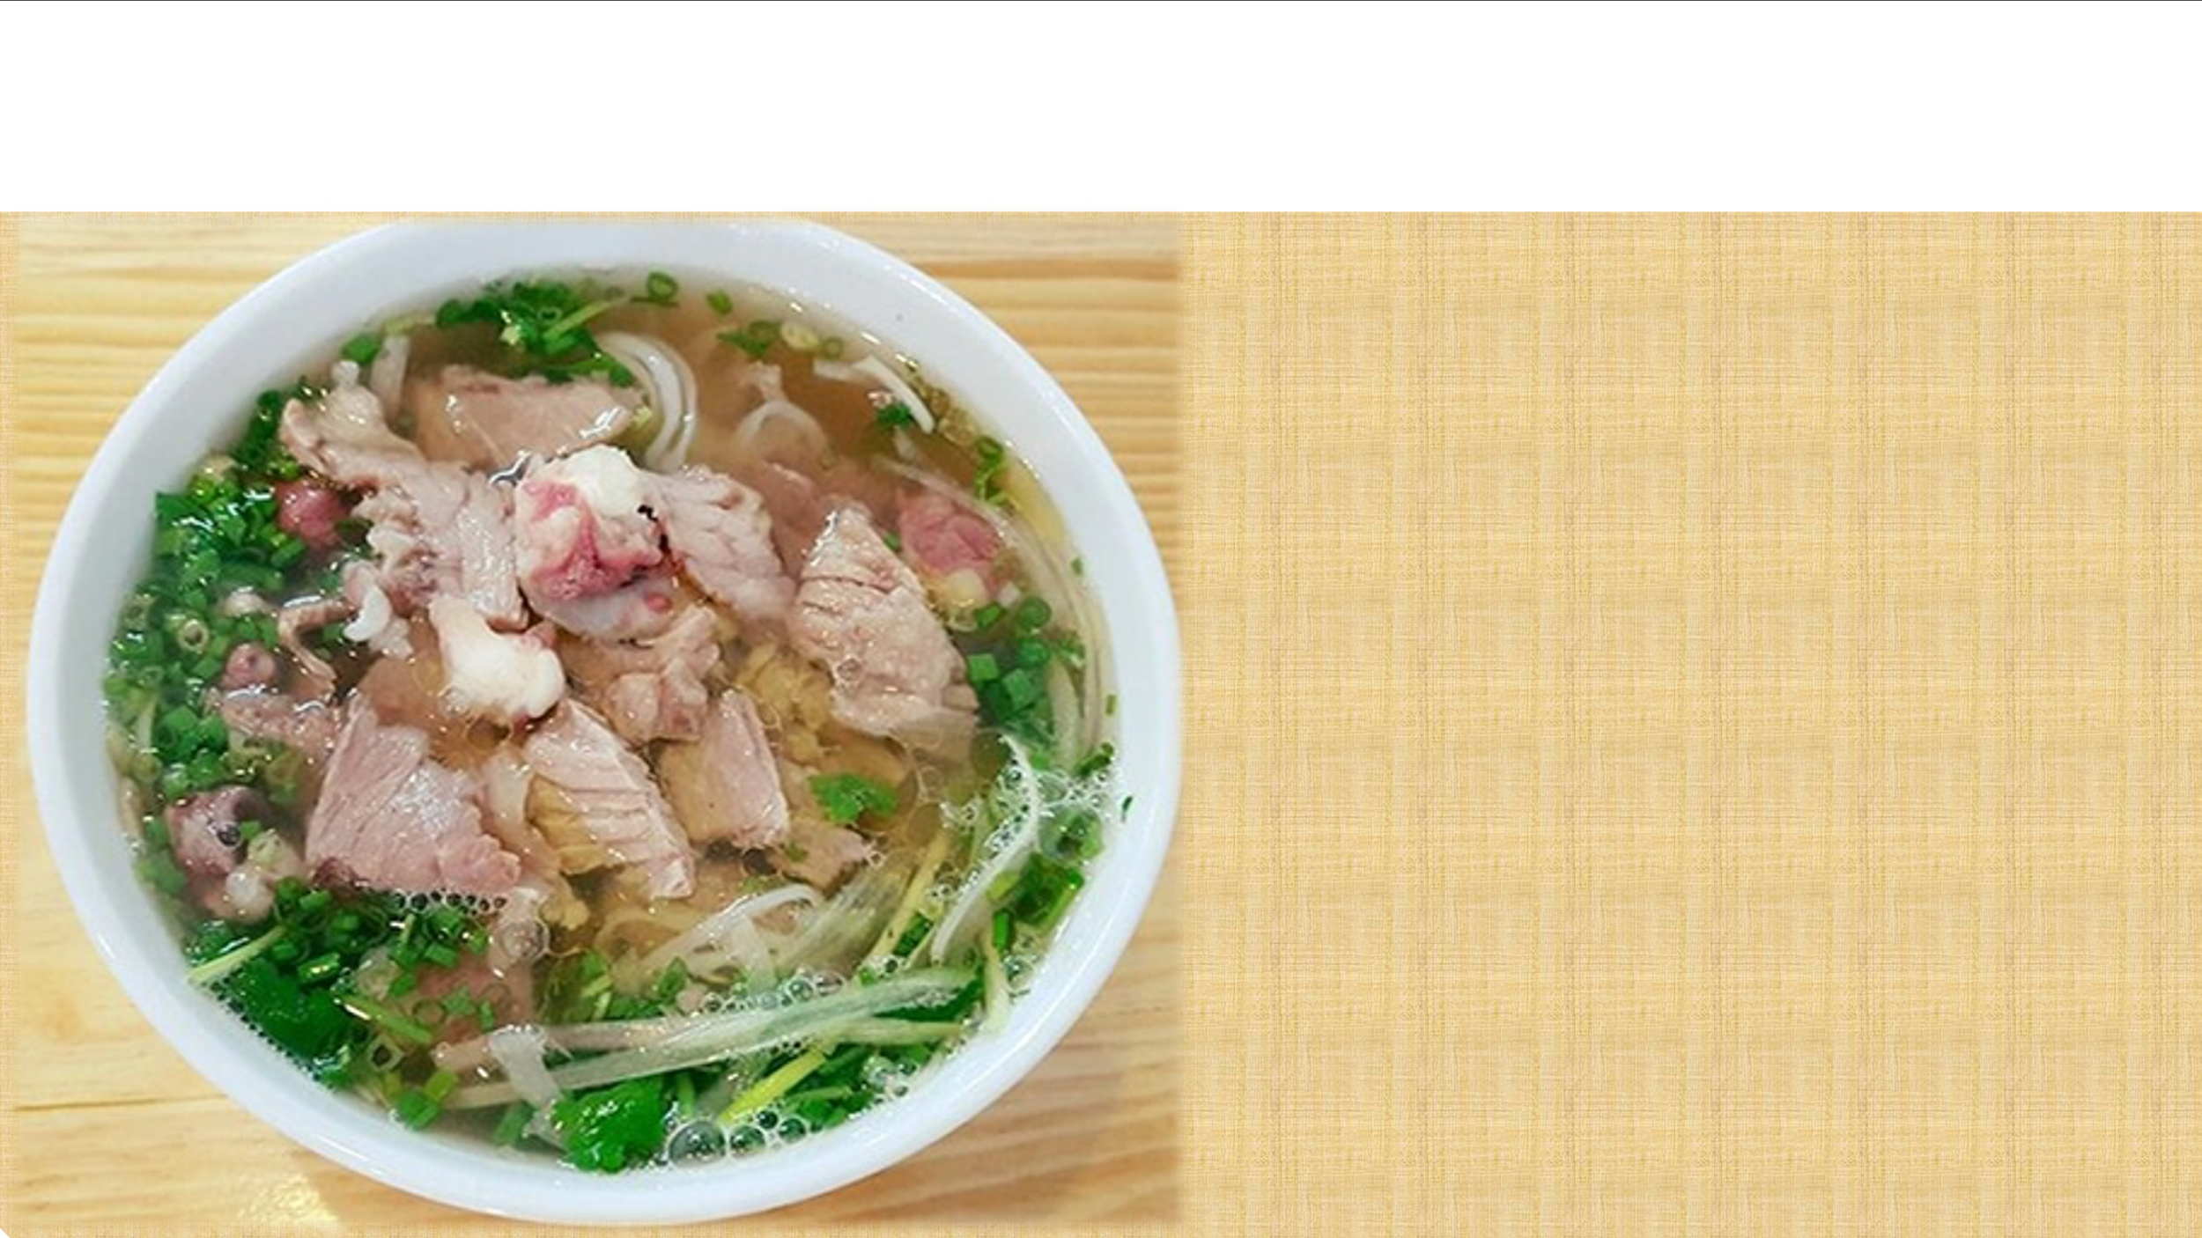

Unit
5
FOOD AND DRINK
Lesson 5: SKILLS 1

Slide 2
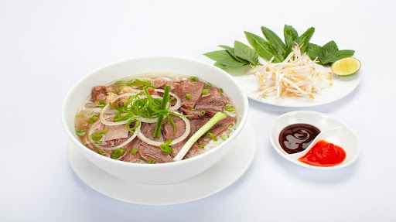
Square 1
Square 2
Square 3
Square 4
Square 5
Square 6
Square 7
Square 8
Square 11
Square 12
Square 9
Square 10
Square 13
Square 14
Square 15
Square 16
Square 17
Square 18
Square 19
Square 20
Square 23
Square 24
Square 21
Square 22
Món Phở
Hiện đáp án
Che hết

Slide 3
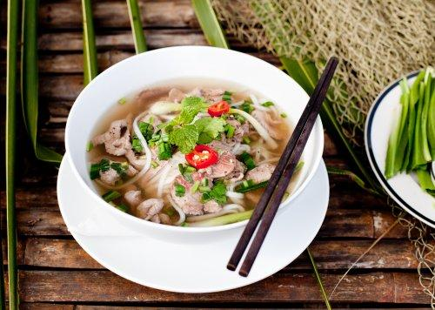
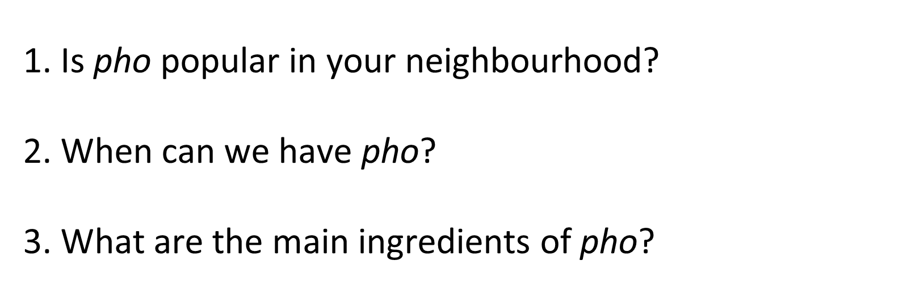

Slide 4
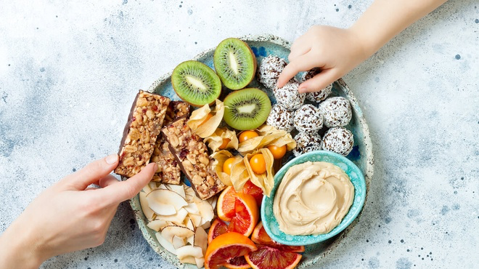
Vocabulary
snack
/snæk/
đồ ăn vặt

Slide 5
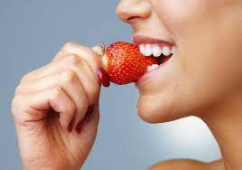
Vocabulary
taste
/teɪst/
nếm

Slide 6
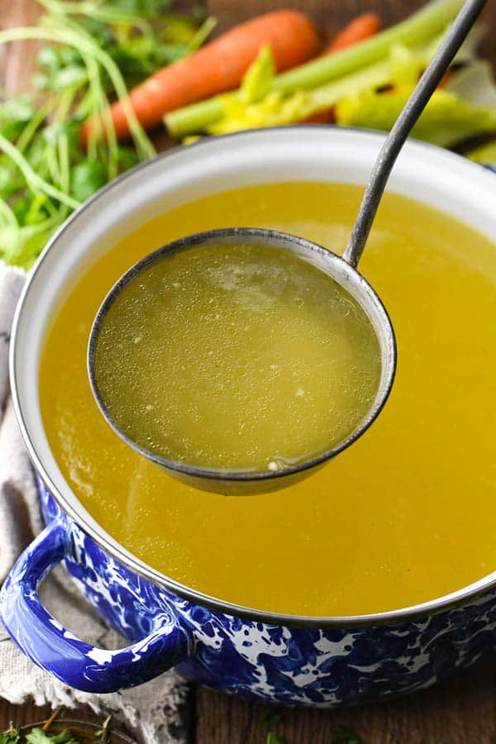
Vocabulary
broth
/brɒθ/
nước dùng, canh

Slide 7
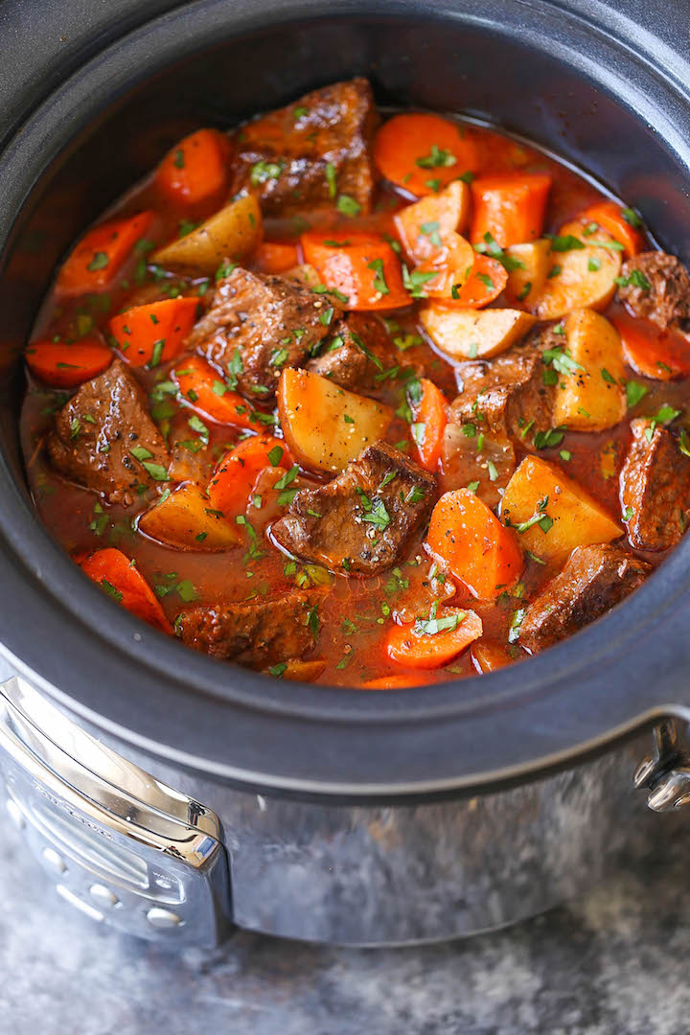
Vocabulary
stew
/stju:/
hầm

Slide 8
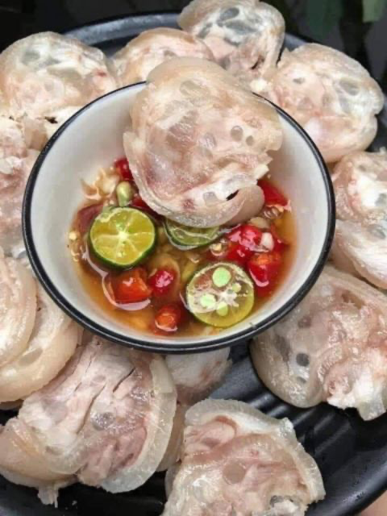
Vocabulary
boneless
/ˈbəʊnləs/
không xương

Slide 9



snack
không xương
taste
hầm
broth
nước dùng, canh
stew
nếm
boneless
đồ ăn vặt

Slide 10
READING
1
Read Phong's blog. Match the underlined words in the text with their meanings.
Pho is a special kind of traditional Vietnamese dish. Its main ingredients are rice noodles and slices of beef or chicken. It is one of the most common dishes you will find in Viet Nam. People enjoy pho at all times of the day, even for a late night snack. Pho has a very special taste. The rice noodles are made from the best kind of rice. There are two main kinds of pho: pho bo (beef noodle soup) and pho ga (chicken noodle soup). The broth for pho is made by stewing beef or chicken bones for a long time in a big pot. The meat (beef and chicken) served with pho is boneless and cut into thin slices ... It's really delicious! Tell me about a popular dish in your area!
Posted by Phong on Feb 22 at 5:30 p.m.
1. snack
a. cooking something slowly, often in water
2. taste
b. the flavour of something
3. broth
c. soup made by boiling bones, meat, etc, and vegetables in water
4. stewing
d. a small meal, usually eaten in a hurry
5. boneless
e. without bones

Slide 11
WHILE-READING
3
Read Phong’s blog again and circle the correct answer A, B or C.
1. The text is mainly about _____.
pho, a popular dish in Viet Nam
popular dishes in Viet Nam
C. different ways to cook pho
2. Pho is made mainly with _____.
rice noodles and beef or chicken
rice, pork, and vegetables
C. fish, shrimp, and noodles
3. We enjoy pho _____.
A. only for breakfast
B. for lunch and dinner
C. at any time of the day
4. To make noodles for pho, we use _____.
A. a variety of sticky rice
B. the best kind of rice
C. eggs and rice flour
5. The broth for pho is made by _____.
slowly cooking beef or chicken bones
cooking beef or chicken with fish sauce
C. boiling potatoes and chicken bones for a long time
(L1)
(L8,9)
(L3)
(L11,12)
(L6)

Slide 12
SPEAKING
4
Make notes about a popular food and drink in your area. Think about its main ingredients, how often and when you have it.
1
main
ingredients
How often?
a popular food and drink in your area
When?
Where?

Slide 13
SPEAKING
5
Work in 3 groups. Take turns to talk about a popular food or drink in your area.
1
main
ingredients
How often?
a popular food and drink in your area
When?
Where?

Slide 14
CONSOLIDATION
2
HOMEWORK
Video your presentation about popular food and drink
Prepare for the next lesson: Skills 2

