Slide 1





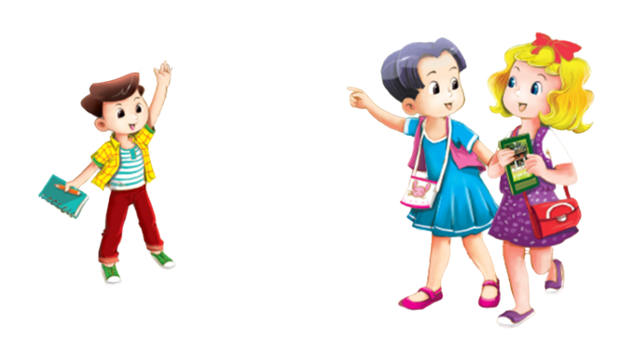

UBND QUẬN HẢI AN
TRƯỜNG TIỀU HỌC ĐẰNG HẢI
MsPham-0936082789
TIẾNG ANH 3
Unit 2
Our names

Slide 2
MsPham-0936082789
TUẦN 4
Unit 2
Our name
Lesson 3 - Period 15

Slide 3




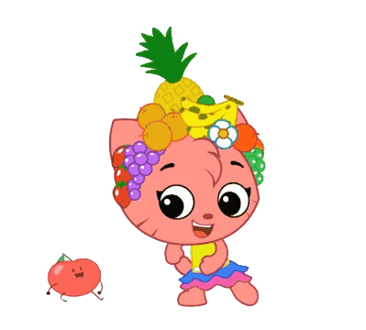
Warm - up
Play

Slide 4


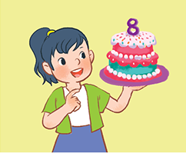
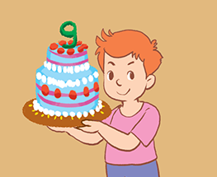
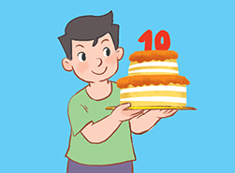
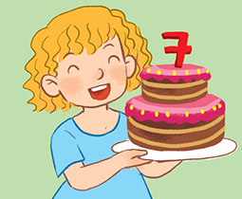
Review
How old are you?
I’m _______ years old.
seven
eight
nine
ten

Slide 5

Phonics
Next

Slide 6

Phonics
/m/

Slide 7
Phonics
Next

Slide 8

Phonics
/n/

Slide 9



What sound is this?
/m/
/n/
Start

Slide 10


What sound is this?
/m/
/n/
Monkey
Next

Slide 11
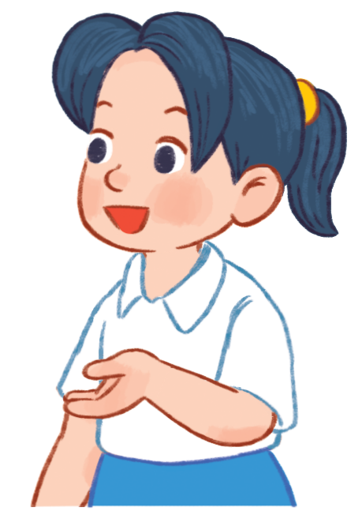
What sound is this?
/m/
/n/
Mai
Next

Slide 12
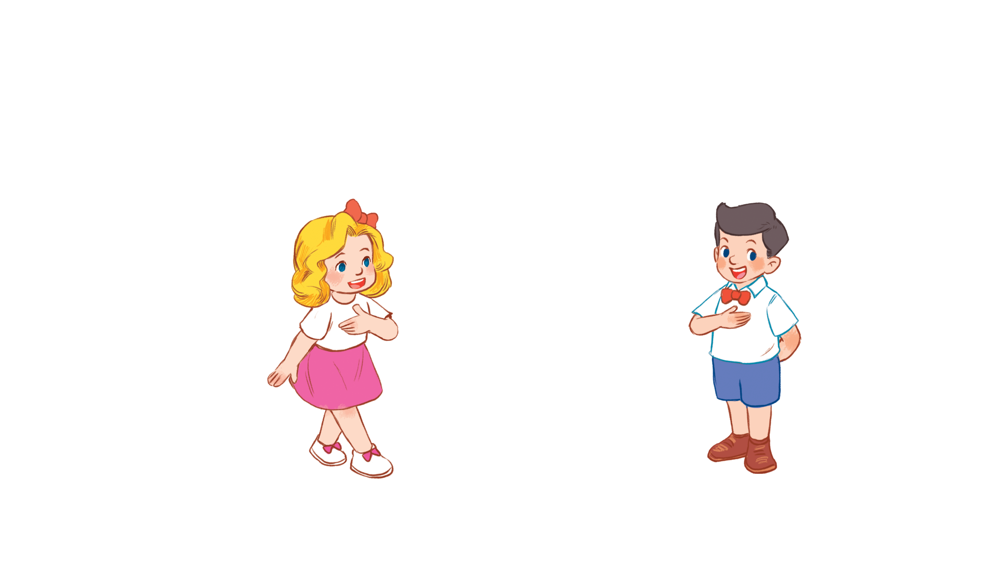
What sound is this?
/m/
/n/
Nam
Next

Slide 13
What sound is this?
/m/
/n/
Mary
Next

Slide 14

What sound is this?
/m/
/n/
name
Next

Slide 15

What sound is this?
/m/
/n/
nine
Next

Slide 16
Welldone!
End

Slide 17
Practice
Next

Slide 18


1
Look, listen and repeat.
m | Mary | I’m Mary.
n | Nam | My name’s Nam.

Slide 19
2
Listen and circle.
1. Hi. I’m __________.
A. Mai B. Mary C. Minh
2. Hello. My name’s __________.
A. Mary B. Mai C. Nam

Slide 20
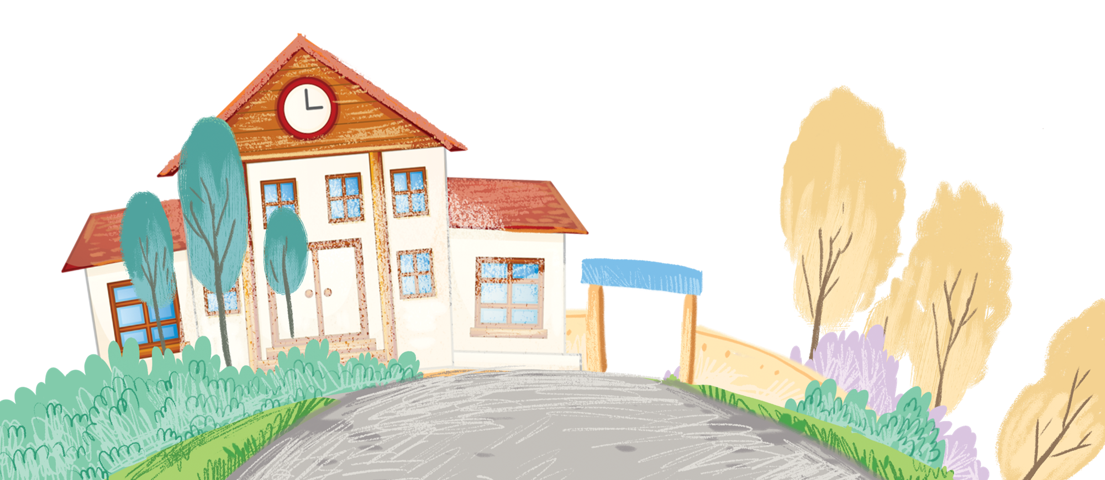
3
Let’s chant.
What’s your name?
My name’s Nam
Nam, Nam, Nam.
What’s your name?
My name’s Mary.
Mary, Mary, Mary.
What's your name?
.

Slide 21
Review
/m/
/n/

