Slide 1





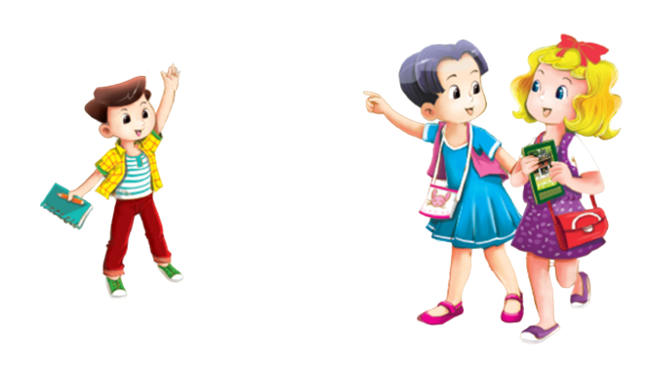

UBND QUẬN HẢI AN
TRƯỜNG TIỀU HỌC ĐẰNG HẢI
MsPham-0936082789
TIẾNG ANH 3
Unit 5
Our hobbies

Slide 2
MsPham-0936082789
TUẦN 9
Unit 5
Our hobbies
Lesson 3 - Period 29

Slide 3



Warm - up
Play

Slide 4



Phonics
Next

Slide 5

Phonics
p
/p/

Slide 6
Phonics
Next

Slide 7
Phonics
r
/r/

Slide 8
Practice

Slide 9

1
Listen and repeat.
p | painting | I like painting.
r | running | I like running.

Slide 10
2
Listen and circle.
A: What’s your hobby?
B: It’s __________.
A. painting B. running C. dancing
1
A: What’s your hobby?
B: I like __________.
A. painting B. singing C. running
2

Slide 11

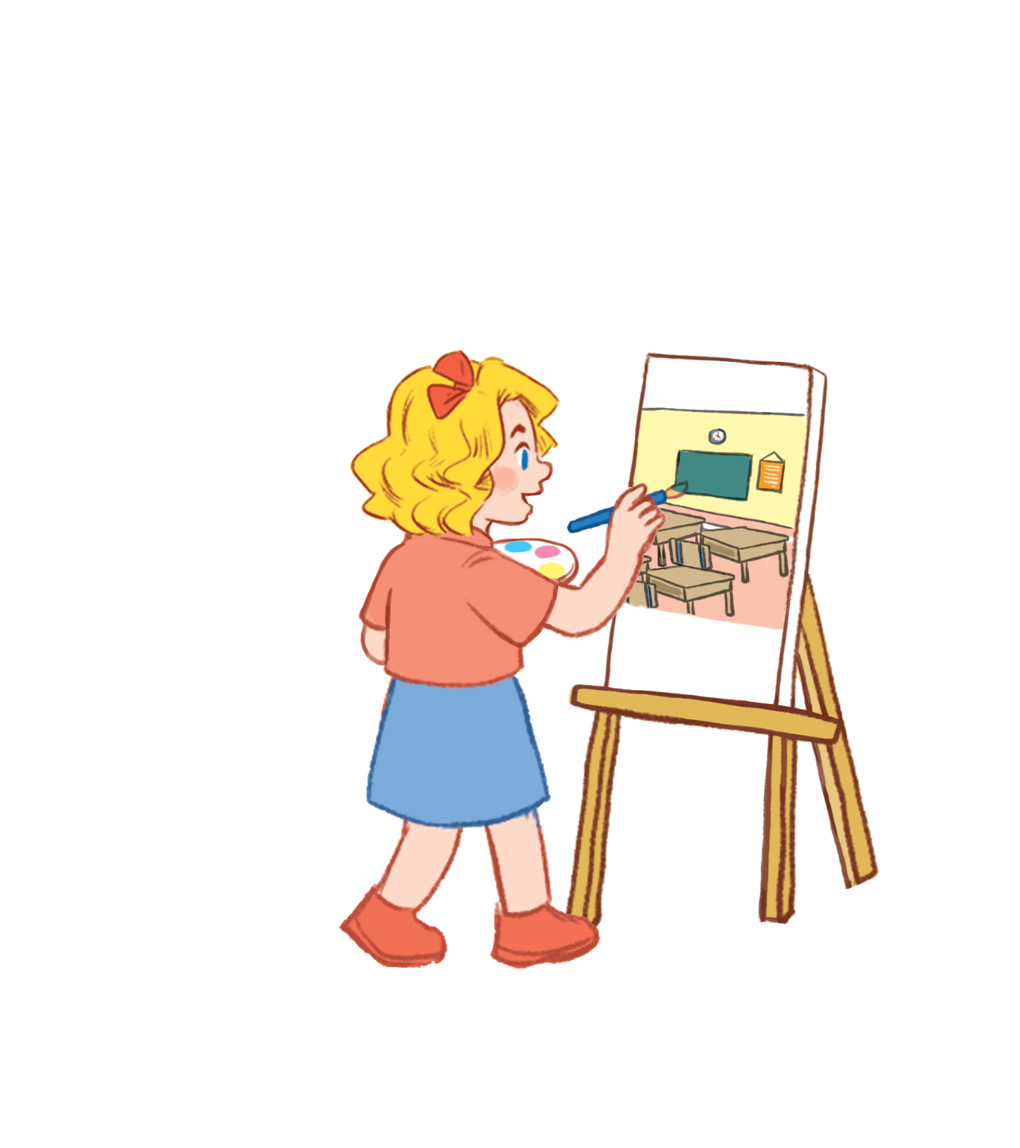
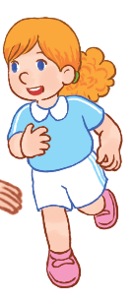
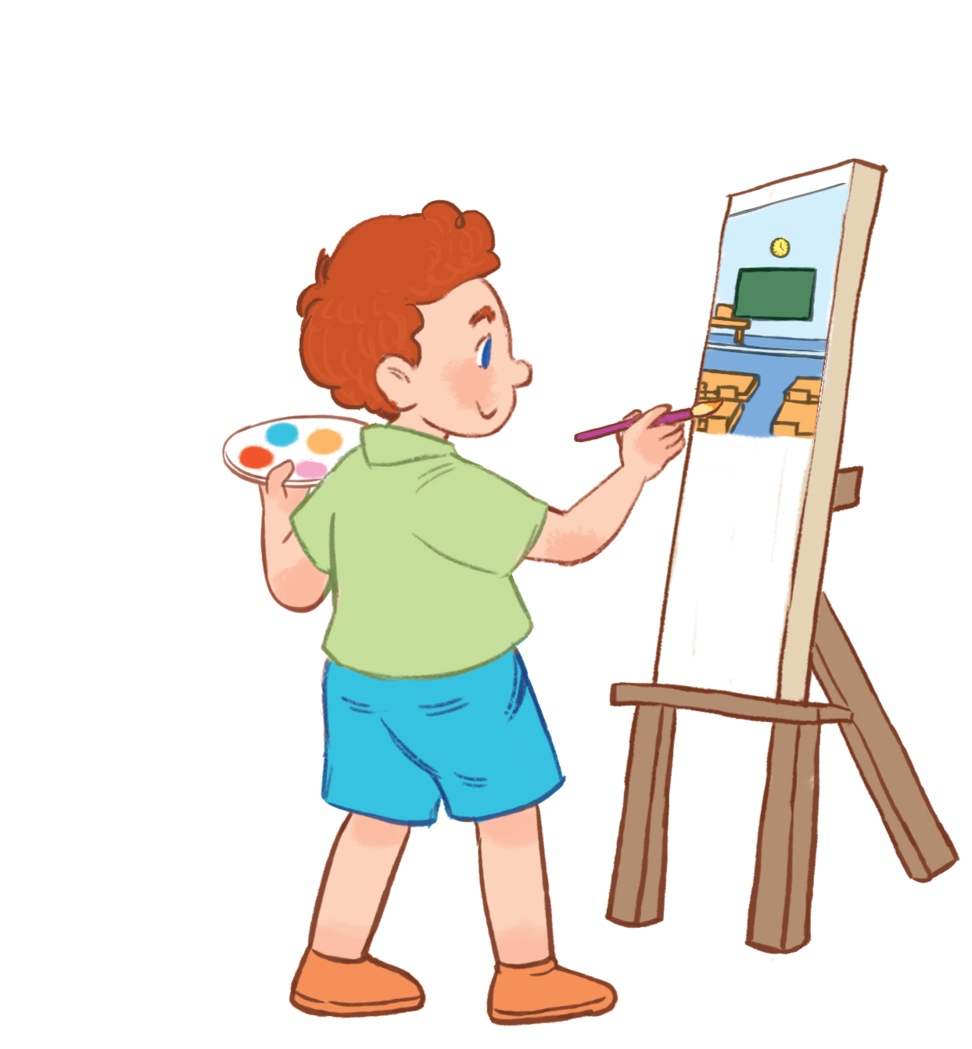
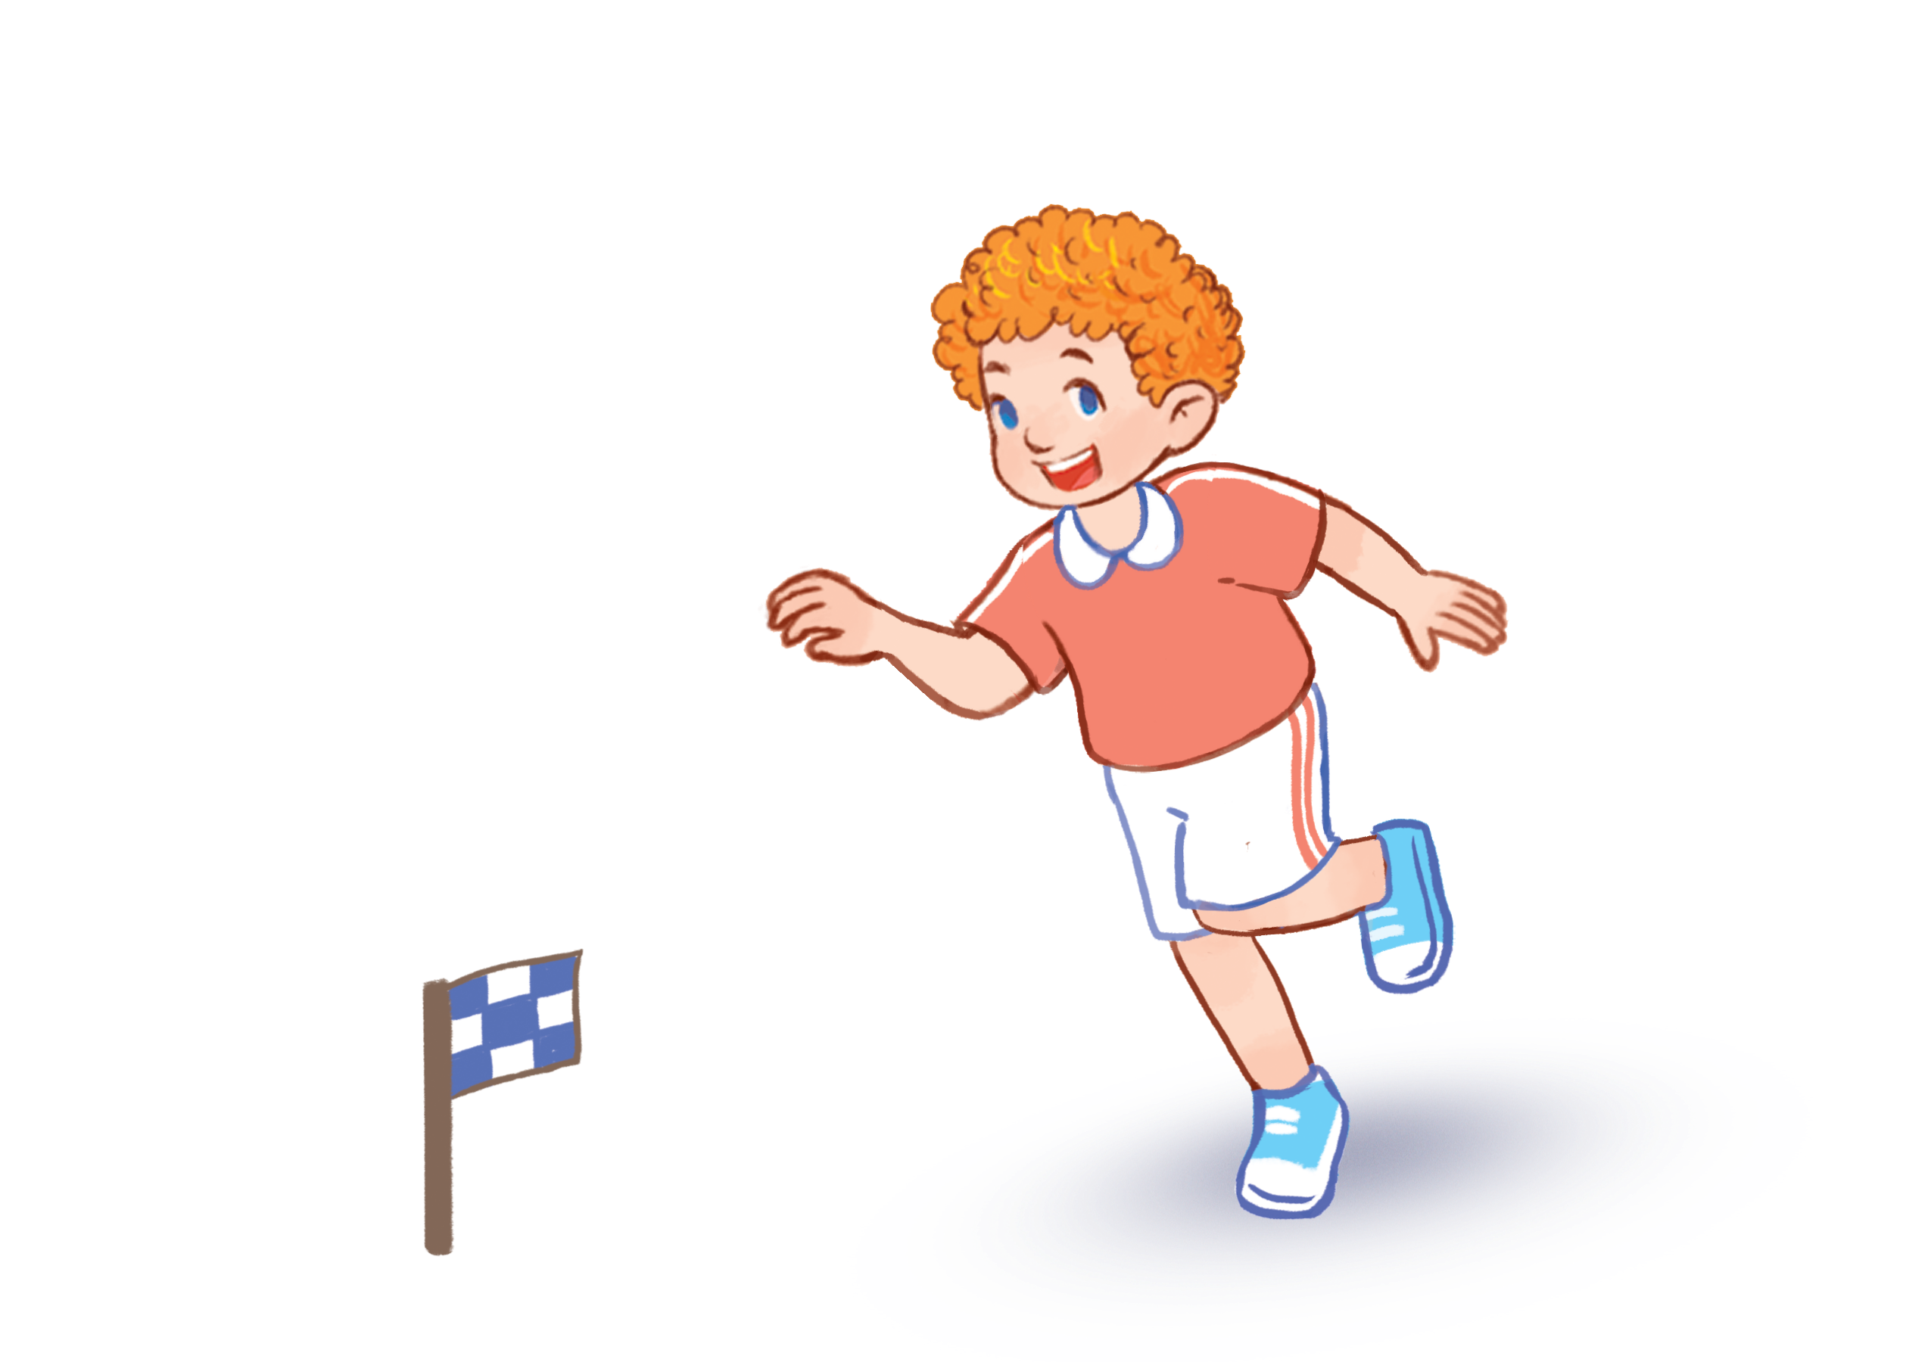
3
Let’s chant.
Painting.
Painting.
I like painting.
Running.
Running.
I like running.
Painting?
Running?
I like painting.
I like running.

Slide 12









Thank you
MsPham-0936082789
For enjoying!

