Slide 1





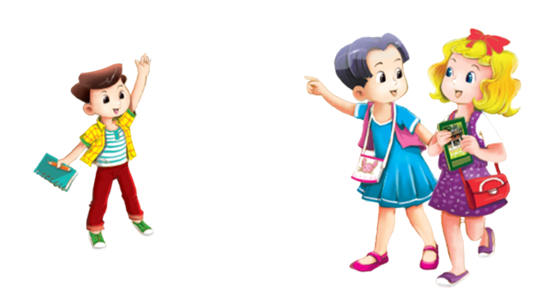

UBND QUẬN HẢI AN
TRƯỜNG TIỀU HỌC ĐẰNG HẢI
MsPham-0936082789
TIẾNG ANH 3
Unit 5
Our hobbies

Slide 2
MsPham-0936082789
TUẦN 9
Unit 5
Our hobbies
Lesson 3 - Period 30

Slide 3



Warm - up
Play

Slide 4










Finding PIKACHU

Slide 5

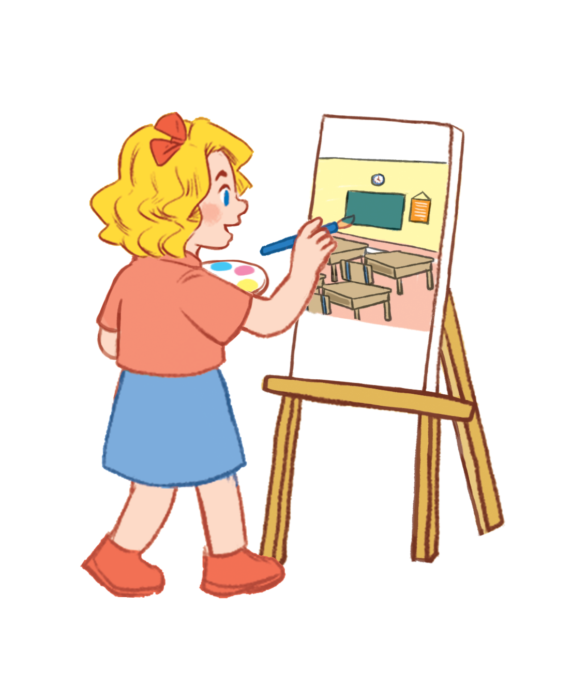


What’s your name?
Fine. Thank you.
It’s drawing.
My name’s Mary.

Slide 6

What’s your hobby?
I like singing.
I’m singing.
Hello.

Slide 7
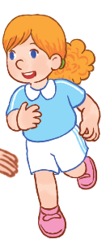
What’s your hobby?
I’m running.
It’s running.
I running.

Slide 8

I like cooking.
What’s your hobby?
What’s your name?
How are you?

Slide 9
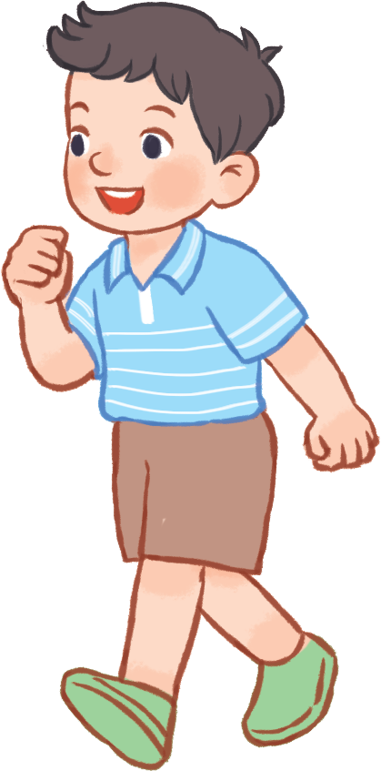
I like ______.
waliking
walking
waking

Slide 10
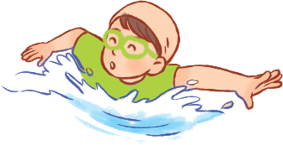
Hello. I’m Nam. I ____ swimming.
am
lik
like

Slide 11
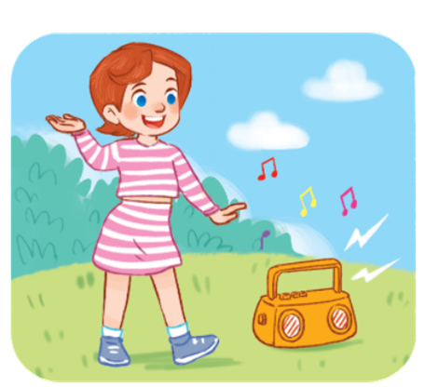
I’m Lucy. I like ______.
dacing
daning
dancing

Slide 12



Excellent!

Slide 13

4
Read and tick.
Teacher: What’s your hobby?
Ben: It’s cooking.
Lucy: It’s dancing.
Minh: I like painting.
Mary: I like drawing.
Hobbies | cooking | dancing | painting | drawing
1. Ben
2. Lucy
3. Minh
4. Mary

Slide 14
5
Let’s write.
Huyen
Hello. My name is _________.
I like _________.
I like _________.
What’s your hobby?
painting
swimming

Slide 15
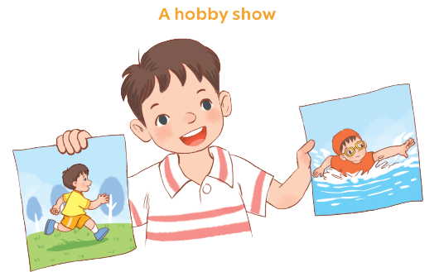
6
Project.

Slide 16









Thank you
MsPham-0936082789
For enjoying!

