Slide 1





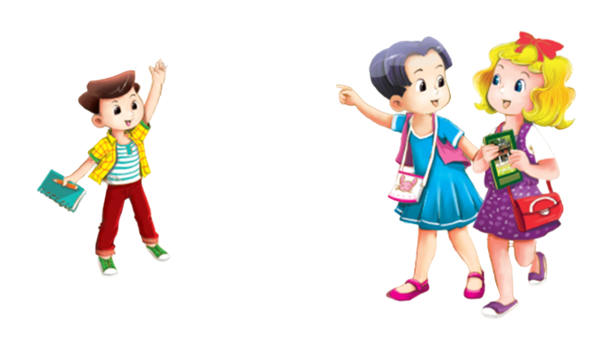

UBND QUẬN HẢI AN TRƯỜNG TIỀU HỌC ĐẰNG HẢI
MsPham-0936082789
TIẾNG ANH 3
Unit 8
My school things

Slide 2







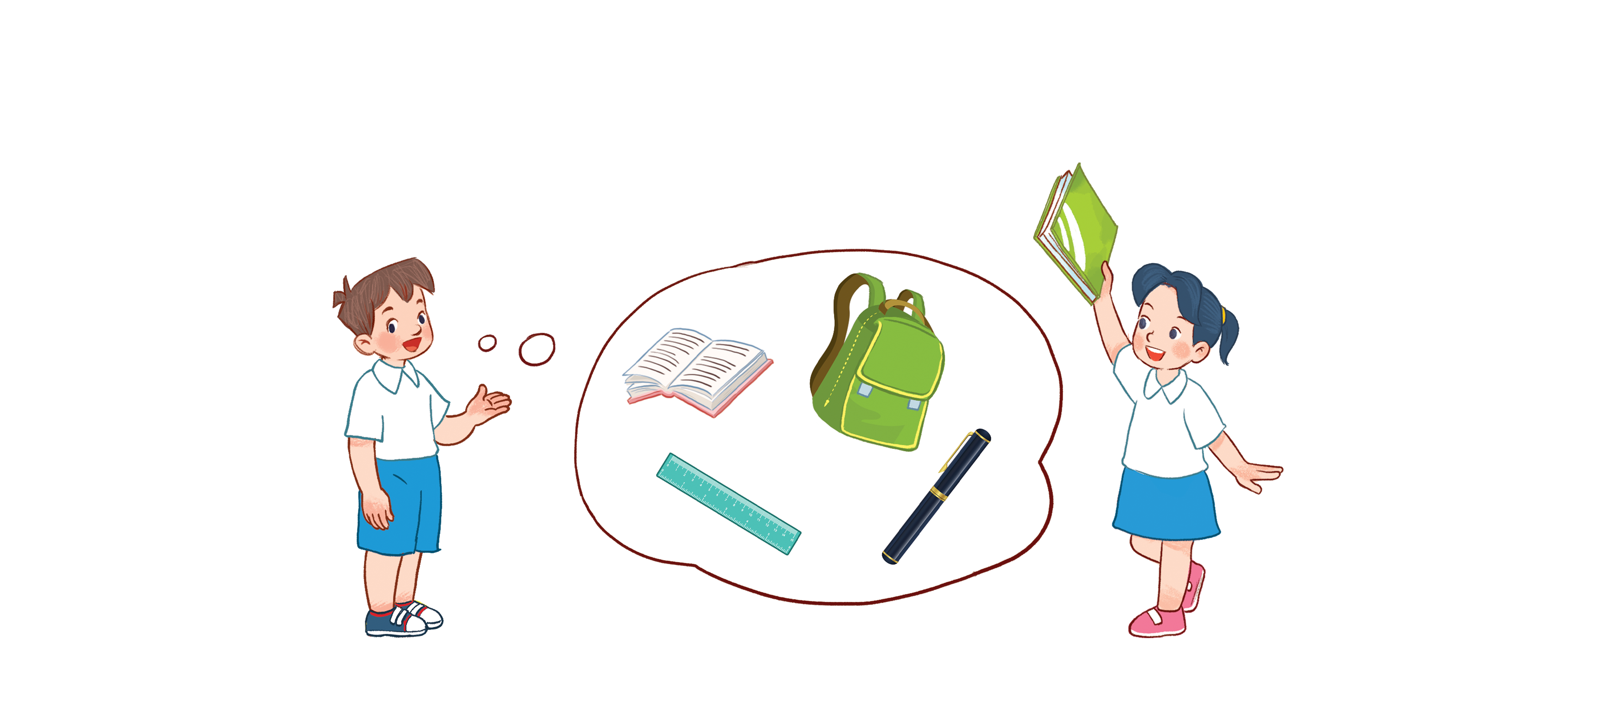


Unit 8
My school things
Lesson 1 - period 50

Slide 3
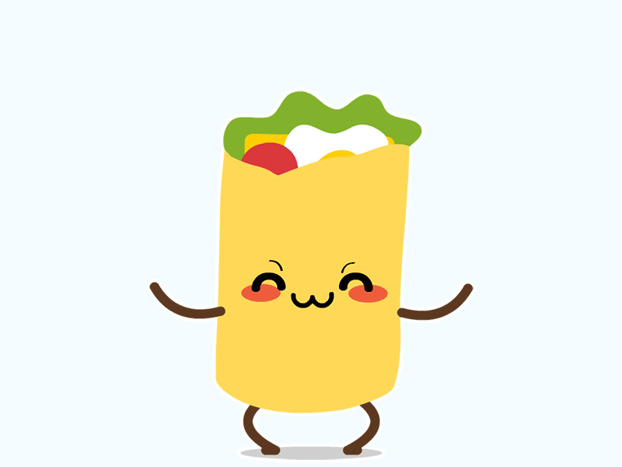
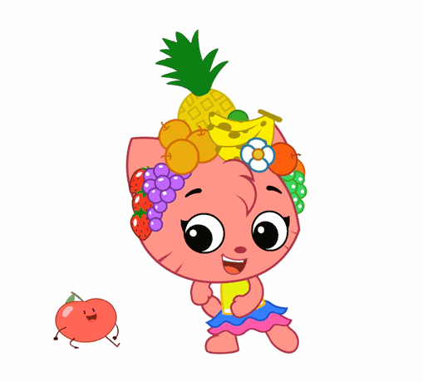

Warm - up
Play

Slide 4


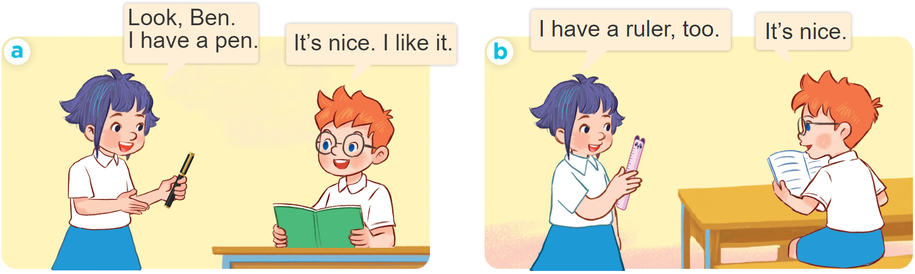
1
Look, listen and repeat.

Slide 5
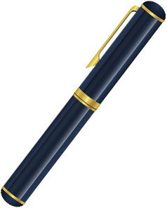
Vocabulary
pen
/pen/
Cái bút

Slide 6
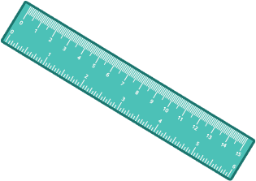
Vocabulary
ruler
/ˈruːlər/
Thước kẻ

Slide 7

Vocabulary
book
/bʊk/
Quyển sách

Slide 8
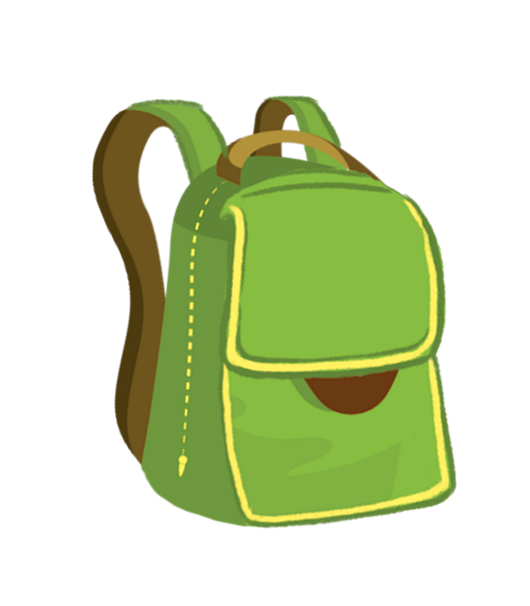
Vocabulary
school bag
/kuːl bæɡ/
Cái cặp

Slide 9
Vocabulary
pen
: Cái bút
/pen/
ruler
: Thước kẻ
/ˈruːlər/
book
: quyển sách
/bʊk/
school bag
: cặp sách
/kuːl bæɡ/

Slide 10

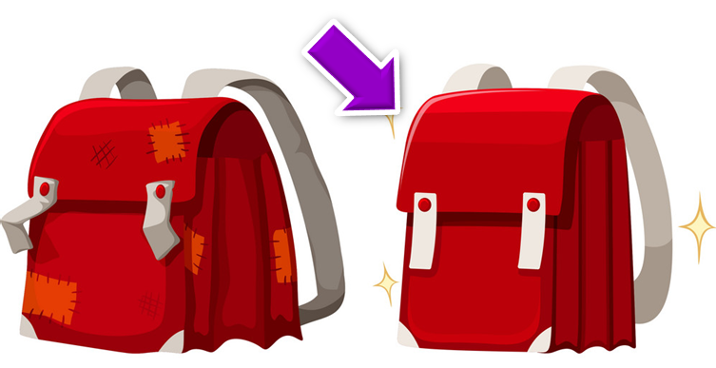
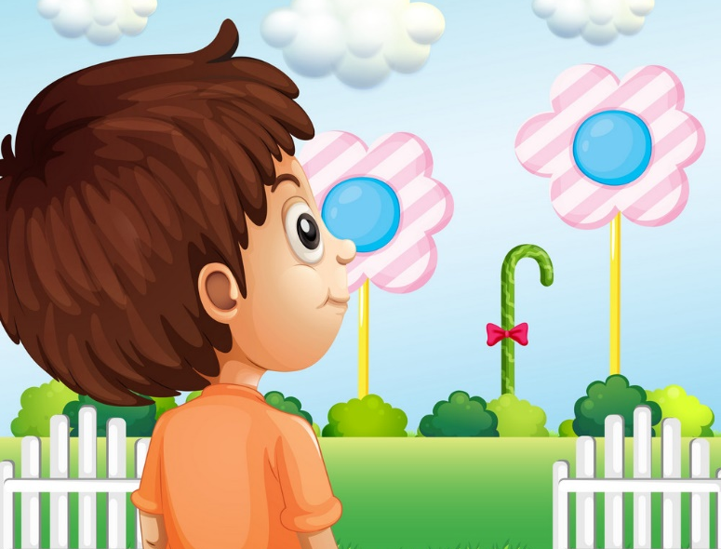
Vocabulary
like
: Thích
/laɪk/
nice
: tốt, đẹp
/naɪs/
look
: nhìn
lʊk/

Slide 11
1
Look, listen and repeat.

Slide 12

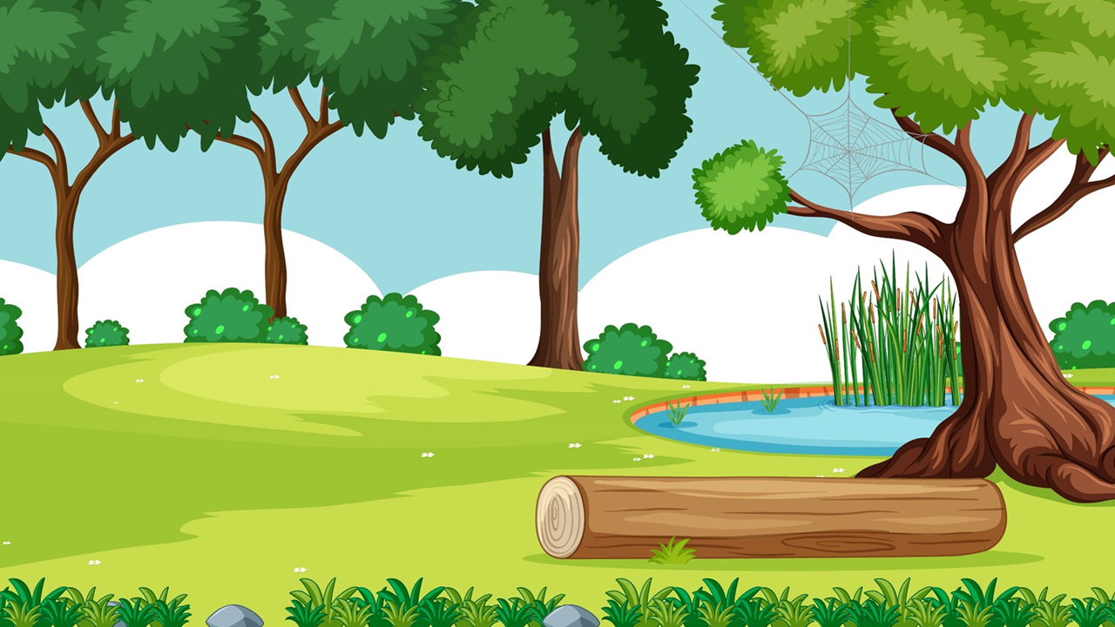

Start

Slide 13
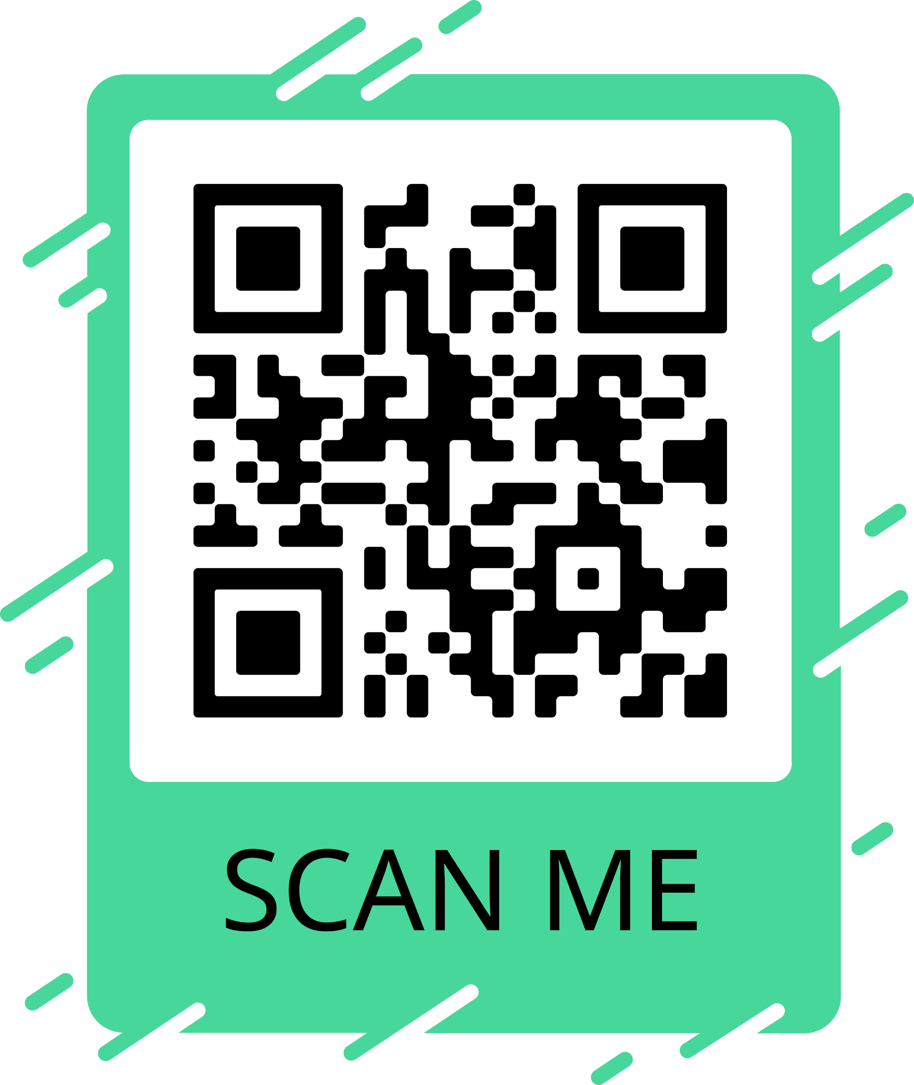
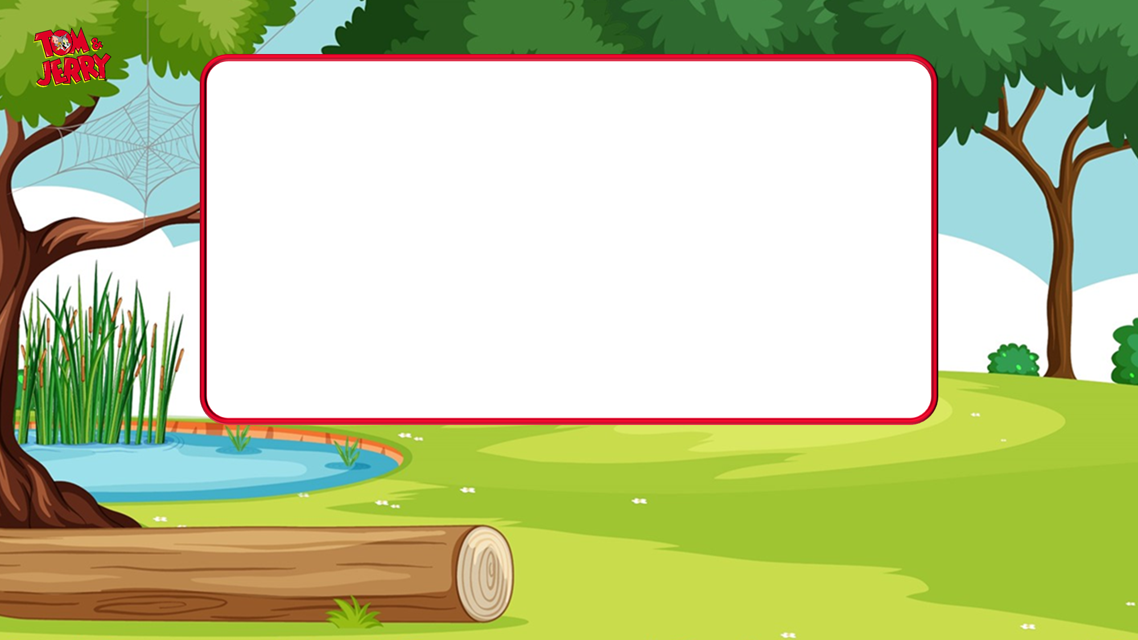
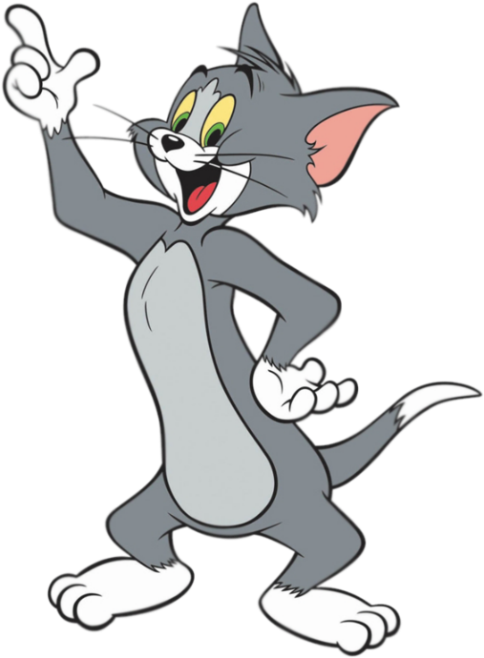
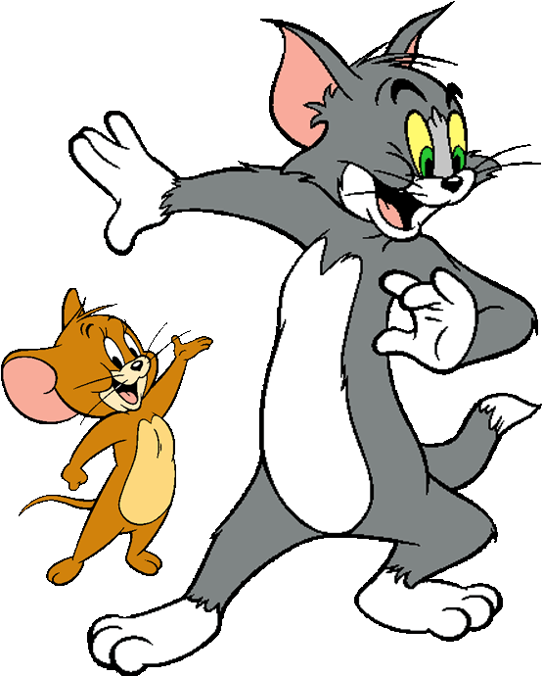




I have a school bag.
Next

Slide 14

I have a ruler .
Next

Slide 15

I have a book.
Next

Slide 16

I have a pen.
Next

Slide 17
I have a book.
Next

Slide 18
I have a ruler.
Next

Slide 19
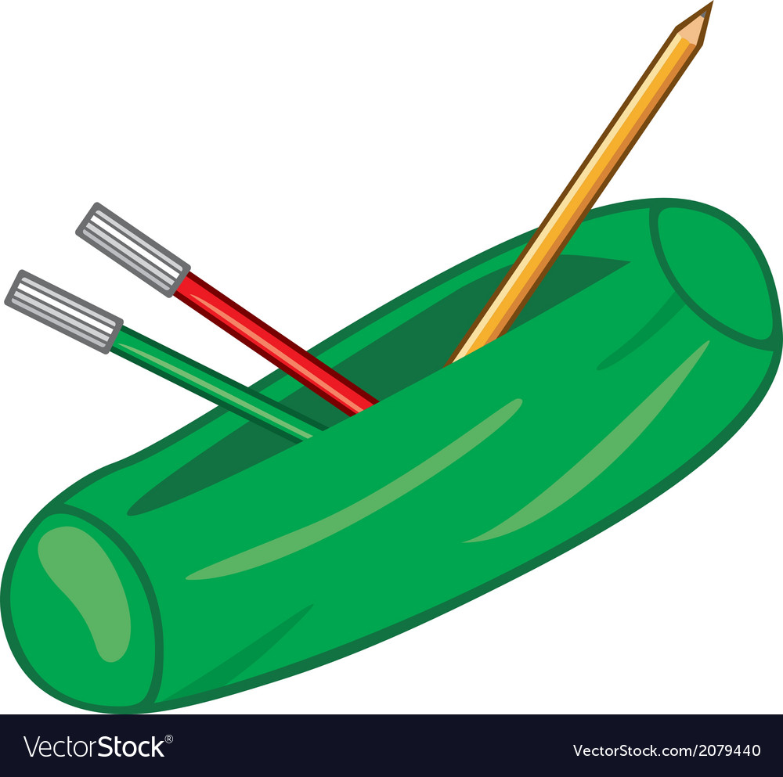
I have a school bag.
Next

Slide 20
I have a pen.
Next

Slide 21


To be continued…
End

Slide 22
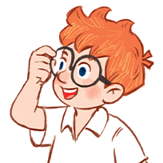
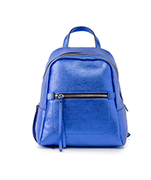

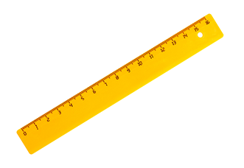
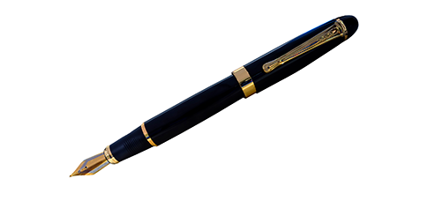
2
Listen, point and say.
I have _____.
a pen
a book
a ruler
a school bag

Slide 23

Structures
Cách nói mình có cái gì đó:
I have a/an _______?
(Tôi có một ________.)

Slide 24
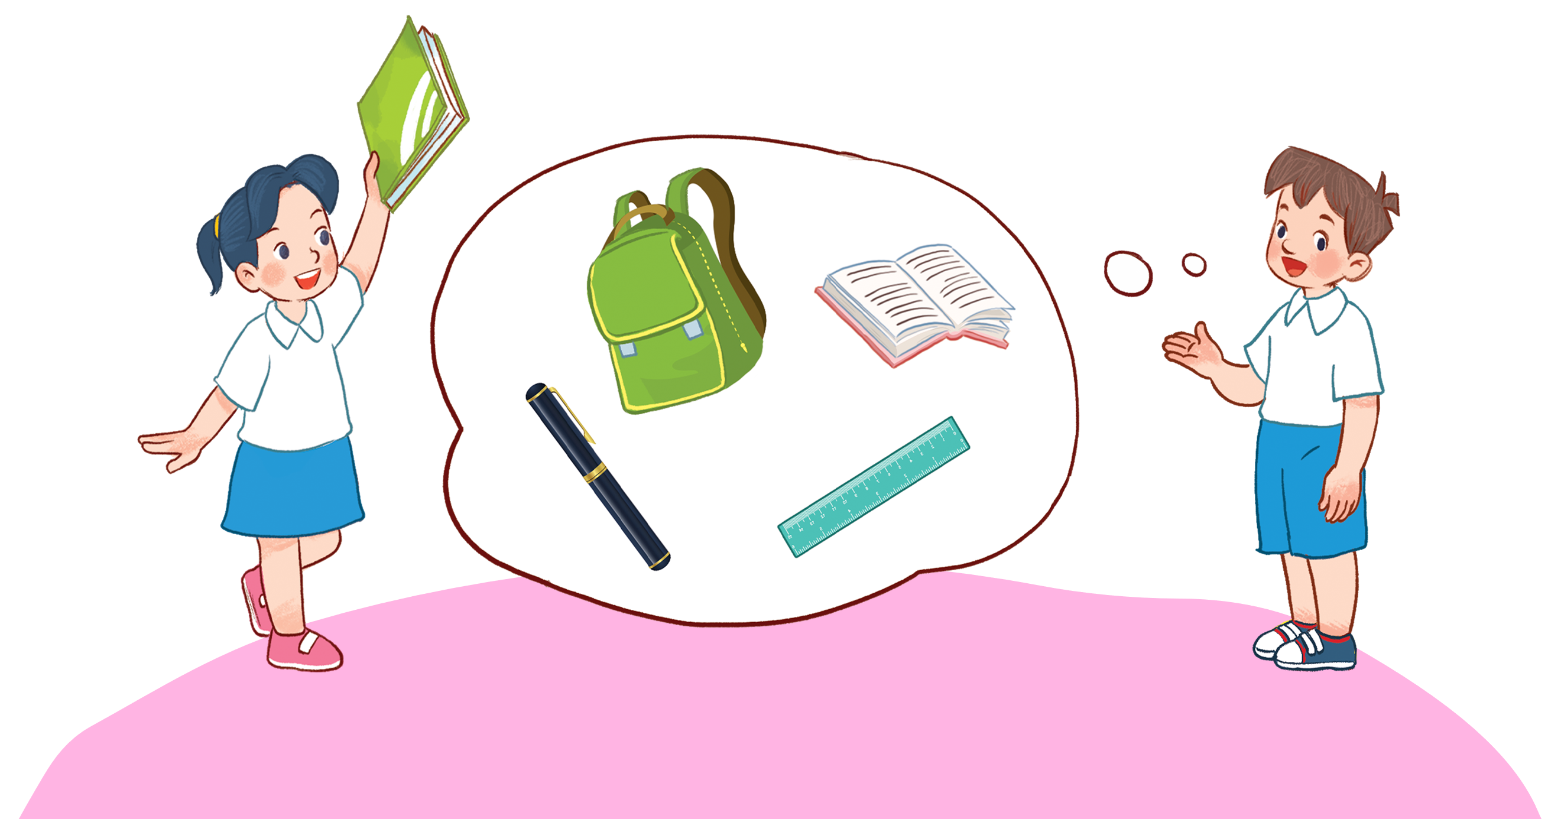
3
Let’s talk.

Slide 25
Thank you!

