Slide 1





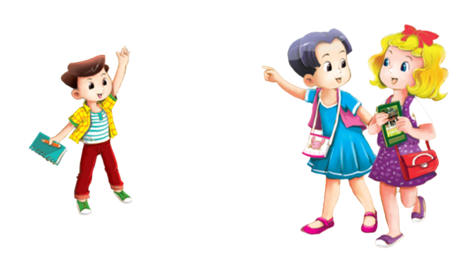


MsPham-0936082789
MsPham
0936092789
Unit 1
Hello
MsPham-0936082789
MsPham-0936082789
Lesson 1 - Period 1
MsPham-0936082789

Slide 2

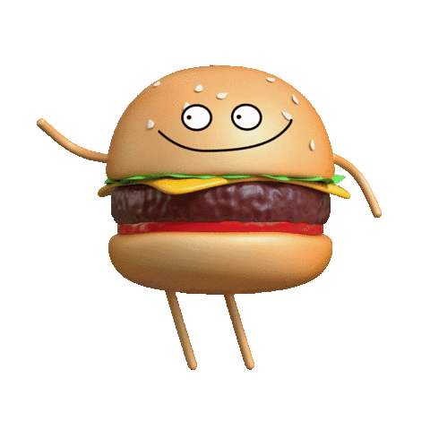
MsPham
0936092789
Warm - up
Play
Next

Slide 3



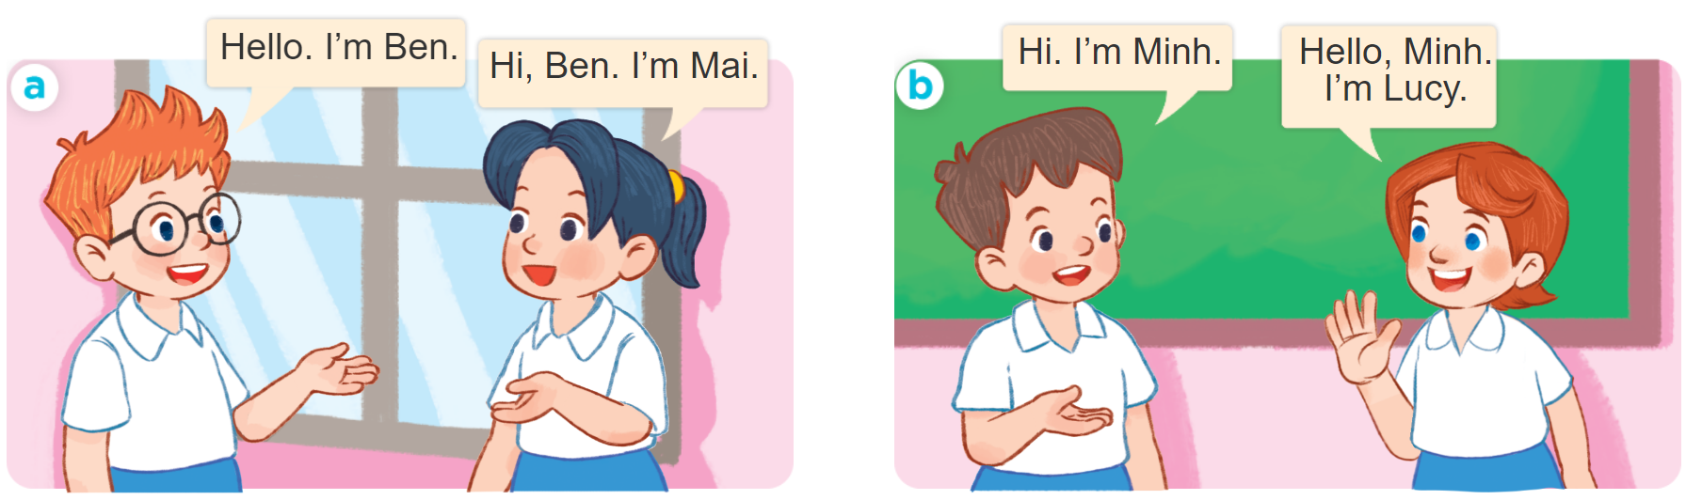
MsPham-0936082789
1
MsPham
0936092789
Look, listen and repeat.
MsPham-0936082789
MsPham-0936082789
Click hình chiếc loa để dừng và nghe tiếp.
MsPham-0936082789

Slide 4


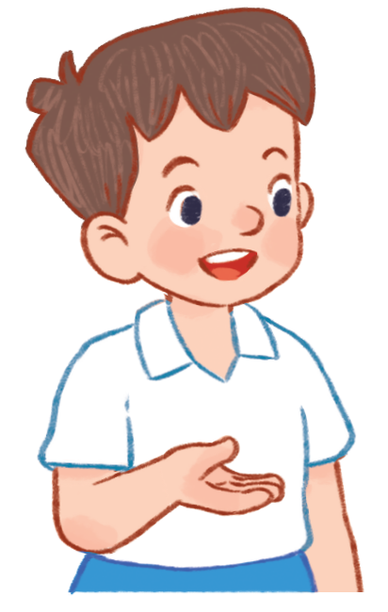


MsPham-0936082789
Vocabulary
MsPham
0936092789
MsPham-0936082789
MsPham-0936082789
Ben
Mai
Minh
Lucy
Hello
(Xin chào)
= Hi
MsPham-0936082789

Slide 5

MsPham-0936082789
1
MsPham
0936092789
Look, listen and repeat.
Hello. I’m Ben.
Hi, Ben. I’m Mai.
MsPham-0936082789
MsPham-0936082789
MsPham-0936082789

Slide 6

MsPham-0936082789
1
MsPham
0936092789
Look, listen and repeat.
MsPham
0936092789
Hi. I’m Minh.
Hello, Minh.
I’m Lucy.
MsPham-0936082789
MsPham-0936082789
MsPham-0936082789

Slide 7
MsPham-0936082789
MsPham-0936082789
Structures
MsPham
0936092789
MsPham
0936092789
Mẫu câu chào hỏi và giới thiệu tên mình.
Hello. I’m ________.
MsPham-0936082789
MsPham-0936082789
(Xin chào, tớ là _____.)
MsPham-0936082789
MsPham-0936082789
Hello, ______. I’m ______.
(Xin chào, _____. Tớ là _____.)
MsPham-0936082789
MsPham-0936082789

Slide 8




MsPham-0936082789
2
MsPham
0936092789
Listen, point and say.
Hello
_____. I’m ______.
Hi
_____, ______. I’m ______.
MsPham-0936082789
MsPham-0936082789
a
b
MsPham-0936082789

Slide 9

MsPham-0936082789
2
MsPham
0936092789
Listen, point and say.
Hello
Hi
Hello
Hi
Hello
Hello
Hi
Hi
_____, ______. I’m ______.
_____. I’m ______.
Ben
Mai
Ben
MsPham-0936082789
MsPham-0936082789
a
MsPham-0936082789

Slide 10
MsPham-0936082789
2
MsPham
0936092789
Listen, point and say.
Hello
Hi
Hello
Hi
Hello
Hello
Hi
Hi
_____, ______. I’m ______.
_____. I’m ______.
Minh
Lucy
Minh
MsPham-0936082789
MsPham-0936082789
b
MsPham-0936082789

Slide 11
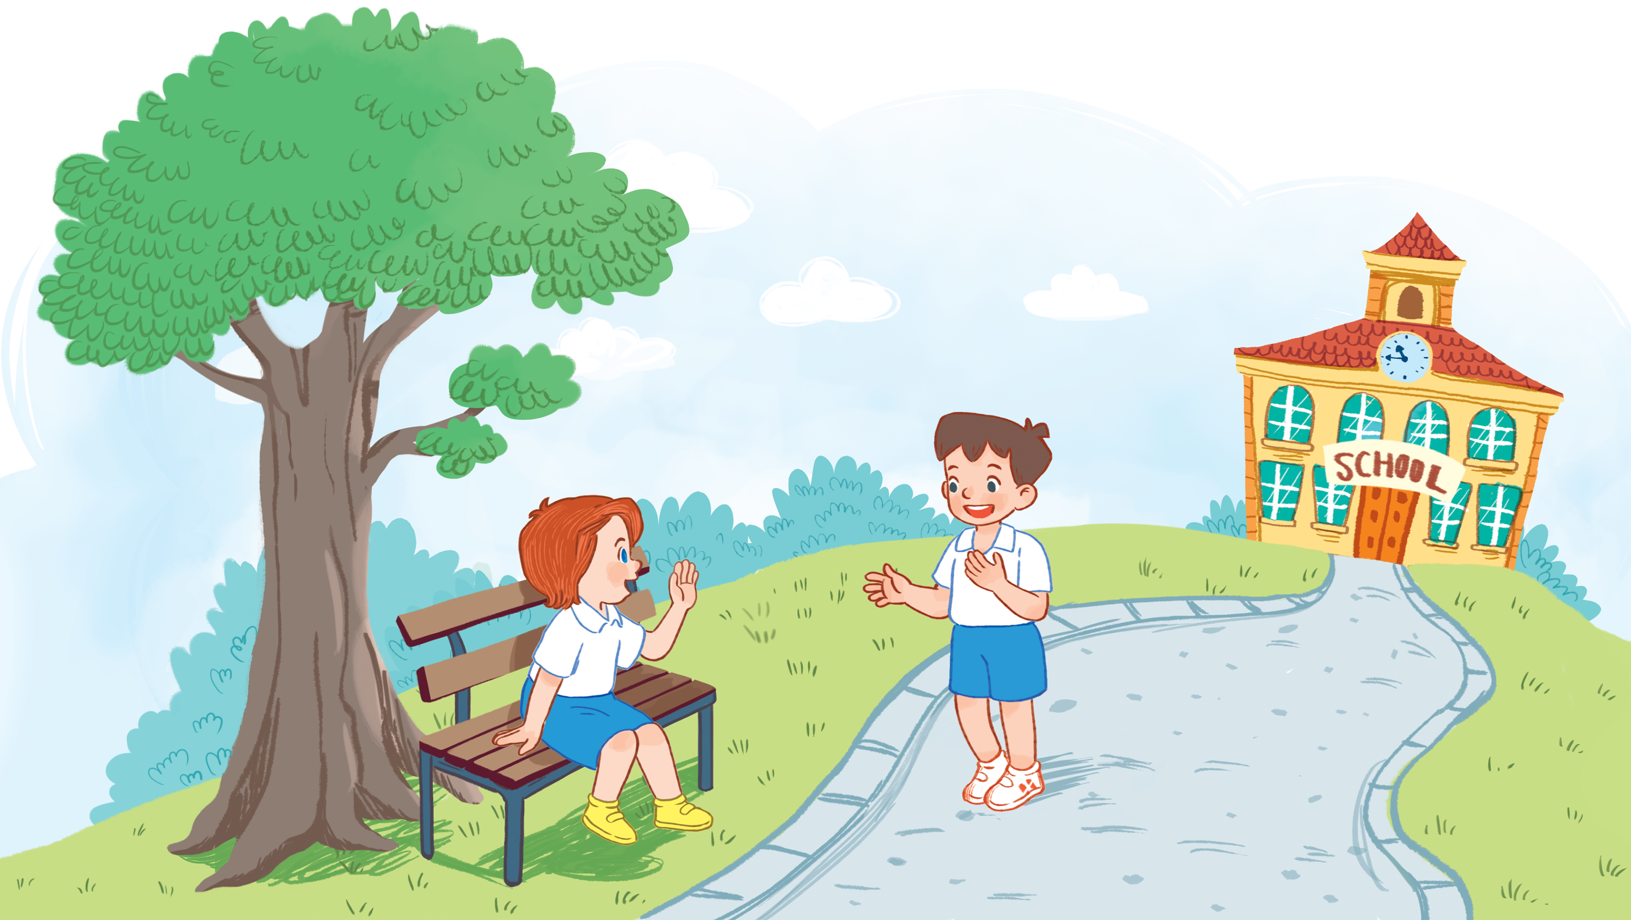
MsPham-0936082789
3
MsPham
0936092789
Let’s talk.
Hi
_____, ______. I’m ______.
Lucy
Minh
MsPham-0936082789
Hello
_____. I’m ______.
Lucy
MsPham-0936082789
MsPham-0936082789

Slide 12

Fun corner wrap-up
MsPham-0936082789
MsPham-0936082789
and
MsPham-0936082789
MsPham-0936082789
Notes:
Step 1: Ask pupils to look at the pictures and say the sentences.
Step 2: Ask some pupils to say the names or the sentences of the characters.
Step 3: Wrap up the lesson.

Slide 13



MsPham-0936082789
MsPham-0936082789
MsPham-0936082789
MsPham-0936082789

Slide 14





MsPham-0936082789
____. I’m Ben.
Hi, Ben. I’m Mai.
MsPham-0936082789
MsPham-0936082789
Hello
Bye
MsPham-0936082789

Slide 15
MsPham-0936082789
Hi. I’m Minh.
Hello, ____. I’m Lucy.
MsPham-0936082789
MsPham-0936082789
Hi
Minh
MsPham-0936082789

Slide 16
MsPham-0936082789
Hello. I’m ___.
Hi, ____. I’m Mai.
MsPham-0936082789
MsPham-0936082789
Ben
Minh
MsPham-0936082789

Slide 17
MsPham-0936082789
Hi. I’m Minh.
Hello, Minh. I’m ____.
MsPham-0936082789
MsPham-0936082789
Mai
Lucy
MsPham-0936082789

Slide 18
MsPham-0936082789
Hello. ____ Ben.
Hi, Ben. ____ Mai.
MsPham-0936082789
MsPham-0936082789
Im
I’m
MsPham-0936082789

Slide 19
MsPham-0936082789
____ . I’m Minh.
Hello, Minh. I’m Lucy.
MsPham-0936082789
MsPham-0936082789
Hi
Lucy
MsPham-0936082789

Slide 20

MsPham-0936082789
MsPham-0936082789
MsPham-0936082789
MsPham-0936082789

Slide 21
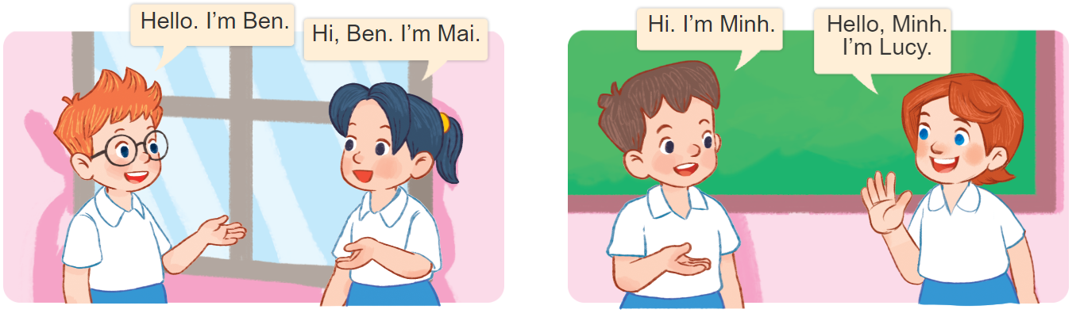
MsPham-0936082789
MsPham-0936082789
MsPham
0936092789
Can you say this?
MsPham-0936082789
MsPham-0936082789
MsPham-0936082789
MsPham-0936082789
MsPham-0936082789
MsPham-0936082789
MsPham-0936082789
Notes:
Divide the class into groups of four. Ask pupils of each group to come to the board and practise saying the conversation of the characters. Give point to the groups.

Slide 22
MsPham-0936082789
MsPham
0936092789
Hello / Hi. I’m Ms. Ha.
Hello, Ms. Ha. I’m ______.
MsPham-0936082789
MsPham-0936082789
Ben
Mai
Minh
Lucy
MsPham-0936082789

