Slide 1





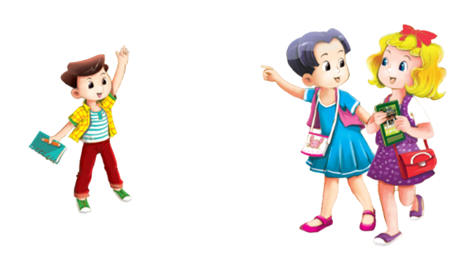
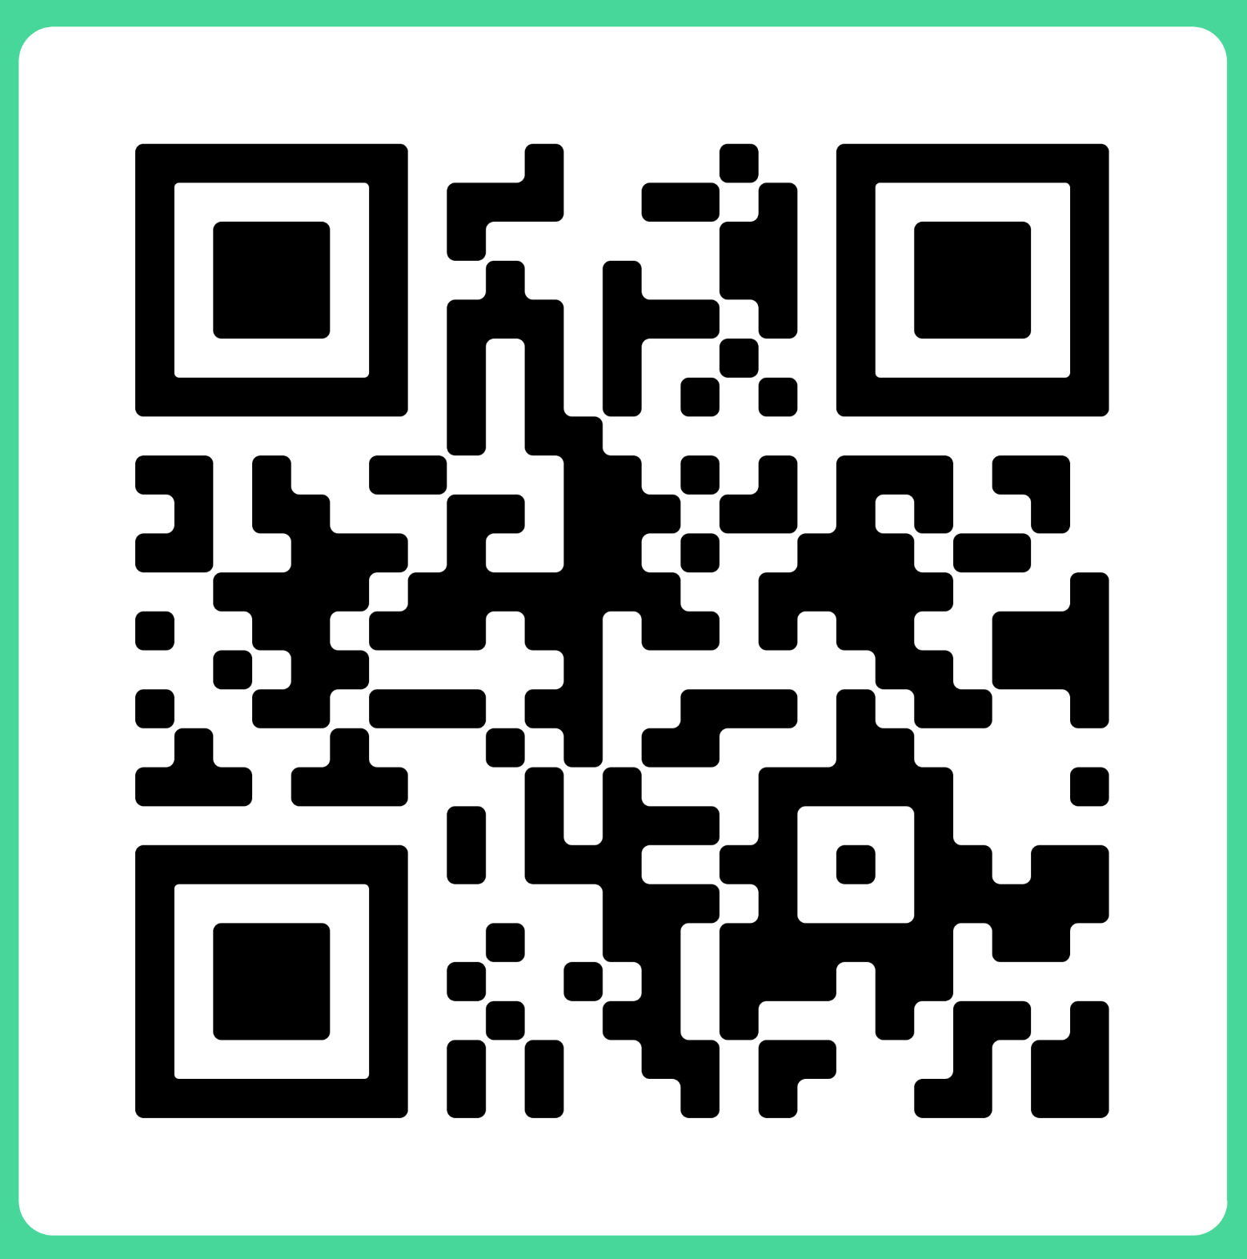

MsPham
0936082789
Unit 1
Hello
MsPham
0936082789
MsPham
0936082789
MsPham
0936082789
Lesson 1 - Period 2
MsPham
0936082789

Slide 2


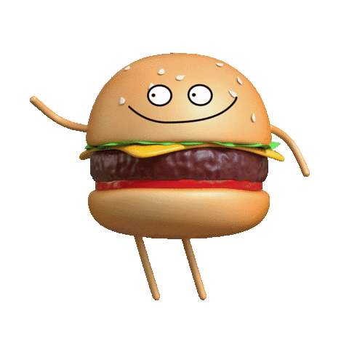
MsPham
0936082789
Warm - up
MsPham
0936082789
MsPham
0936082789
Play
Next
MsPham
0936082789

Slide 3


MsPham
0936082789
What is the letter missing?
MsPham
0936082789
MsPham
0936082789
Start
MsPham
0936082789

Slide 4



MsPham
0936082789
What is the letter missing?
Check
MsPham
0936082789
MsPham
0936082789
Next
____
M i n h
MsPham
0936082789

Slide 5

MsPham
0936082789
What is the letter missing?
Check
MsPham
0936082789
MsPham
0936082789
Next
L u c y
____
MsPham
0936082789

Slide 6

MsPham
0936082789
What is the letter missing?
Check
MsPham
0936082789
MsPham
0936082789
Next
____
B e n
MsPham
0936082789

Slide 7

MsPham
0936082789
What is the letter missing?
Check
MsPham
0936082789
MsPham
0936082789
Next
_____
M a i
MsPham
0936082789

Slide 8
MsPham
0936082789
What is the letter missing?
Check
MsPham
0936082789
MsPham
0936082789
Next
____
H e l l o
MsPham
0936082789

Slide 9
MsPham
0936082789
Excellent!
MsPham
0936082789
MsPham
0936082789
End
MsPham
0936082789

Slide 10
MsPham
0936082789
Review
Hello / Hi. I’m Ms. Ha.
Hello / Hi, Ms. Ha. I’m ______.
MsPham
0936082789
MsPham
0936082789
Ben
Mai
Minh
Lucy
MsPham
0936082789

Slide 11






MsPham
0936082789
4
Listen and tick.
1
MsPham
0936082789
MsPham
0936082789
a
b
2
a
b
MsPham
0936082789

Slide 12


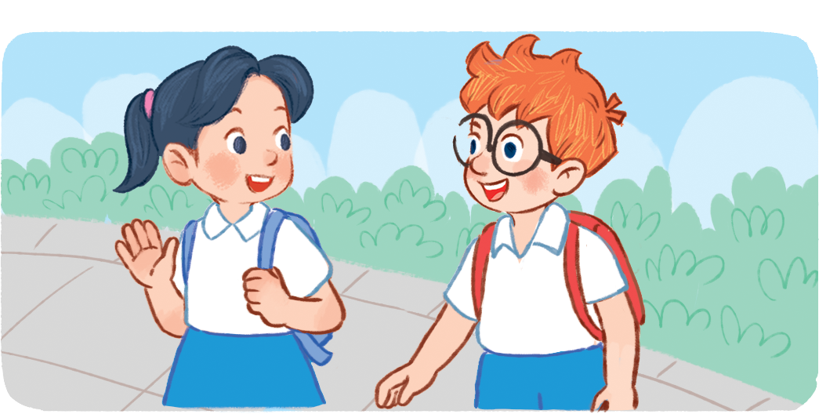
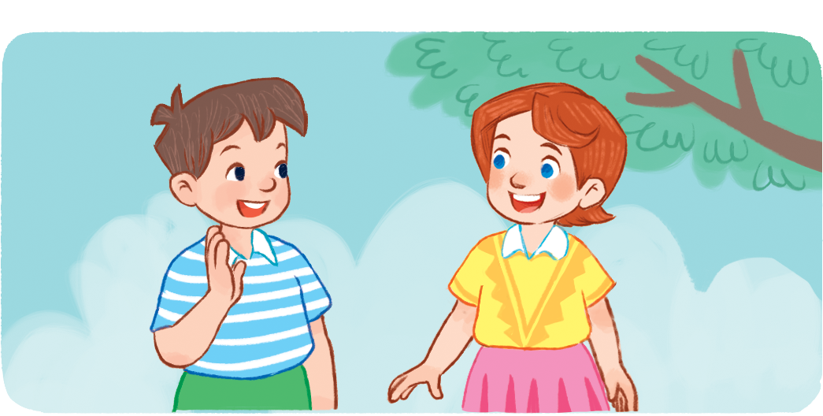
MsPham
0936082789
5
Look, complete and read.
MsPham
0936082789
Hello / Hi
Hello / Hi
1. __________. I’m Ben.
2. __________. I’m Lucy.
MsPham
0936082789
I’m
Hello / Hi
I’m
3. Hi, Ben. ______ Mai.
4. _________, Lucy. ____ Minh.
MsPham
0936082789

Slide 13
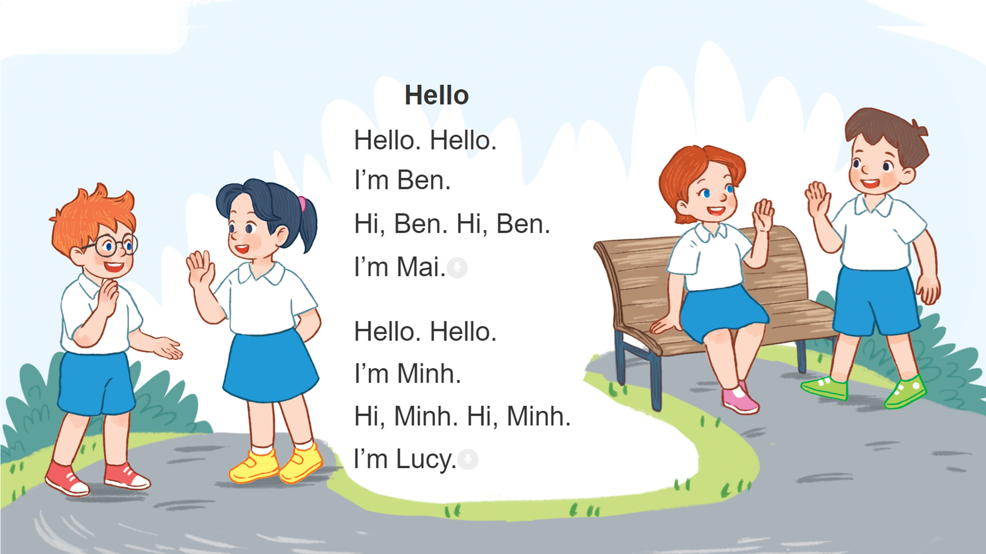
MsPham
0936082789
6
Let’s sing.
MsPham
0936082789
MsPham
0936082789
MsPham
0936082789

Slide 14
Fun corner wrap-up
MsPham
0936082789
and
MsPham
0936082789
MsPham
0936082789
MsPham
0936082789
Notes:
Step 1: Ask pupils to look at the pictures and say the sentences.
Step 2: Ask some pupils to say the names or the sentences of the characters.
Step 3: Wrap up the lesson.

Slide 15



MsPham
0936082789
Hello. I’m Doremon.
MsPham
0936082789
MsPham
0936082789
Hello / Hi, Doremon.
I’m Lucy.
MsPham
0936082789

Slide 16

MsPham
0936082789
Hello. I’m Doremon.
MsPham
0936082789
MsPham
0936082789
Hello / Hi, Doremon.
I’m Ben.
MsPham
0936082789

Slide 17

MsPham
0936082789
Hello. I’m Doremon.
MsPham
0936082789
MsPham
0936082789
Hello / Hi, Doremon.
I’m Mai.
MsPham
0936082789

Slide 18
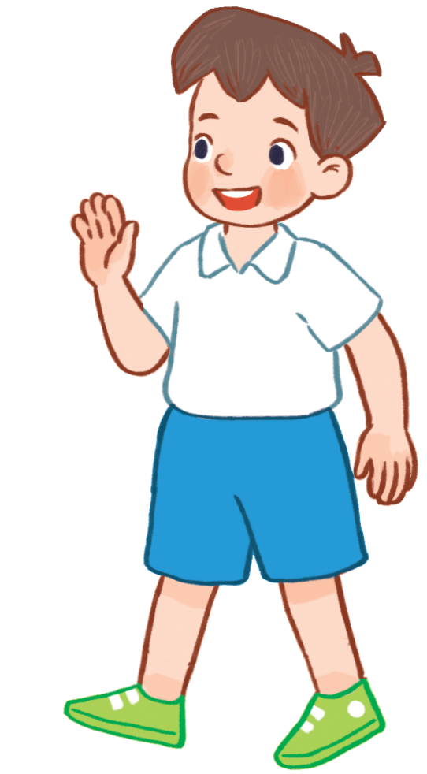
MsPham
0936082789
Hello / Hi, Minh.
I’m Doremon.
MsPham
0936082789
MsPham
0936082789
Hi. I’m Minh.
MsPham
0936082789

Slide 19

MsPham
0936082789
Hello. I’m Doremon.
MsPham
0936082789
MsPham
0936082789
Hello / Hi, Doremon.
I’m _________.
MsPham
0936082789

Slide 20
MsPham
0936082789
Goodbye!
MsPham
0936082789
MsPham
0936082789
MsPham
0936082789

